Slide 1
Stakeholder Meeting | June 27, 2022
Notes:
Good afternoon everyone – thank you for joining us today. We are excited to be kicking off this very important project for the Hillsborough TPO and the City of Tampa. This project is a collaboration between the Hillsborough TPO and the City of Tampa, with the TPO leading the project and the study focus being schools located in Tampa.

Slide 2
Meeting Agenda
Brief Project Overview
School Site Selection
Summary of Data Collection and Initial Ideas
Field Observations
Survey Results
Next Steps

Slide 3
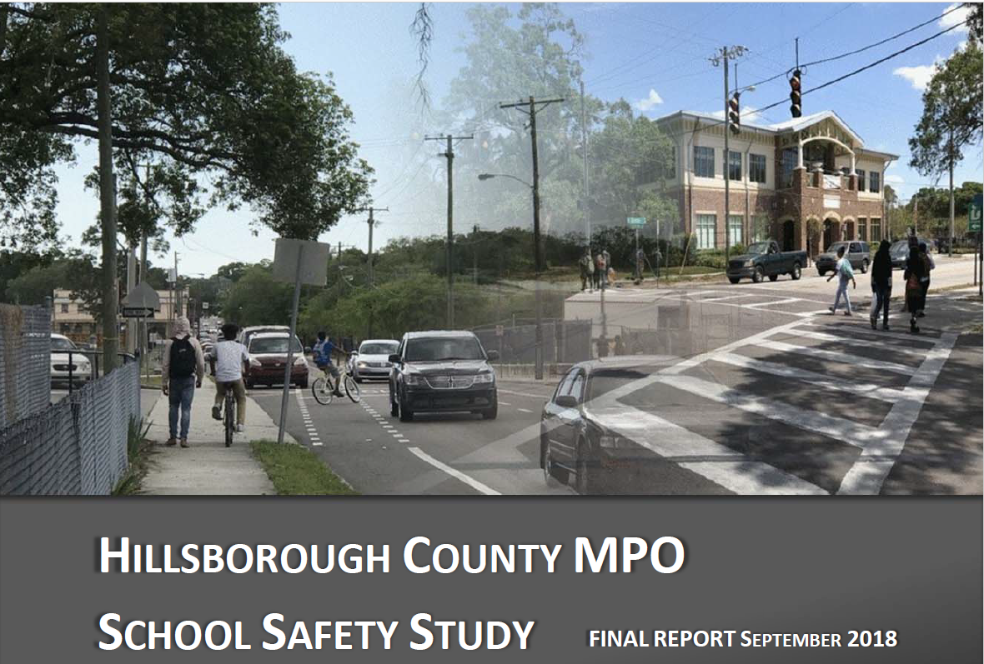
Project Overview
Building on the School Safety Study completed in 2018
Identification of physical transportation system improvements around and connecting to a set-of schools
Development of school specific education and encouragement strategies and a template/process that can be used for other schools in the district
Notes:
As many of you may be aware, the TPO completed a school safety study in 2018 that identified physical improvements at 12 schools in the district, including 5 high schools, 3 middle schools, 3 magnet schools and one k-8 that were selected through a data driven process than considered equity factors and transportation safety surrounding schools in the district.
Selected schools were located throughout the County, including in the City of Tampa and the unincorporated areas. That study identified a host of engineering countermeasures, such as sidewalk connections, enhanced crosswalk markings and signage, and changes to signalization, such as providing a leading pedestrian interval to give people walking a head start to cross the street. Specific projects and cost estimates were developed, and the City and County have been hard at work implementing those improvements.
This project will identify projects at a new set of schools, and since the City of Tampa requested a study update, our focus schools will all be within the City of Tampa, although we will refine the priority list for all schools in the County so others know what schools they should look at next. Similar to the prior project, we will be identifying engineering countermeasures at a set of schools. However, we recognize that there is an educational and encouragement component to getting students and parents out of the car line and into the sidewalk, bike lane or bus. Therefore, a component of the project will focus on that educational and encouragement component. We are partnered with Sidewalk Stompers for this portion of the project as they have had success at eight schools in the district advocating for safety improvements and then developing outreach programs to get more students walking and biking to school. We are excited to learn from them through this process and help them serve more schools in the district.

Slide 4
Project Overview
Assemble Stakeholder Group
Survey District Families and School Administration
Update School Prioritization List
Assess Existing Safe Routes to School Programs at Area Schools
Develop Educational and Encouragement Materials for Select Schools
Identify Physical Improvements for Select Schools
Notes:
Our project consists of six primary tasks, including convening our stakeholder group, so thank you! This is our second of three calls to share with you project progress and solicit feedback, with opportunities for more in-depth participation for those who are interested.
After our last call, we sent a survey to all district families as well as each school in the district, so we will share the initial results today.
We have also updated the
We updated the school prioritization list and conducted initial field reviews while schools were still in session.
After our discussion today, we will also have more conversations with each of the schools selected for inclusion in the focused study.
This will allow us to combine our observations, feedback from the surveys, feedback from this group, and discussions with each school to identify a set of physical improvements as well as educational and encouragement material that can be used at the District level as well as tailored to select transportation issues.

Slide 5
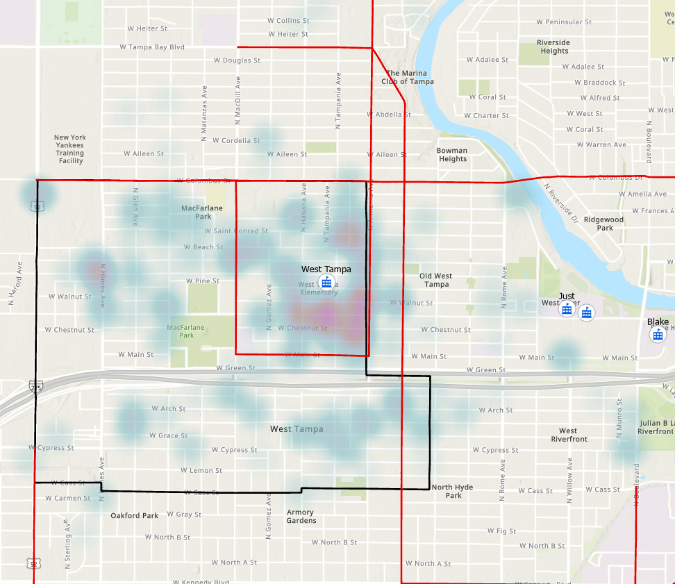
School Site Selection
Evaluation Criteria
School location and enrollment
Size/dimensions of enrollment boundary area
Underserved community designations
Percent of students qualifying for free or reduced lunch
High Injury Network
Bicycle and Pedestrian fatality and serious injury locations (2017-2021)
All Traffic crashes that involve school aged people during travel to/from school times and other times
Roadway network characteristics
Proximity to other schools, libraries, and recreation centers

Slide 6
School Site Selection
Scoring
Scoring
1. Within a designated underserved community
(20 points / equity)
2. Percent of students who receive a free or reduced cost lunch (20 points / equity)
3. Enrollment area includes Top 50 Corridor (5 points / safety)
4. Number of Bike/Ped KSIs within school enrollment boundary (20 points / safety)
5. Number of Total KSIs within school enrollment boundary (15 points / safety)
6. Density of students within enrollment area (5 points / other)
7. Roadway network characteristics (5 points / other)
8. Within a half mile of a school/library/community activity hub (10 points / other)

Slide 7
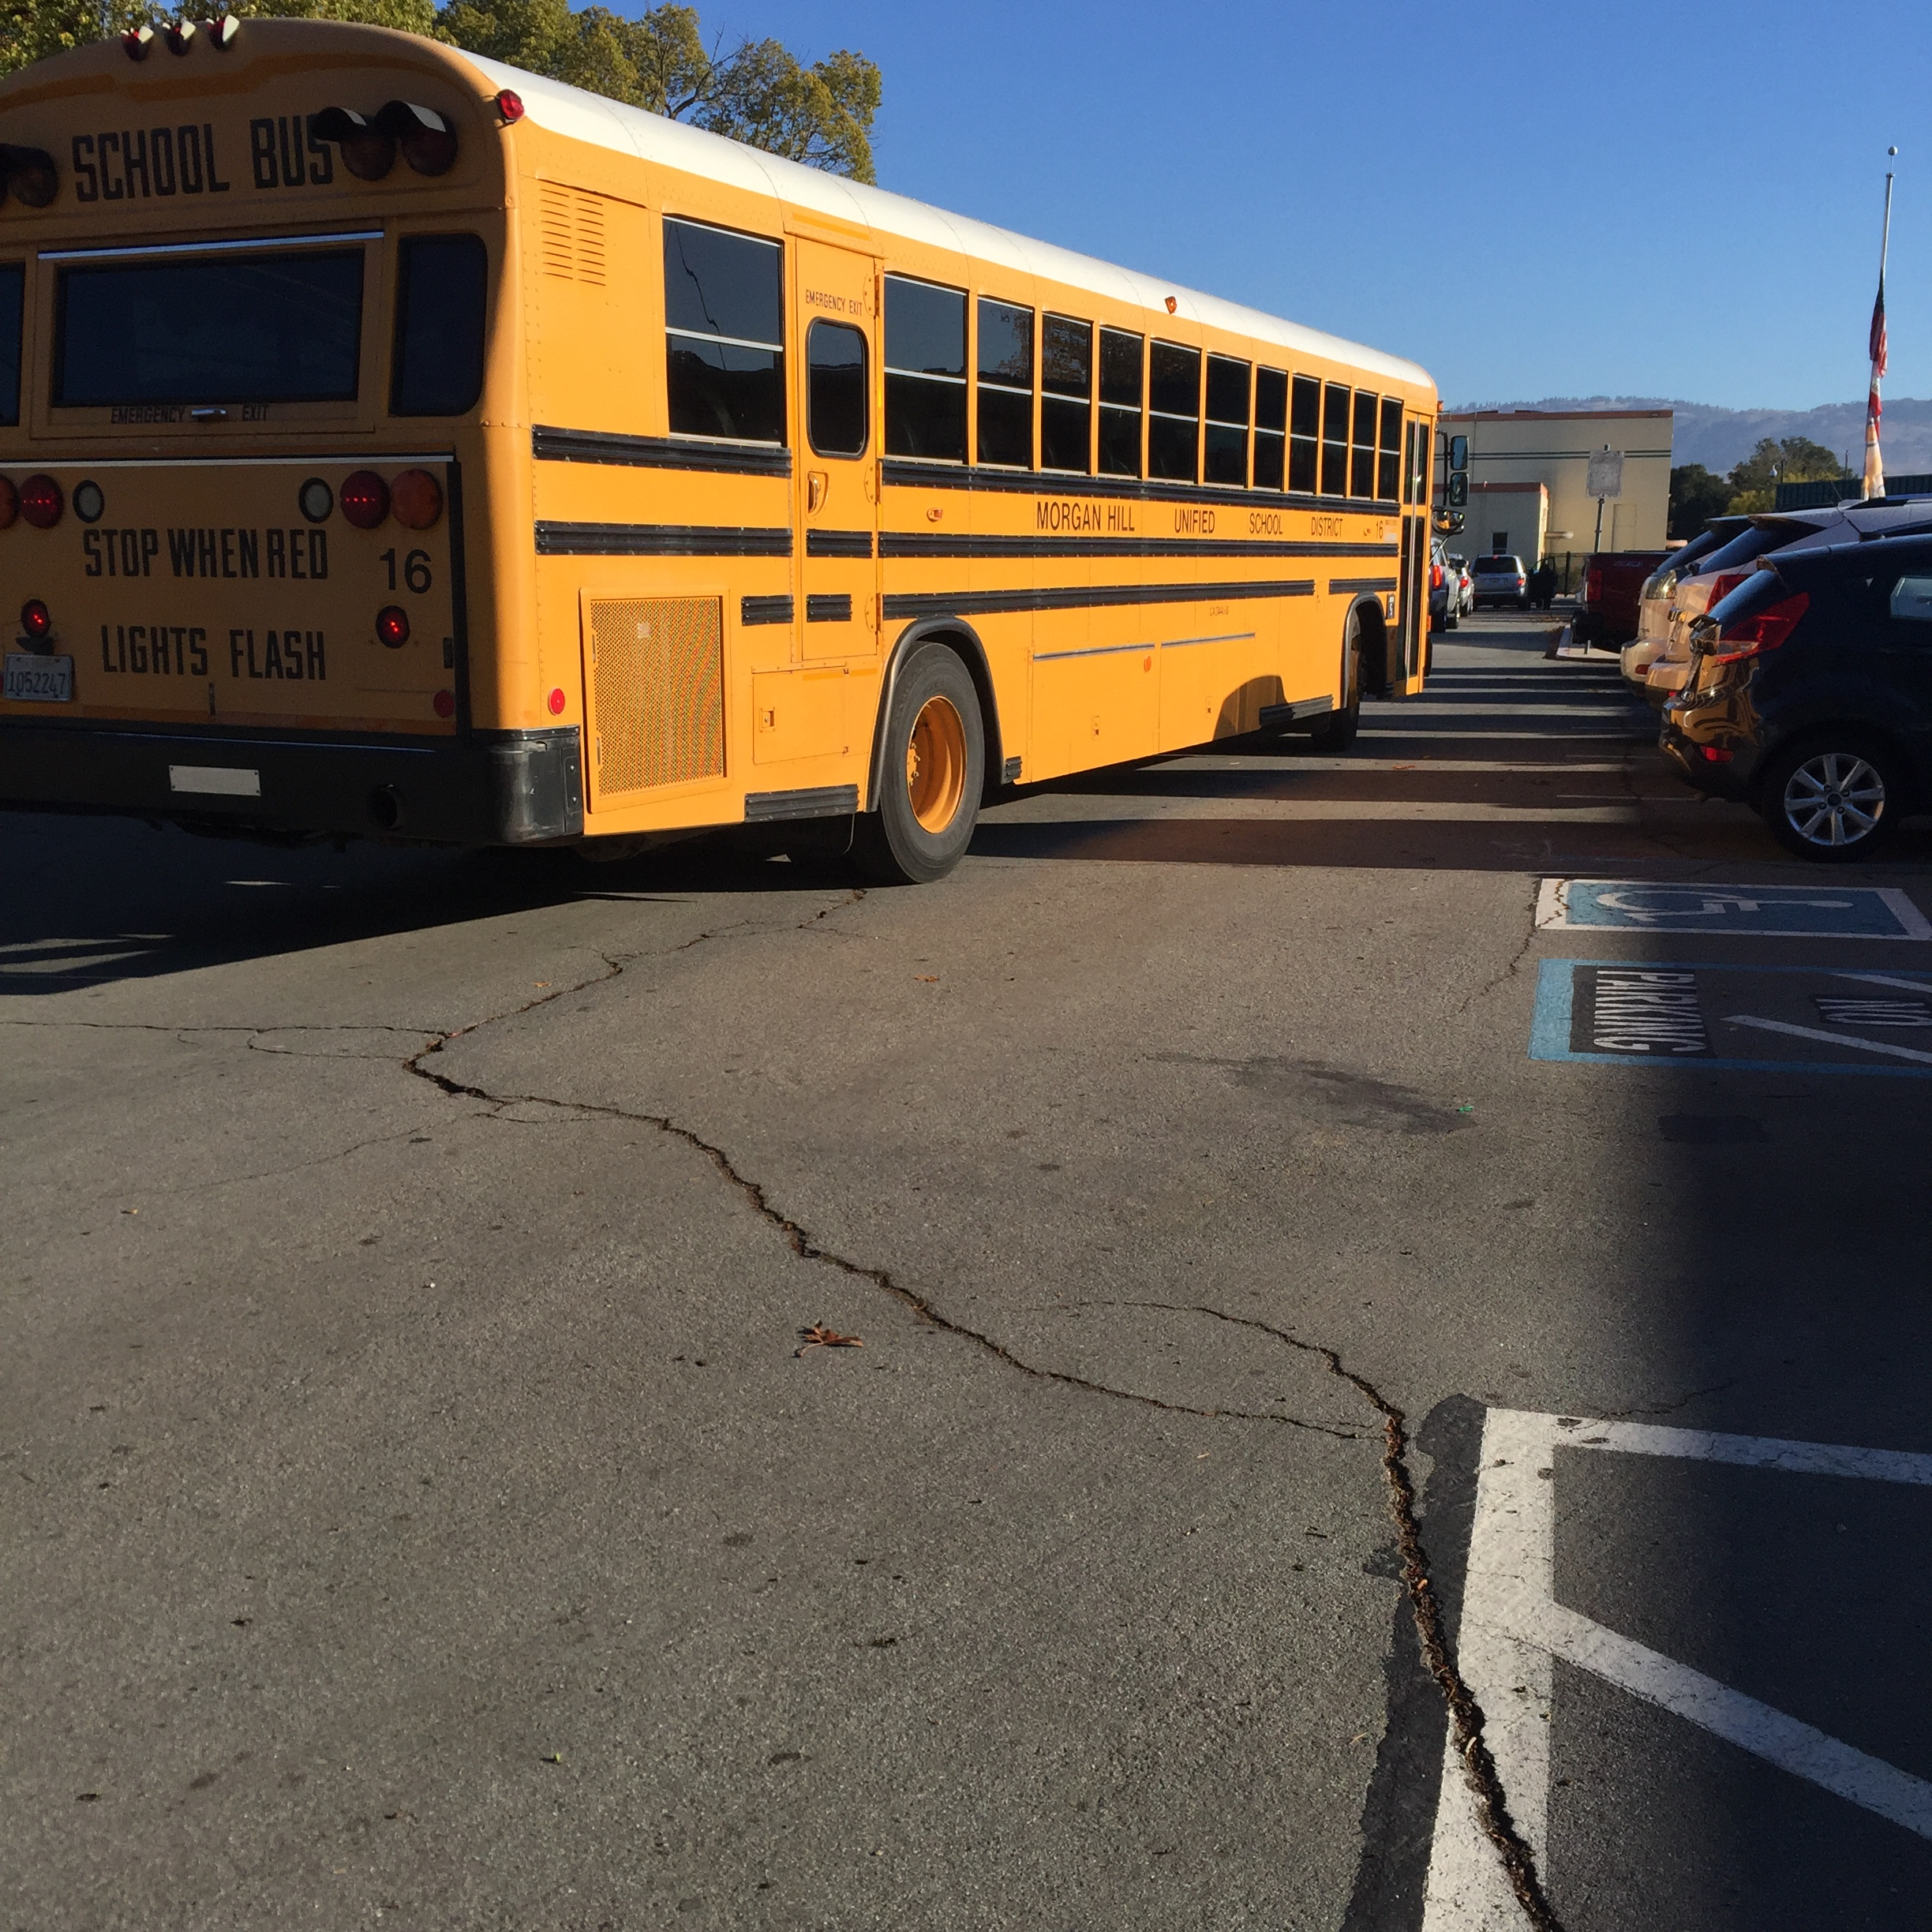
Final List of Schools
Shaw Elementary – top ranked elementary school in the district (53 points)
Blake High School – top ranked high school in district (53 points)
Orange Grove Middle Magnet – top ranked middle school that was not studied in 2018 (50 points)
Just Elementary (50 points)
West Tampa Elementary (48 points)
Stewart Middle Magnet (47 points)
Potter Elementary (47 points)
Jefferson High School (41 points)
Notes:
Many of the schools evaluated in 2018 were on the top of the list since it does take time to implement infrastructure improvements and for change to occur. We did not consider those locations for further investment.

Slide 8
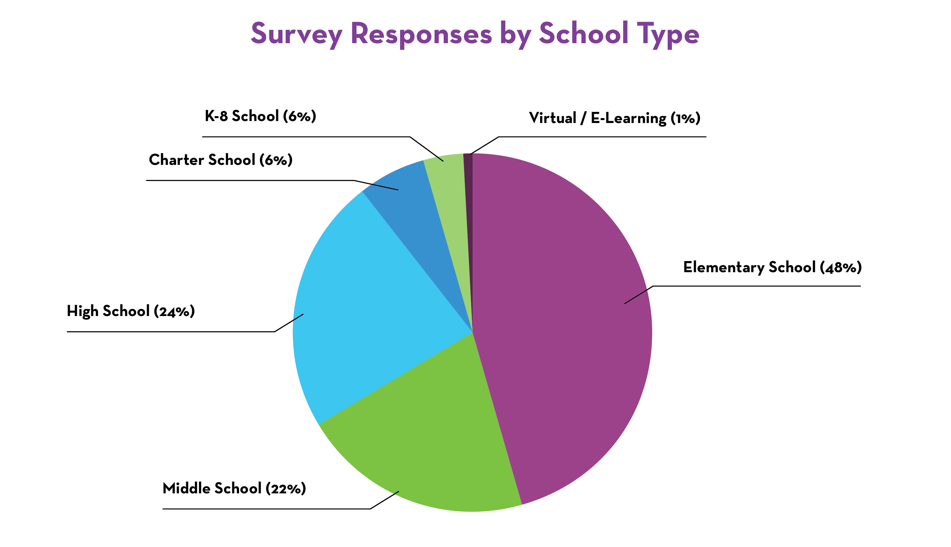
High Level Survey Results – Family Surveys
Notes:
Over 6000 responses

Slide 9
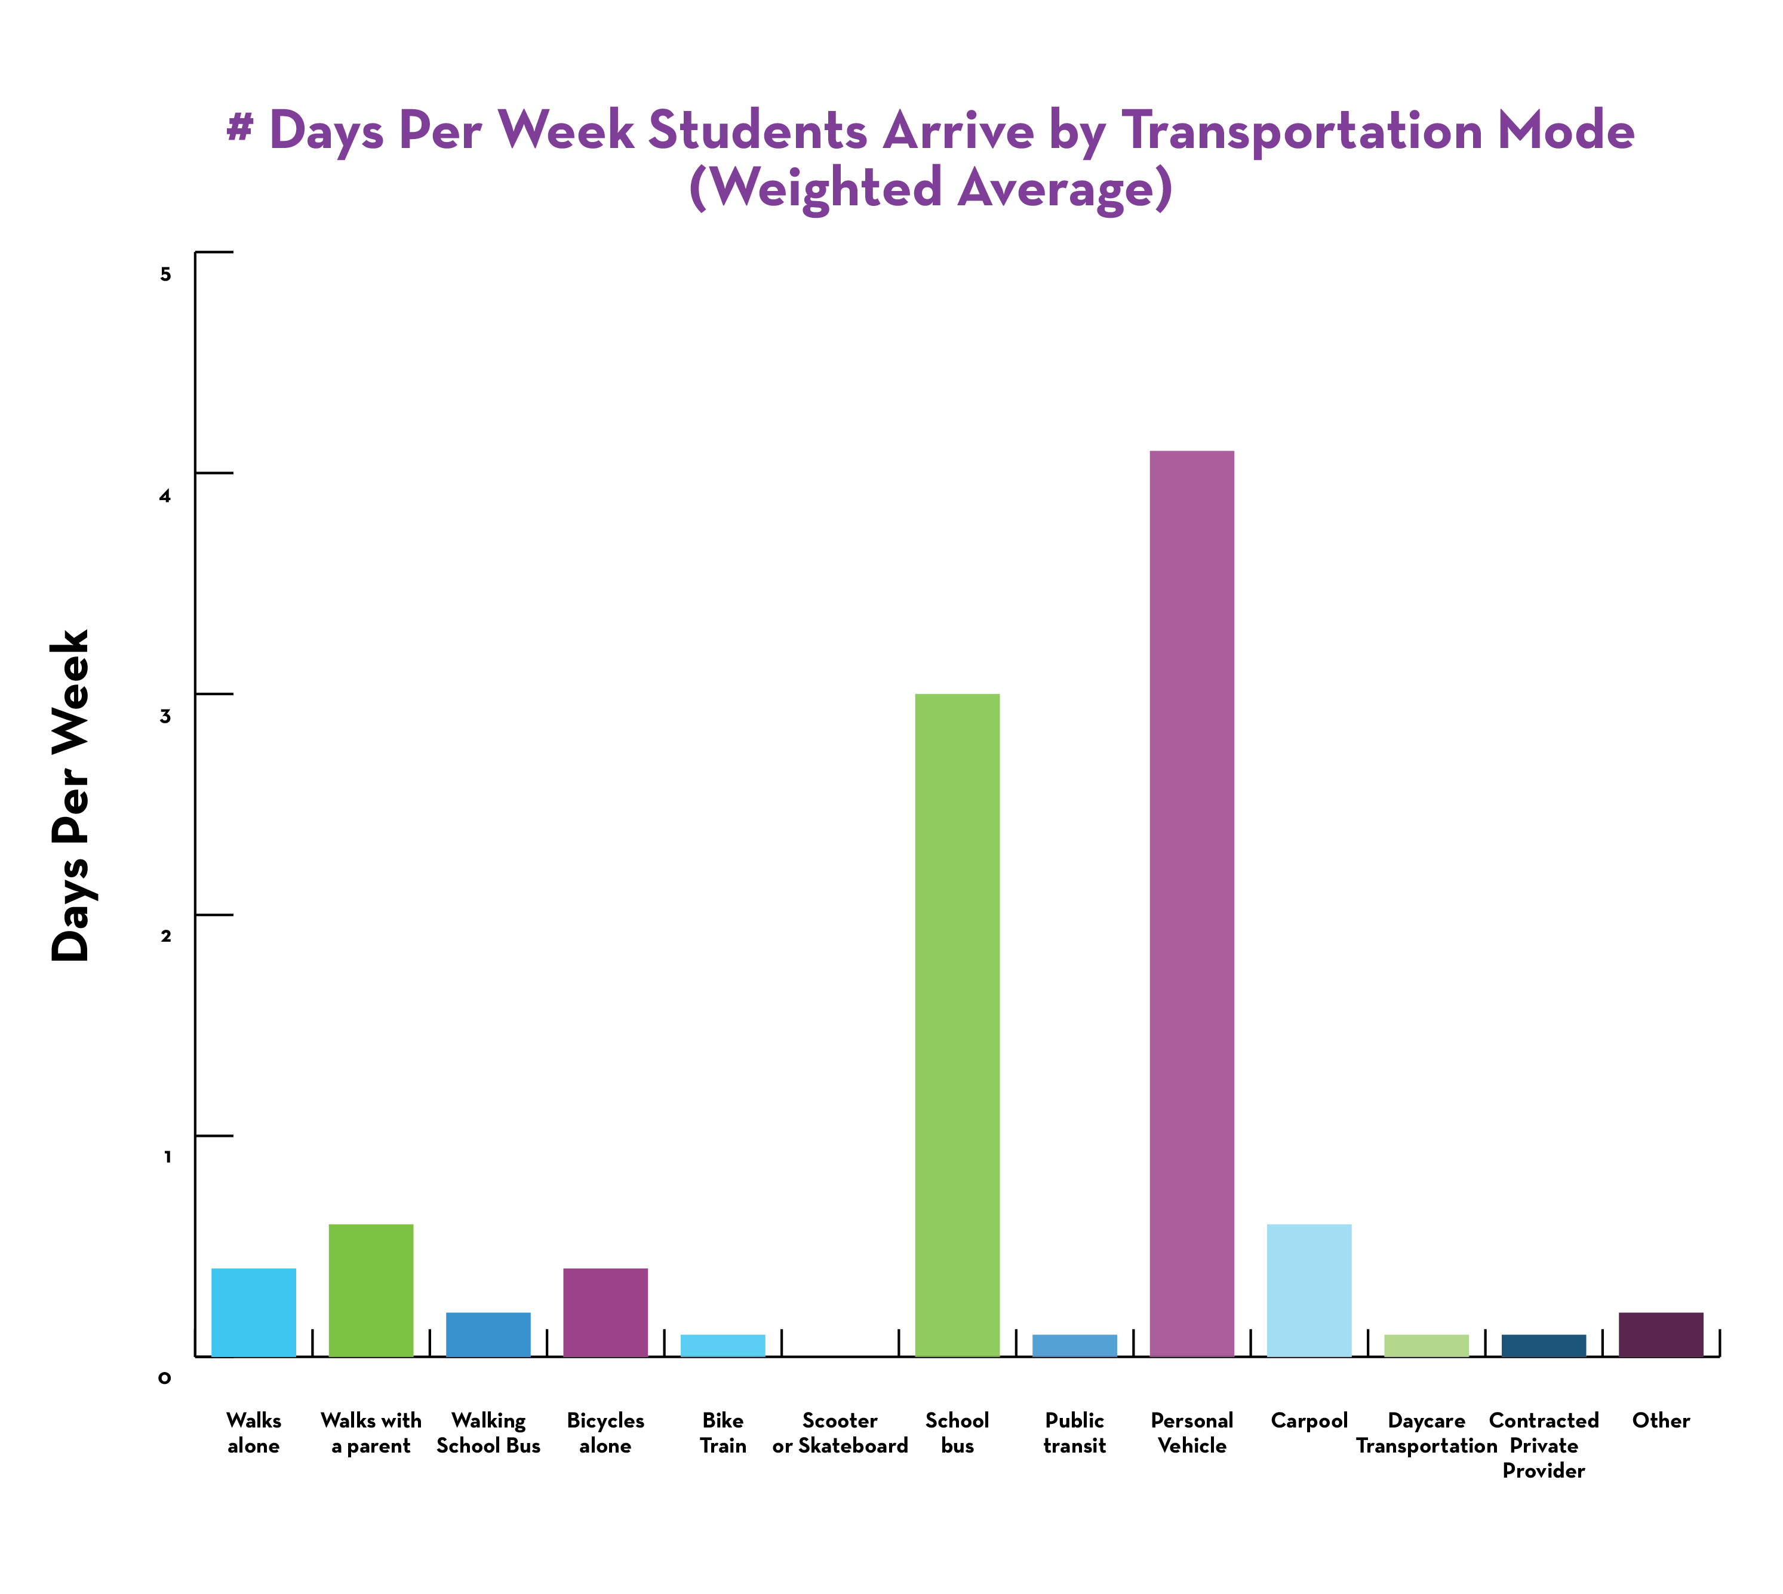
High Level Survey Results – Family Surveys

Slide 10
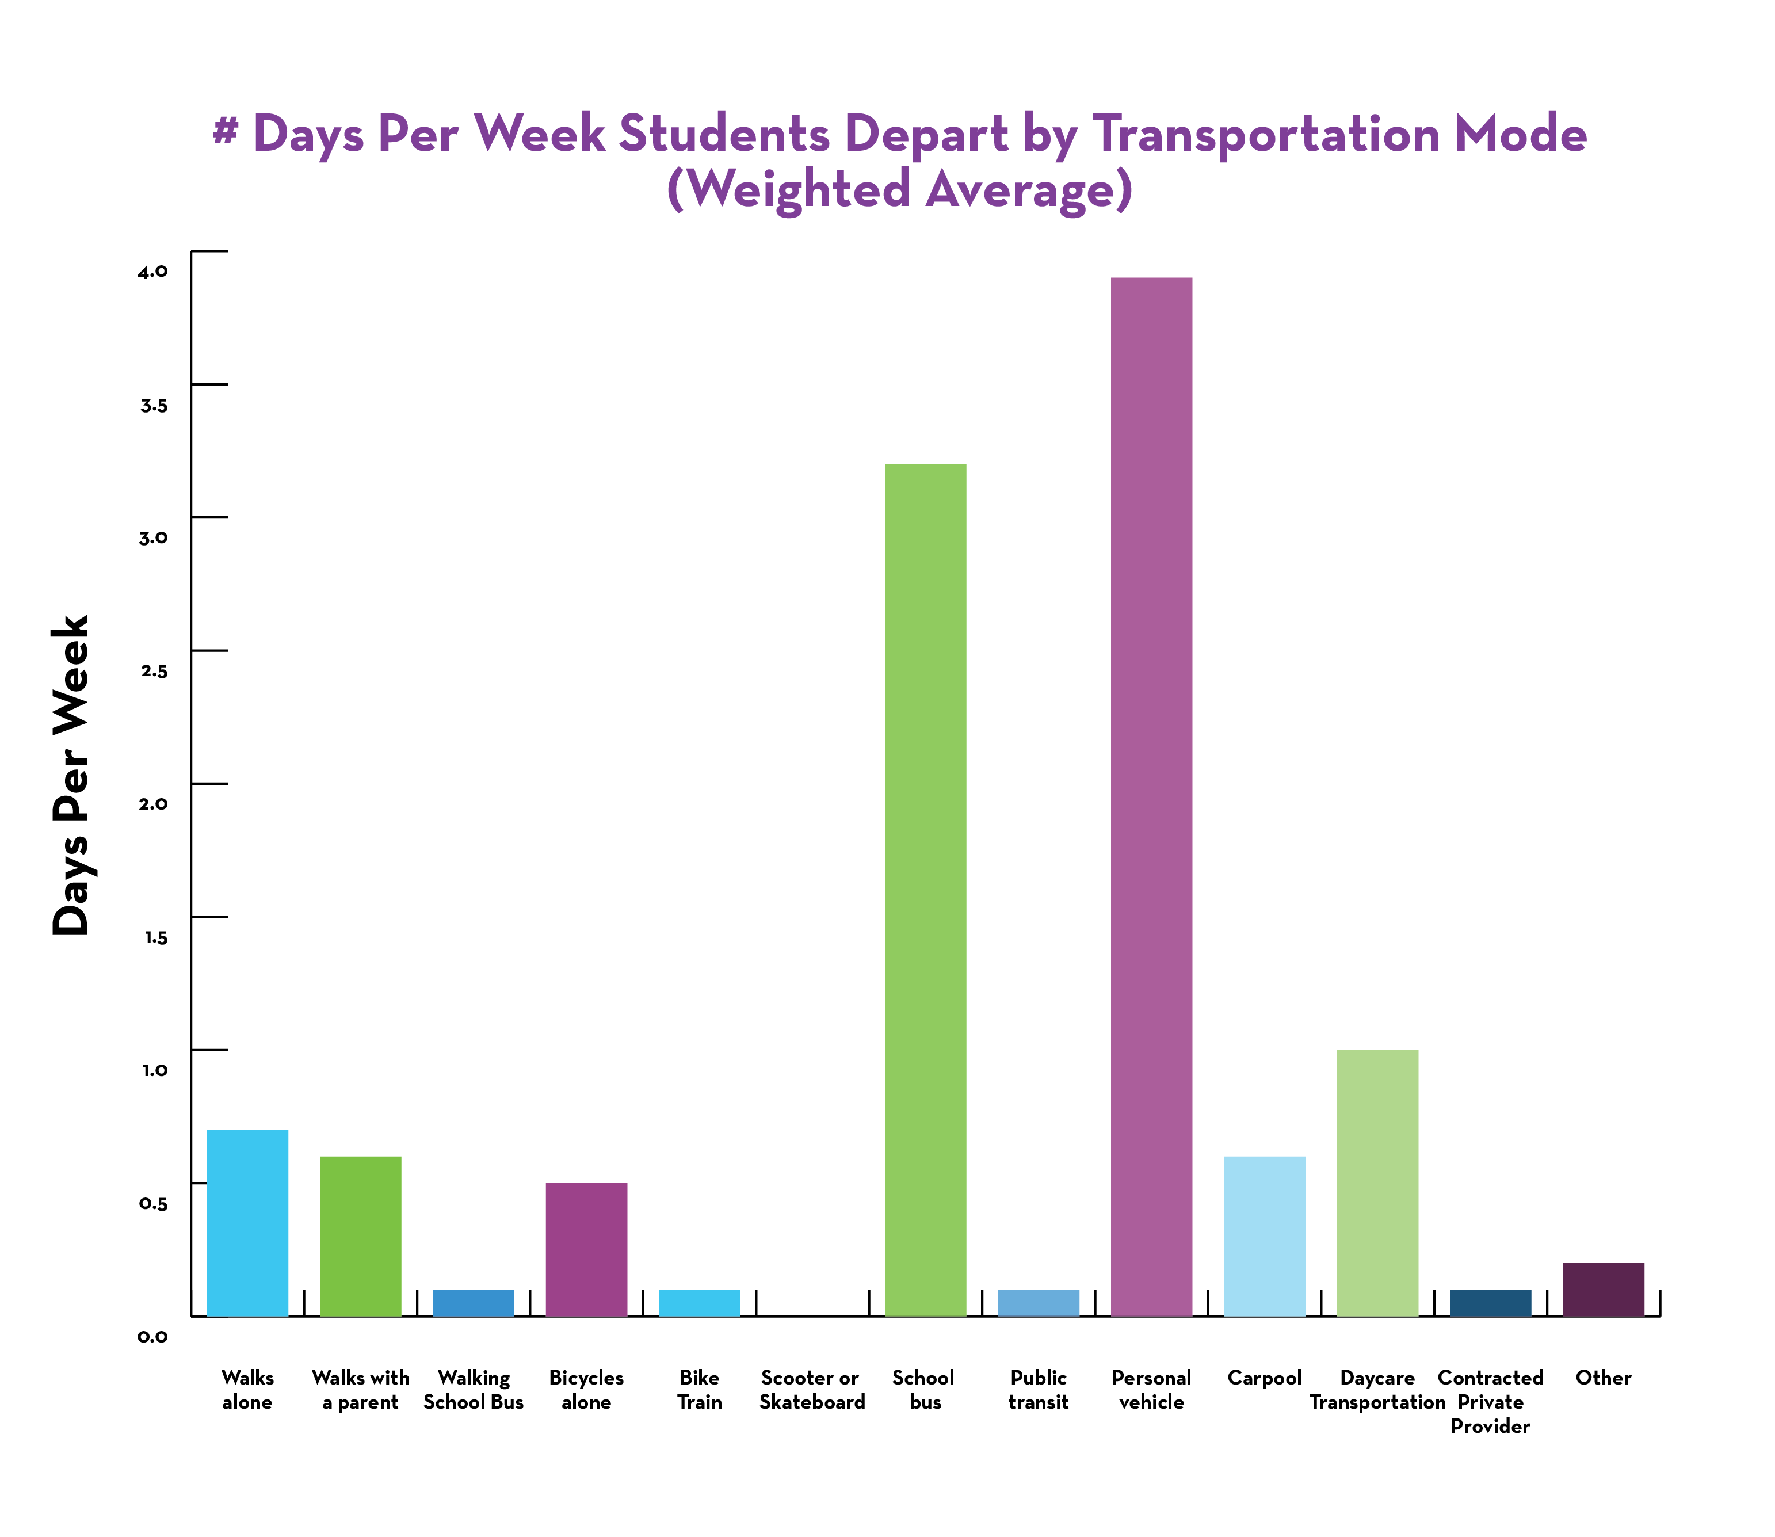
High Level Survey Results – Family Surveys

Slide 11
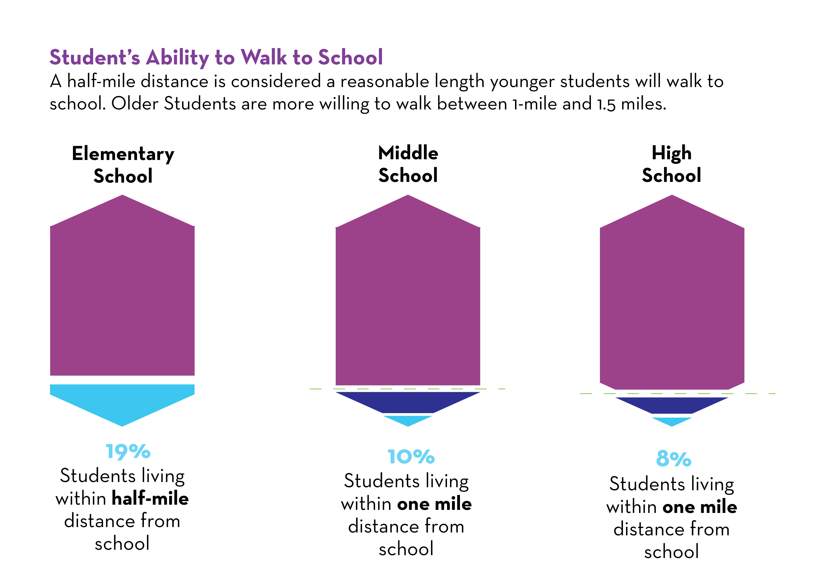
High Level Survey Results – Family Surveys

Slide 12
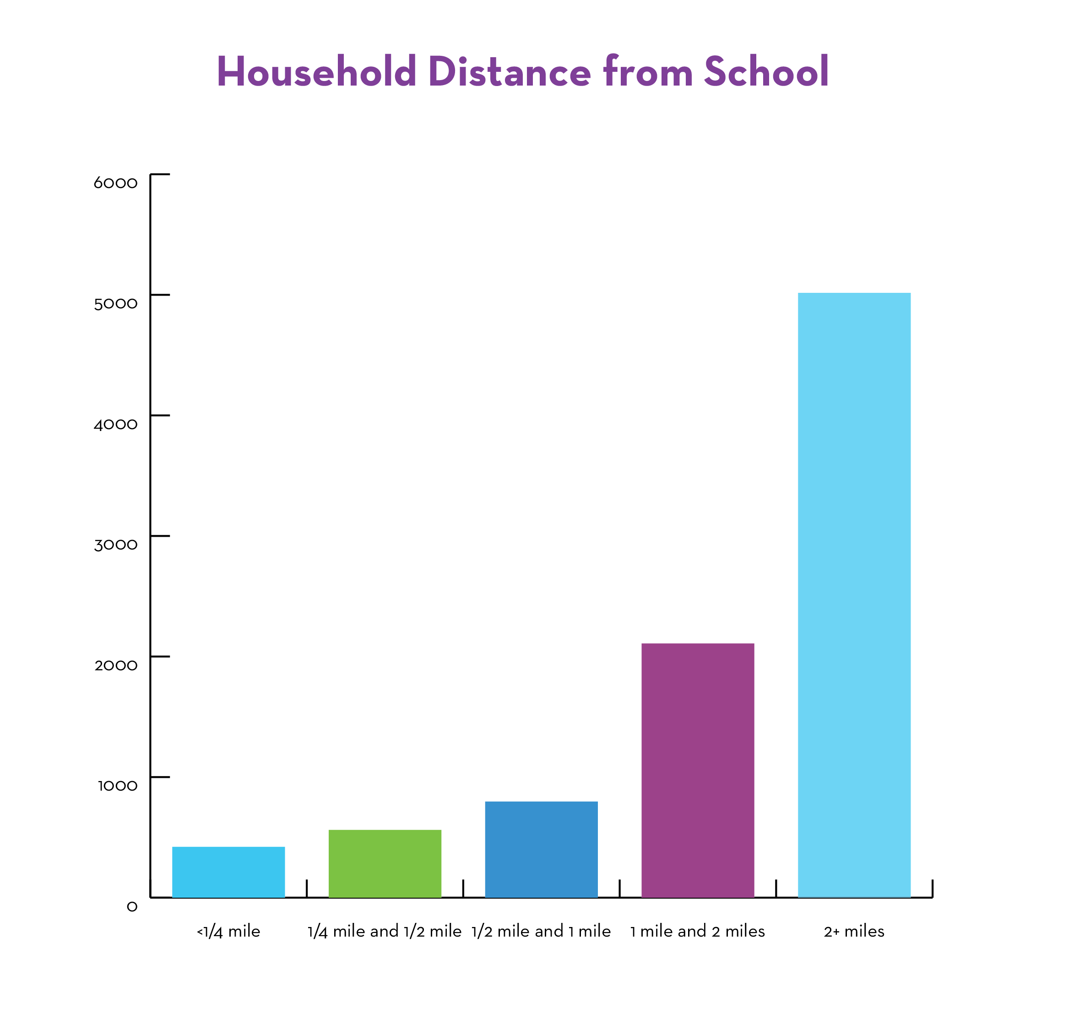
High Level Survey Results – Family Surveys

Slide 13
High Level Survey Results – Family Surveys

Slide 14
High Level Survey Results – Family Surveys
Covid Shifts in travel
57 percent noted no change in travel to/from school compared to pre-covid.
4 percent reported that their student stopped taking the bus to school
3 percent reported that their student started taking the bus
Less than one percent reported that their student is transported to school in a car less often
8.5 percent reported that their student is transported to school in a car more often
1.6 percent reported carpooling more often
1 percent started walking

Slide 15
High Level Survey Results – Strategies for tracking student travel
Phone/video calls
Text messages
Phone applications (find my friend, find my kids, followmee.com, Google Family App, etc.)
Life 360
AirTag
Preschool has an app that notifies parents when students arrive (Hunter’s Green Elementary)
GPS Phone Watch – Gizmodo
Neighbors keep an eye out
Follow the kids
Trust
Carpool with friends and parents coordinate
Ring Doorbell
Parent works from home
Wait with them/for them at bus stop
Alexa

Slide 16
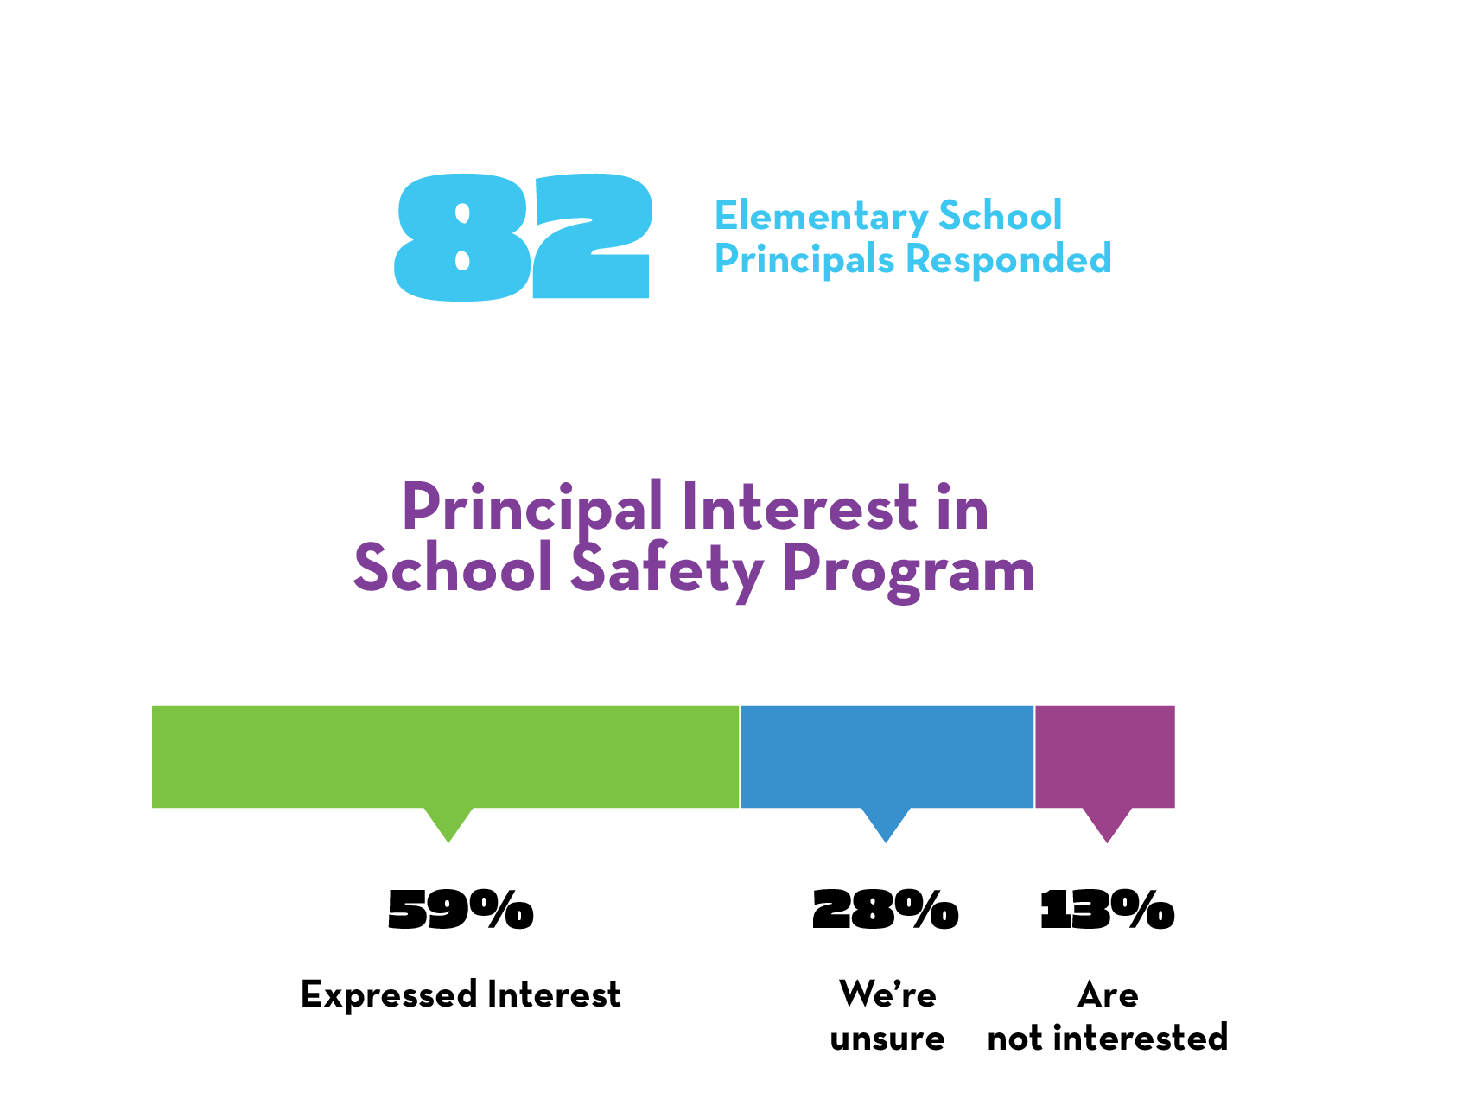
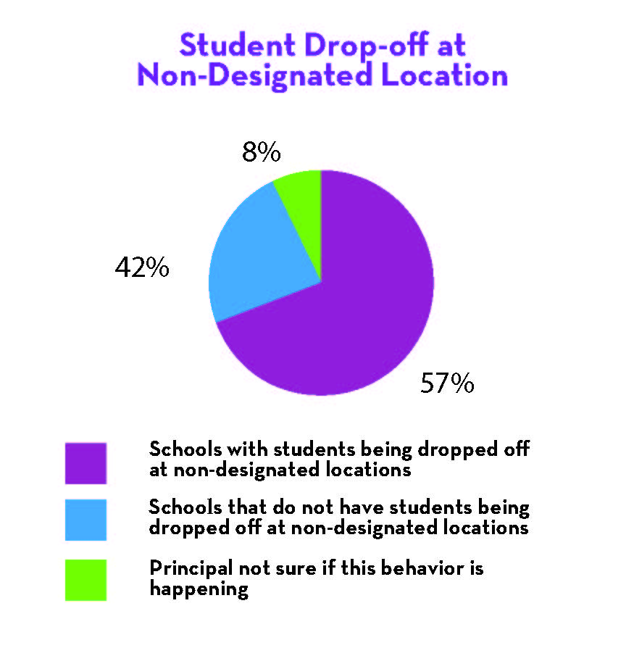
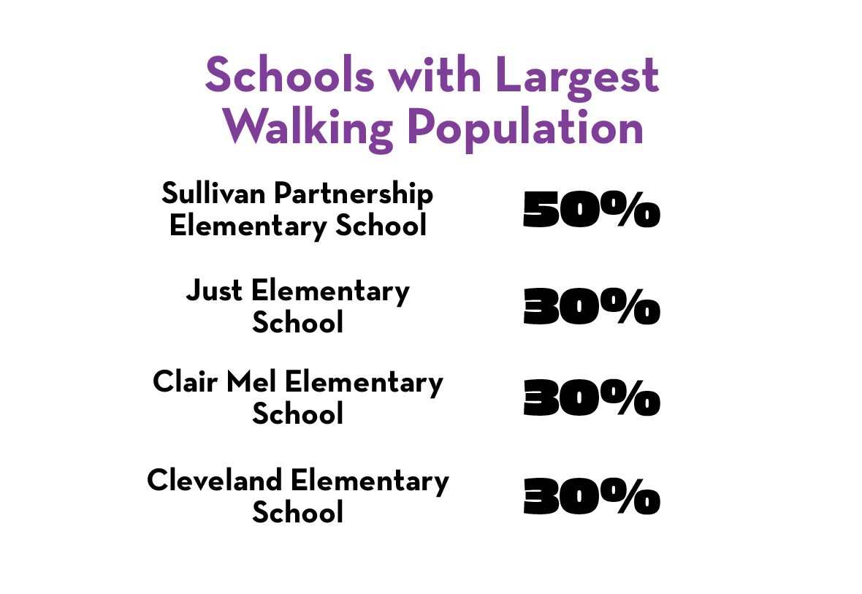
High Level Survey Results – Schools

Slide 17
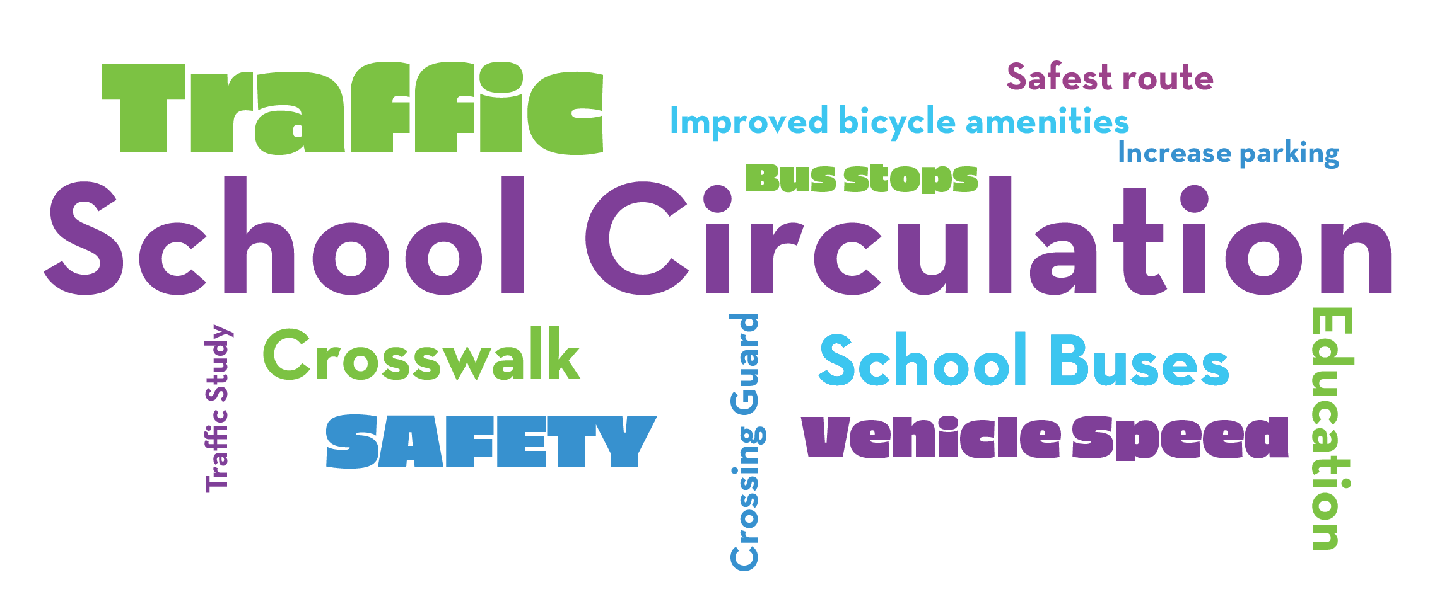
High Level Survey Results – Schools

Slide 18
Common School Circulation Strategies
Staggered dismissals by grade
Placards/Tags on vehicles (per assigned numbers/names)
Multiple dismissal locations
Staggered dismissal by mode
Use phone-based app to communicate with drivers (Voxer)
Walking school bus
Temporary road closures to private vehicles (buses allowed through)
Use walkie talkies to identify upcoming vehicles and get student ready to load faster
Signage / cones to direct traffic in car line
Car riders wait in cafeteria and wait for their name to be called
Priority pick-up line for carpools
Priority days for walking
Prizes for walking/biking

Slide 19
Common School Circulation Strategies
Staggered dismissals by grade
Placards/Tags on vehicles (per assigned numbers/names)
Multiple dismissal locations
Staggered dismissal by mode
Use phone-based app to communicate with drivers (Voxer)
Walking school bus
Temporary road closures to private vehicles (buses allowed through)
Use walkie talkies to identify upcoming vehicles and get student ready to load faster
Signage / cones to direct traffic in car line
Car riders wait in cafeteria and wait for their name to be called
Priority pick-up line for carpools
Priority days for walking
Prizes for walking/biking
Resources Needed
Cones
Movable Barriers
Walkie-Talkies
Cardboard signs
Staff and staff training
Prizes
Phones
Parent cooperation

Slide 20
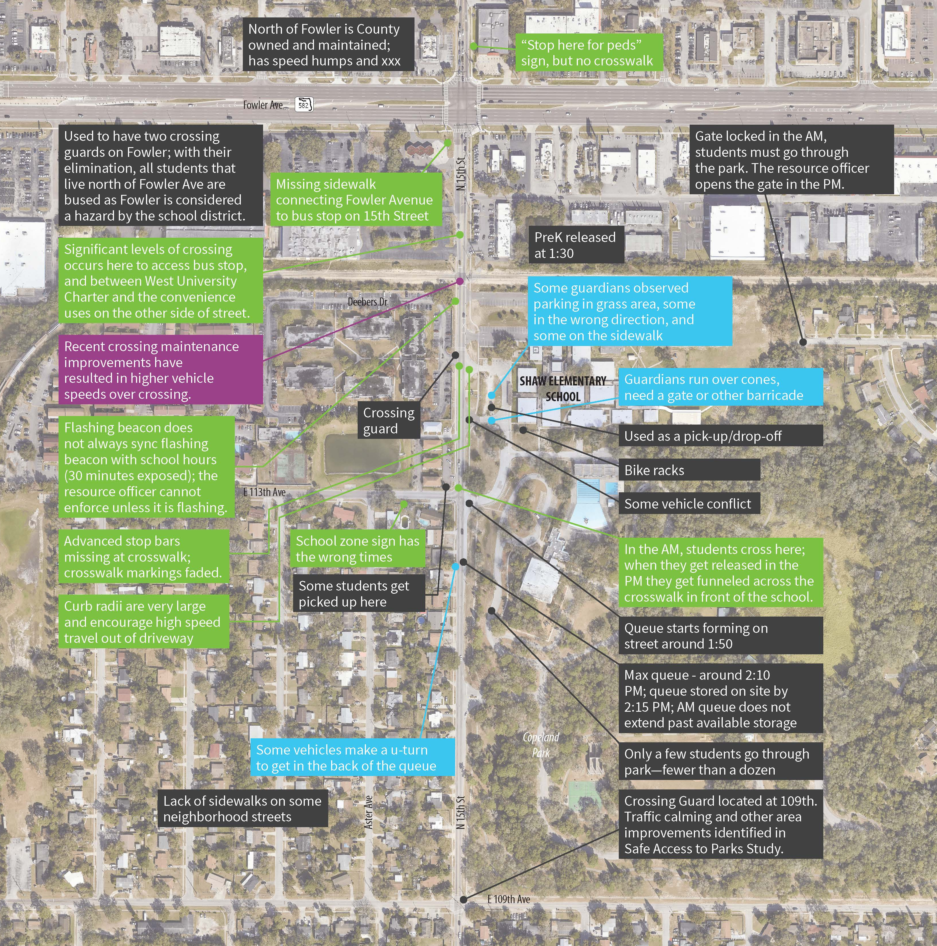
Shaw Elementary
Notes:
We classified observations into four different categories – The first in black is informational data, like where there are crossing guards and the extent of vehicle queues.
People driving in excess of posted speed limit. (Purple)
Parents/guardians not following rules (we should figure out which ones probably fine and which ones we want to have some sort of engineering countermeasures) (Blue)
Incomplete infrastructure - missing sidewalks, and opportunities for crossing treatments, ROW reallocation, signal adjustments, etc. (Green)

Slide 21
Shaw Elementary – Survey Results
Family Survey
Principal Survey
Eight families completed survey, some with multiple children at the school
The students in 1 family walks, 4 take the bus, 2 in personal vehicles and one is transported by a day care vehicle
Half would not feel comfortable allowing their child to walk in any grade
Half cited distance as a barrier to walking to school
Speed of traffic, the safety of intersections, and presence of crossing guards(lack of) are all factors that affect their decision to let their student walk / bike to school
Some are also concerned about crime in the area
Noted school would benefit from a school transportation study but did not complete remainder of survey

Slide 22
Shaw Elementary Preliminary Ideas

Slide 23
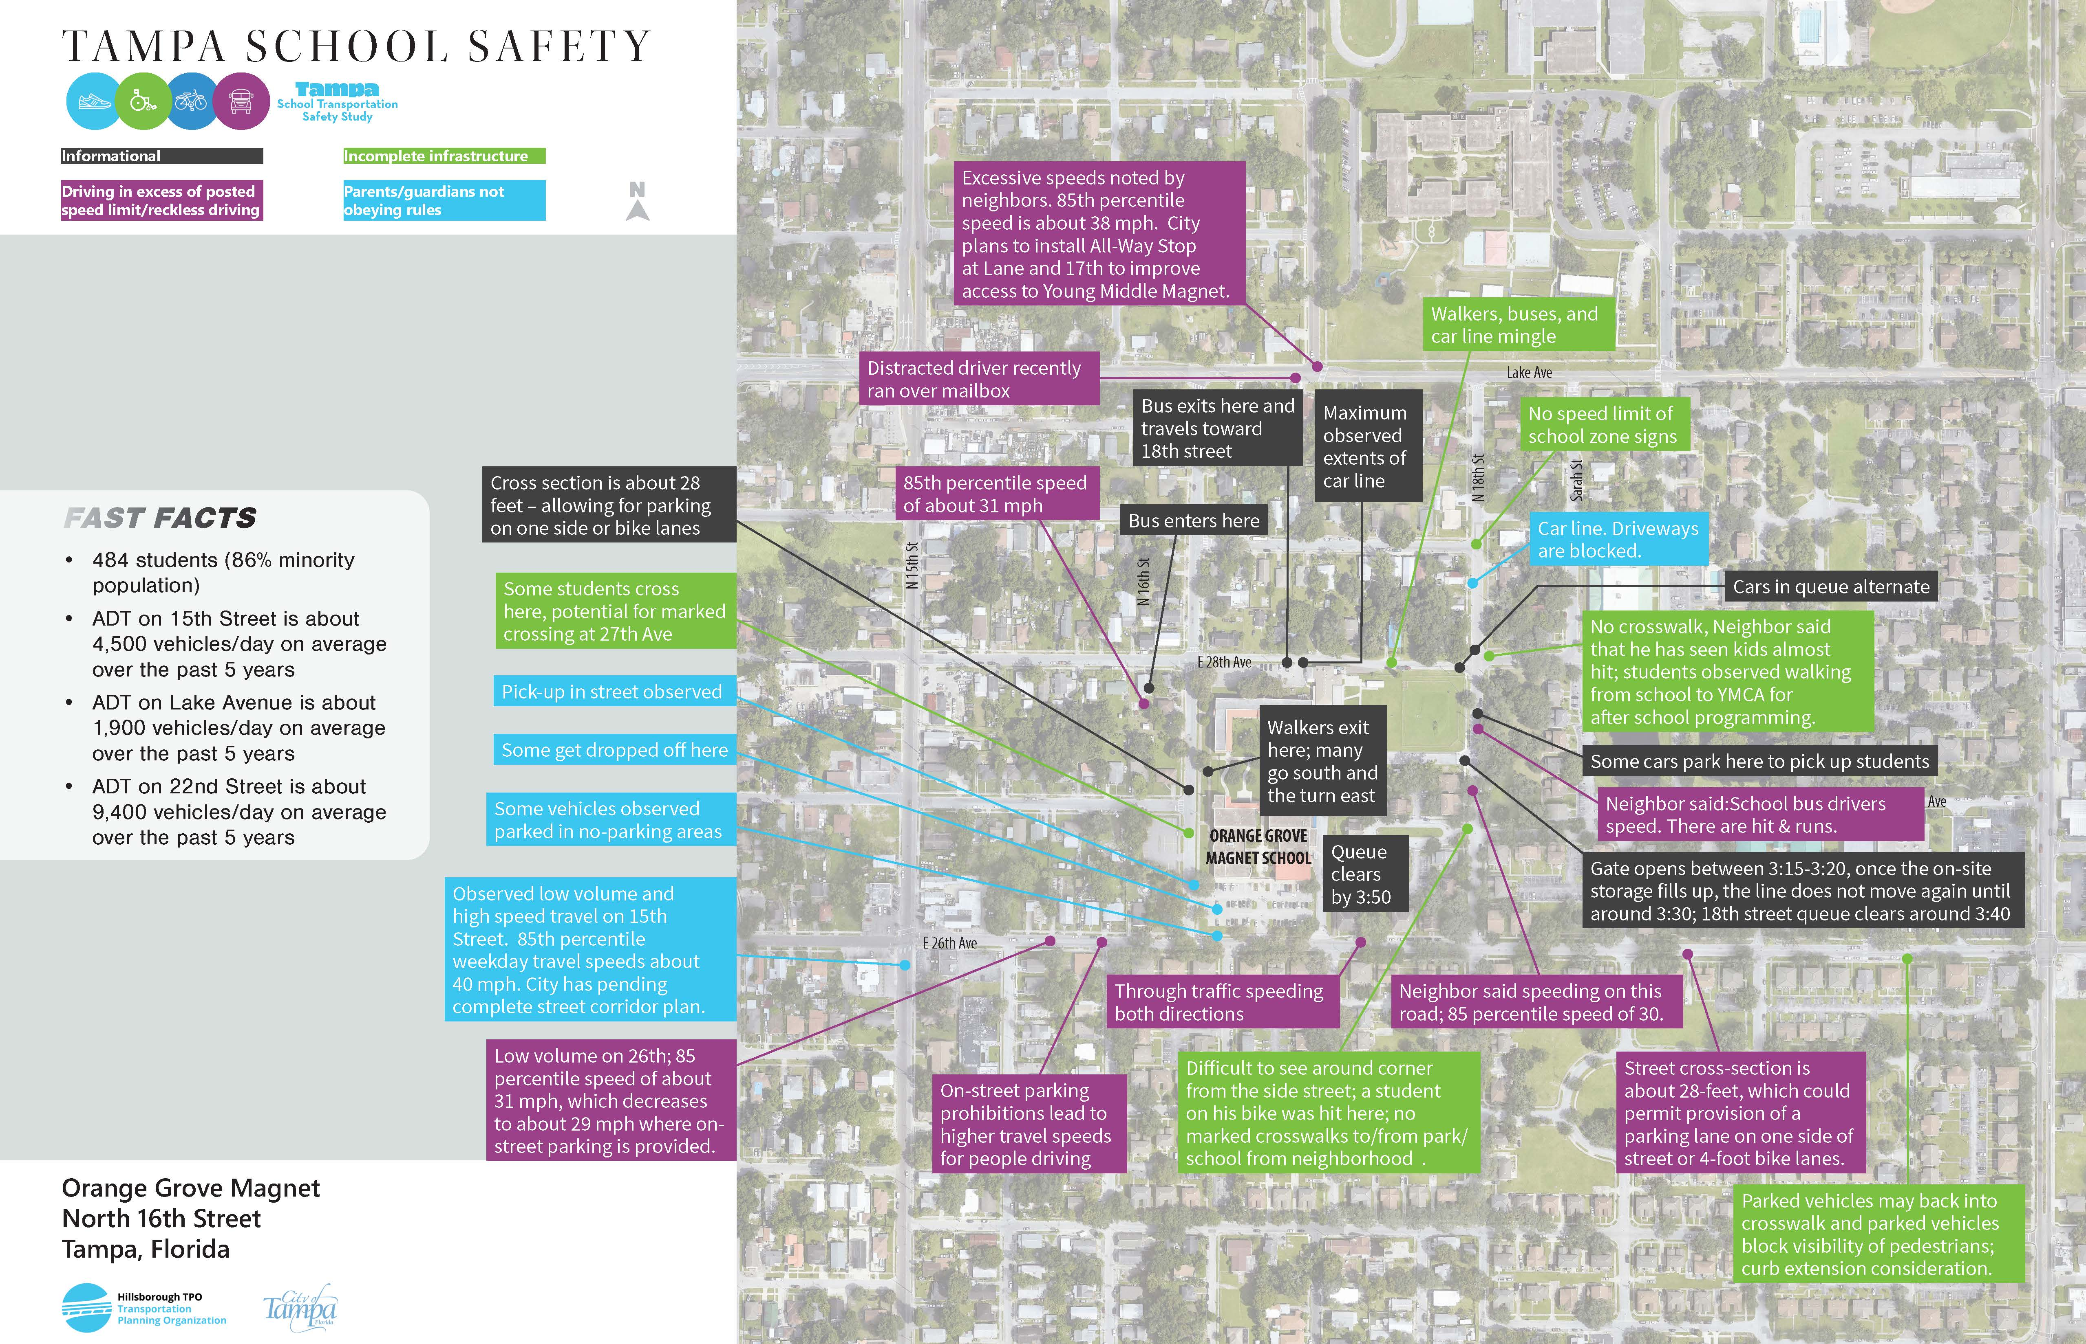
Orange Grove Magnet Middle
Notes:
We classified observations into four different categories – The first in black is informational data, like where there are crossing guards and the extent of vehicle queues.
People driving in excess of posted speed limit. (Purple)
Parents/guardians not following rules (we should figure out which ones probably fine and which ones we want to have some sort of engineering countermeasures) (Blue)
Incomplete infrastructure - missing sidewalks, and opportunities for crossing treatments, ROW reallocation, signal adjustments, etc. (Green)

Slide 24
Orange Grove Magnet Middle – Survey Results
Family Survey
Principal Survey
37 families completed survey, some with multiple children at the school
Most arrive/depart in a school bus or personal vehicle. A few walk with others or walk alone. Two families carpool
About 75 percent would not feel comfortable allowing their child to walk in any grade
About 75 percent cited distance as a barrier to walking to school, as many come from long distances to attend this school
Speed of traffic, the safety of intersections, and presence and presence of crossing guards (lack of) are all factors that affect their decision to let their student walk / bike to school
Some would allow their student to walk to school if they had a peer or another adult to walk with
Did not complete

Slide 25
Orange Grove Middle Preliminary Ideas

Slide 26
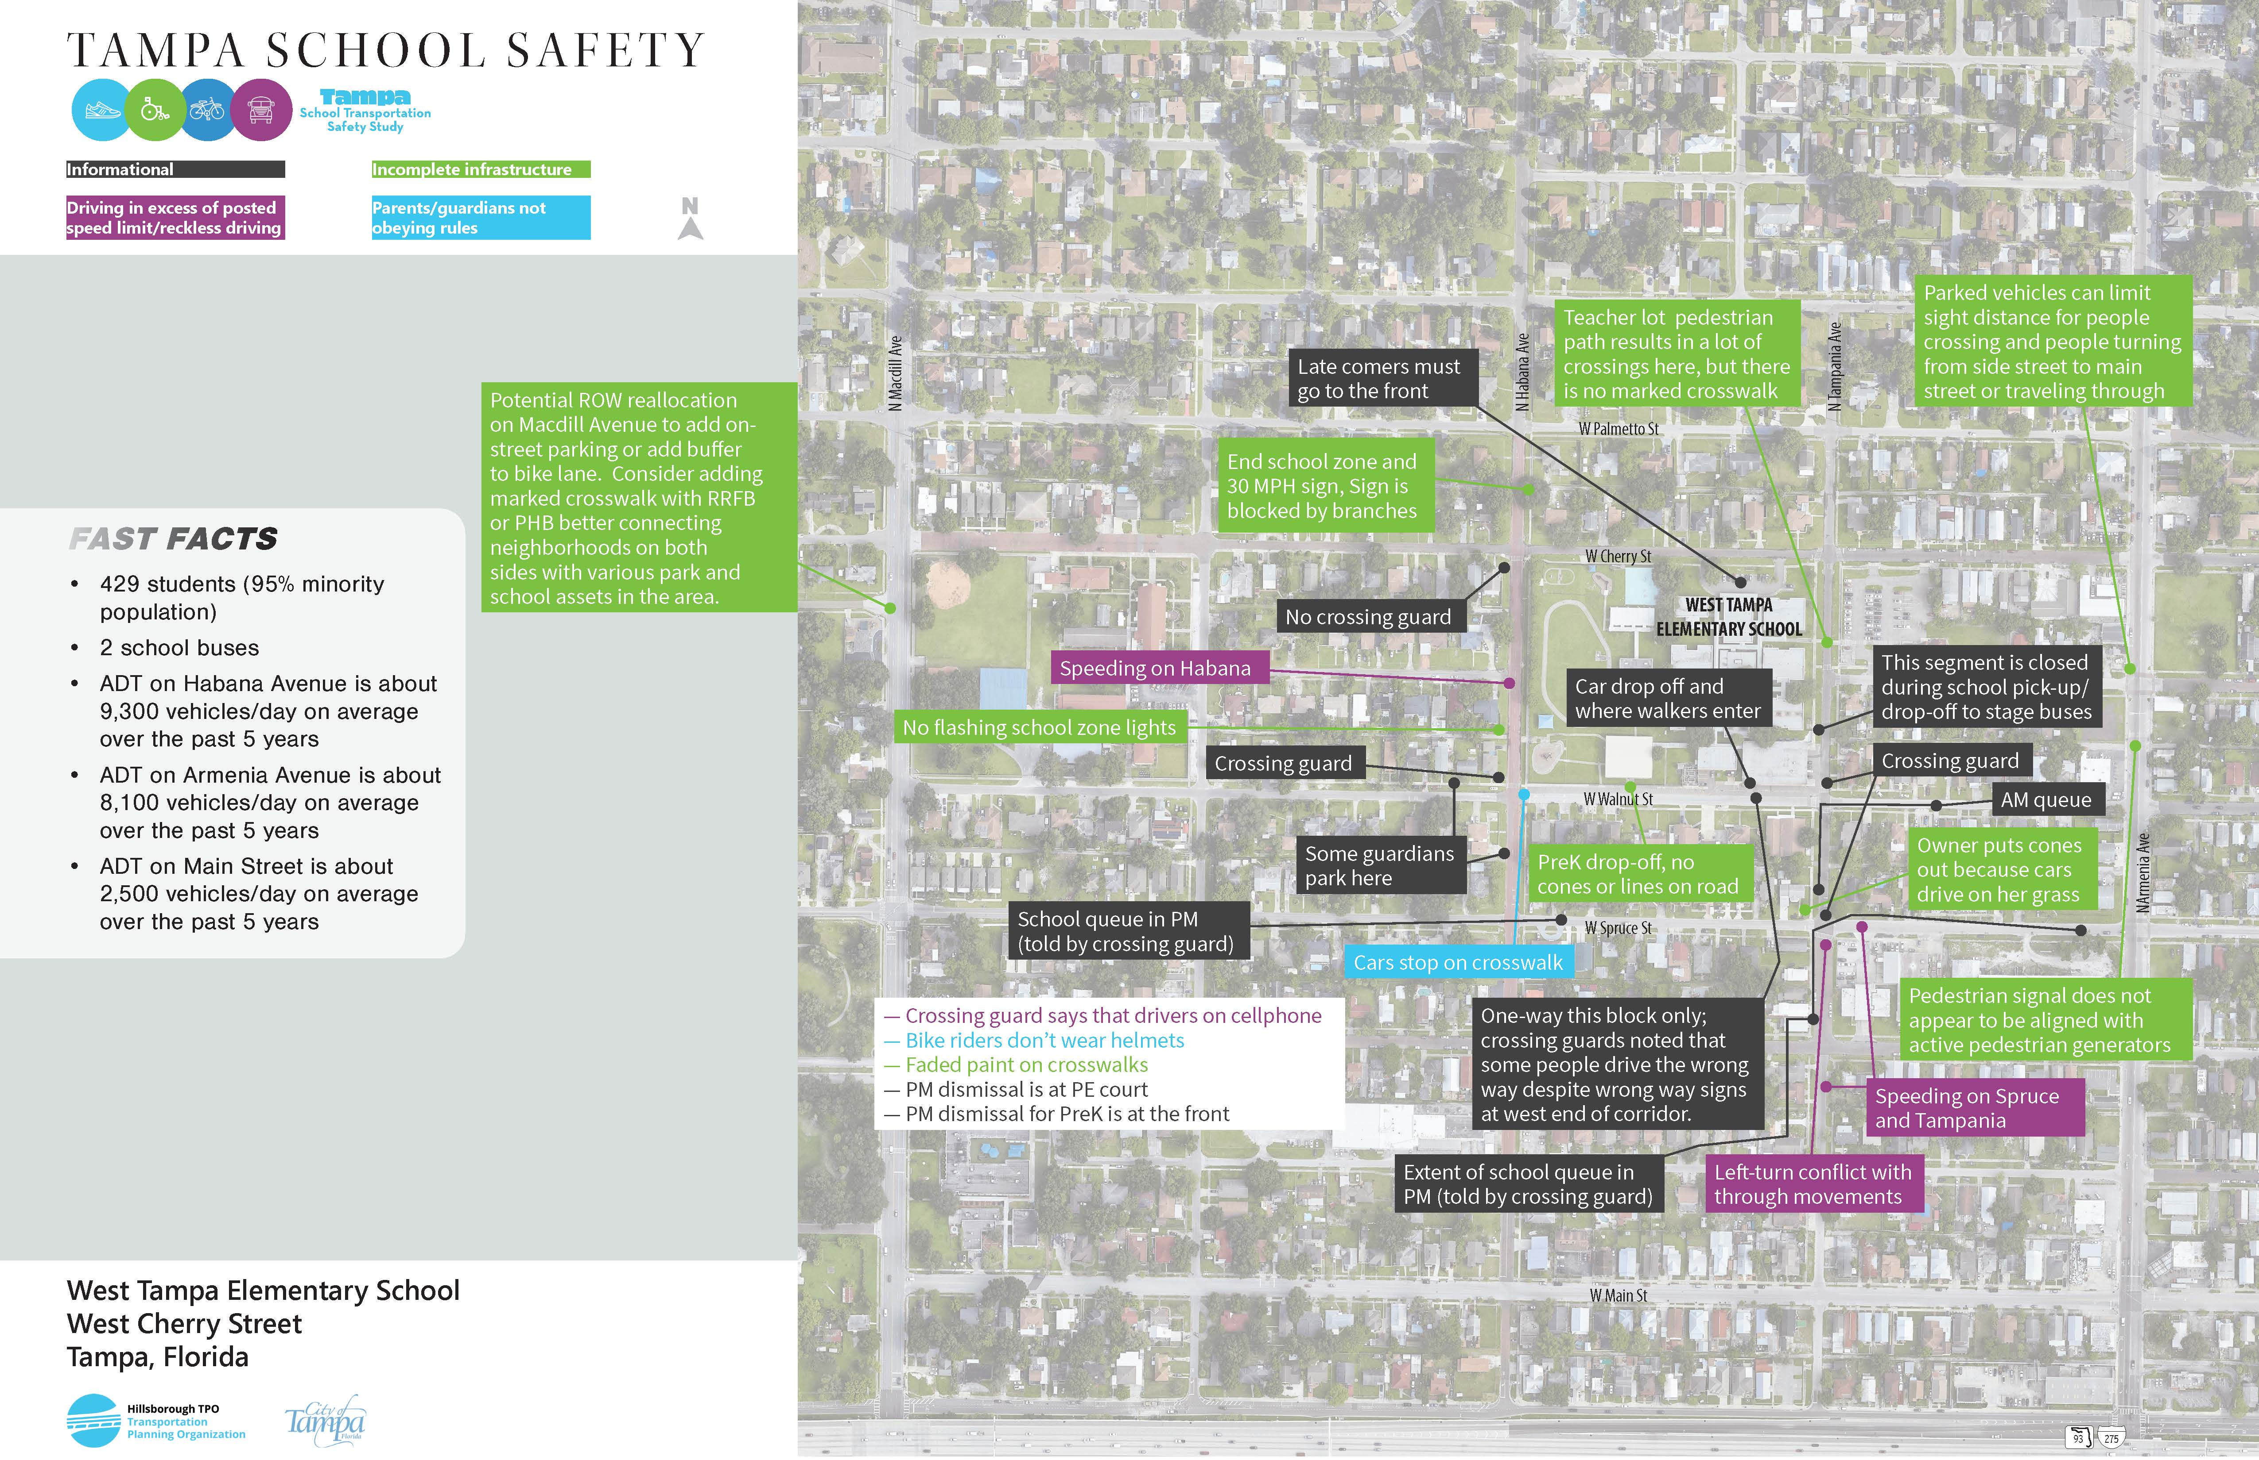
West Tampa Elementary
Notes:
We classified observations into four different categories – The first in black is informational data, like where there are crossing guards and the extent of vehicle queues.
People driving in excess of posted speed limit. (Purple)
Parents/guardians not following rules (we should figure out which ones probably fine and which ones we want to have some sort of engineering countermeasures) (Blue)
Incomplete infrastructure - missing sidewalks, and opportunities for crossing treatments, ROW reallocation, signal adjustments, etc. (Green)

Slide 27
West Tampa Elementary – Survey Results
Family Survey
Eight families completed survey, some with multiple children at the school
These families represent:
Personal vehicle
Walks alone
Walks with parent
75 percent would not feel comfortable allowing their child to walk in any grade
Half cited distance as a barrier to walking to school
Speed of traffic, the safety of intersections, and presence of crossing guards (lack of) are all factors that affect their decision to let their student walk / bike to school
Some are also concerned about crime in the area
Specific mention of challenges crossing Armenia and Howard, as well as parked cars on major streets impeding visibility when trying to cross

Slide 28
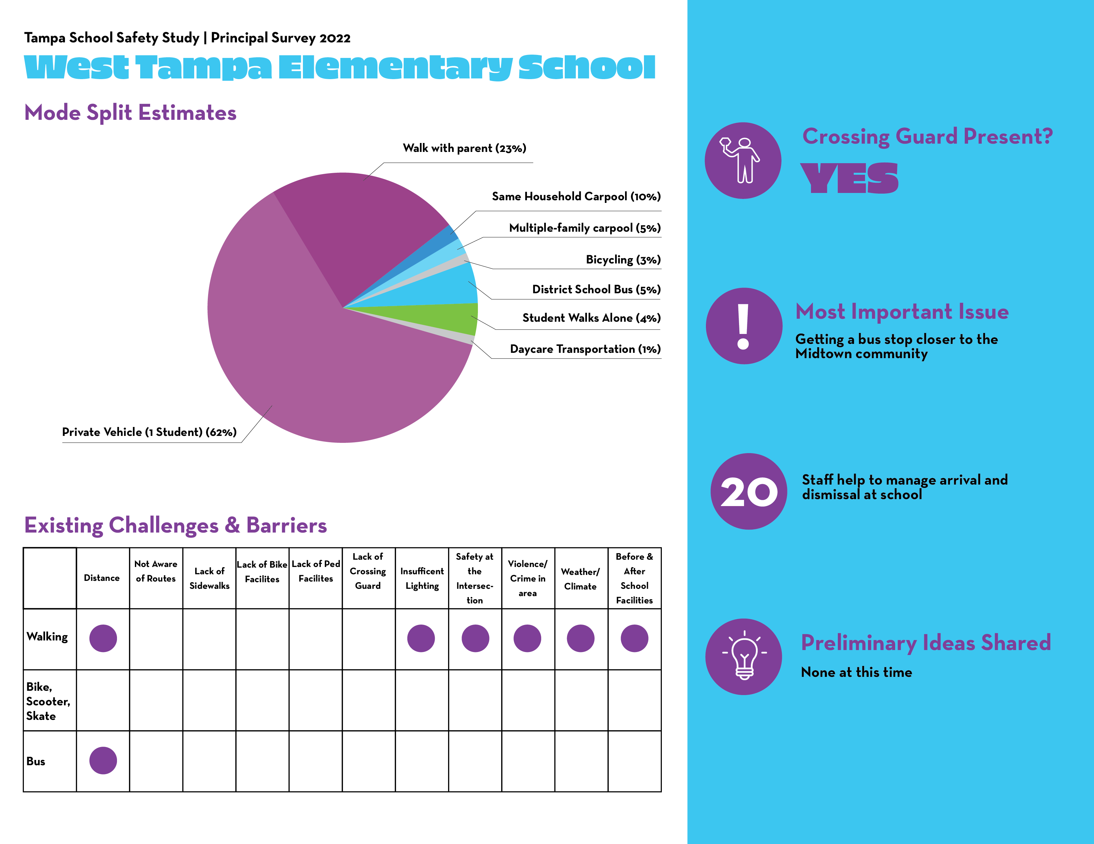
West Tampa Elementary Survey Results

Slide 29
West Tampa Elementary Preliminary Ideas

Slide 30
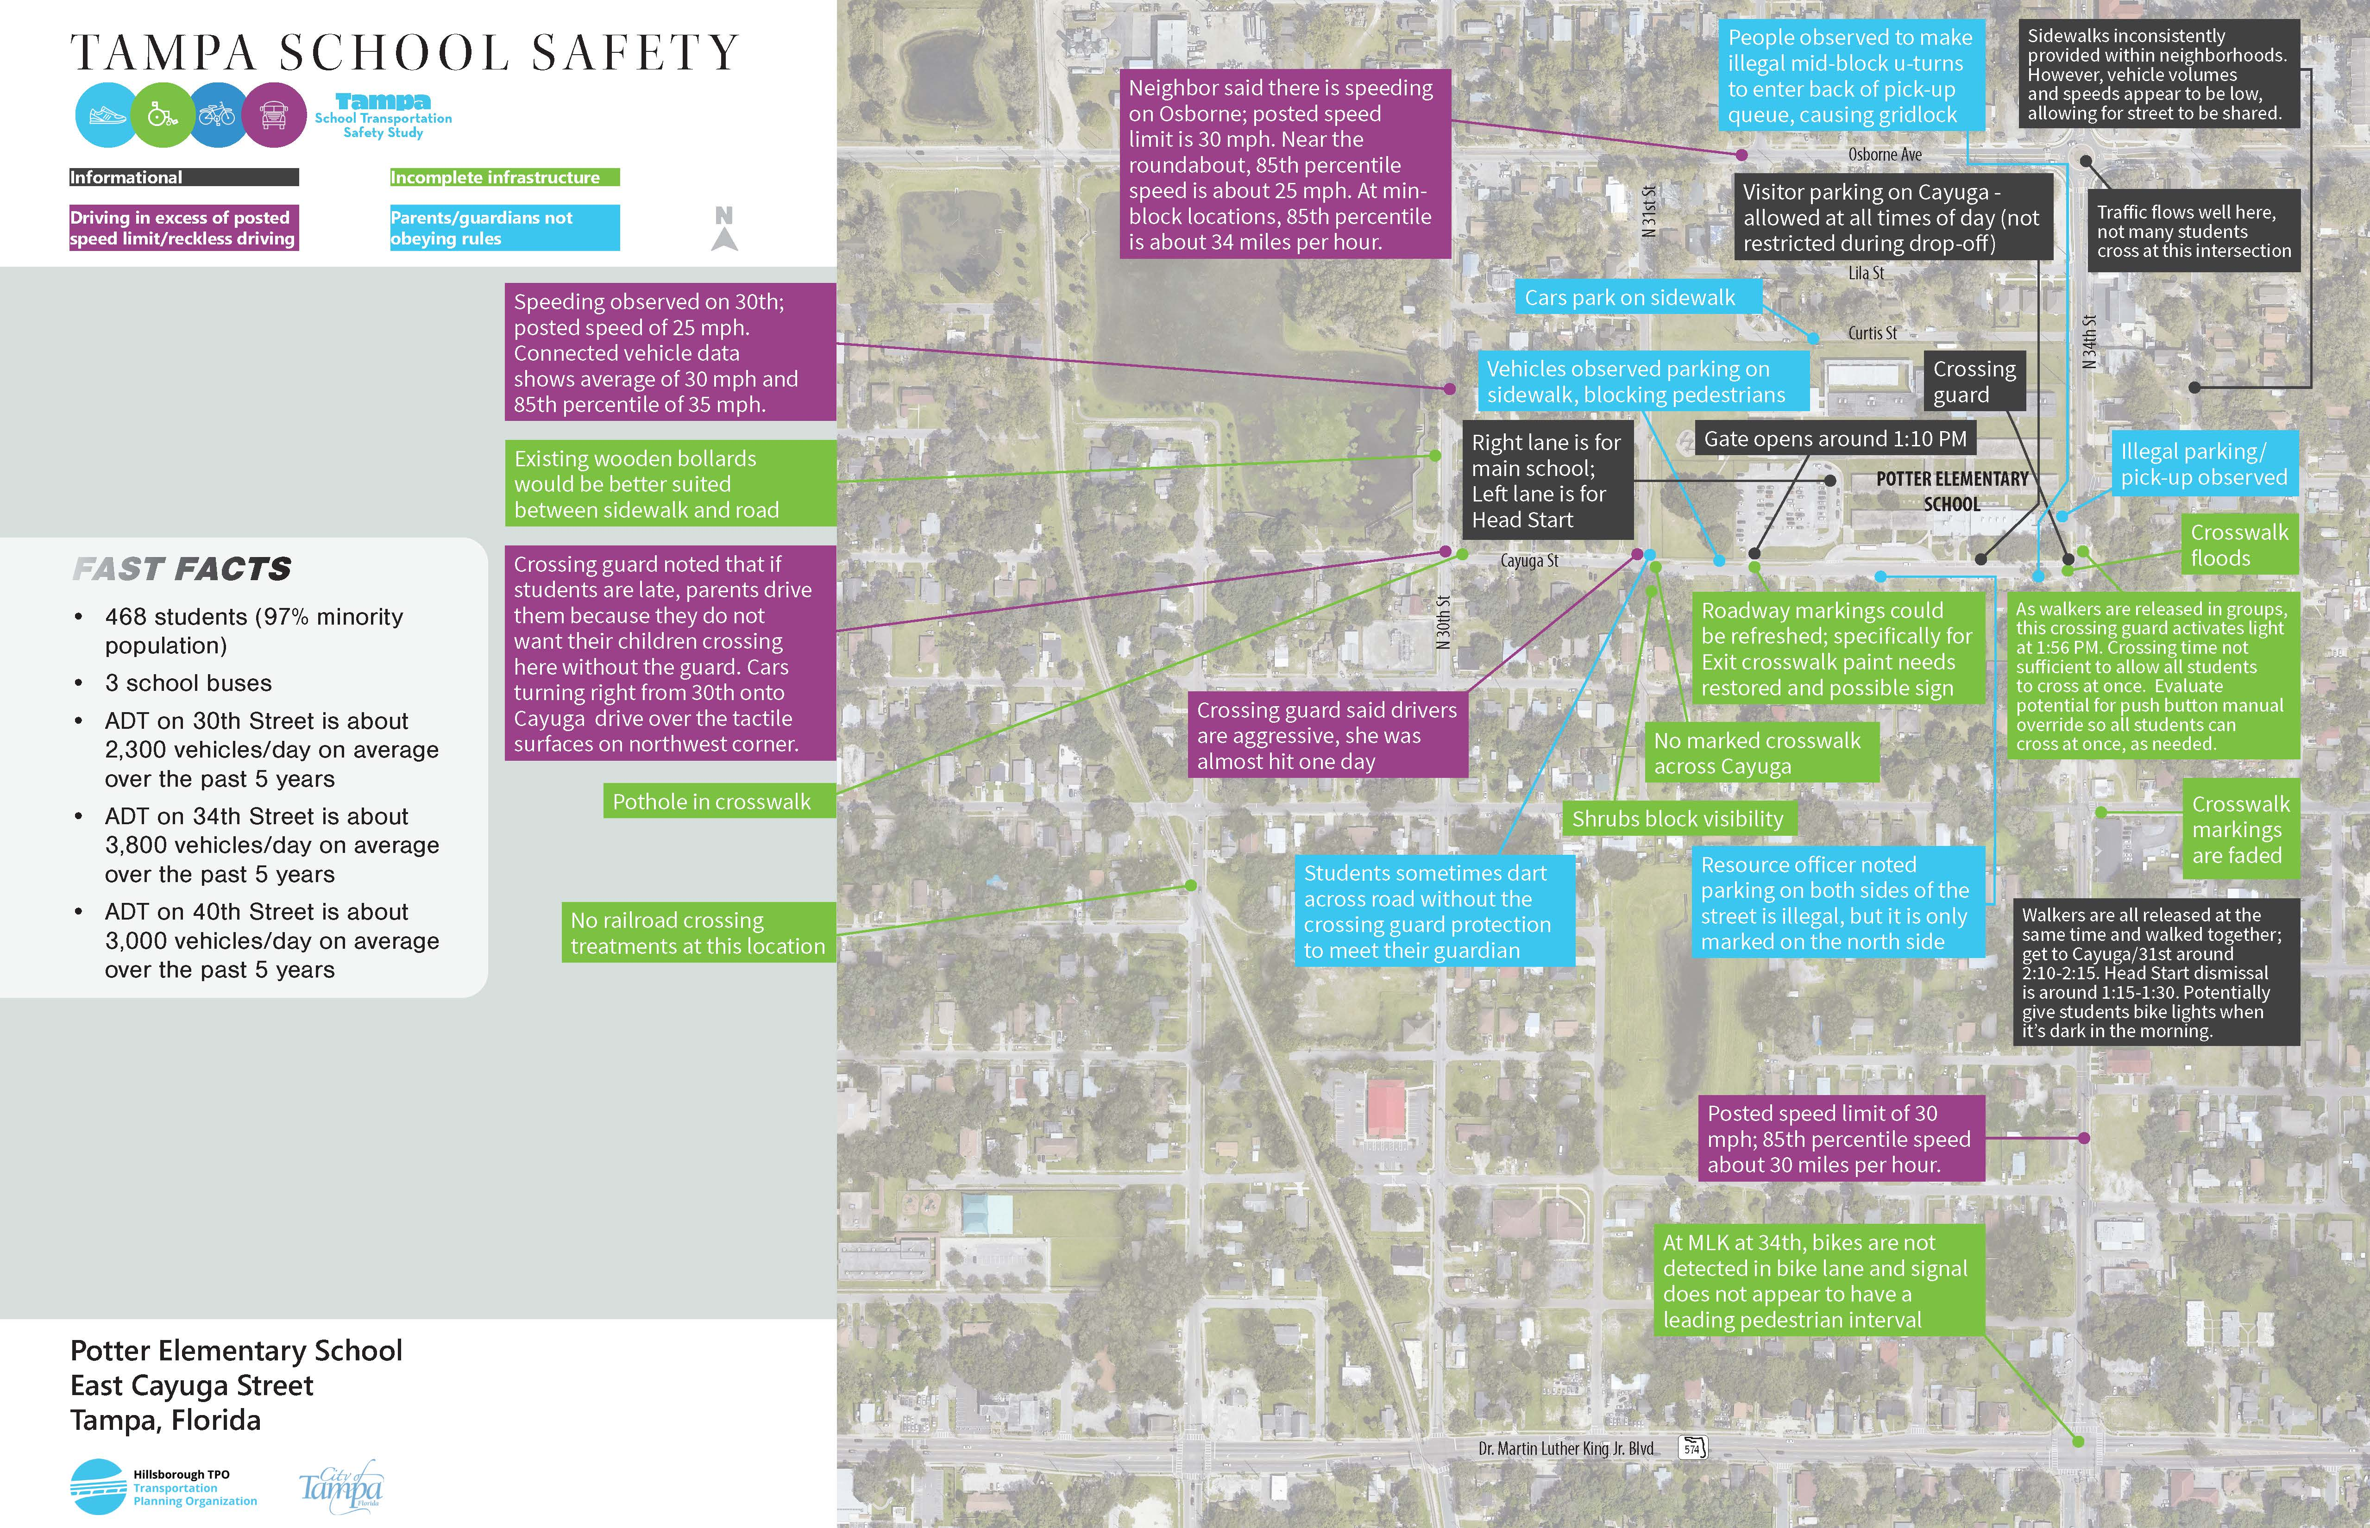
Potter Elementary
Notes:
We classified observations into four different categories – The first in black is informational data, like where there are crossing guards and the extent of vehicle queues.
People driving in excess of posted speed limit. (Purple)
Parents/guardians not following rules (we should figure out which ones probably fine and which ones we want to have some sort of engineering countermeasures) (Blue)
Incomplete infrastructure - missing sidewalks, and opportunities for crossing treatments, ROW reallocation, signal adjustments, etc. (Green)

Slide 31
Potter Elementary – Survey Results
Family Survey
Four families completed survey, some with multiple children at the school
These families represent:
Bus rider
Personal vehicle
Walking school bus participant
Half would not feel comfortable allowing their child to walk in any grade
Half cited distance as a barrier to walking to school
Speed of traffic, the safety of intersections, and presence (lack of) are all factors that affect their decision to let their student walk / bike to school
Some are also concerned about crime in the area

Slide 32
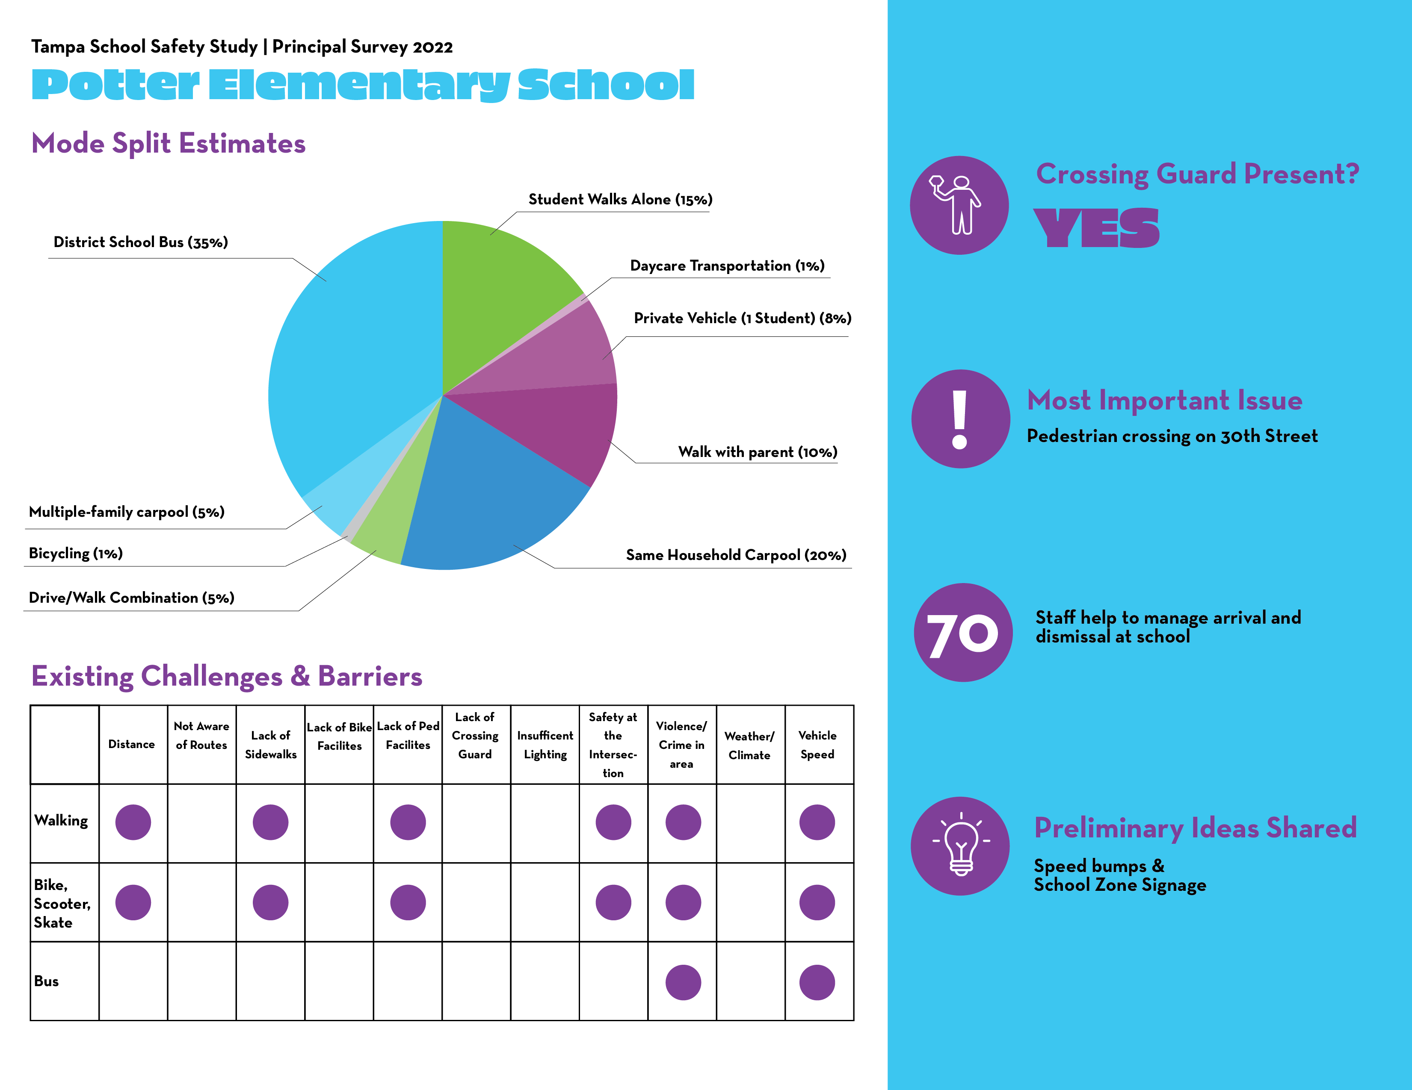
Potter Elementary Survey Results

Slide 33
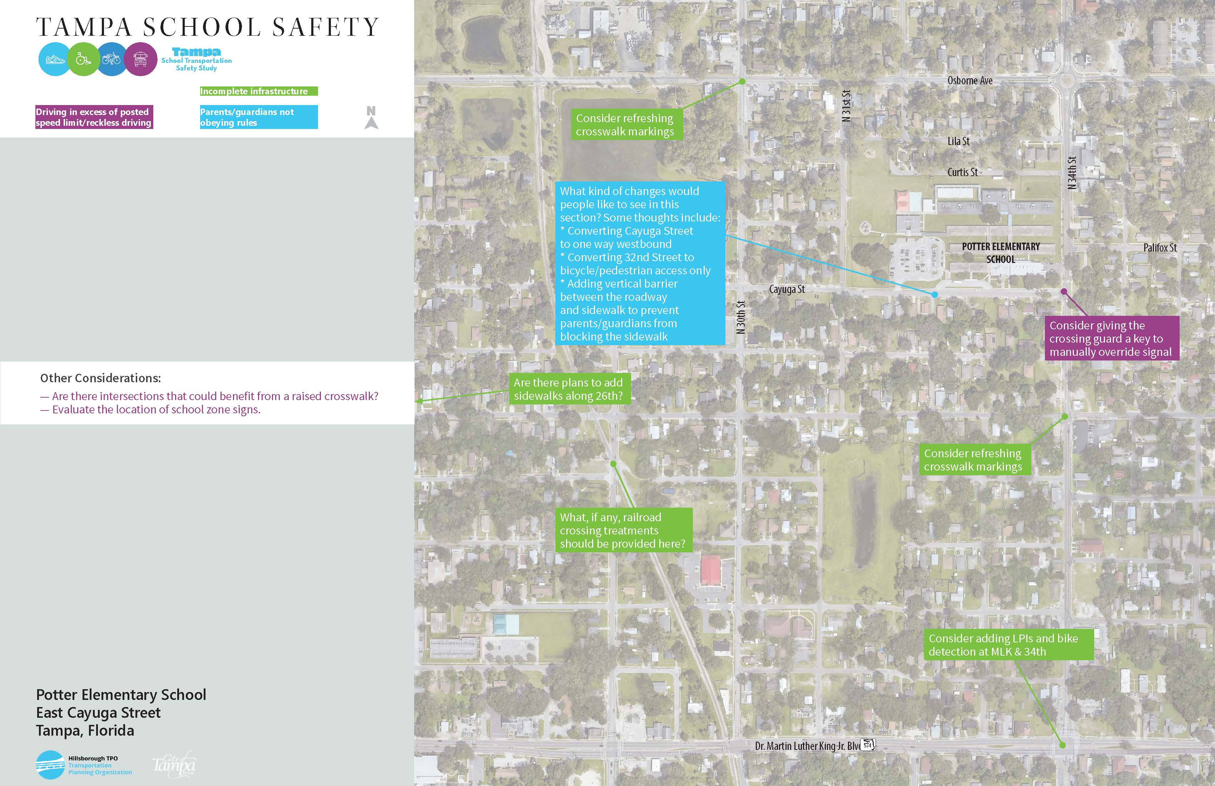
Potter Elementary Preliminary Ideas

Slide 34
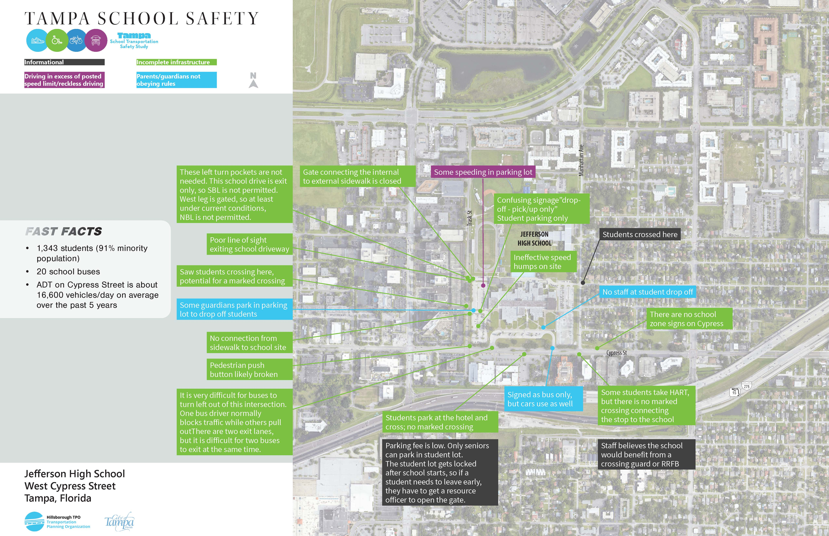
Jefferson High School
Notes:
We classified observations into four different categories – The first in black is informational data, like where there are crossing guards and the extent of vehicle queues.
People driving in excess of posted speed limit. (Purple)
Parents/guardians not following rules (we should figure out which ones probably fine and which ones we want to have some sort of engineering countermeasures) (Blue)
Incomplete infrastructure - missing sidewalks, and opportunities for crossing treatments, ROW reallocation, signal adjustments, etc. (Green)

Slide 35
Jefferson High School – Survey Results
Family Survey
Principal Survey
28 families completed survey, some with multiple children at the school
These families represent:
Bus rider (58%)
Personal vehicle (25%)
Public Transit (4%)
Carpool (4%)
Walks (4%)
67% would not feel comfortable allowing their child to walk in any grade
Half cited distance as a barrier to walking to school
Speed of traffic, the safety of intersections, and lighting are all factors that affect their decision to let their student walk / bike to school
Some are also concerned about crime in the area
Noted school would benefit from a school transportation study but did not complete remainder of survey

Slide 36
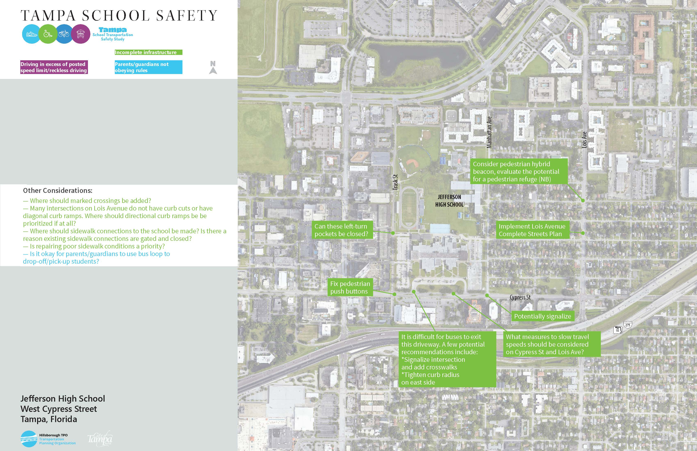
Jefferson High School Preliminary Ideas

Slide 37
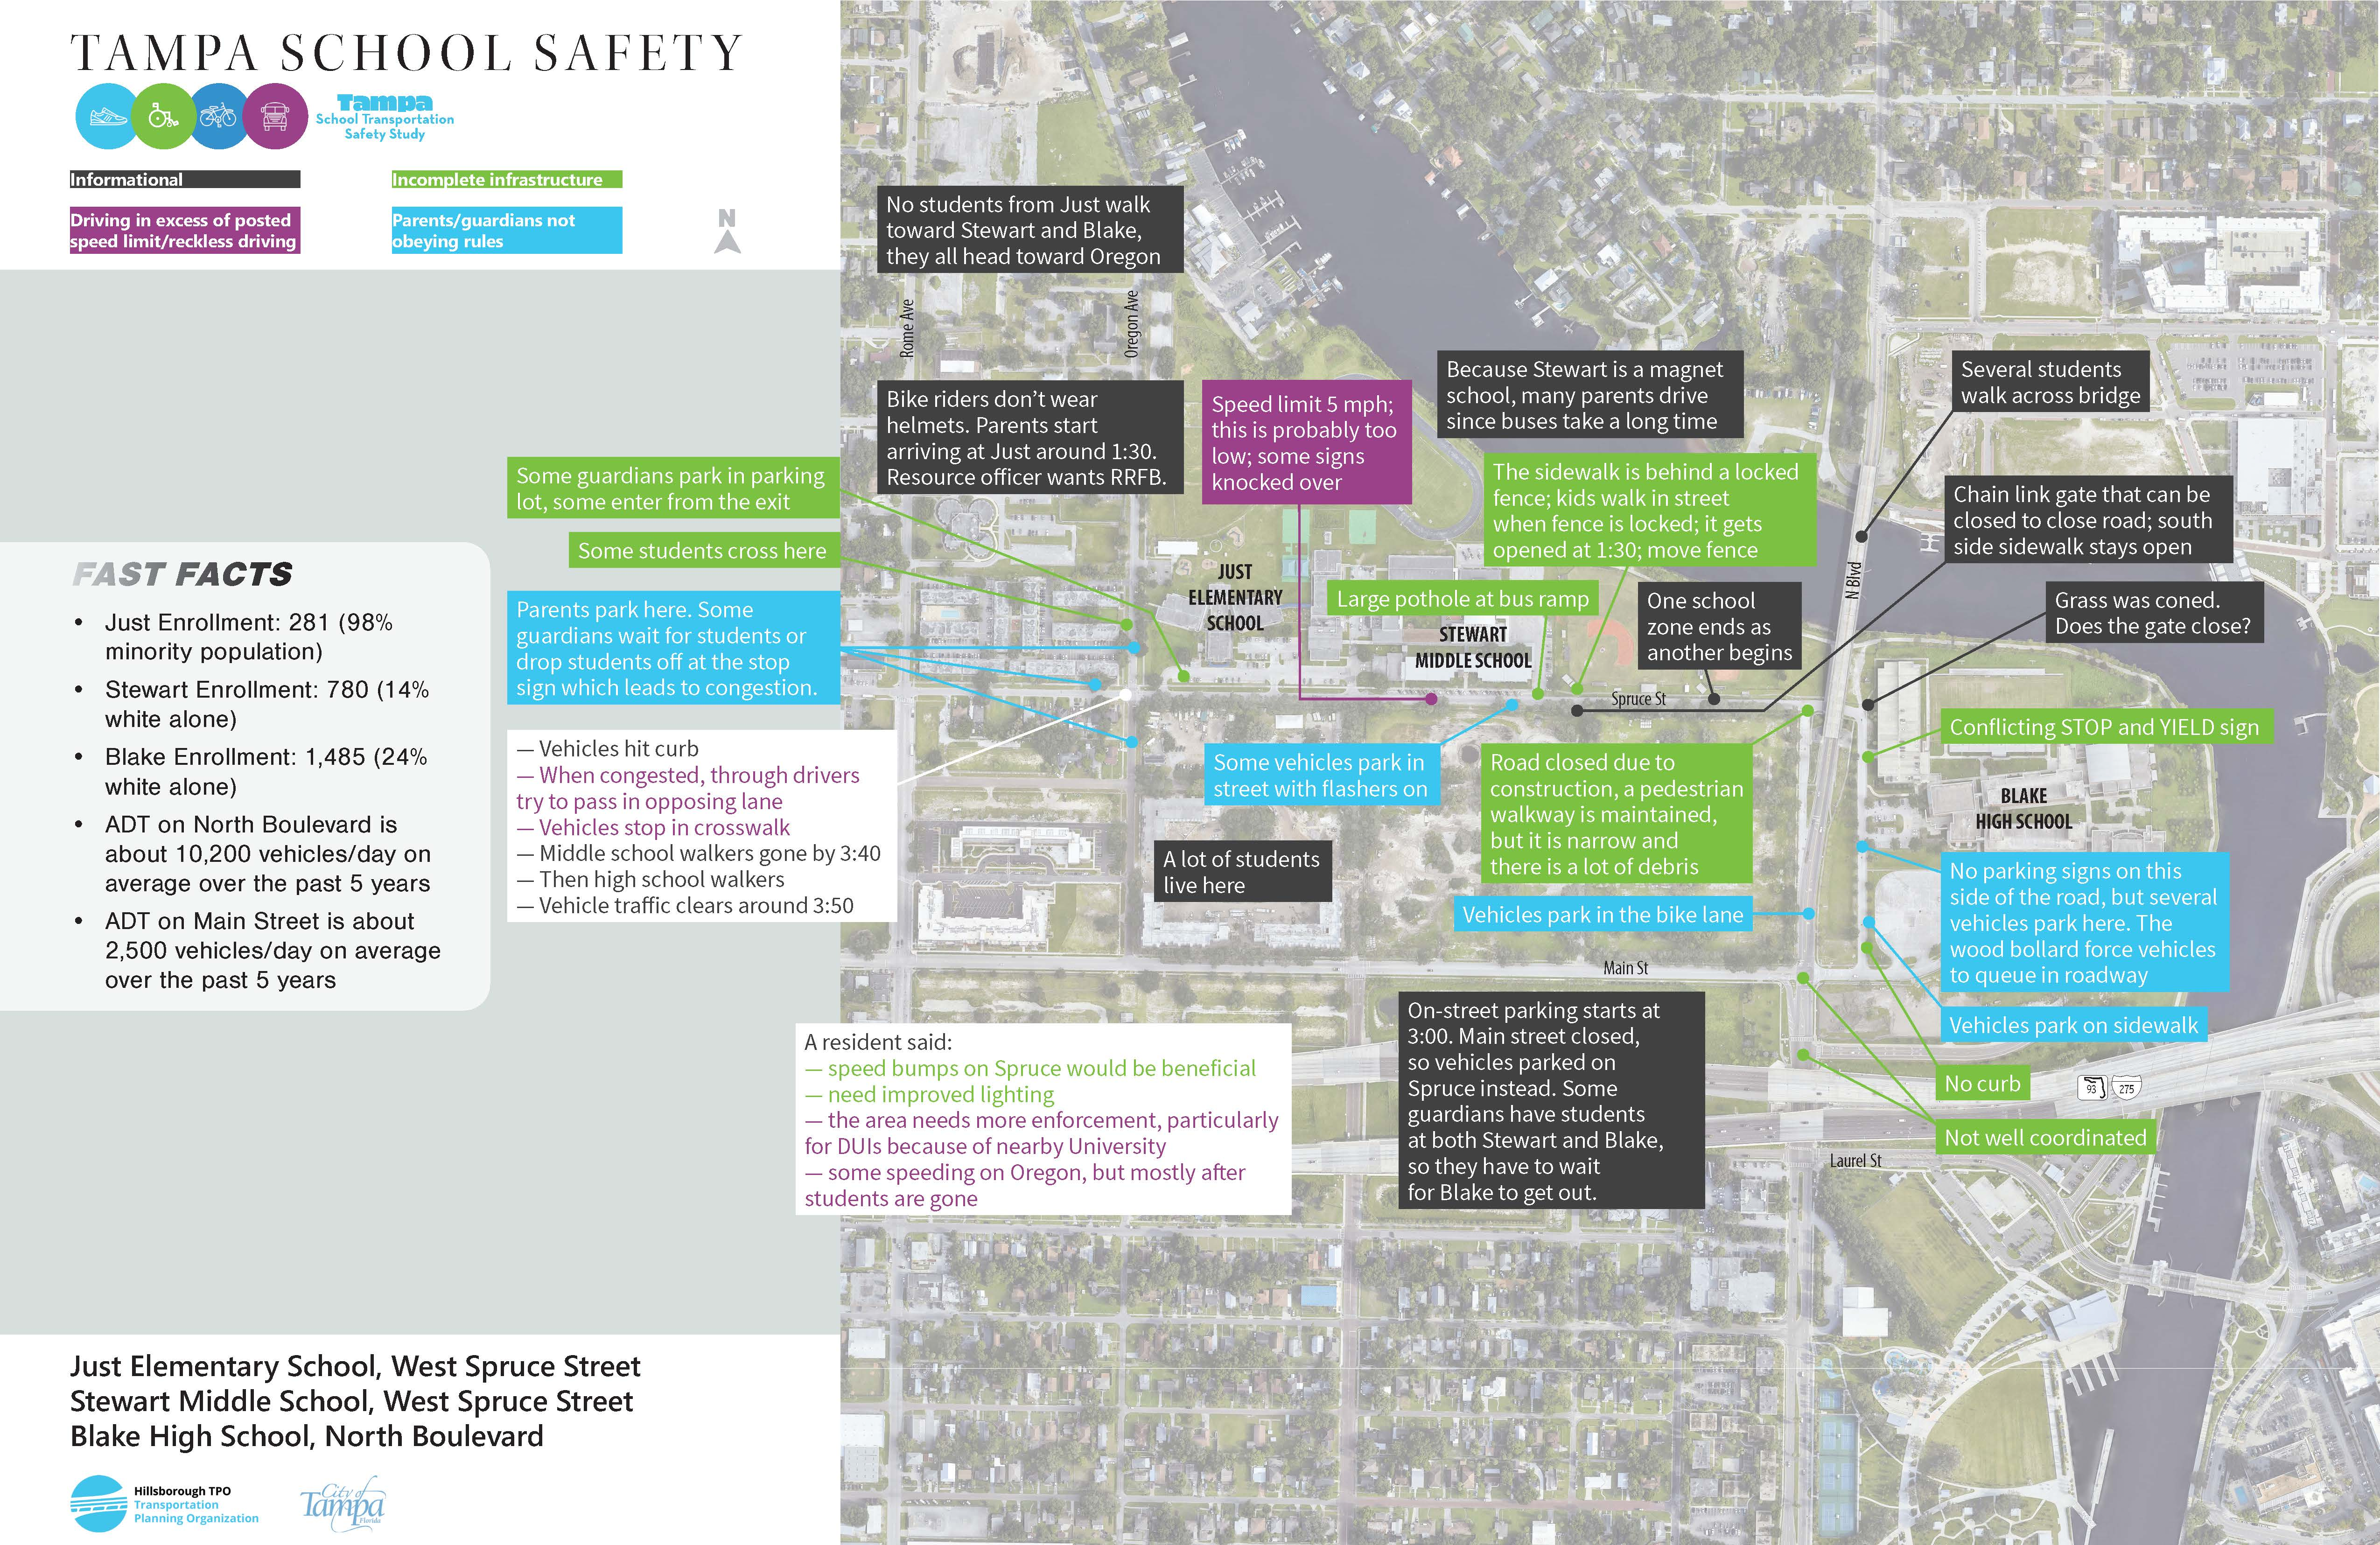
Just/Stewart/Blake
Notes:
We classified observations into four different categories – The first in black is informational data, like where there are crossing guards and the extent of vehicle queues.
People driving in excess of posted speed limit. (Purple)
Parents/guardians not following rules (we should figure out which ones probably fine and which ones we want to have some sort of engineering countermeasures) (Blue)
Incomplete infrastructure - missing sidewalks, and opportunities for crossing treatments, ROW reallocation, signal adjustments, etc. (Green)

Slide 38
Just – Survey Results
Family Survey – Just Elementary
No responses from Just Families; we interviewed several neighbors and families during the field review

Slide 39
Stewart – Survey Results
Family Survey – Stewart
Family Survey – Stewart
40 families completed survey, some with multiple children at the school. These families represent:
Bus rider (55%)
Personal vehicle (33%)
Public Transit (2.5%)
Carpool (0%)
Walks (7%)
Bikes (2.5%)
73% would not feel comfortable allowing their child to walk in any grade
Speed of traffic, the safety of intersections, and lighting are all factors that affect their decision to let their student walk / bike to school
Lack of peers / group to walk with
Safety at bus stop is a deterrent
Locked gates on Riverwalk barrier to biking
Assault of other students on bus
Lack of infrastructure for people walking and biking
Groups of students in neighborhood behaving inappropriately a barrier to others walking
Location of bus stop adjacent to sex offender residence (this has not been independently verified)
Lack of lighting at bus stop

Slide 40
Blake – Survey Results
Family Survey – Blake
Family Survey – Blake
49 families completed survey, some with multiple children at the school. These families represent:
Bus rider (40%)
Personal vehicle (45%)
Public Transit (0%)
Carpool (0%)
Walks (15%)
Bikes (0%)
36% would not feel comfortable allowing their child to walk in any grade
Speed of traffic, the safety of intersections, and lighting are all factors that affect their decision to let their student walk / bike to school
Lack of peers / group to walk with
Safety at bus stop is a deterrent
Assault of other students on bus
Lack of infrastructure for people walking and biking
Lack of lighting at bus stop

Slide 41
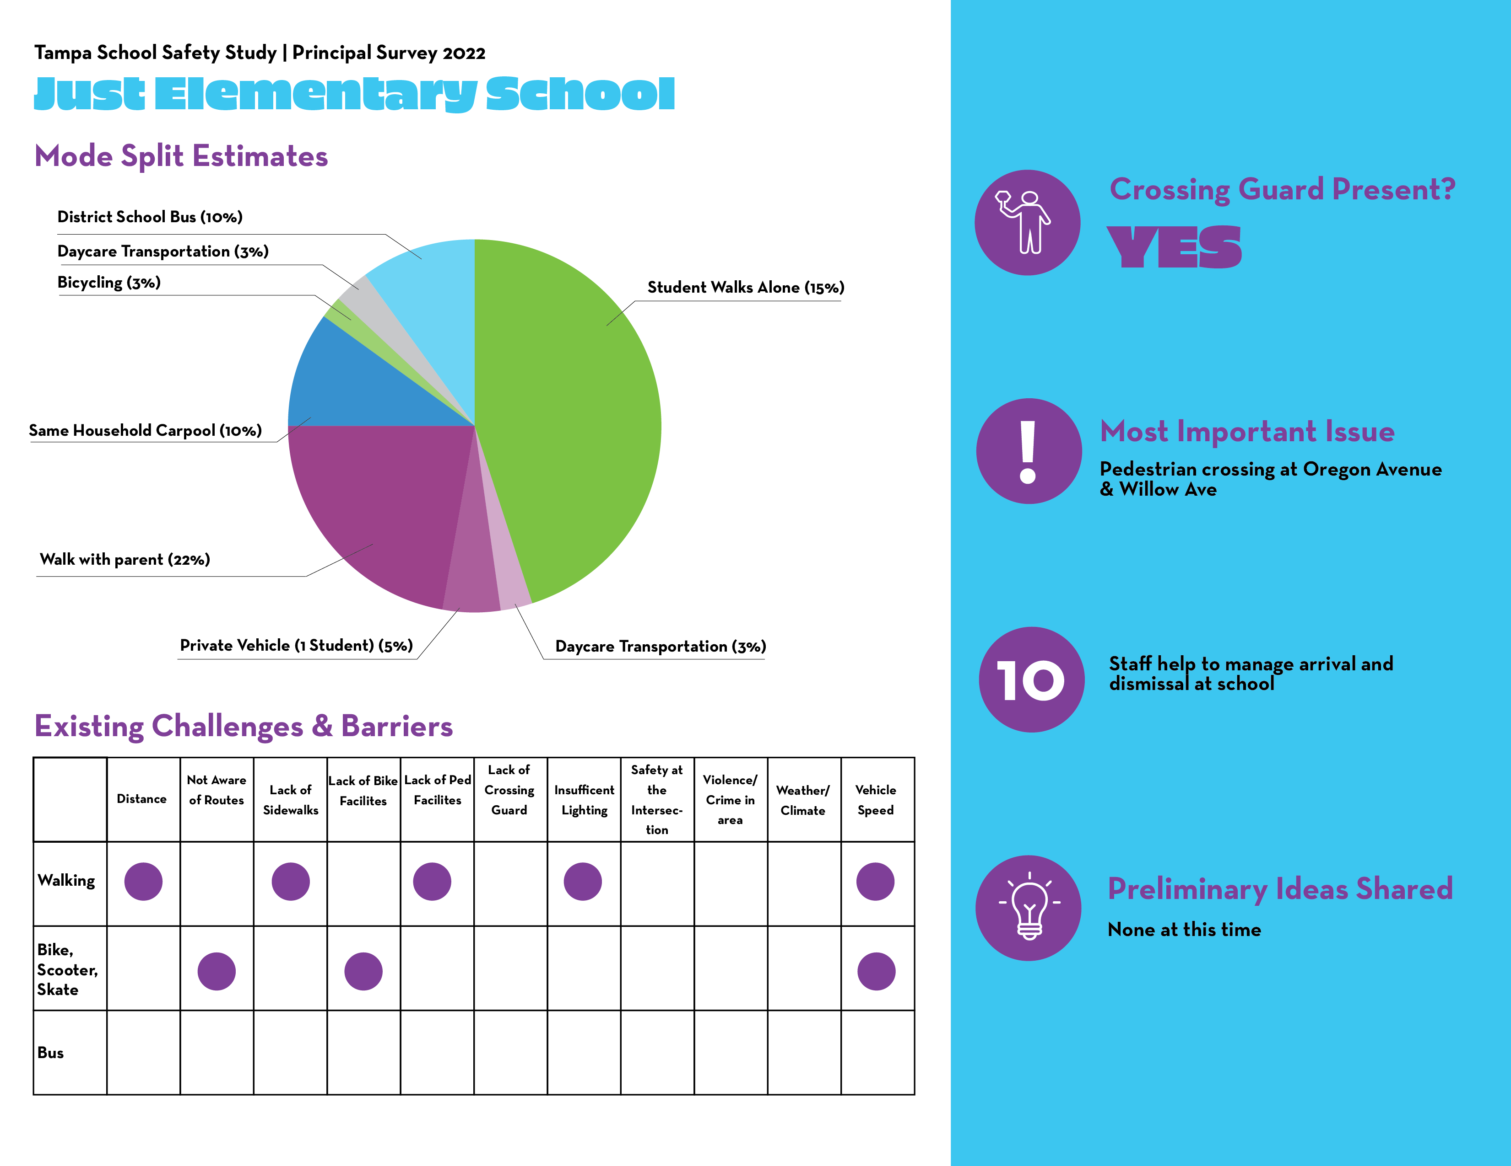
Just Survey Results

Slide 42
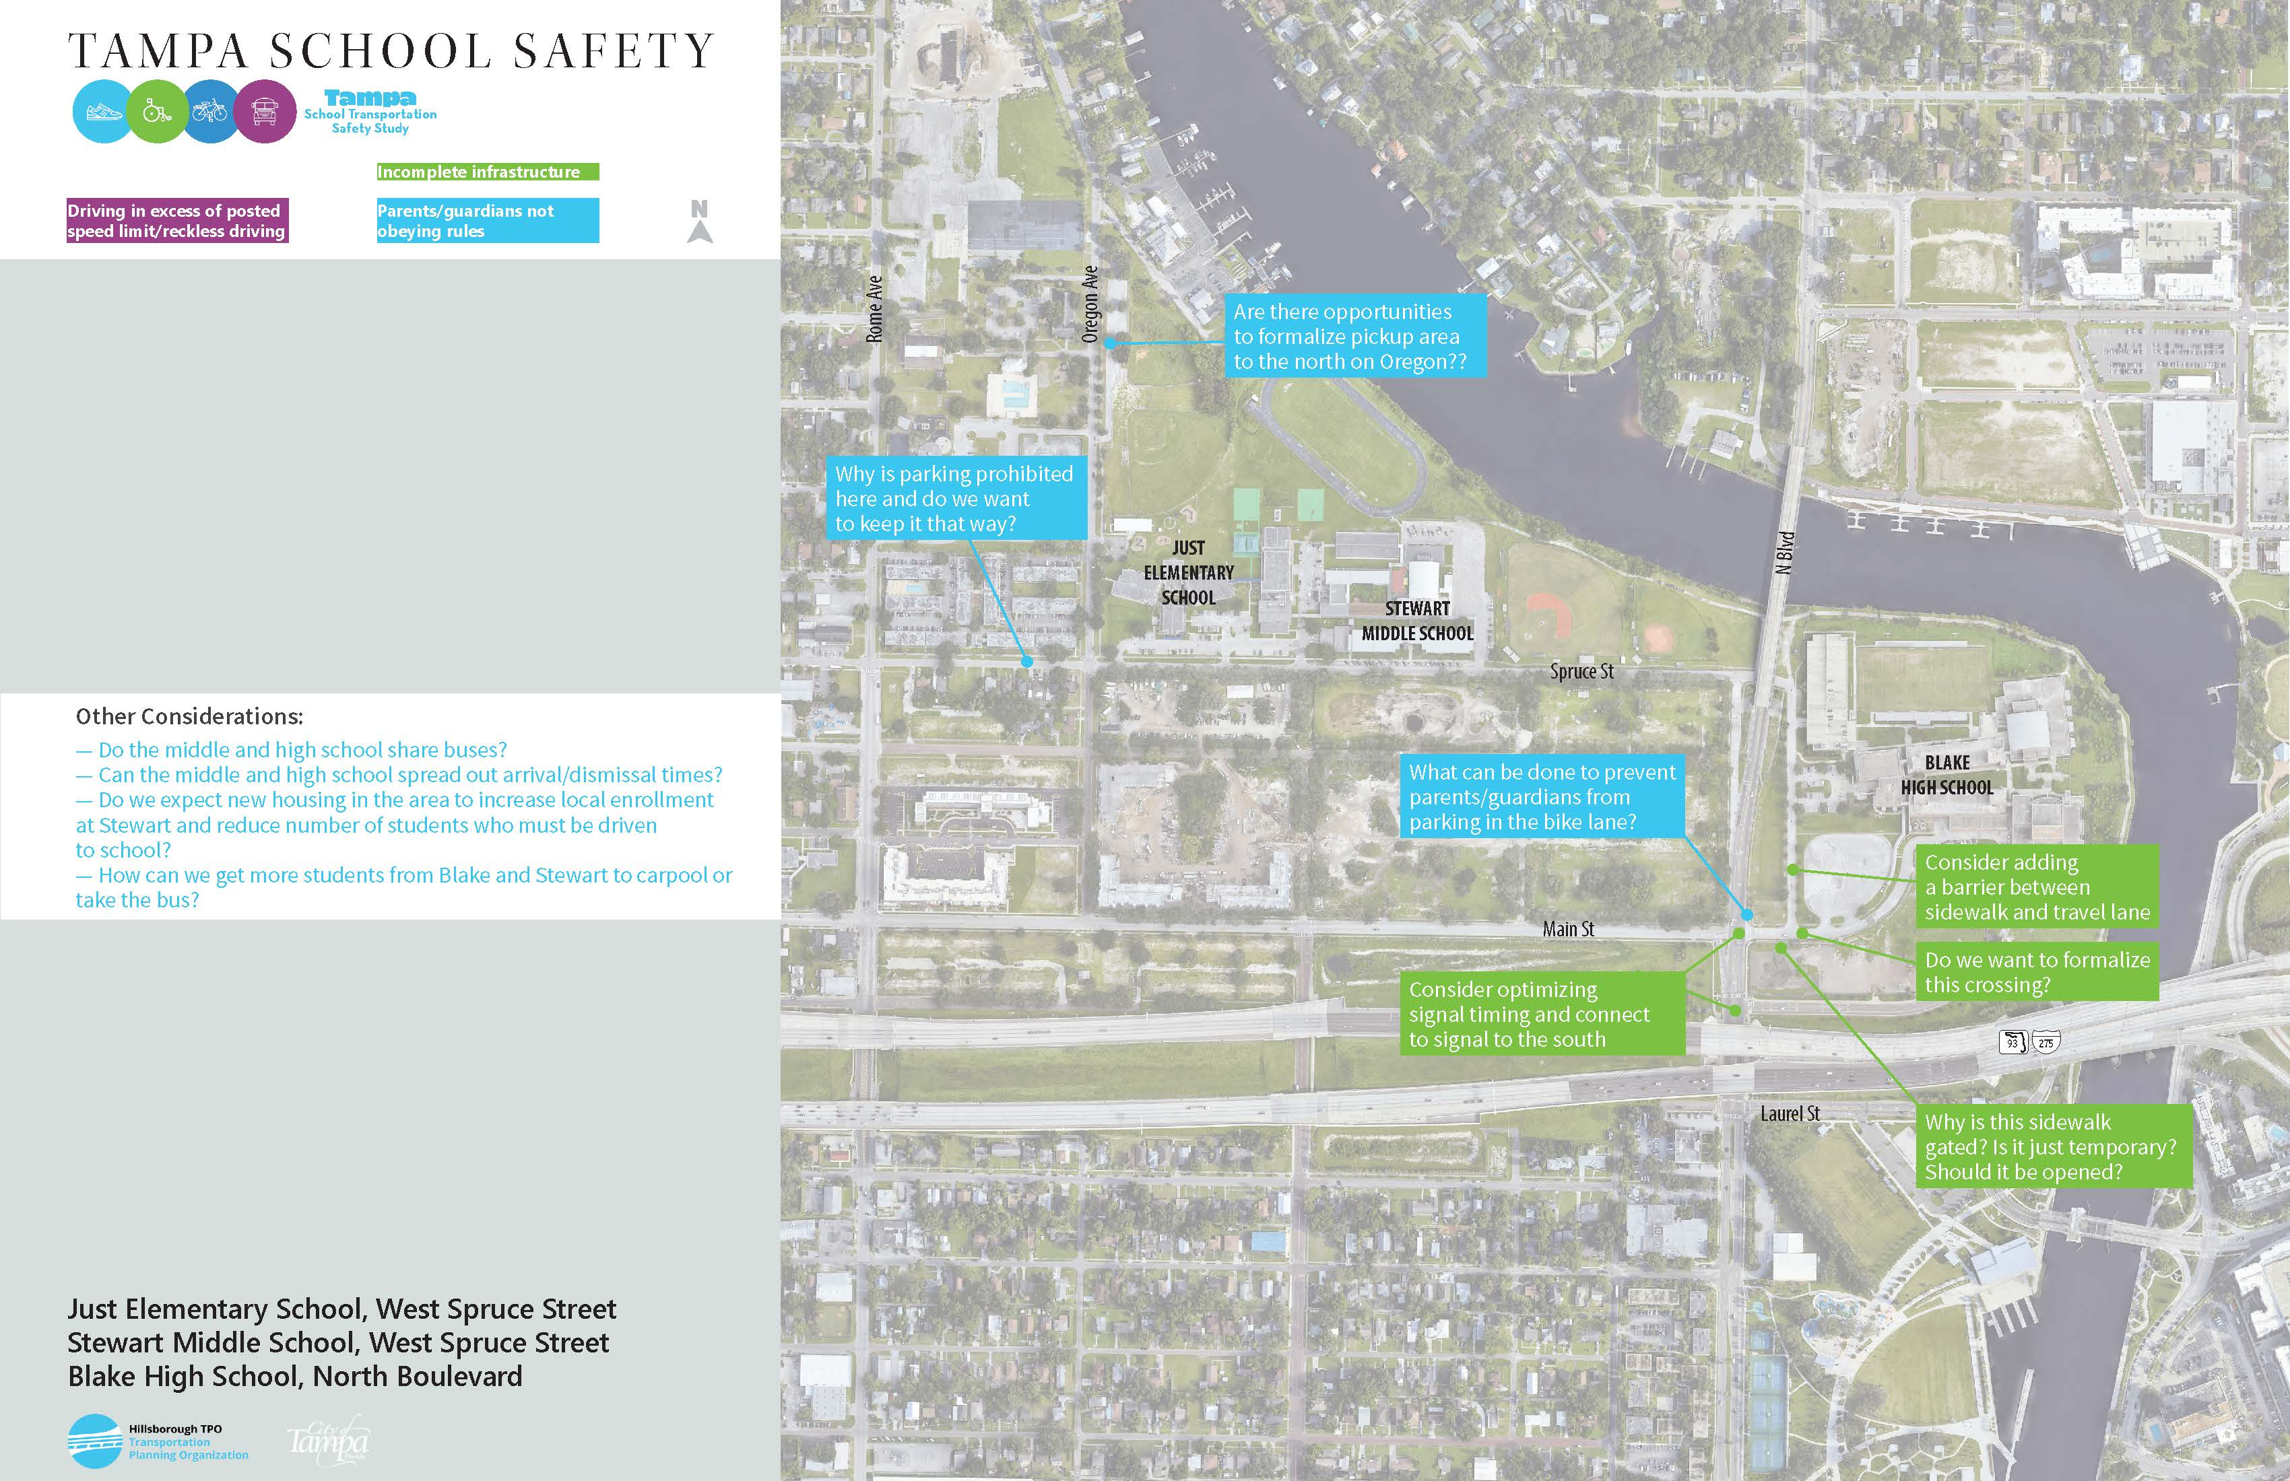
Just/Stewart/Blake Preliminary Ideas

Slide 43
Common School Circulation Strategies – What else have you seen?
This will be used to develop a school idea guide.
Staggered dismissals by grade
Placards/Tags on vehicles (per assigned numbers/names)
Multiple dismissal locations
Staggered dismissal by mode
Use phone-based app to communicate with drivers (Voxer)
Walking school bus
Temporary road closures to private vehicles (buses allowed through)
Use walkie talkies to identify upcoming vehicles and get student ready to load faster
Signage / cones to direct traffic in car line
Car riders wait in cafeteria and wait for their name to be called
Priority pick-up line for carpools
Priority days for walking
Prizes for walking/biking
Resources Needed
Cones
Movable Barriers
Walkie-Talkies
Cardboard signs
Staff and staff training
Prizes
Phones
Parent cooperation

Slide 44
Common School Circulation Strategies – What other resources do schools need?
This will be used to develop a school resource guide.
Staggered dismissals by grade
Placards/Tags on vehicles (per assigned numbers/names)
Multiple dismissal locations
Staggered dismissal by mode
Use phone-based app to communicate with drivers (Voxer)
Walking school bus
Temporary road closures to private vehicles (buses allowed through)
Use walkie talkies to identify upcoming vehicles and get student ready to load faster
Signage / cones to direct traffic in car line
Car riders wait in cafeteria and wait for their name to be called
Priority pick-up line for carpools
Priority days for walking
Prizes for walking/biking
Resources Needed
Cones
Movable Barriers
Walkie-Talkies
Cardboard signs
Staff and staff training
Prizes
Phones
Parent cooperation

Slide 45
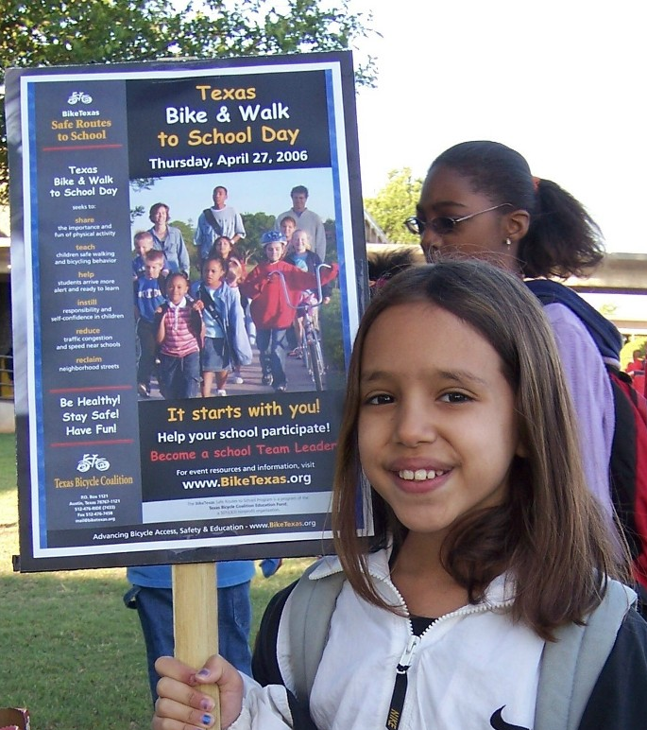
Encouragement and Educational Ideas
Notes:
Accessible Communication Methods
Equitable programs plan for language and technology barriers
Prioritizing Underserved Schools
SRTS programs can serve the largest number of students by prioritizing low-income, underserved schools. Low-income students typically make up the largest percentage of students who walk to school.
Reduce Barriers to Participation
Provide a variety of free and low-cost resources to encourage participation
Host inclusive events for all abilities
Use a Combination of Strategies to Engage School Stakeholders
Successful SRTS programs combine various “E” strategies

Slide 46
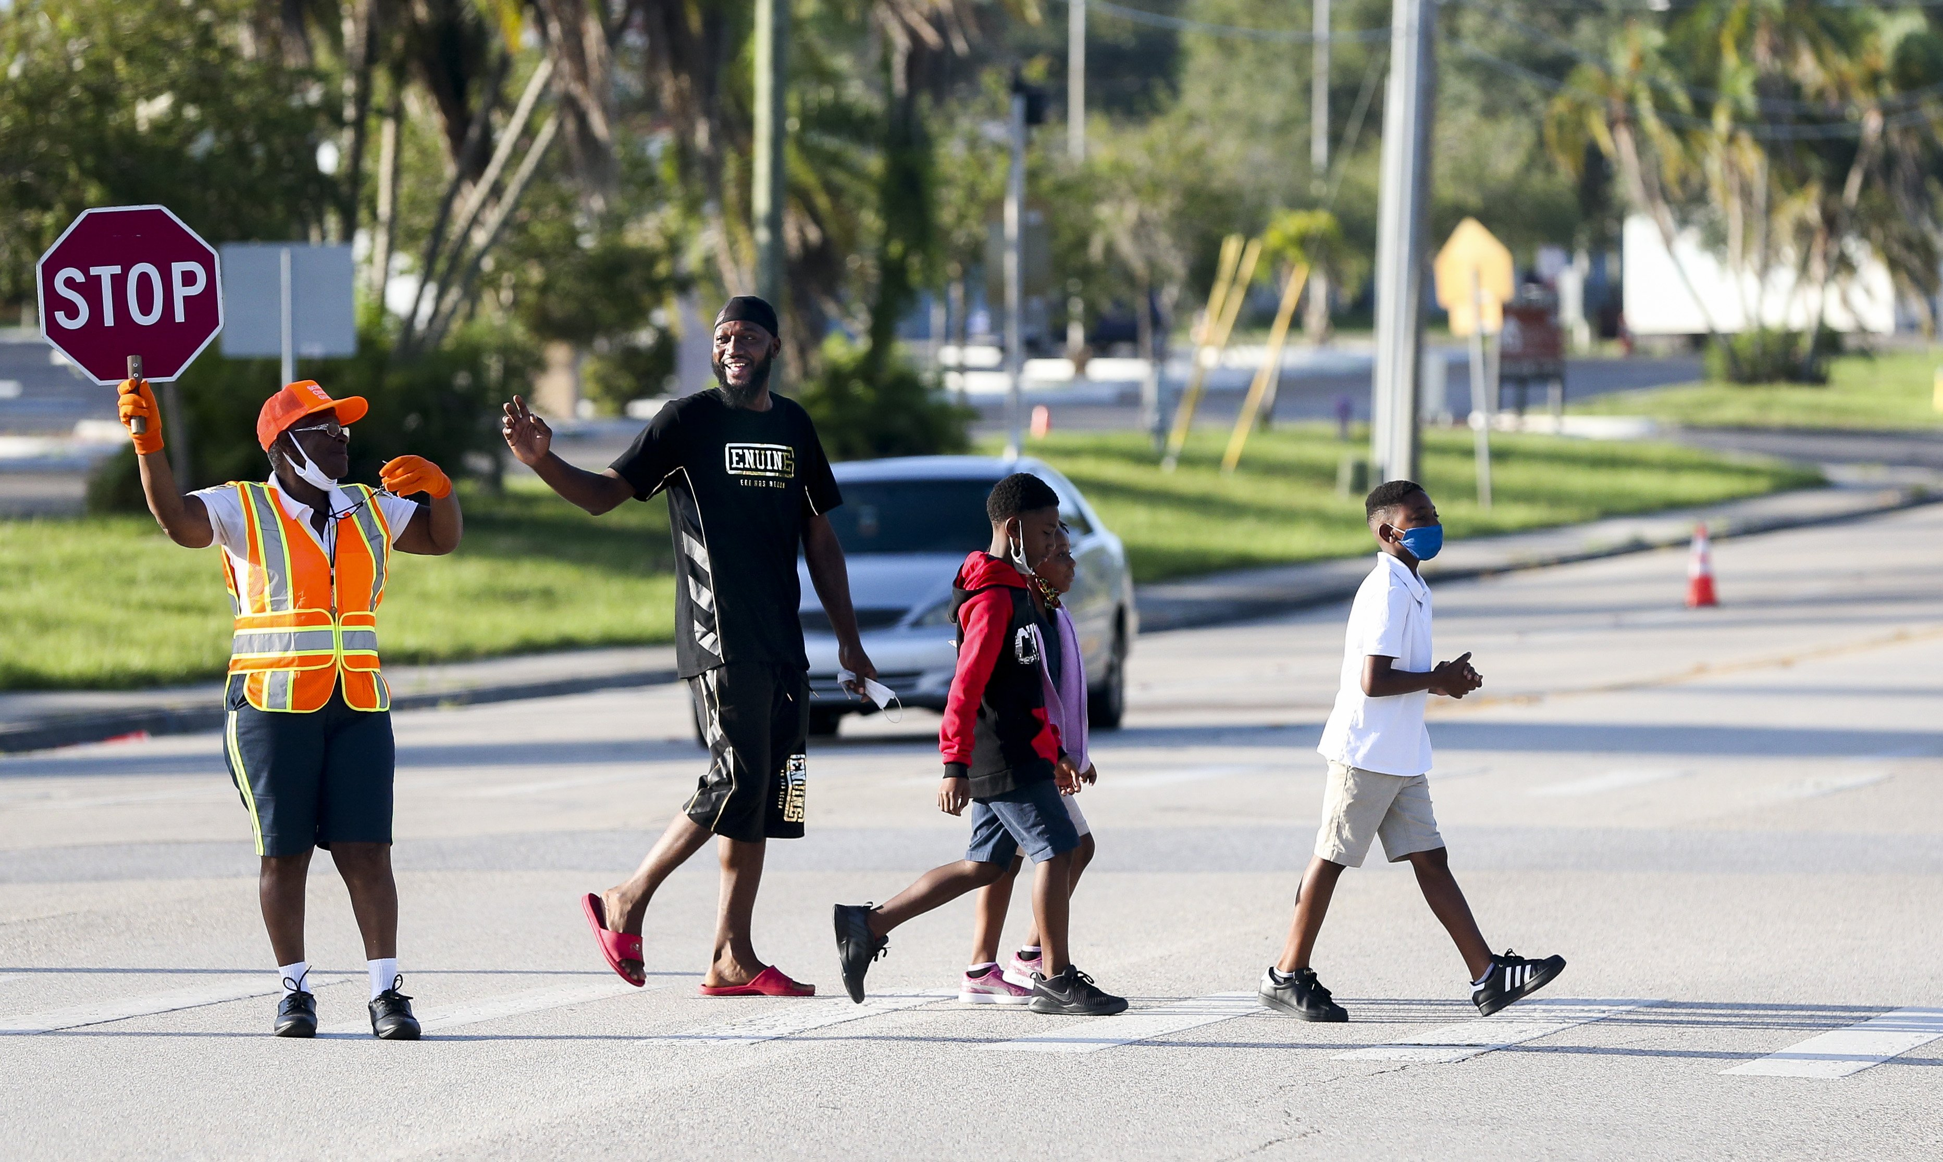
Questions?

