Slide 1
Tampa Comprehensive Plan Update
Melissa Dickens, AICP
Stephen Benson, AICP, CNU-A

Slide 2
Project Team
CITY PLANNING
DEPARTMENT
Independent, consolidated planning agency providing long range planning for all four local governments in Hillsborough County.
Responsible for maintaining and updating the Tampa Comprehensive Plan, providing recommendations to City Administration and City Council.
Comprehensive Plan updates developed via coordination and collaboration with the City Planning Department and other City staff.
City Planning fosters a strategic, multi-disciplinary, holistic approach to guiding growth, development and redevelopment citywide. Responsible for facilitating amendments to Code of Ordinances, coordinating City review of Comp Plan updates, managing a variety of planning studies, and supporting implementation of plans.
The City Planning Department is responsible for coordinating implementation of the goals, objectives & policies in the Comprehensive Plan with all City Departments.

Slide 3
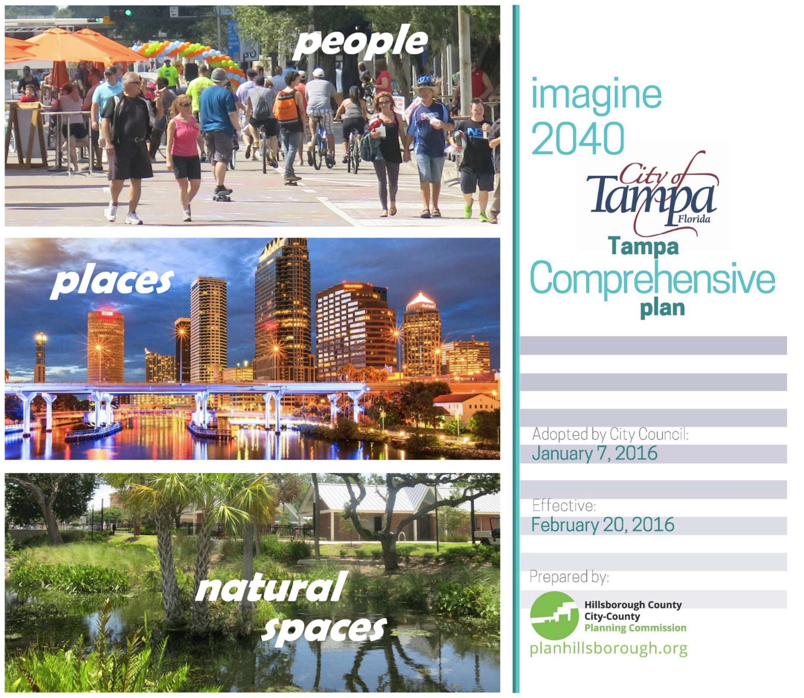
What is a Comprehensive Plan?
- A long-range plan that sets a vision and goals for a city's future
- Includes policies and maps that guide a community's development, infrastructure and preservation decisions
- Policies look to the future to anticipate trends and challenges facing the city

Slide 4
How Does a Comprehensive Plan Work with Other Regulations?
State law requires sections that cover a variety of topics that affect the community
For example:
- Land Use
- Mobility
- Infrastructure
- Housing
Comprehensive Plan Goals, objectives & policies
Zoning & Land Development Code Implements the Land Use goals objectives & policies
Site Development Building Code Addresses site/structure

Slide 5
Where can I view the current Plan?
https://planhillsborough.org/city-of-tampa-2040-comprehensive-plan/

Slide 7
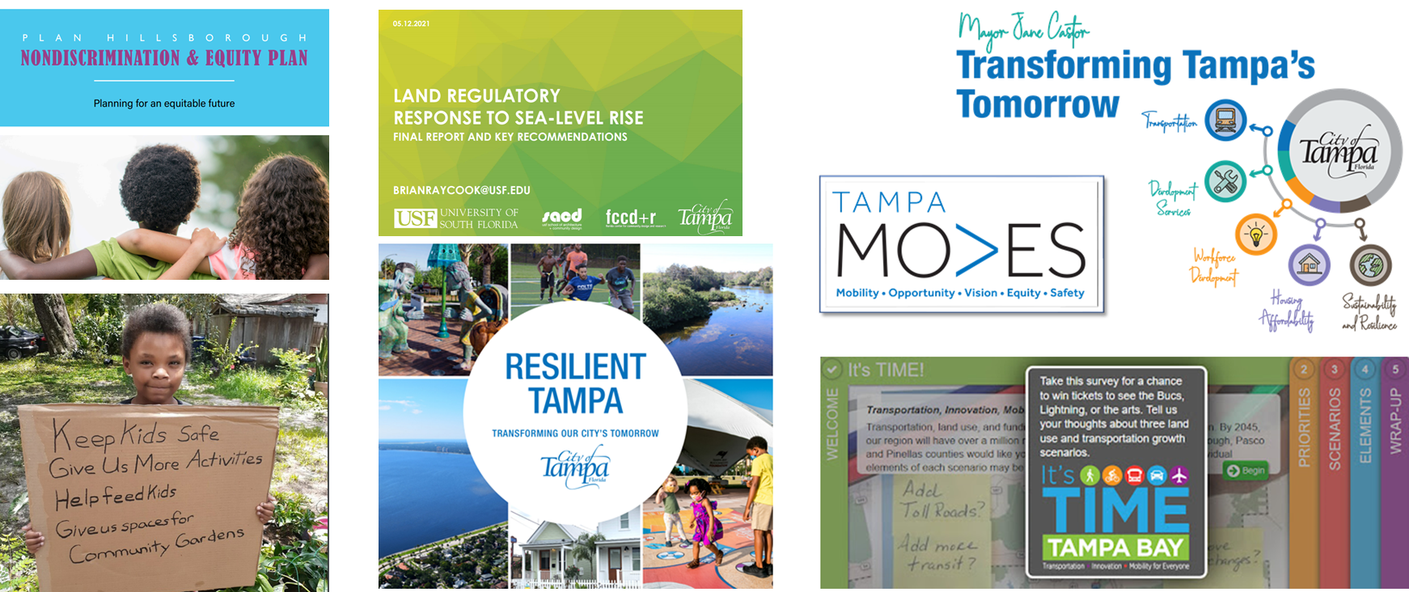
Incorporating Previous Plans and Outreach

Slide 8
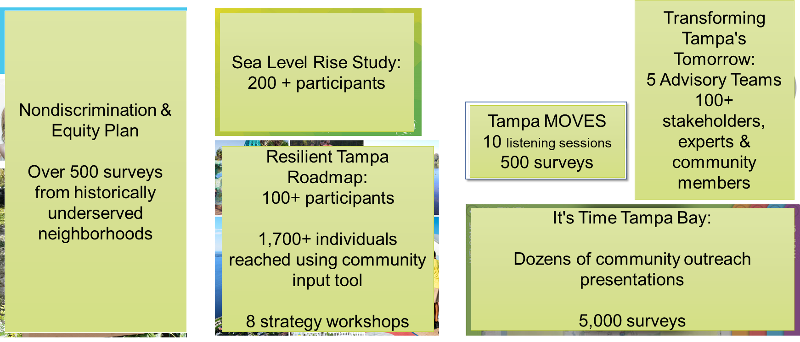
Building on Previous Feedback

Slide 9
Vision Inputs to Vision Themes to Plan Update
Incorporate Public Input to Update Vision
Previous Plans and Outreach
Public Input on Vision Themes (current phase)
Update to Goals, Objectives, and Policies in the Comp Plan

Slide 10
Preliminary Themes for Public Input

Slide 11
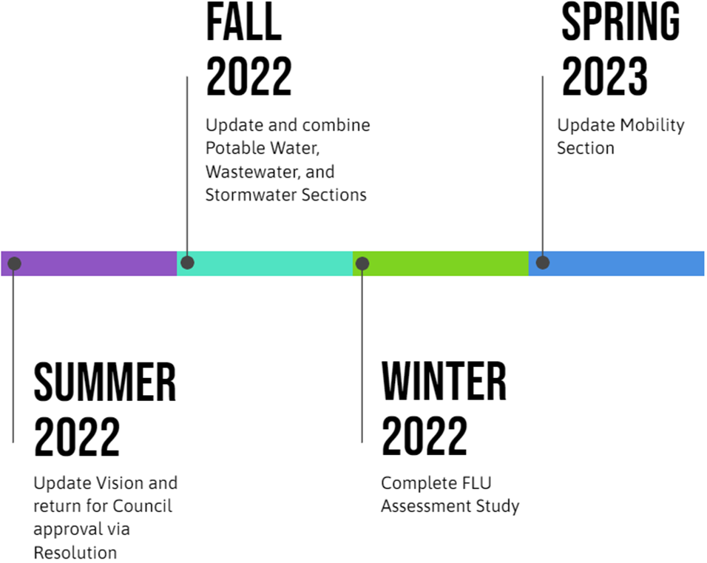
Preliminary Areas of Focus

Slide 12
We want your feedback!
Take our 2045 Vision Survey!
Visit the link or scan the QR code to participate.

Slide 13
Contact Information
Jennifer Malone, AICP
Planning Commission
Executive Planner, City of Tampa Liaison
Phone: 813-582-7324
Email: malonej@plancom.org
Stephen Benson, AICP, CNU-A
City of Tampa
Director of City Planning, City Planning Department
Phone: 813-274-8185
Email: Stephen.Benson@tampagov.net
Melissa Dickens, AICP
Planning Commission
Strategic Planning and Policy Manager
Phone: 813-756-0355
Email: dickensm@plancom.org

