Slide 1
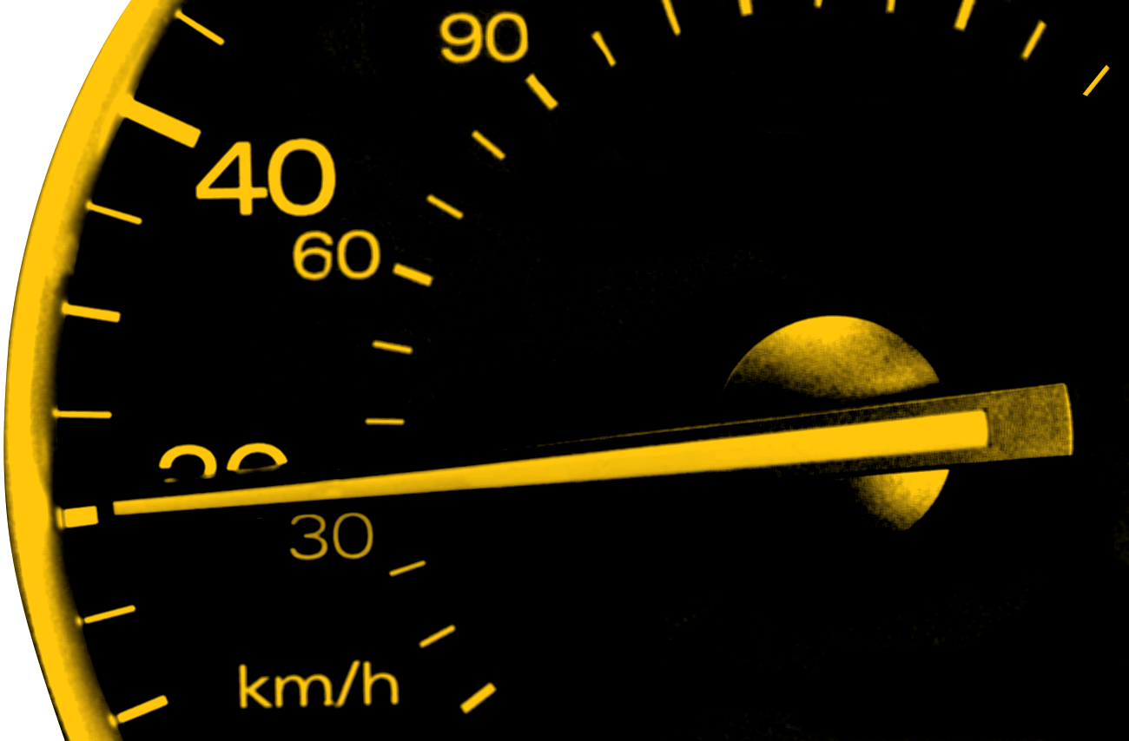
PARK SPEED ZONE STUDY SAFE ACCESS TO PARKS
Fix-It Ideas
Kathrin Tellez, Fehr & Peers
Lisa Silva, TPO Staff
SPEED MANAGEMENT IMPLEMENTATION

Slide 2
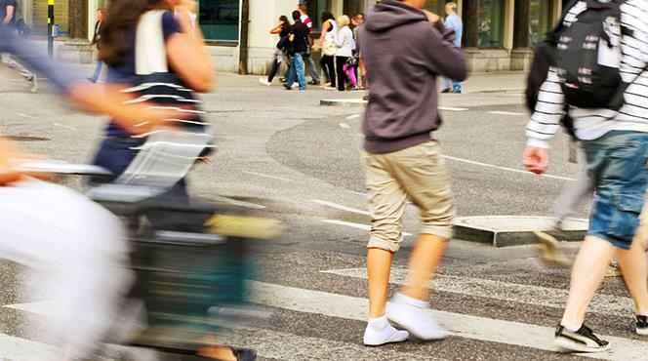
Vision Zero and
Speed Management
Action Plans Implementation
Notes:
As you know, we developed a Vision Zero (2017), followed by the Speed Management Action Plan in 2019. The Park Speed Zone Project is just one of many implementation steps to helps us prioritize where and how to set lower speed limits, implement engineering countermeasures to achieve the desired speeds, and reduce the number of severe and fatal injuries on our roadways. With over 260 people killed on Hillsborough County roadways in 2021, a 25 percent increase from 2020, and a 1,000 more severely injured, projects like these are important steps for is to reach zero.

Slide 3
SPEED MANAGEMENT IMPLEMENTATION – Safe Access to Parks
Task 1 – Park Selection
Task 2 – Existing Conditions
Task 3 – Public Outreach
Task 4 – Countermeasure Toolbox
Task 5 – Recommendations
Notes:
We kicked off the project in March 2021 with a stakeholder meeting to review the park selection process and receive feedback on the finalist park locations. In September, we met to share our preliminary existing conditions assessment, and progress on the public outreach. We also heard feedback related to the project name and have since rebranded the project “Safe Access to Parks”. In the fall we also completed a countermeasure toolbox and then applied the strategies in the toolbox to each of the study locations.
Today, we are going to review the project process and then present the Fix-it ideas that were developed for each of the park locations, and refined based on feedback from the public and various other committees. The final reports are on the TPO website.
https://planhillsborough.org/park-study/

Slide 4
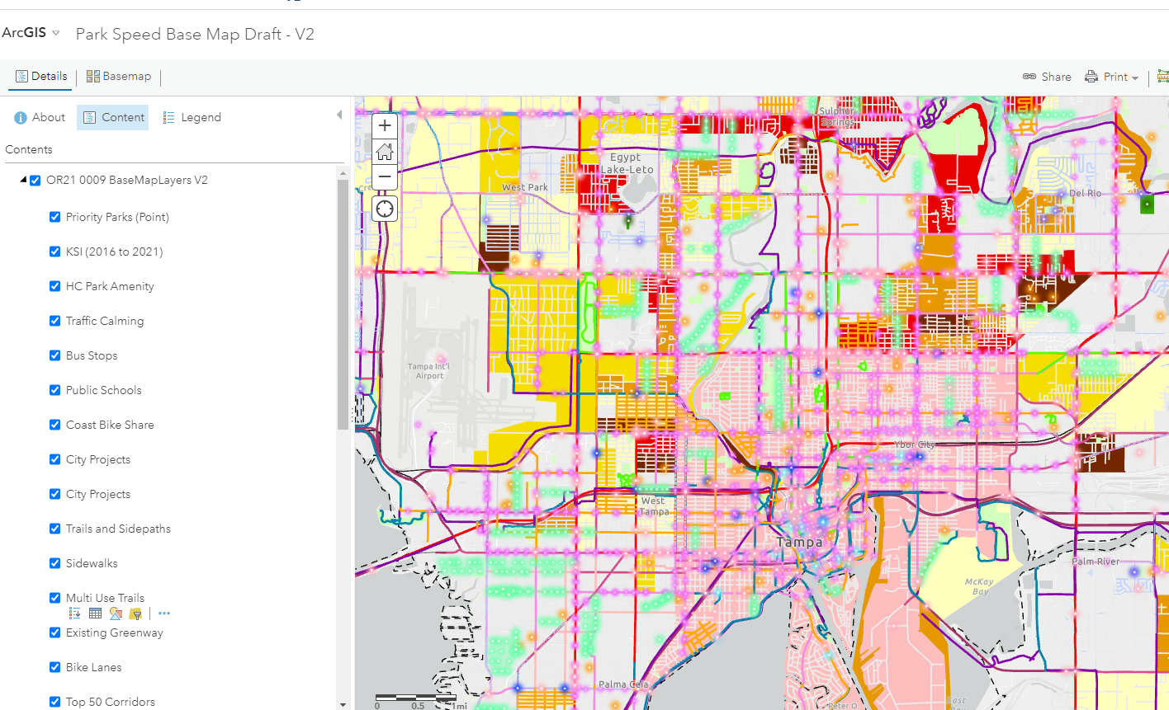
Task 1 – Park Selection
Data Driven Process
Define different types of parks within the County
Develop Evaluation criteria
Initial Ranking
Final Selection – 3 parks
Notes:
The park selection process was data intensive and considered a wide array of factors, including equity and safety. The goal was to select 3 different types of parks in three different contexts in the County.
Final Parks were Sulphur Springs / River Tower Park, Copeland Park and Upper Tampa Bay Trail

Slide 5
TASK 2 – Existing Conditions
Park Setting
Transportation Setting
Collisions
Catchment Area
Speed
Comfort
Other Area Studies
Notes:
We conducted an existing transportation conditions assessment for the area around each of our study parks and we looked at other studies that had been conducted in the area. We also looked at best practices related to safe routes studies.

Slide 6
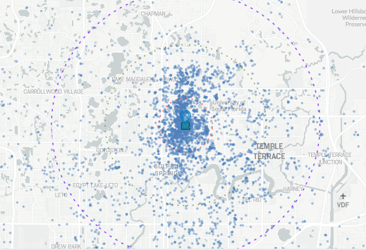
Copeland Park
Key Findings
Most people come from within a 1 to 3-mile radius of the park
Inconsistent and uncomfortable pedestrian facilities connecting to the park
No bicycle facilities connect to the park
Barriers to walking and bicycling are created by Fowler Avenue and railroad crossings
Notes:
The next few slides provide some highlights of the existing conditions assessment for each park location.
People who visit Copeland Park primarily come from within a 3-mile radius, there are inconsistent and uncomfortable pedestrian facilities connecting to the park, and there are no designated bicycle facilities that connect to the park.

Slide 7
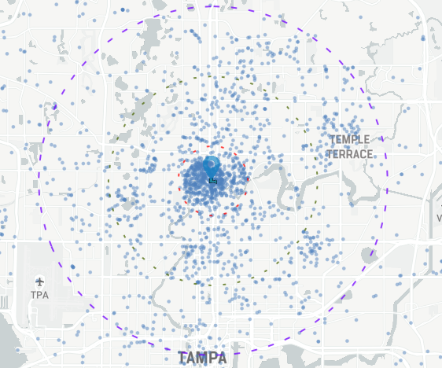
Sulphur Springs Park
Key Findings
Most people come from within a 1-mile radius of the park
Inconsistent and uncomfortable pedestrian facilities connect to the park
No bicycle facilities connect to the park
Opportunities to reallocate right-of-way to enhance bicycle and pedestrian connections
Opportunities to reduce speed limits without appreciably changing overall corridor travel times
Notes:
For Sulphur Springs, most people come from within a 1-mile radius. Similar to Copeland Park, there are inconsistent and uncomfortable pedestrian facilities connecting to the park, and there are no designated bicycle facilities that connect to the park.

Slide 8
Upper Tampa Bay Trail
Key Findings
Regional destination
Non-motorized connections from surrounding area can be limited and uncomfortable
Most trailheads designed for vehicle access, not bicycling and pedestrian access from street network
Opportunities to improve trailhead access, trail crossings, and slower travel speeds on roadways connecting to trail crossings
Notes:
Upper Tampa Bay Trail is a regional destination, with non-motorized connections limited. Most trailheads are designed for vehicle access, not bike ped access.
A common theme around all the park sites is a roadway system and park access locations designed for vehicle travel, not people walking or biking.

Slide 9
Notes:
The public feedback campaign included placing yard signs around all the parks, handing out flyers to local businesses, social media posts, and outreach to interested partners and groups. We appreciate everything that you did to spread the word to your networks as we got a lot of great feedback.

Slide 10
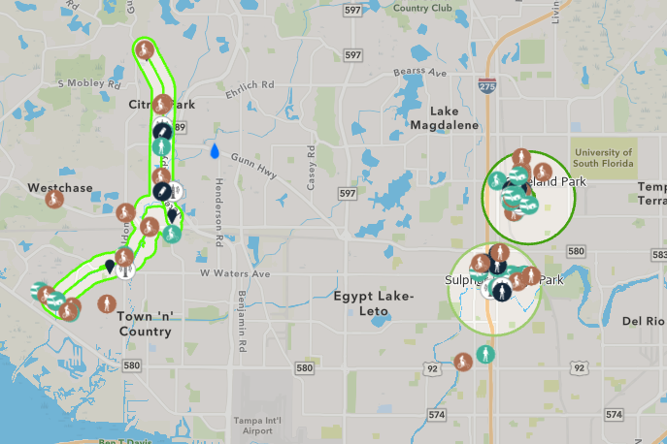
TASK 3 – Public Feedback
On-line Feedback (English and Spanish)
Survey
In person outreach
Notes:
On-line feedback was solicited from the community in multiple ways, including an on-line mapping tool and a survey. The mapping tool and survey were conducted in both English and Spanish.

Slide 11
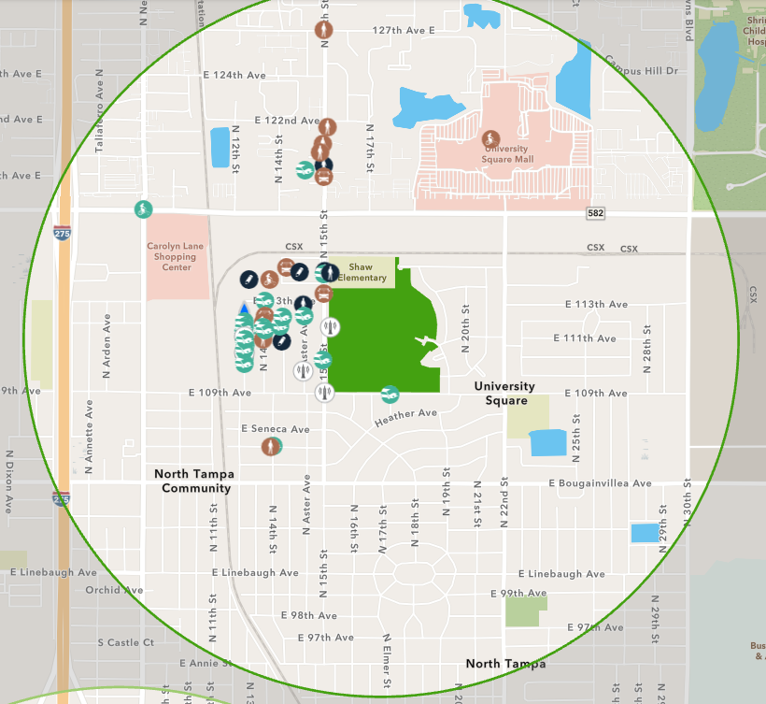
Copeland Park
What are people saying?
Cars race up and down 15th Street
Dangerous to cross the street to get to the school/park
More lighting is needed
Speed bumps!
More transportation options, especially for those on fixed incomes
Dedicated bicycle infrastructure needed
Notes:
Here is a summary of feedback around Copeland park – of the almost 50 comments received, 44 percent were related to people speeding, 21 percent were related to inadequate pedestrian infrastructure, and 10 percent were related to inadequate lighting. Frequency of transit being insufficient, inadequate bike infrastructure and other issues were each less than 10 percent of comments.

Slide 12
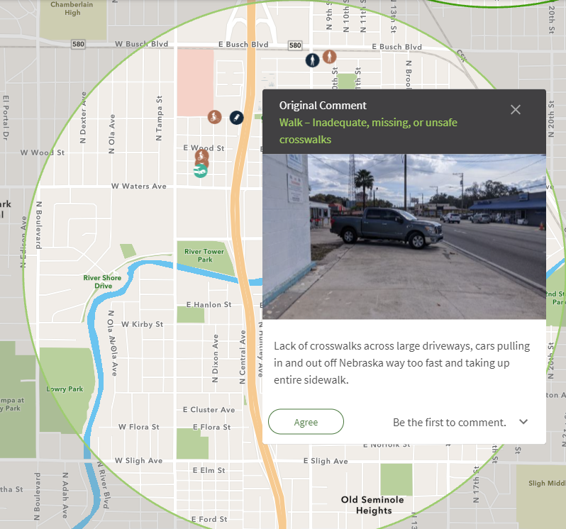
Sulphur Springs Park
What are people saying?
Lots of speeding especially on streets without sidewalks or sidewalks adjacent to the travel lane
Lack of sidewalks and large driveway areas
Bus stops need protection from the elements
Need dedicated bicycle facilities
More street lighting is needed
Notes:
For Sulphur Springs, 25 comments were received through the web map. 16 percent were related to people speeding, 40 percent were related to inadequate pedestrian infrastructure, and 16 percent were related to inadequate lighting. Frequency of transit being insufficient was 8 percent, inadequate bike infrastructure was 16% and other issues was 4 percent.

Slide 13
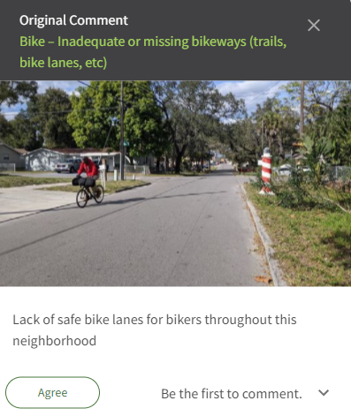
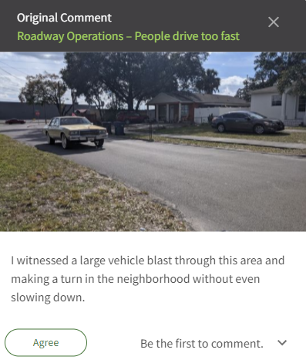
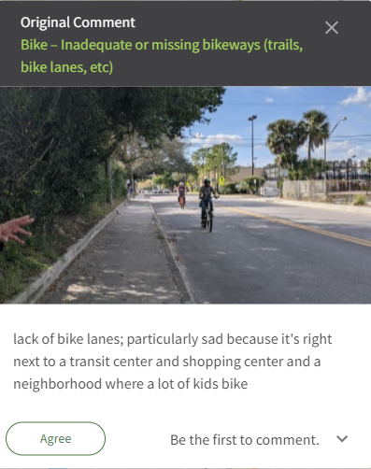
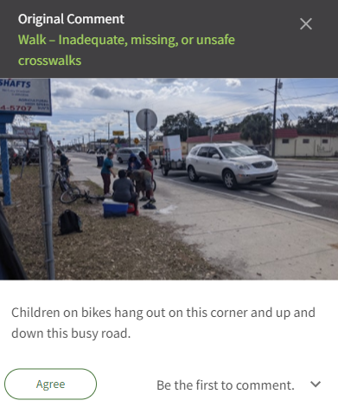
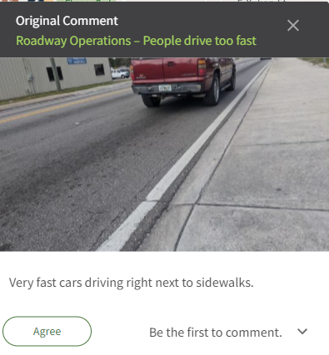
Notes:
While Sulphur Springs area had the lowest number of comments, many of them included pictures to better illustrate their feedback which really helped us to understand the specific concern.

Slide 14
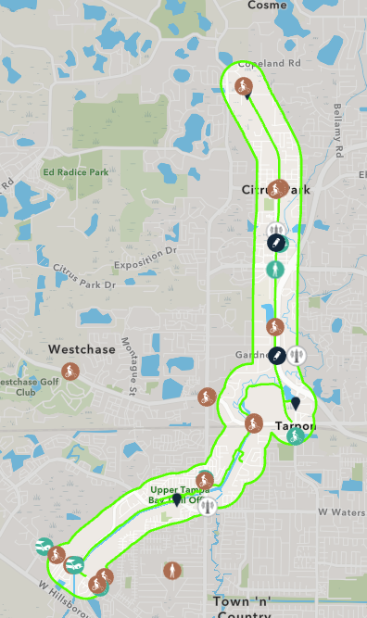
Upper Tampa Bay Trail
What are people saying?
Need buffered bike lanes connecting to the trail
Need wider sidewalks connecting to the trail
Debris in bike lanes can make them unusable
We need to extend the trail
Trail crossings need improved signage and trail markings
Notes:
For UTBT, 29 comments received through the webmap. 14 percent were related to people speeding, 10 percent were related to inadequate pedestrian infrastructure, and 14 percent were related to inadequate lighting. Inadequate bike infrastructure was 52% and other issues was 7 percent.

Slide 15
TASK 3 – Public Feedback
On-line Feedback (English and Spanish)
Survey
In person outreach
Notes:
This is a sample of the feedback received through the survey tool, where over 90 people participated. Between the webmap and survey tool, we had almost 200 response.
There was even one resident in the UTBT Area that did not have access to a computer or smartphone, so she called Lisa and we input her feedback into the webmap.
For the survey, I’ll highlight a few key items – full details are in the reports.
How do you typically get to the park or trail? Of the 88 people total across all parks who answered this question, 17 percent walk, 42 percent bicycle and 38 percent drive a car. The remaining do not actually go to the trail or park.
How easy or difficult is it for you to get to/from parks and trails, with 0 being the hardest and 10 being the easiest? Of the 81 people who answered this question overall, the average score was 6.7.
When thinking about going to the park or trail, where do you feel unsafe walking or bicycling and why?
Here are the specific responses related to Sulphur Springs:
Most roads feel unsafe. Lack of sidewalks, drug dealing and speeding
Not enough dedicated bike lanes
For the Sulphur Springs Park trail next to the public pool, there is insufficient lighting at dawn and dusk, making dog walks unsafe at these times.
Here are specific responses related to Copeland:
Any of the major East-West Roads (Fowler, Busch, Waters) and some of the others (Bird St. / Bougainvillea Ave). They have high volumes of traffic going high speeds, and either no bike lane or ones that are too close to traffic.
Nowhere
Crossing wide highways that have many lanes, in order to get to the park.
Crossing streets. Stop signs seem to be advisory at best, speed limits are ignored.
For Upper Tampa Bay Trail, pretty much every major street in the area was named
Does the behavior of people driving, like speeding or not paying attention, make you not walk or bike to the park or trail? Of the 72 people total across all parks who answered this question, 40 percent responded “Yes”, 33 percent responded “No”, and 27 percent responded “Sometimes”.
Are there specific locations where you would like to see marked crosswalks connecting to the park or trail?
Would you walk, bike or take transit more to the park or trail if it was safer? People would be more likely to walk to or bike to parks and trails if access is easier. Improved transit would not result in a lot of additional trips to the park or trail.
Are there specific locations where more street lighting is needed? Please tell us where.
Are there drainage issues that affect your travel during and after periods of rain? Where?
Please share other suggestions for improvements that would help you access parks and trails in your neighborhood.

Slide 16
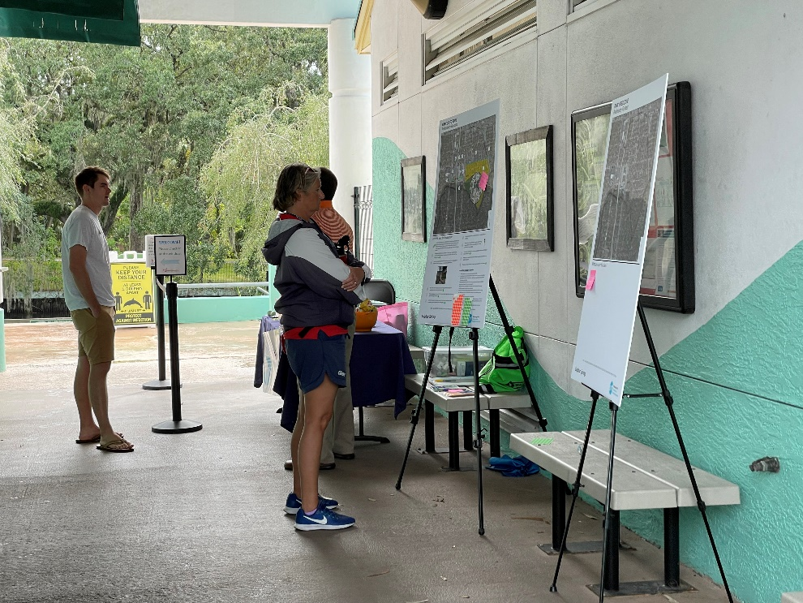
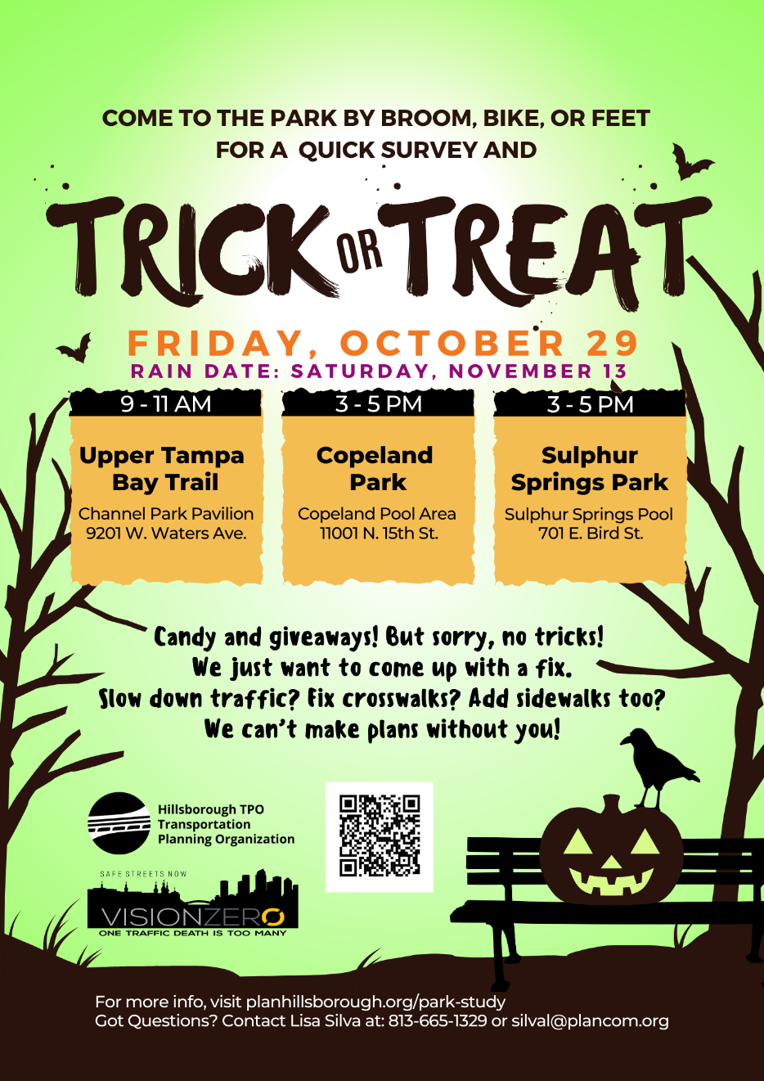
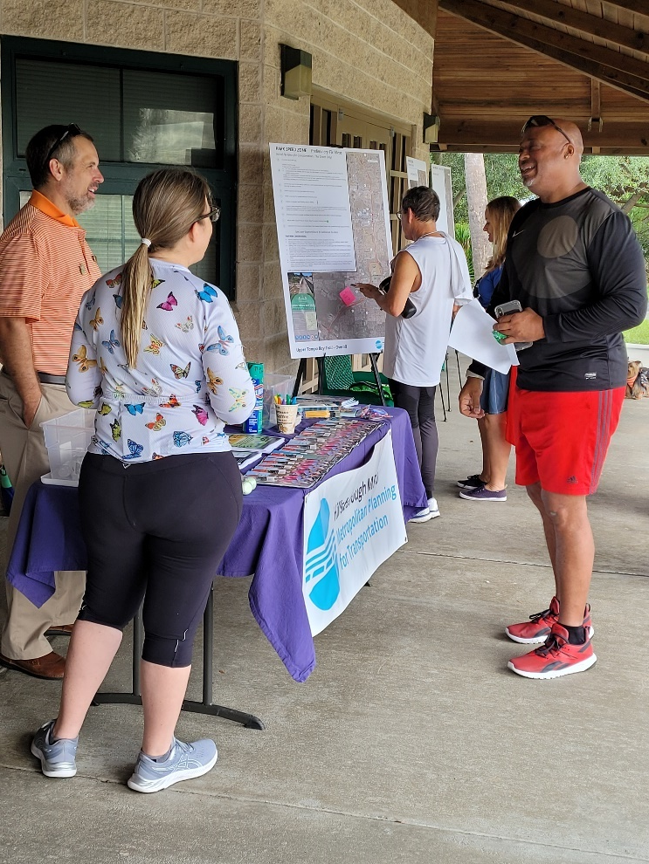
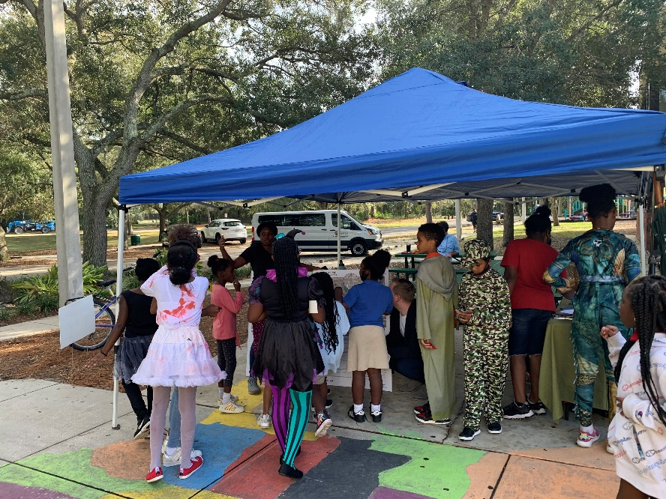
Notes:
We also did in-person public engagement at each of the parks on Friday October 29. We talked with about 20 people at each of the park locations, and overwhelmingly the feedback was positive. One person around the Copeland park area even commented on how important this work is and how much she appreciates the efforts. Each park had its own unique challenges in getting people to provide feedback. At Copeland, we had people walking around and a native Spanish speaker available. At UTBT, we set out on our bikes and handed out flyers to entice people to come to the station. And at Sulphur Springs, we managed to get the lifeguards from the pool and law enforcement to provide their insights. Overall, we had lots of quality feedback, and generated some new ideas that were incorporated into the fix-it ideas.

Slide 17
TASK 4 – Toolbox Development
Building on Speed Management Action Plan
Speed Management and Safety Countermeasures in the following categories:
Bikeway facilities
Intersection and Roadway Design
Walking Facilities
Signals
Signing and Striping
Other
Notes:
We developed a safety countermeasure toolbox that includes approximately 90 countermeasures in 6 different categories. While many of them have a speed reduction component, many are cross cutting strategies that have multiple benefits, hence why the change of project name to Safe Access to Parks was appropriate.

Slide 18
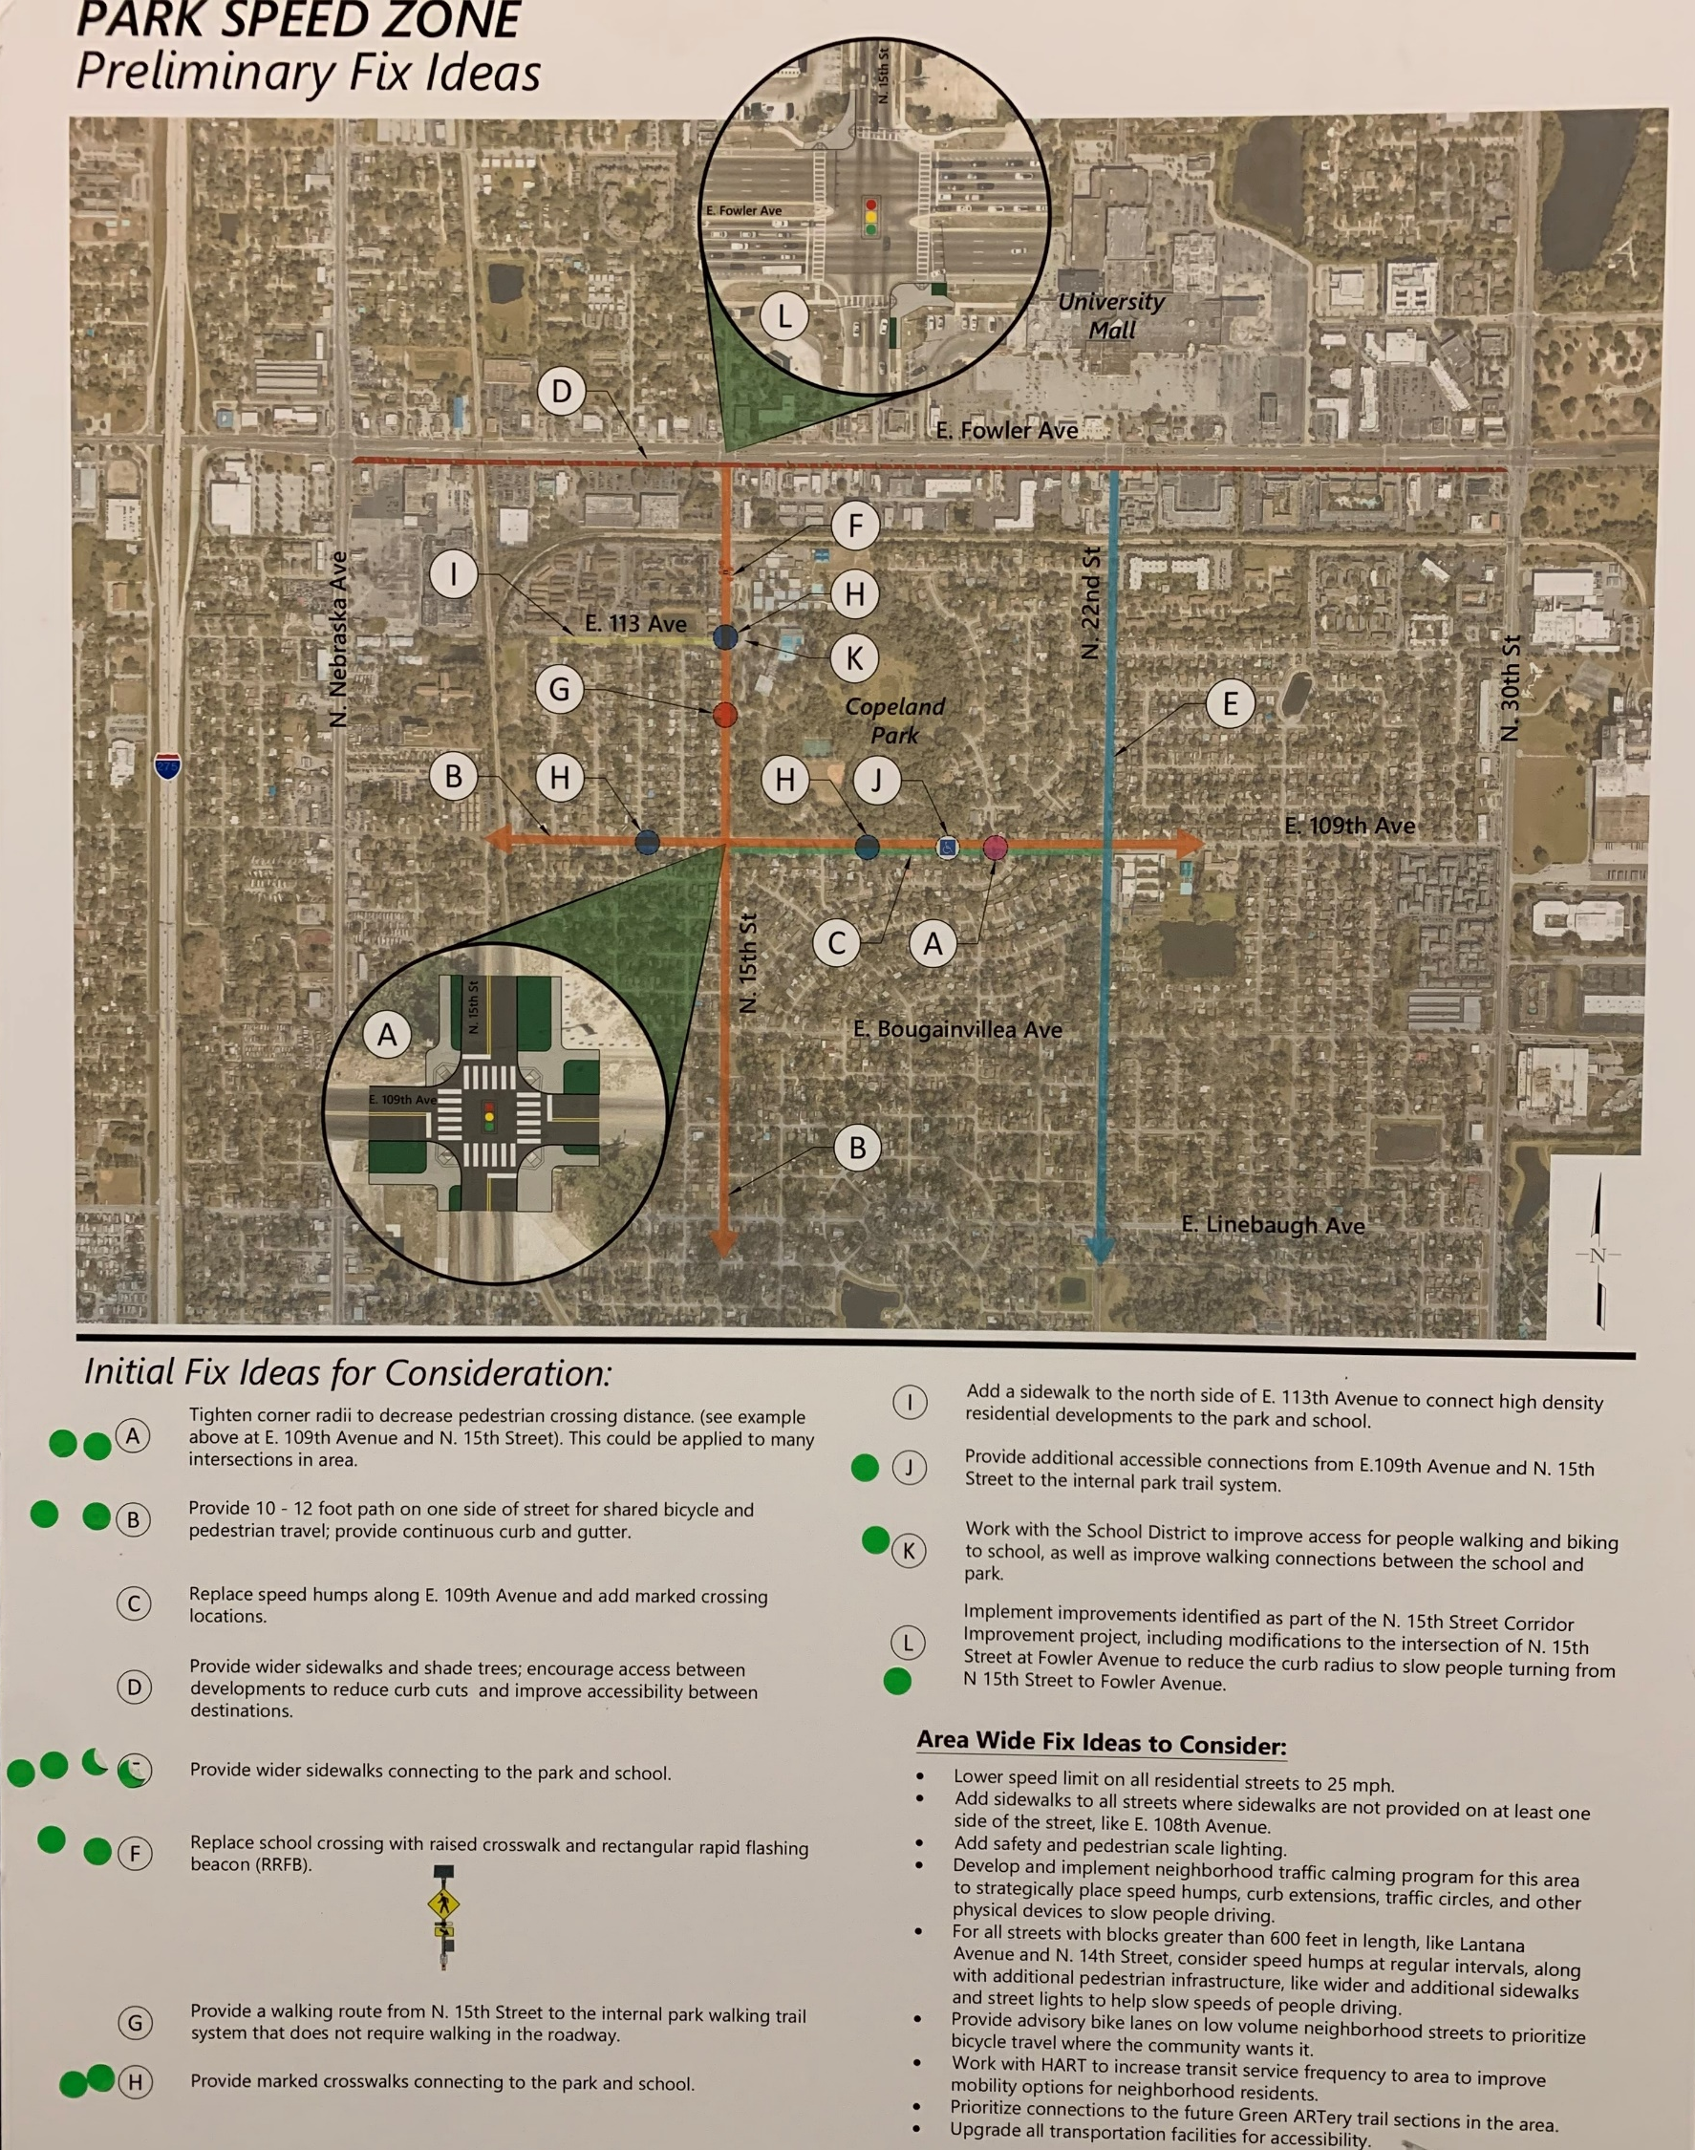
Copeland Fix-It
Notes:
The toolbox was applied to each of the park locations and preliminary fix ideas were developed. We then took these ideas out to the community on October 29th to ask for feedback. As we presented this to the public, stakeholder group and other committees, we requested their help to identify fix-it ideas that we missed and ideas that we had that were just not good ideas. At each location, people were given green and red dots to note ideas they liked (green) and ideas they did not like (red). Across all three park locations, no one placed a red dot!

Slide 19
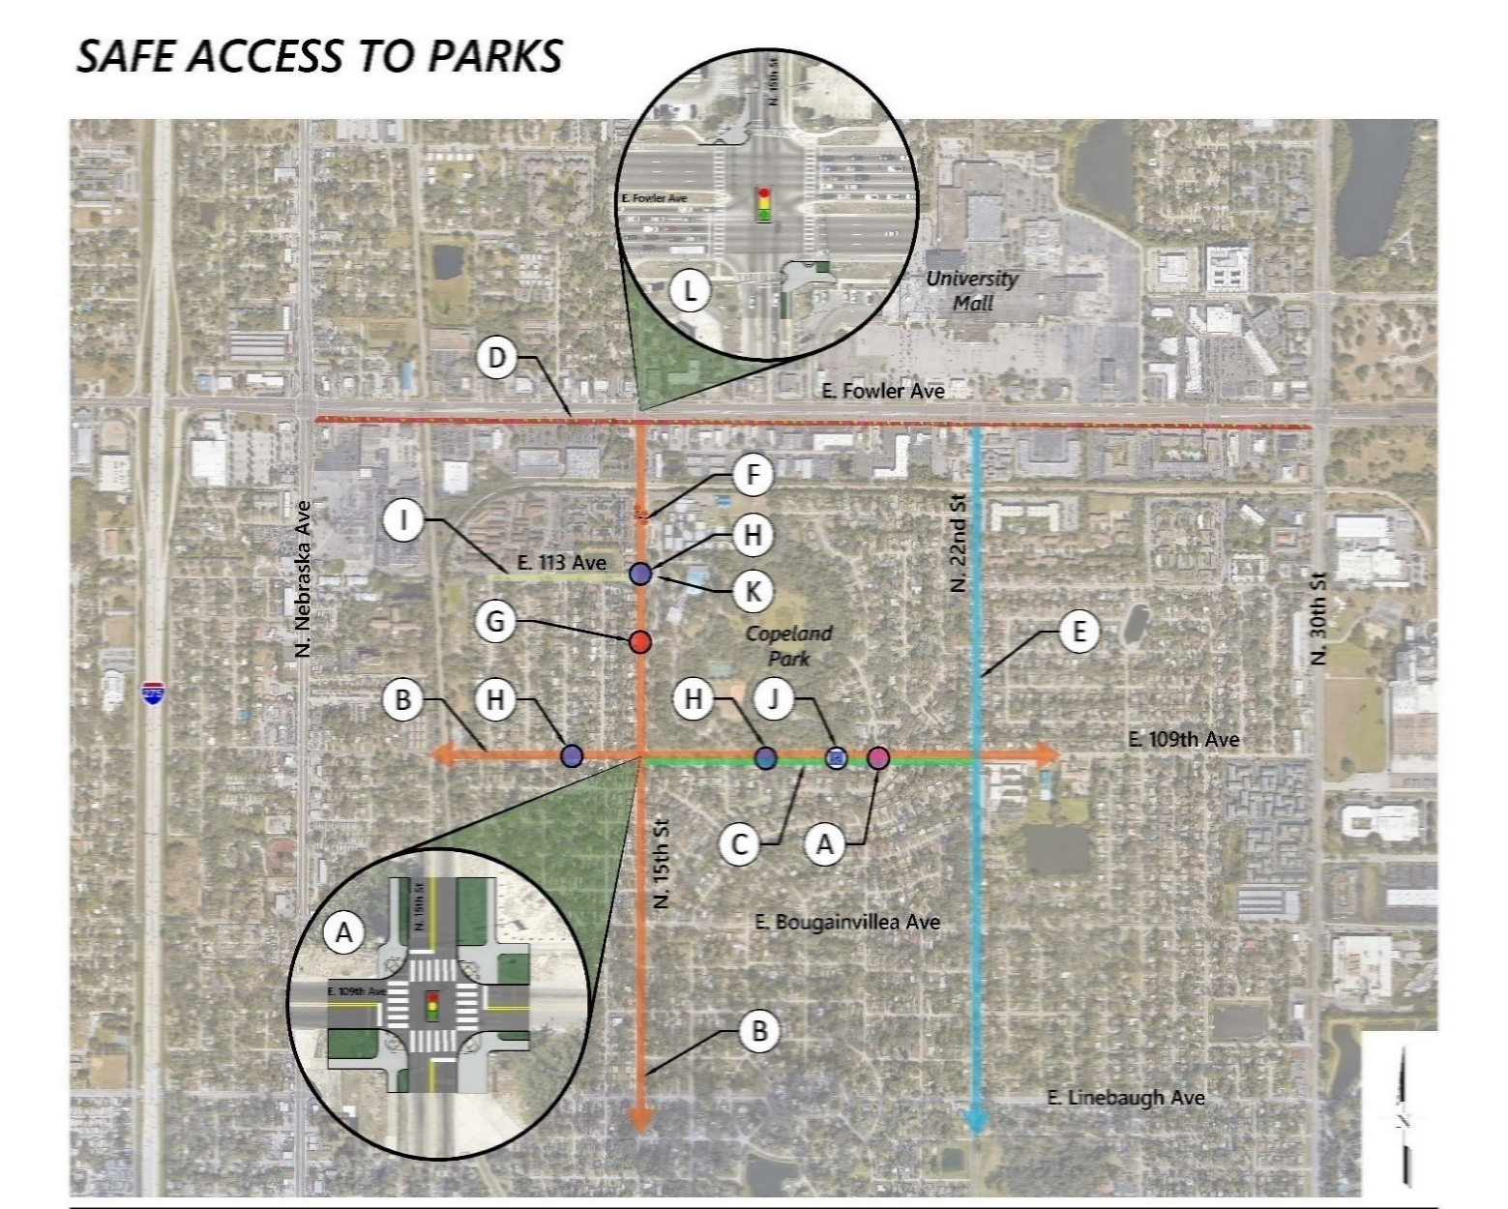
Fix-It Ideas: Copeland Park
Notes:
For Copeland Park, we identified 21 fix-it ideas, including 9 general ideas and 12 location specific ideas.
Bikeway facilities (2)
Intersection and Roadway Design (5)
Walking Facilities (12)
Signals (0)
Signing and Striping (0)
Other (2)
For Stakeholder Meeting, will switch to large format on screen to discuss each one individually.
For Committee Meeting:
Around Copeland Park, most ideas fall into the walking facility category, which includes items such as implementing traffic calming, reducing crossing distances at intersections, and adding more marked and controlled crosswalks.

Slide 20
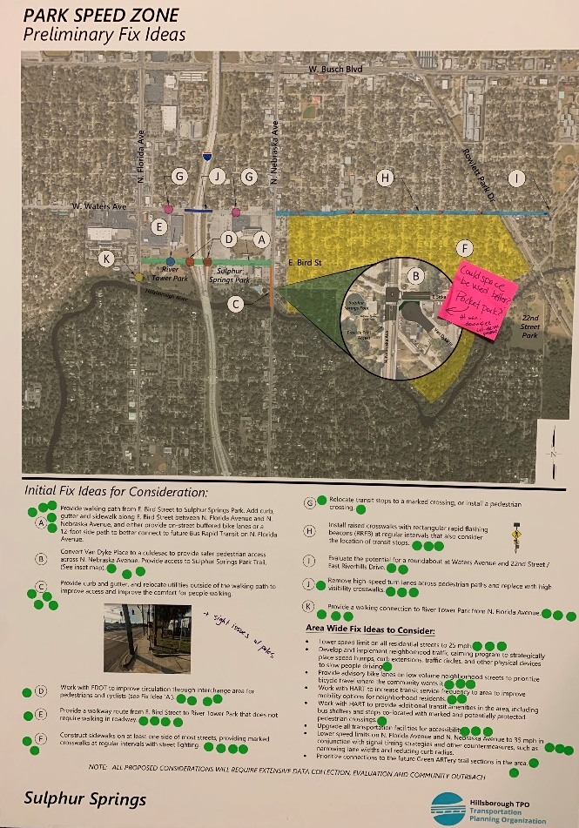
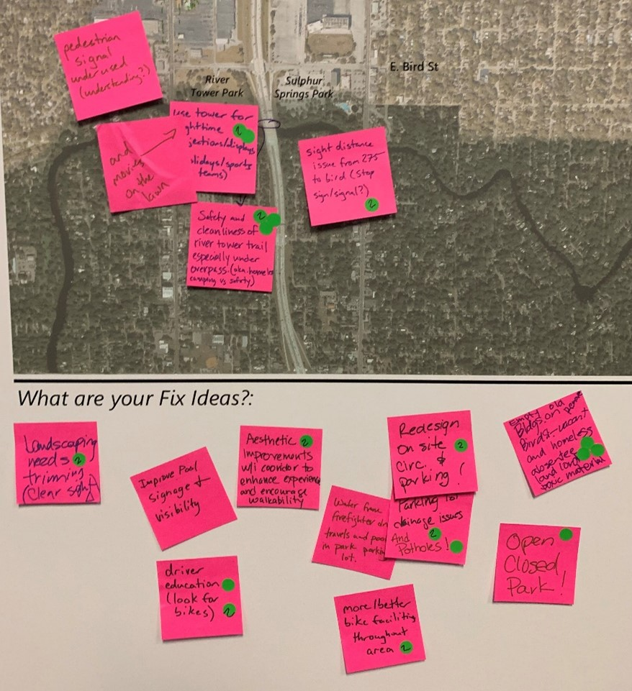
Sulphur Springs Fix-It Overview
Notes:
Here are the results from Sulphur Springs. As you can see, people provided a lot of great feedback and were supportive of a lot of the ideas that were developed.

Slide 21
Fix-It Ideas: Sulphur Springs
Notes:
For Sulphur Springs, we identified 21 fix-it ideas, including 9 general ideas and 12 location specific ideas.
Bikeway facilities (2)
Intersection and Roadway Design (5)
Walking Facilities (12)
Signals (0)
Signing and Striping (0)
Other (3)
For Stakeholder Meeting, will switch to large format on screen to discuss each one individually.
For Committee Meeting:
Around Sulphur Springs, most ideas fall into the walking facility category, which includes adding more sidewalks, providing better connections to River Tower Park, raised crosswalks, relocation of transit stops and improving circulation for people walking and biking through the interchange area.

Slide 22
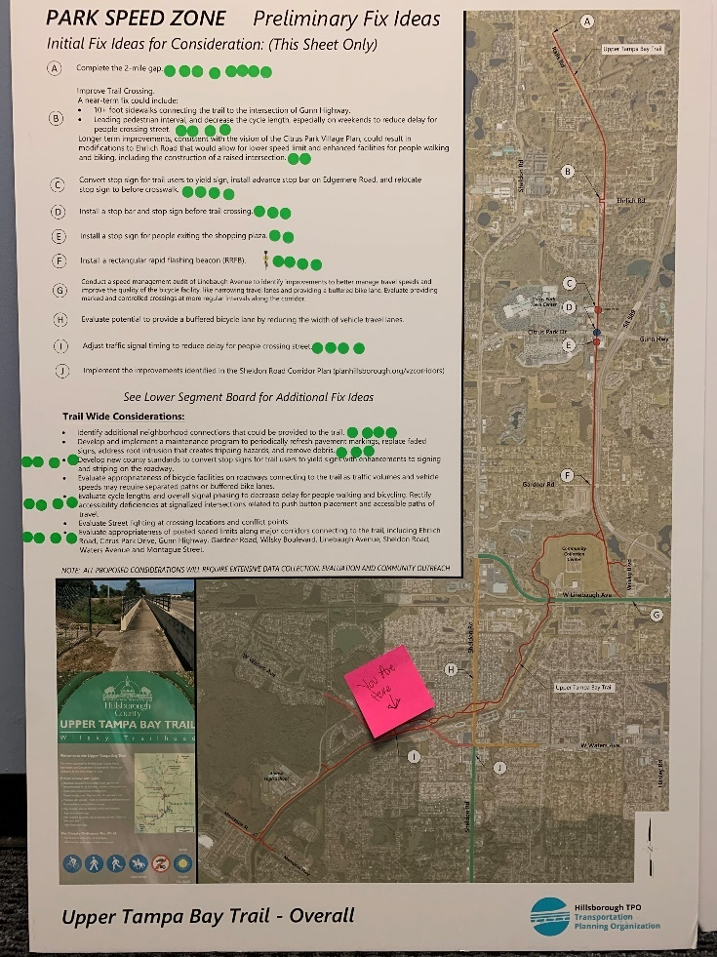
Fix-It Ideas: Upper Tampa Bay Trail
Notes:
We had a lot of ideas for Upper Tampa Bay Trail, and the trail is rather long, so it took two boards to show all the ideas. This is for the northern portion of the trail.

Slide 23
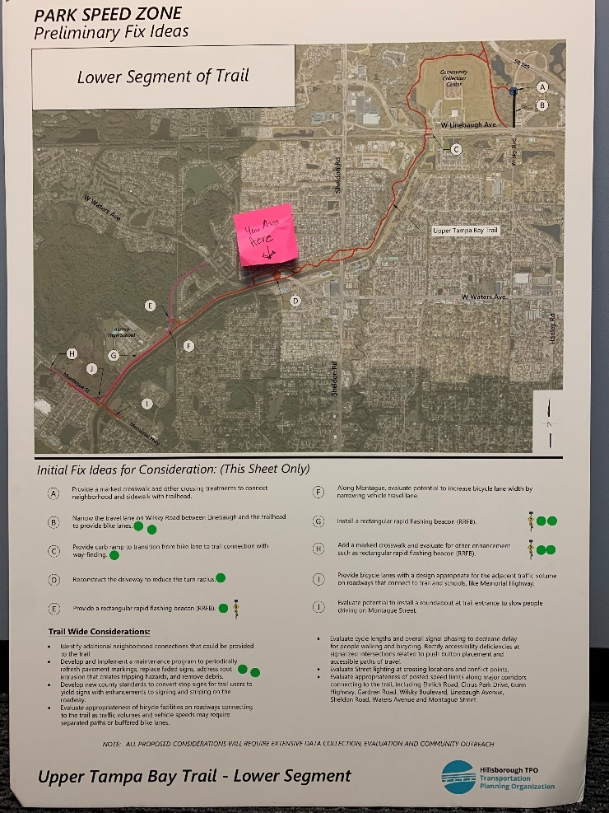
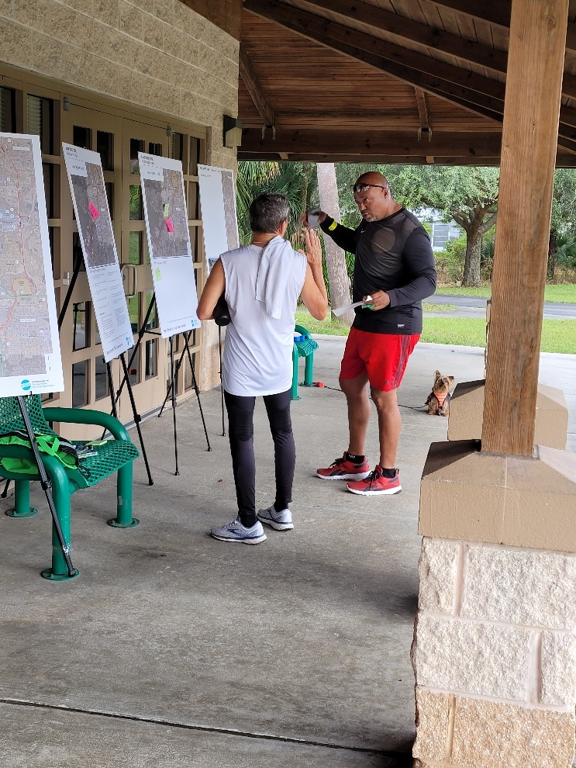
Fix-It Ideas: Upper Tampa Bay Trail
Notes:
And here is the feedback on the southern portion of the trail.

Slide 24
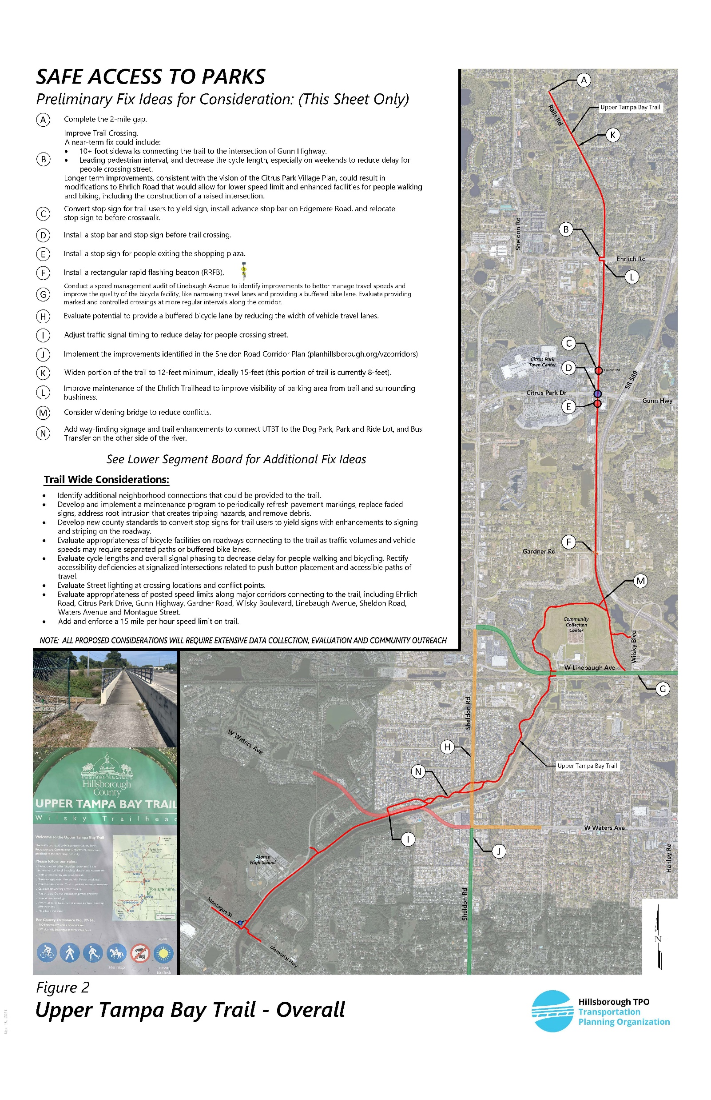
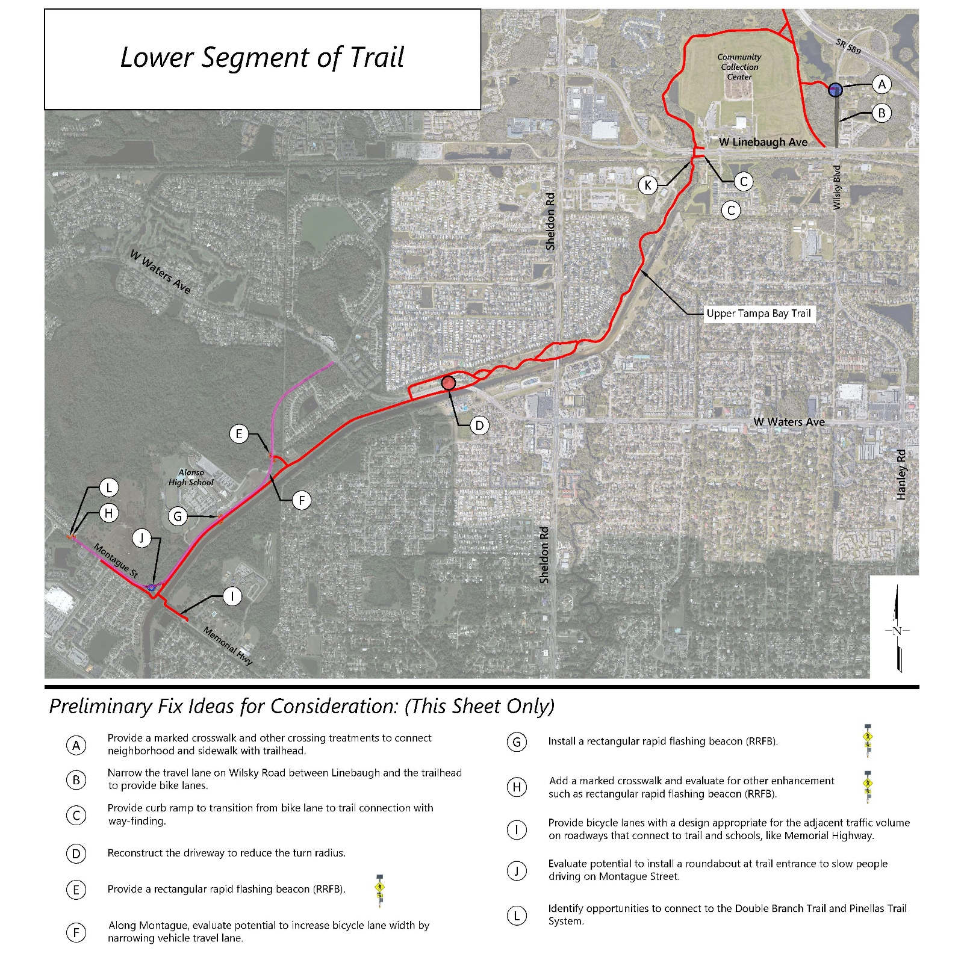
Fix-It Ideas: Upper Tampa Bay Trail
Notes:
For Upper Tampa Bay Trail, we identified 28 fix-it ideas, including 8 general ideas and 20 location specific ideas.
Bikeway facilities (8)
Intersection and Roadway Design (3)
Walking Facilities (6)
Signals (2)
Signing and Striping (3)
Other (6)
For Stakeholder Meeting, will switch to large format on screen to discuss each one individually.
For Committee Meeting:
Around UTBT, most ideas fall into the Bicycle Facility category, which includes completing the 2 mile gap, widening some portions of the trail that are narrow, evaluating and upgrading bicycle facilities that are on roadways connecting to the trail. Other ideas are specific locations for enhanced crossings, additional wayfinding, and implementing a speed limit on the trail.

Slide 25
What was changed as a result of feedback?
Changed the project name
Added additional Fix-it Ideas to the final documents:
Widen portion of the trail to 12-feet minimum, ideally 15-feet (this portion of trail is currently 8-feet) (UTBT)
Identify opportunities to connect to the Double Branch Trail and Pinellas Trail System (UTBT)
Add a marked crosswalk and evaluate for other enhancement such as rectangular rapid flashing beacon (RRFB) at the Champions Forest entrance (UTBT)
Add way-finding signage and trail enhancements to connect UTBT to the Dog Park, Park and Ride Lot, and Bus Transfer on the other side of the river (UTBT)
Improve maintenance of the Ehrlich Trailhead to improve visibility of the parking area from trail and surrounding businesses (UTBT)
Add and enforce a 15 mile per hour speed limit on the trail (UTBT)
Provide advisory bike lanes on low volume roadways connecting to the trail (UTBT)
Develop shared parking process with retail centers along the trail (UTBT)
Notes:
As a result of the feedback we received, we changed the project name. While much of the feedback collected during the initial outreach stages of the project was incorporated into the initial fix-it ideas, we did add a few more fix-it ideas to the draft document, which are noted above and also in the draft documents.

Slide 26
What was changed as a result of feedback?
Added additional Fix-it Ideas to the final documents:
Redesign on-site circulation and parking areas to prioritize walking and biking to the pool and park, as well as address existing drainage issues that result in standing water in the parking area (Sulphur Springs)
Provide a walking connection to River Cove Park (Sulphur Springs)
Evaluate signal timing strategies to reduce red light running and conflicts between roadway users (All Parks)
Paint Conflict Zones between different travel modes, with an emphasis on roadways with bike lanes connecting to trails, parks and schools (All Parks)
Prioritize connections to the park in the future Transit Oriented Development plans (Sulphur Springs)
Notes:
As a result of the feedback we received, we changed the project name. While much of the feedback collected during the initial outreach stages of the project was incorporated into the initial fix-it ideas, we did add a few more fix-it ideas to the draft document, which are noted above and also in the draft documents.

Slide 27
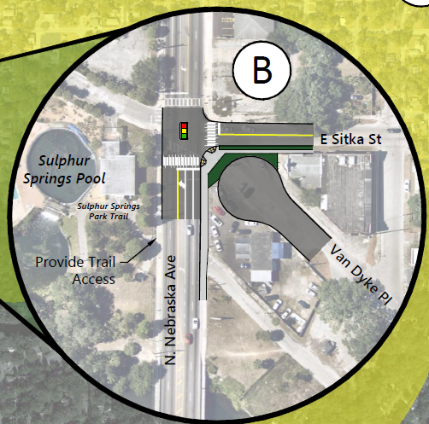
How to Guide
Select your park location
Conduct existing conditions assessment
Solicit feedback from the public and other stakeholders
Identify potential Countermeasures
Think big and small
Monitor Outcomes and Identify Potential Funding Sources
Notes:
Park Selection – consider equity (who does it benefit, have there been area improvements recently), co-benefits if close to a school or other public facility, are there other studies underway where resources could be shared, are their known safety issues?
Existing Conditions – walking and biking audit of area; review collision data, review existing traffic volume data, review speed data, demographic data, review existing area plans, identify what you don’t know and can ask about during public engagement
Public Feedback – look to obtain feedback in a variety of ways. On-line, in-person. Engage the local media. Reach out to HOAs and bike advocacy groups. Coordinate with other agencies who can help with implementation
Identify potential countermeasures – some can be implemented without much additional planning or capital costs – like signal timing adjustments. Others will require more outreach, planning and capital funding for construction and maintenance – like adding more sidewalks, lowering speed limits, closing roadways.
Monitor Outcomes – We do not expect that every Fix-idea that was developed as a part of this process will be implemented. Part of our goal for the meeting today is to get your feedback on what ideas should be scrapped and what ideas should receive further consideration. For the TPO, Near-term monitoring includes noting if an idea is then included in other planning documents, is the focus of a more in-depth planning study, or added to the capital improvement program. There may also be opportunities to use these documents to obtain grant funding for implementation, or to approach agency partners such as HART and FDOT.

Slide 28
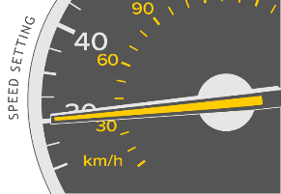
Next Steps
After approval, we will work with our partner agencies to advance some of the projects identified and continue outreach to area HOAs and others to continue project momentum

