Slide 1
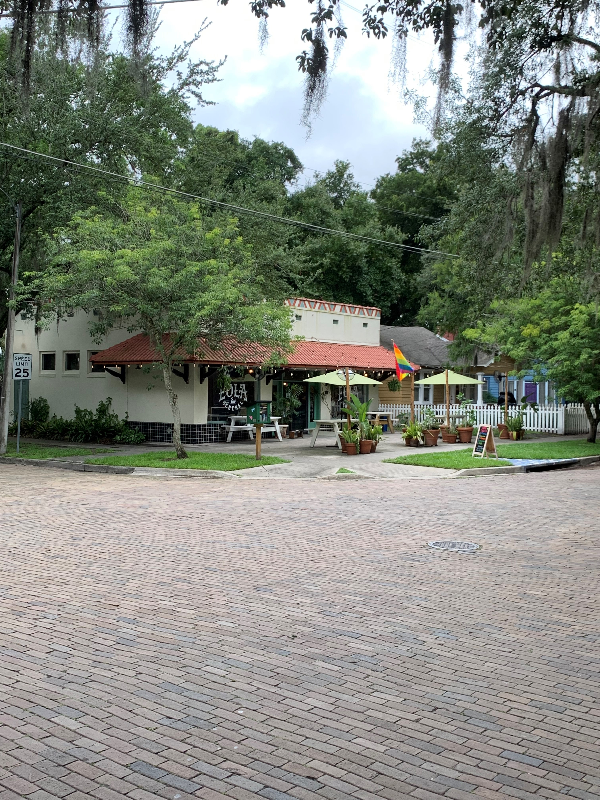
Hillsborough Planning Commission CLC UPDATE Public Workshop #2 01.20.22
Notes:
Thanks
Name
Hopefully you are here for the public workshop
Please note, meeting is being recorded – will be posted on the project website

Slide 2
AGENDA
AGENDA
AGENDA
1
Introductions
2
The Commercial Locational Criteria (CLC)
3
Research & Analysis Process
4
Public Engagement Opportunities & Schedule
5
Proposed Changes Summary
6
Discussion & Next Steps

Slide 3
INTRODUCTIONS

Slide 4
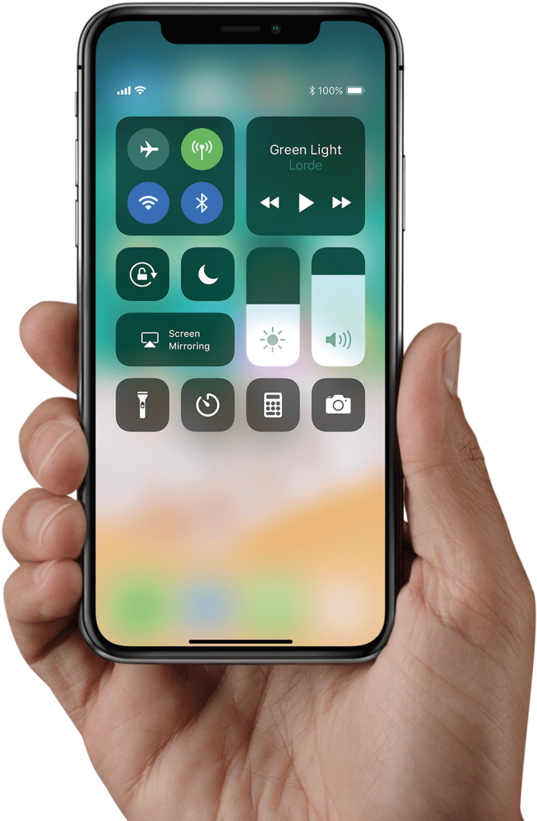
POLLING INSTRUCTIONS
VISIT:
POLLEV.COM/CREAD280
** Paper copies are available
for those without their phone

Slide 5
POLL 1
Notes:
2 QUESTIONS

Slide 6
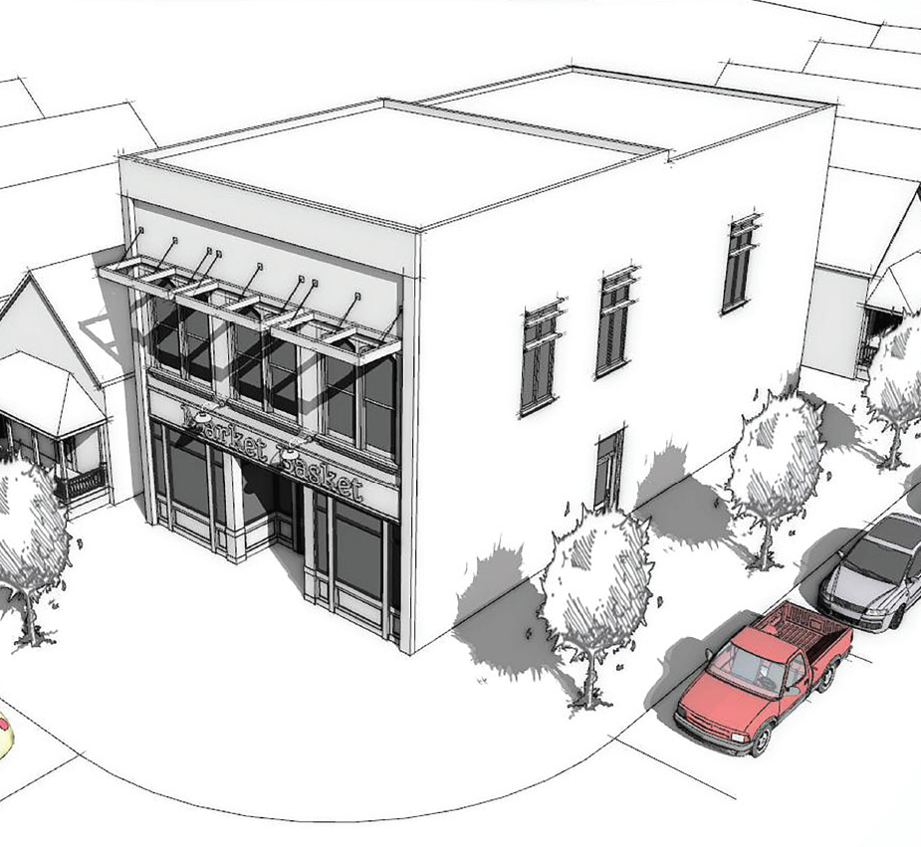
THE CLC
The CLC of the Comprehensive Plan was established to ensure that:
residents can meet their daily needs for goods and services within a reasonable distance from their neighborhood
commercial activities are integrated seamlessly into nearby residential neighborhoods
new commercial which services nearby neighborhoods do not require a Comprehensive Plan amendment
Notes:
In case you need a refresher, the commercial-locational criteria (OR CLC) is a set of requirements established under Objective 22 of the Future Land Use Element of the Comprehensive Plan. Like the name implies, the CLC is intended to ensure that:
3 […] meaning, if a small neighborhood-serving convenience store or coffee shop wants to locate within a portion of the County designated as Residential on the FLUM, they would not be expected to go through comprehensive plan amendment process, which often adds considerable time to development.
EXPLAIN FLUM VS ZONING

Slide 7
THE CLC
Daily needs typically include…
Fresh Foods
Prof. Services
Health Care
Restaurants

Slide 8
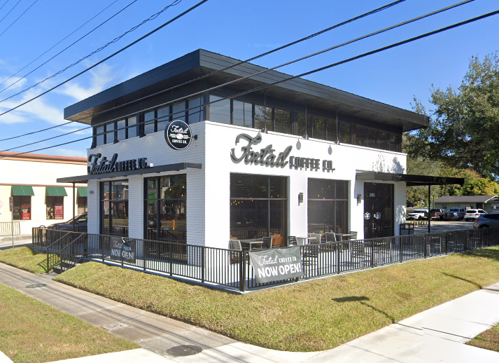
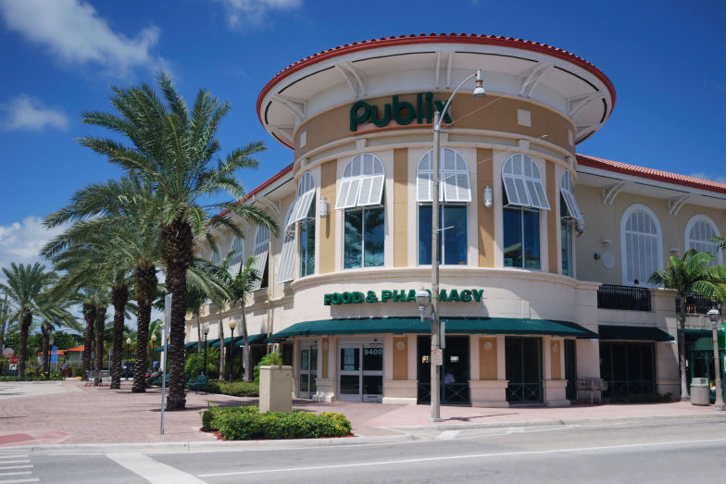
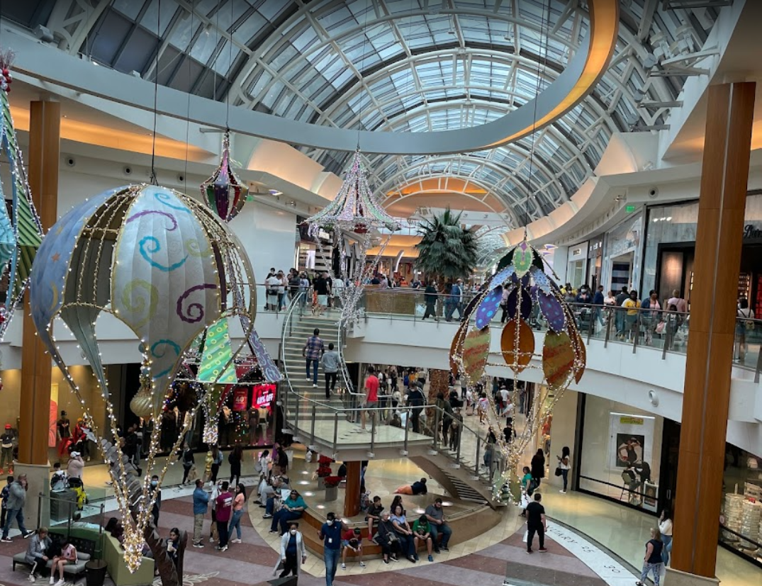
THE CLC
Neighborhood
Community
Regional
Commercial Service Areas (Urban)
Notes:
Before moving on, I think its important to establish this particular project is really focusing on the smallest type of commercial development, which are those at the neighborhood level.
Neighborhood-scale commercial activities typically serve just immediate area residents and its generally close enough to walk or maybe ride your bike. These can include things like coffee shops, some retail, neighborhood convenience store, or gas stations.

Slide 9
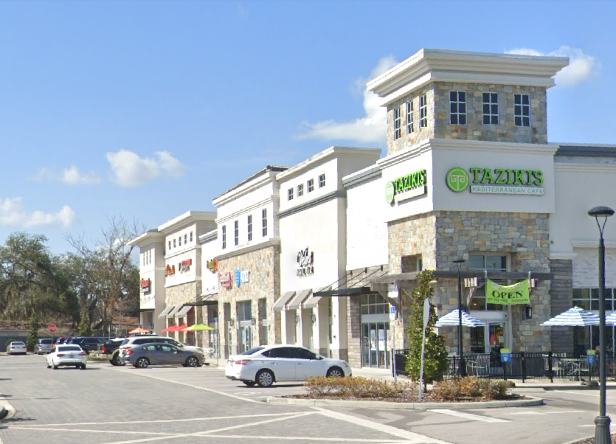
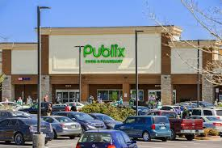
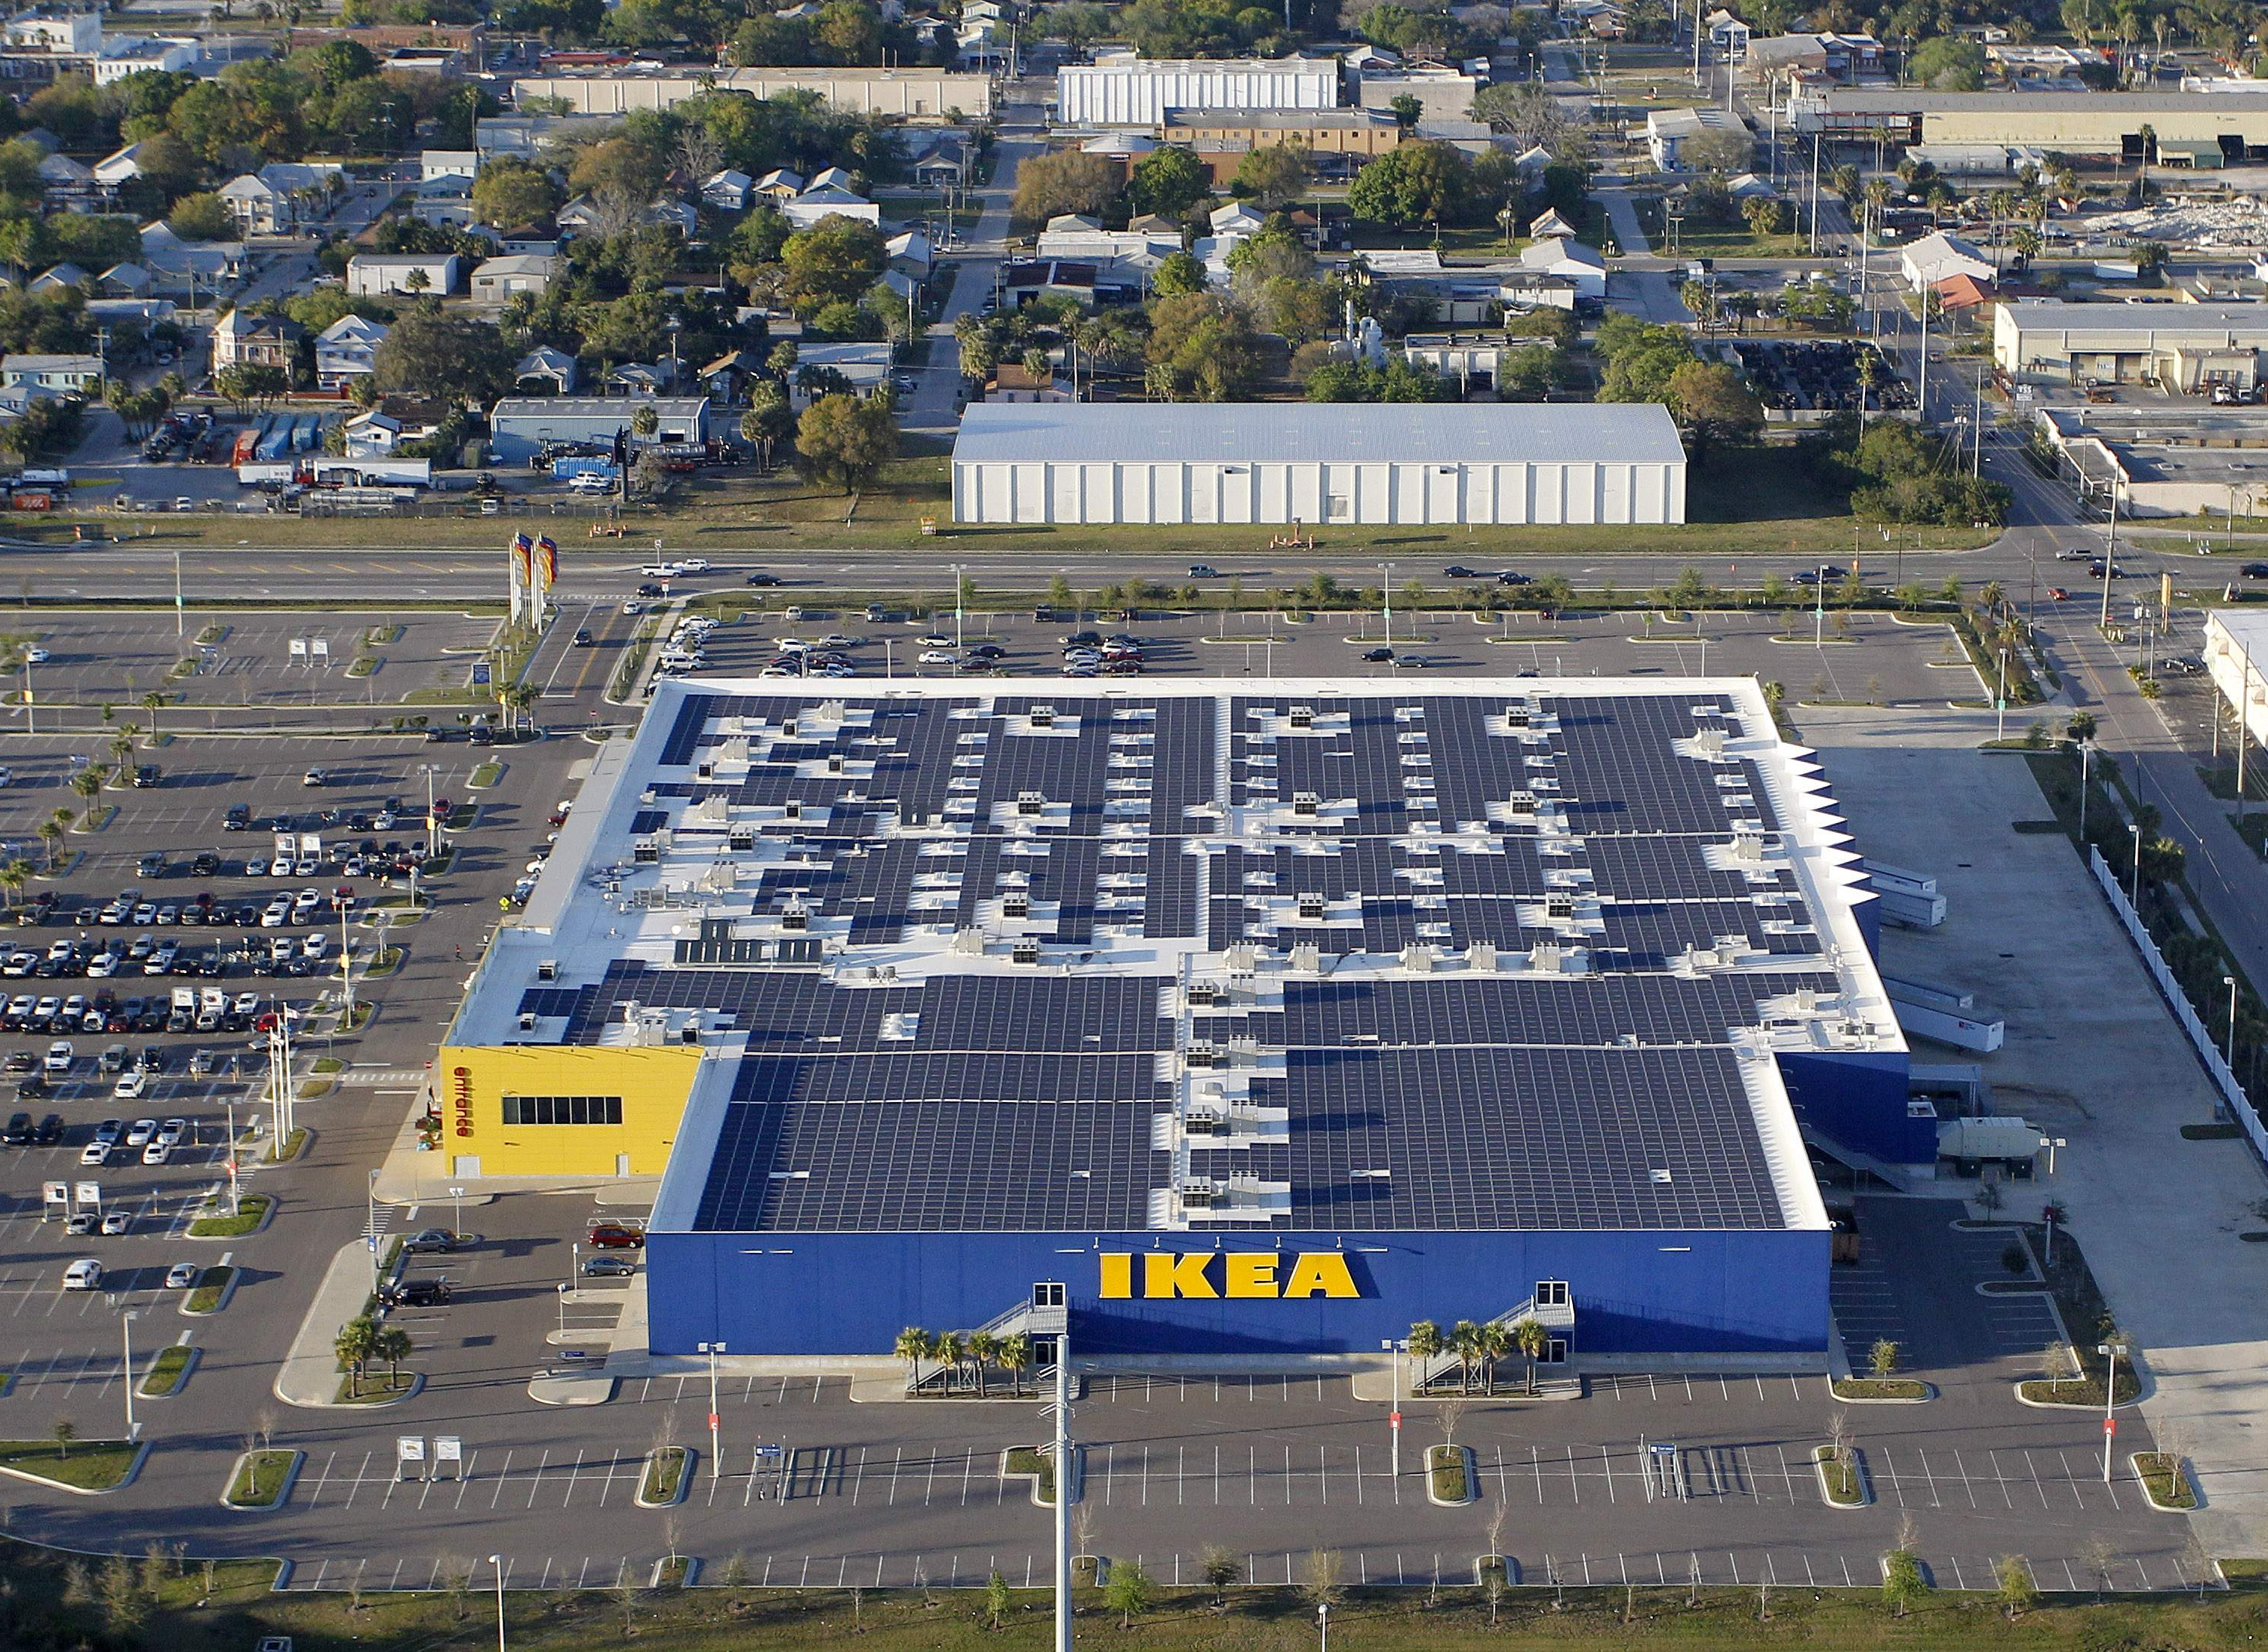
THE CLC
Neighborhood
Community
Regional
Commercial Service Areas (Suburban)

Slide 10
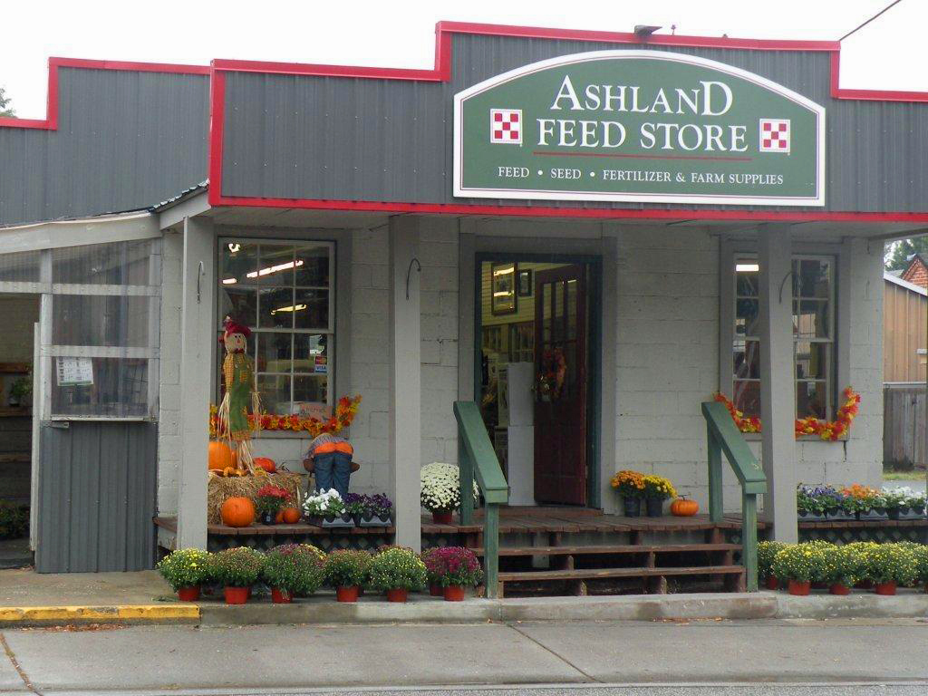
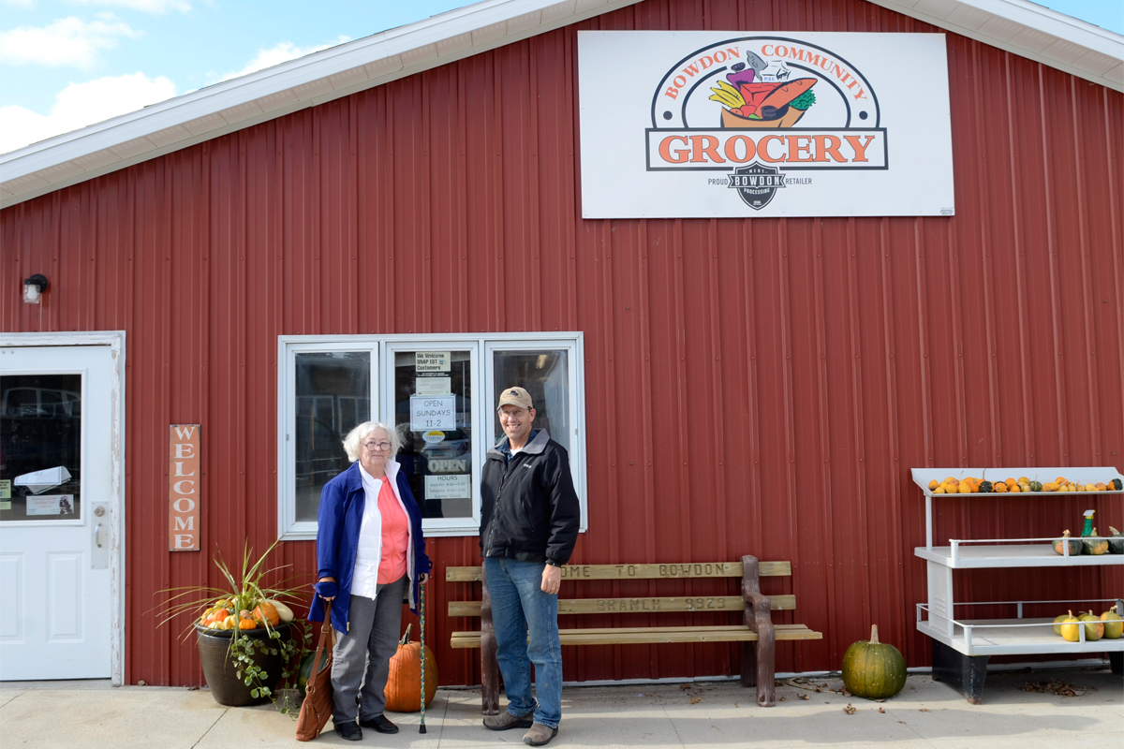
THE CLC
Neighborhood
Community
Regional
Commercial Service Areas (Rural)

Slide 11
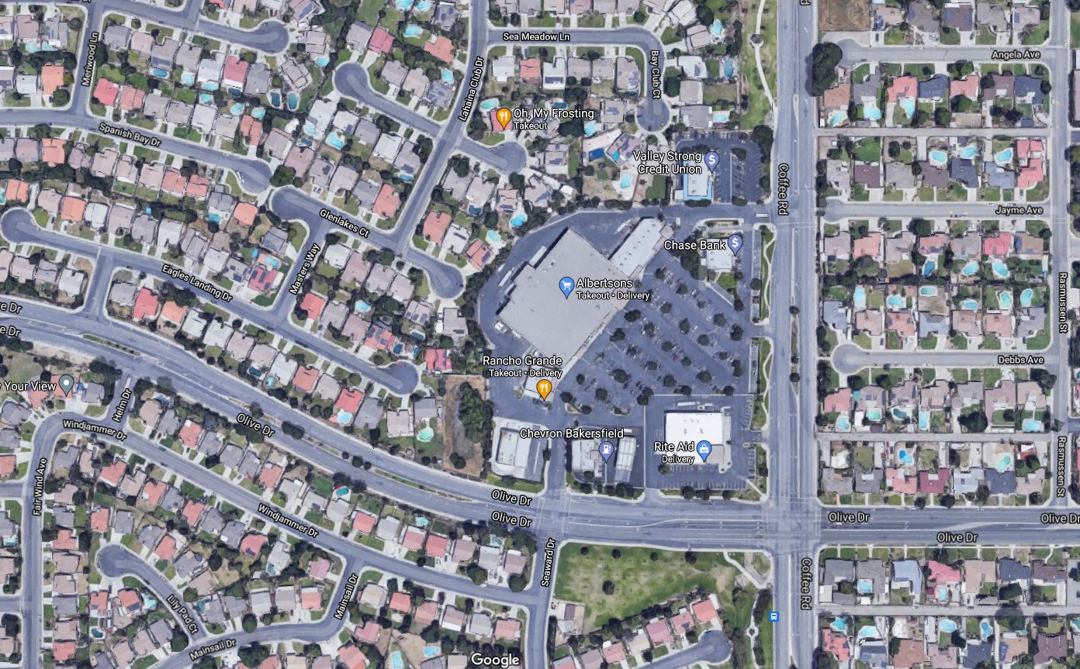
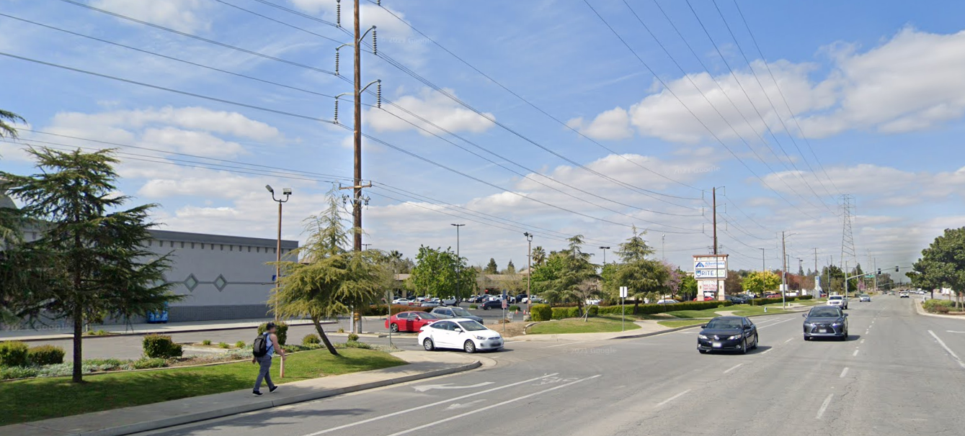
THE CLC
Notes:
Now on this slide, I am going to show you two very different examples of how neighborhood services may integrate into our communities when they are adjacent to single-family homes.
The first example is in Bakersfield, CA. -- [IMAGINE] -- Unless you want to jump over a 6-foot wall and through the landscaping to walk just a few hundred feet to the store, you have to walk out of the neighborhood first, along a busy road, and through a parking lot to get to the store. This site contains neighborhood serving uses (groceries, haircut, dry cleaners, bank and restaurant), but it is disconnected from the neighborhood.
The second example shows a traditional, historic downtown neighborhood in Orlando. They have a corner store immediately adjacent to single family homes. It is easily accessible to the surrounding neighborhood, and it blends in really well into the neighborhood thanks to the scale of the building and the building placement consistent with the surrounding homes.
Hillsborough County has a wide variety of settings, rural, suburban and urban. We can’t come up with a one-size-fits-all solution. We need to consider the context to ensure these uses serve their purpose, are easily accessible and do not clash with the surrounding neighborhoods.

Slide 12
POLL 2
Notes:
5 QUESTIONS (last question – indifferent)

Slide 13
THE CLC
opportunities for improvement
1
Revise outdated language
2
Assess need for waiver requests
3
Reflect the current realities of the commercial marketplace and the community’s desire for more pedestrian/bicycle/transit opportunities
4
Ensure standards are in place to require a more harmonious integration into nearby neighborhoods

Slide 14
RESEARCH & ANALYSIS
What direction do prior County planning documents provide for this effort?
Address transportation and access issues
Accommodate for pedestrian, cyclists, and transit users
Support the creation/retention of town centers
Implement CLC only in locations desired by the community
Local Planning
Documents Review
Notes:
So we have our objectives laid out in front of us and it’s a pretty sizable effort.
Luckily, we don’t have to reinvent the wheel.
The community, via the County’s wealth of planning documents, have already given us a lot direction for how the CLC should look.
Although this is an ongoing process, some of the findings we observed so far include the desire to:

Slide 15
RESEARCH & ANALYSIS
How are other comparable/notable communities accomplishing this?
Few communities permit neighborhood-serving commercial within residential areas
Where permitted, most communities require a commercial rezoning supplemented with additional compatibility, buffering, and locational requirements
Principles are established within the Comprehensive Plan; Criteria are established within the LDR
Local Planning
Documents Review
Best Practices Literature Review
Notes:
We also researched best practices across the State:
Following Counties in FL:
Broward, Manatee, Miami-Dade, Orange, Palm Beach, Pasco
Then expanded our search nationwide to:
Arlington County (VA), Forsyth County (NC), James City County (VA), Richmond (VA), Washington DC
As part of the R&A Process, we also reviewed over two dozen scholarly articles on best practices for neighborhood commercial development.
Increase the flex of land use and zoning
Empower the private sector to develop these 3rd places in between work and home
Explore new planning tools, such as ACU

Slide 16
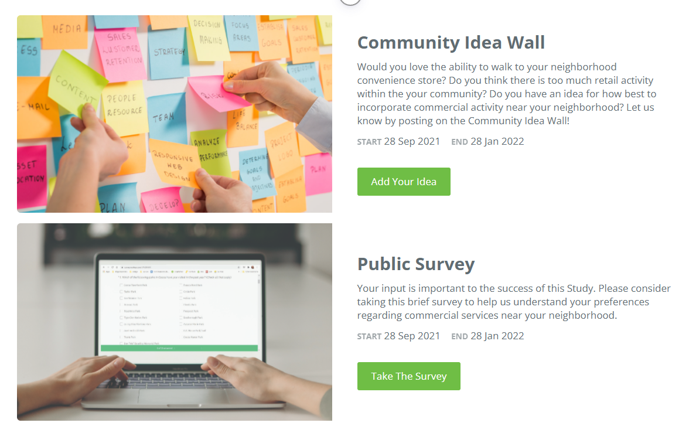
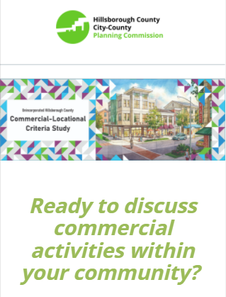
PUBLIC ENGAGEMENT
ENDS JAN 28, 2022
Scan
Me!
tinyurl.com/HillsboroughCLC

Slide 17
PUBLIC ENGAGEMENT
PC Briefing
Public Workshops
Stakeholder Sessions
BOCC Briefings
01
02
03
07

Slide 18
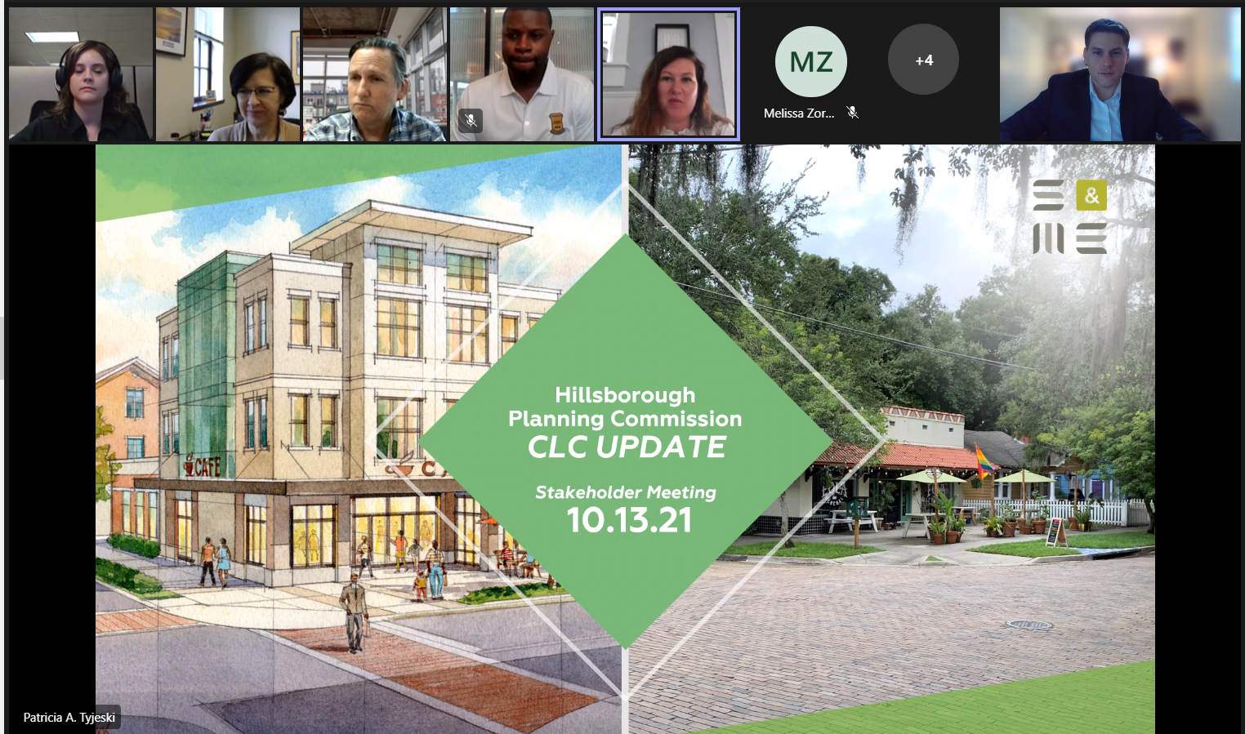
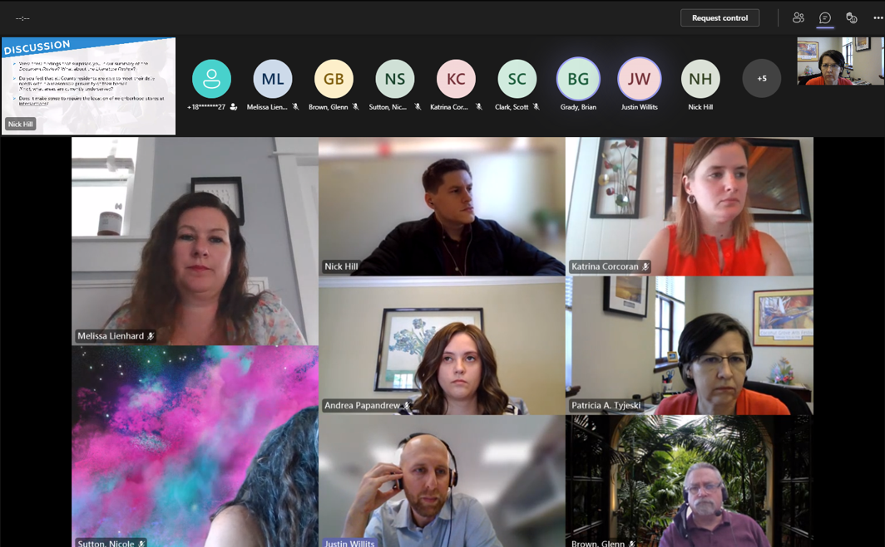
STAKEHOLDER INTERVIEWS
Requirements for accessibility and connectivity for new development must be context sensitive
Identify opportunities for the CLC to address communities unable to meet their daily needs
Residents are willing to walk to meet their daily needs if pedestrian facilities are readily available
Empower communities to determine the appropriateness of the CLC within their neighborhoods

Slide 19
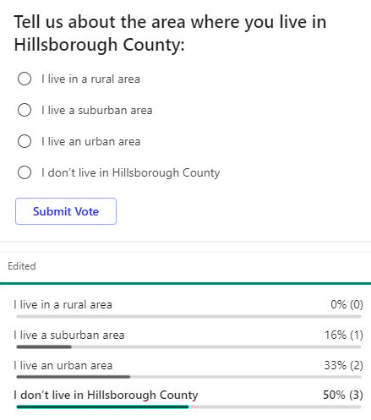
PUBLIC WORKSHOP
Revisions to the CLC should not conflict with the provisions of individual Community Plans, some of which address the protection of rural areas
Residents are often unable to meet their daily needs within a reasonable distance of their home
Residents would generally appreciate more opportunities to safely walk to their destinations
New commercial uses should connect to neighborhoods via driveways, trails, and sidewalks
Buffers are highly desired by residents when new commercial uses are developed adjacent to homes

Slide 20
PROPOSED CHANGES
Limit the types of uses which are eligible for the Commercial Locational Criteria to neighborhood-serving uses
Auto-oriented uses (e.g., drive-throughs and gas stations) would not qualify as a neighborhood-serving use
Restrict individual establishments to 30,000 square feet (smaller than an average grocery store)
Larger establishments would be required to pursue an amendment to the Future Land Use Map and a Rezoning
Notes:
Draft 2 out of 4

Slide 21
PROPOSED CHANGES
Eliminate opportunities for waiver requests to the Commercial Locational Criteria
Projects meeting the Commercial Locational Criteria would be subject to additional design standards which advance the area’s urban form, connectivity, and compatibility
Notes:
Considering the creation of a unique Neighborhood Commercial – Low Intensity (NC-LI) zoning district

Slide 22
POLL 3
Notes:
3 QUESTIONS

Slide 23
NEXT STEPS
Revise Draft CLC Language (draft #2 due Feb. 1)
Begin the Case Study Analysis
Prepare for PC & BOCC Hearings (tentatively scheduled for April)

Slide 24
CONTACT US
Public Input Website
Andrea Papandrew
Tinyurl.com/HillsboroughCLC
Planning Commission
Planner II
papandrewa@plancom.org
County Project Website
https://planhillsborough.org/
commercial-locational-criteria-study/
(813) 665-1331

Slide 25
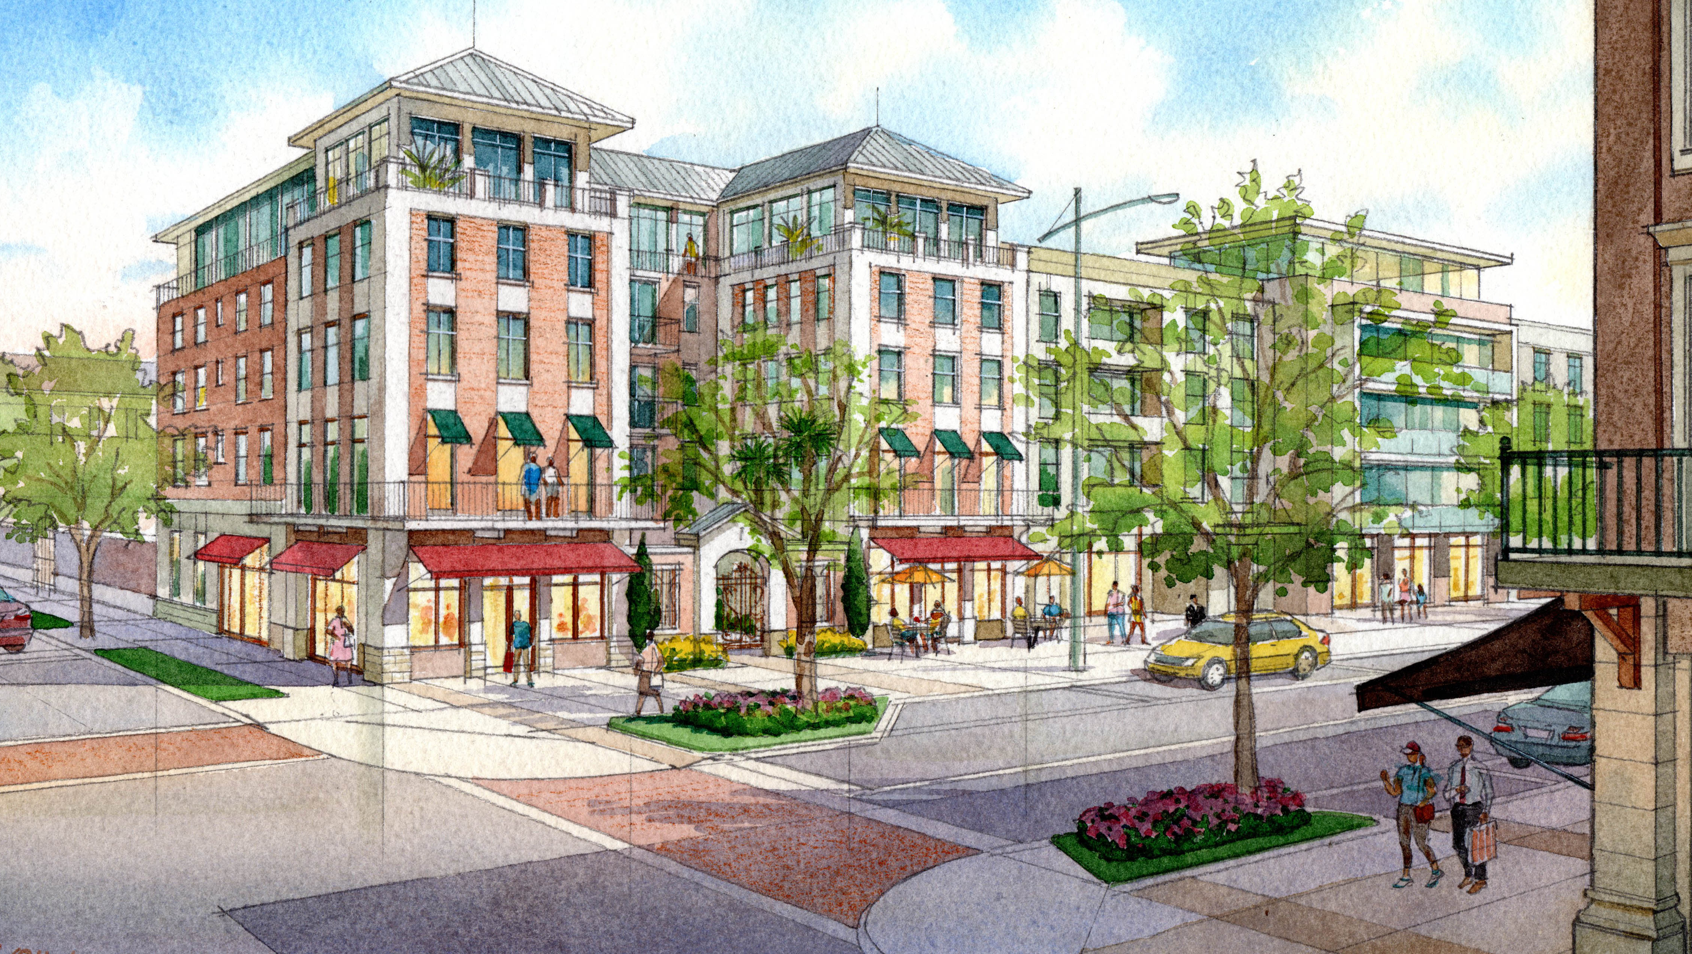
THANK YOU!

