Slide 1
WELCOME
PLANT CITY TRANSIT STUDY
OPEN HOUSE
Notes:
Good afternoon everybody. Welcome to the Plant City Transit Study Virtual Open House Live Presentation. Today we will be presenting the virtual open house and walking you through the project website where you can see the different rooms and provide your feedback.
I am Vishaka Shiva Raman, MPO staff.
I have with me Nicole McCleary from HART who is my coproject manager and
Sarah McKinley from MPO.
Other staff for supporting me.
At any time you can raise your hands for questions. I will pause after every section for questions if you might have but will take more questions at the end of the presentation
With this I will move on to the presentation

Slide 2
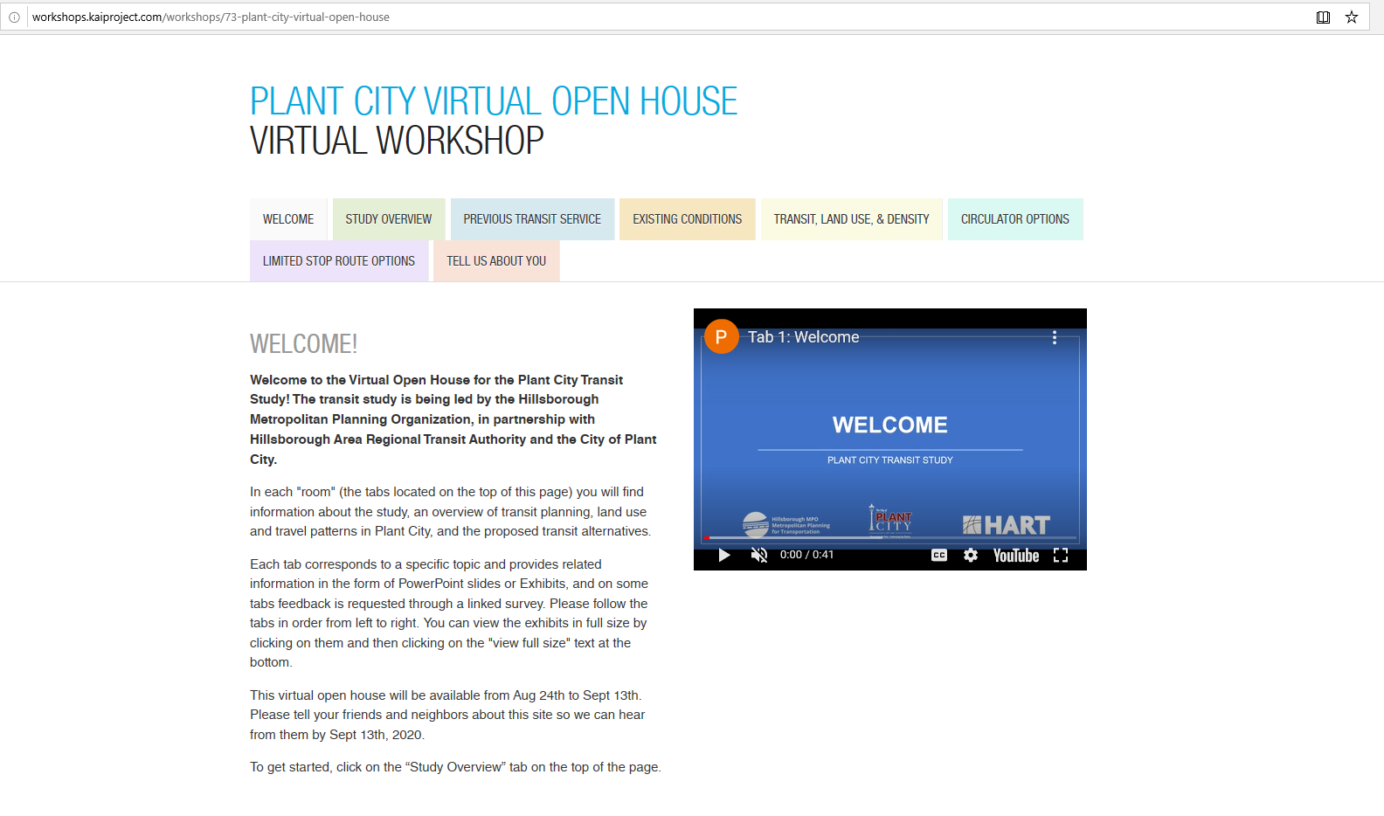
https://tinyurl.com/PlantCityTransitStudy
Notes:
Welcome to the Virtual Open House main page. This is how the main page will look like. The address is given at the bottom of this page. Please take your time reviewing the materials presented in this open house, starting with the Study Overview tab. Then you will work your way through each tab or room, reviewing the text, exhibits, and video recordings.
Throughout the open house there are opportunities to gather feedback and preferences on how you move around Plant City and what types of transit options you would like to see in the future. Please fill out the survey which will help us to understand the needs better.
If you have questions, contact info is provided at the bottom of the page. Let’s get started!

Slide 3
STUDY OVERVIEW
PLANT CITY TRANSIT STUDY
Notes:
Just to give you an idea about the study, The Plant City Transit Study is being led by the Hillsborough MPO, in partnership with (HART) Hillsborough Area Regional Transit Authority and Plant City

Slide 4
Survey
Notes:
This is the study overview tab room. In this room you will find more details on the Study Area Map , the Goals and Objectives and the Project Schedule.

Slide 5
Background
Currently over 40,000 residents in Plant City
Plant City one of the fastest growing areas of Hillsborough County (by percent)
Study Area includes Plant City and portions of Unincorporated Hillsborough County
Plant City
Notes:
Plant City is one of the fastest growing areas of Hillsborough County. Yet its 40,000 residents currently have no transit options.

Slide 6
Study Purpose & Outcomes
Explore
Explore options for transit in Plant City:
Transit circulator to serve transit needs within Plant City
Express route connecting Plant City to Tampa and potentially Lakeland
Evaluate
Evaluate alternative routes and service based on:
Identify
Recommend final set of proposed transit alternatives
Identify areas to serve in the future to meet projected growth
Recommend
Costs
Potential ridership
And other performance measures
Notes:
This study is intended to explore potential transit options for providing a local circulator service and a limited route transit service connecting Plant City to other parts of Hillsborough County and possibly to Polk County
Through public outreach, we have identified potential alternatives for each transit service.
These are being evaluated based on their costs, potential ridership, and other performance measures.
This study will provide a set of transit options to meet the growing demands that could one day be implemented by HART and Plant City.

Slide 7
Notes:
This study began in early 2020. We have conducted community engagement through two stakeholder meetings, which were open to the public, and this public open house. The final report will be completed by the end of September and presented to the HART Board, MPO Board, and Plant City Commission before the end of the year.
At this point we will pause and take a few questions.

Slide 8
PREVIOUS TRANSIT SERVICE
PLANT CITY TRANSIT STUDY
Notes:
Handing over to Nicole.
This study researched the previous transit service that was provided in the early 2000s to understand what worked well and what could be modified in future transit service.
Plant City was previously served by two transit options, including a commuter express bus (Route 28X) and a local circulator called the Strawberry Connector.

Slide 9
Survey
Notes:
This is the previous service tab where you will find information on the previous transit services including the Strawberry Connector and the Route 28X, operated by HART.
You can use the survey link at the bottom of the page to provide feedback.

Slide 10
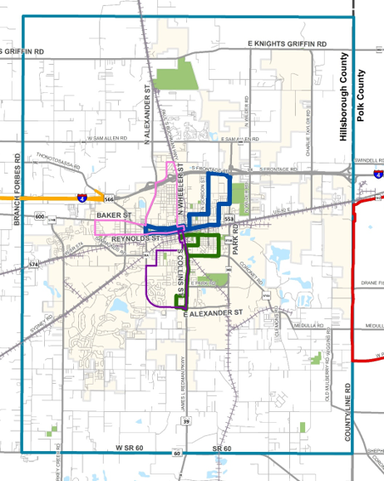
Previous Local Commuter
Strawberry Connector
Four Routes operated weekdays from 9 am to 5 pm
Operated by HART from 2001-2005, and Plant City from 2005-2008
Routes 70 & 71 had highest ridership
Highest annual ridership: 47,543 (FY 2006/2007)
2008 (final year of service)
37,392 annual riders
12.3 riders per hour
Notes:
Plant City was also previously served by the Strawberry Connector, a community circulator that took residents to work, shopping, recreational, and other trips. Service began on March 19, 2001 through a mutual cooperation agreement between Plant City and HART. Funding for this service was provided by a grant under the Congestion Mitigation and Air Quality Improvement Program (CMAQ), which was designed to promote the shift from single occupant vehicles (SOVs) to a fixed route transportation service. From 2001 to June 2005, the service was operated by HART. Plant City operated the service from June 6, 2005 to the end of operation in June of 2008. In the final year of service, the Strawberry Express experienced an annual ridership of over 37000 riders and 12.3 riders per hour. Ridership was at its peak in the early days of the service when it was provided fare-free, but as fares increased, ridership decreased. Ridership also increased as wait times between buses decreased to every 30 minutes.

Slide 11
Previous Transit Service
28X East County Express
Connected through Brandon before downtown Tampa
Provided two trips per day in morning and evening
Final year scaled back to one trip per day
Operated between 2010 to 2017
Peak average annual ridership in 2012:
14,363 annual riders
17.3 riders per trip
2017 (last year of operation):
7,474 annual riders
15 passengers per trip
Notes:
Route 28X was a commuter express service operated by HART from 2010 to 2017. It operated along I-4 and connected Tampa to the western edge of Plant City. It exited I-4 at Thonotosassa Rd to pick up and drop off passengers at a Park and Ride stop at the Mount Zion Assembly of God. The peak of annual ridership was in 2012 with 14,363 riders, with an average of 17.3 riders per bus trip. Initially the service provided two pickups and drop-offs per day but was cut down to one pickup and drop-off per day in 2012. In 2017, the year service was cut, there was a total ridership of 7,474 riders and an average of 15.1 riders per bus trip. It was removed from service in 2017 during the Mission Max Comprehensive Operations Analysis in which service throughout Hillsborough County was scaled back due to budget restraints.
We can take any questions at this time if you have.

Slide 12
Existing conditions & travel market highlights
PLANT CITY TRANSIT STUDY
Notes:
Vishaka will talk
This transit study included an analysis of existing conditions and travel market characteristics of people living and working in Plant City. This information helped to inform the proposed transit options and routes.

Slide 13
Notes:
This is the existing conditions tab where you can find more information about where Plant City residents live and work. This will help to understand who would benefit from transit the most. Click on the existing conditions report to read more.

Slide 14
Inflow / Outflow
Total Primary Jobs: 17,477
Live in Plant City & Work Outside: 13,709
Live & Work in Plant City: 2,435
Live Outside Plant City & Work In: 16,064
Source: U.S. Census Bureau. (2020). LEHD Origin-Destination Employment Statistics (2002-2017). https://onthemap.ces.census.gov.
Notes:
According to the U.S. Census Bureau, there are over 17,000 primary jobs in Plant City. We developed this using the US Census tool called ON the MAP.
\
Over 13,000 people live in Plant City but work outside of the city. Over 16,000 Live outside of Plant City but work in the City. Only about 2500 people both live and work in Plant City.
Primary jobs are your highest paying job.

Slide 15
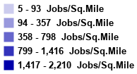
Where Plant City Residents Work
Top Places
Tampa
Plant City
Lakeland
Brandon
East Lake
Source: U.S. Census Bureau. (2020). LEHD Origin-Destination Employment Statistics (2002-2017). https://onthemap.ces.census.gov.
Notes:
When looking at where Plant City residents work, Tampa is the top place, followed by Plant City and Lakeland.

Slide 16
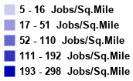
Where Plant City Workers Live
Top Places
Plant City
Lakeland
Brandon
Tampa
Riverview
Source: U.S. Census Bureau. (2020). LEHD Origin-Destination Employment Statistics (2002-2017). https://onthemap.ces.census.gov.
Notes:
When looking at where Plant City workers live, most live in Plant City. This is followed by Lakeland and Brandon.

Slide 17
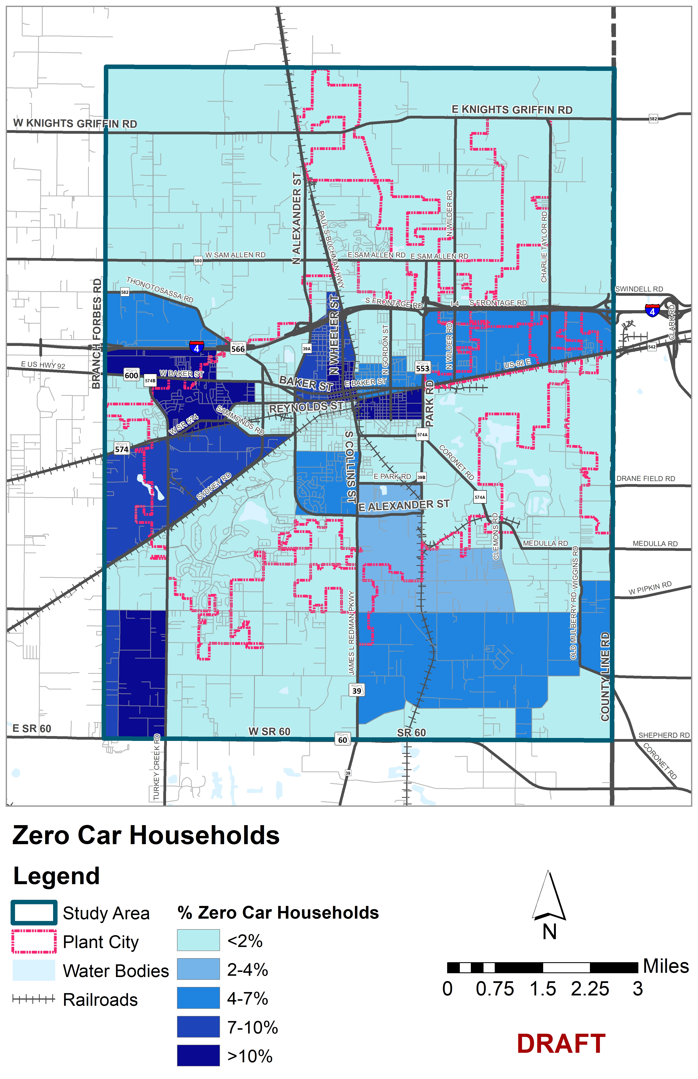
Commute Patterns & Zero Car Households
84% of workers drive alone
Mean travel time to work is 23.6 minutes
18% of residents travel less than 10 minutes to work
1.5% of households in Plant City have no vehicle
Notes:
The map shown on this slide shows the percentage of households with no vehicle by Census Tract. The darker areas have higher percentages of households with no vehicle. These are areas where transit service is more likely to see higher ridership
84% of workers drive alone, and the mean travel time is 23.6 minutes. 18% of Plant City residents travel less than 10 minutes to work. 1.5% of households in Plant City do not own a vehicle. The map shown on this slide shows the percentage of households with no vehicle by Census Tract. The darker areas have higher percentages of households with no vehicle. These are areas where transit service is more likely to see higher ridership.

Slide 18
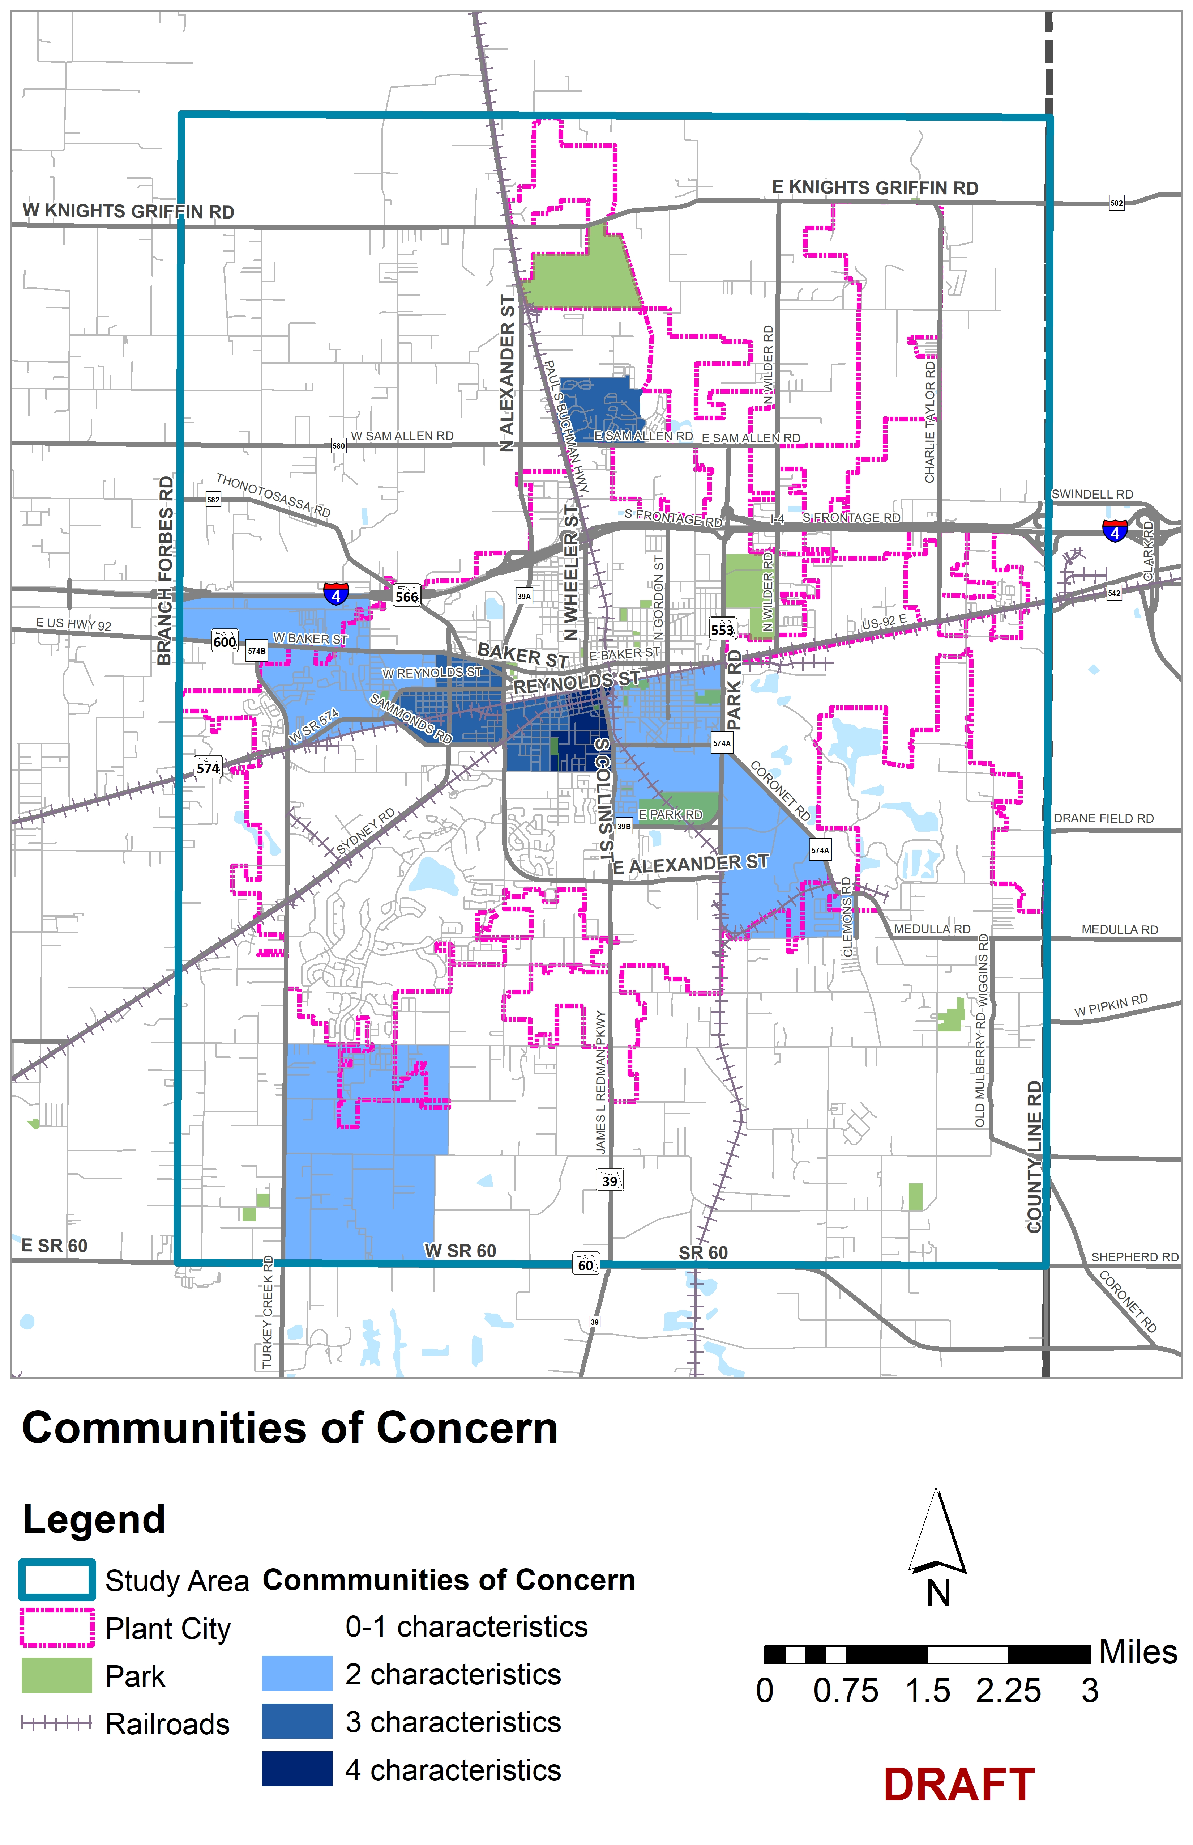
Communities of Concern
Census Block Groups that measure more than one standard deviation above the county’s median in two or more of the following characteristics:
Low income
Disability
Youth
Elderly
Limited English proficiency
Minorities
Carless households
Notes:
This study also looked at the Communities of Concern as defined above. The darker areas have more characteristics as shown. (point to the map)
This almost overlaps with the Zero car HH map. These areas are potentially more likely to need access to transit and would provide higher ridership than other parts of Plant City.

Slide 19
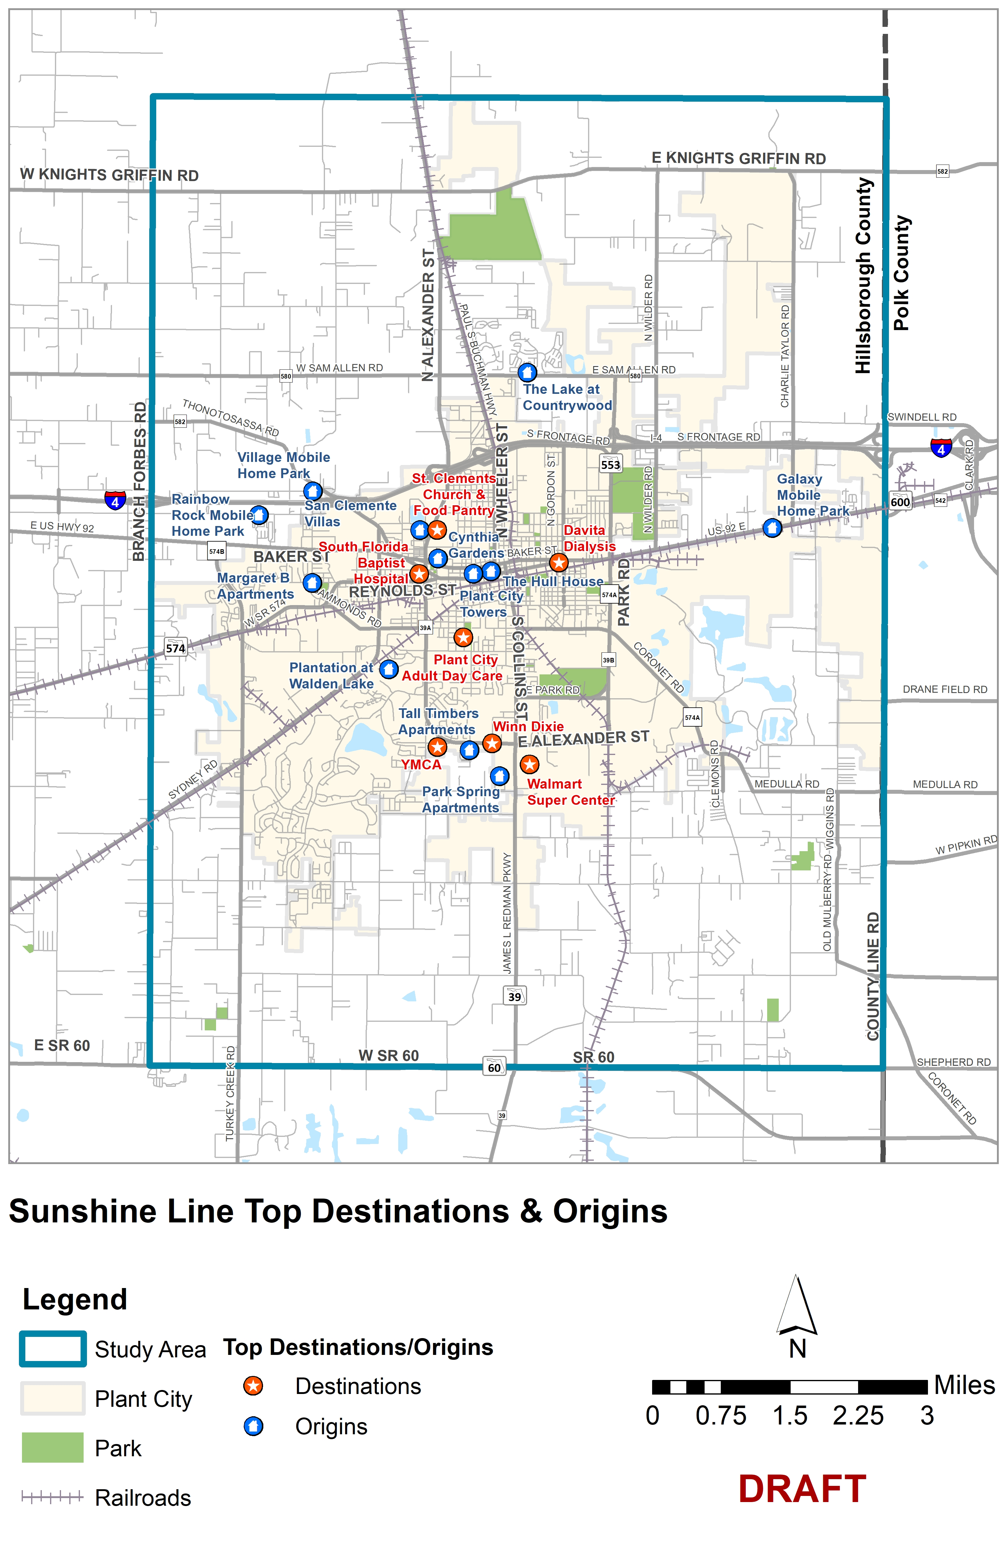
Sunshine Line
Top Destinations | Type
Plant City Adult Day Care | Day Care
YMCA | Community Center
Lighthouse for the Blind | Rehabilitation Center
Davita Dialysis | Medical
South Florida Baptist Hospital | Medical
Walmart Super Center | Grocery/Shopping
Winn Dixie | Grocery
St. Clements Church & Food Pantry | Church/Food Pantry
Save-A-Lot | Grocery
Notes:
Sunshine Line is the only service that is currently available to residents who qualify. These trips help people meet their daily needs such as groceries, medical appointments, or community centers.
The Sunshine Line is a service provided by Hillsborough County that provides door-to-door service for certain types of trips for people who qualify. People who qualify meet certain criteria such as seniors, lower income, disabilities, or others.. The map on the slide shows the top Sunshine Line trip origins (where people get picked up) and the highest destinations (where people get dropped off). These are potential locations that could be served by a circulator service.
We can take any questions after this

Slide 20
Transit, Land Use and density
PLANT CITY TRANSIT STUDY
Notes:
Nicole will talk
This study researched the previous transit service that was provided in the early 2000s to understand what worked well and what could be modified in future transit service. Plant City was previously served by two transit options, including a commuter express bus (Route 28X) and a local circulator called the Strawberry Connector.

Slide 21
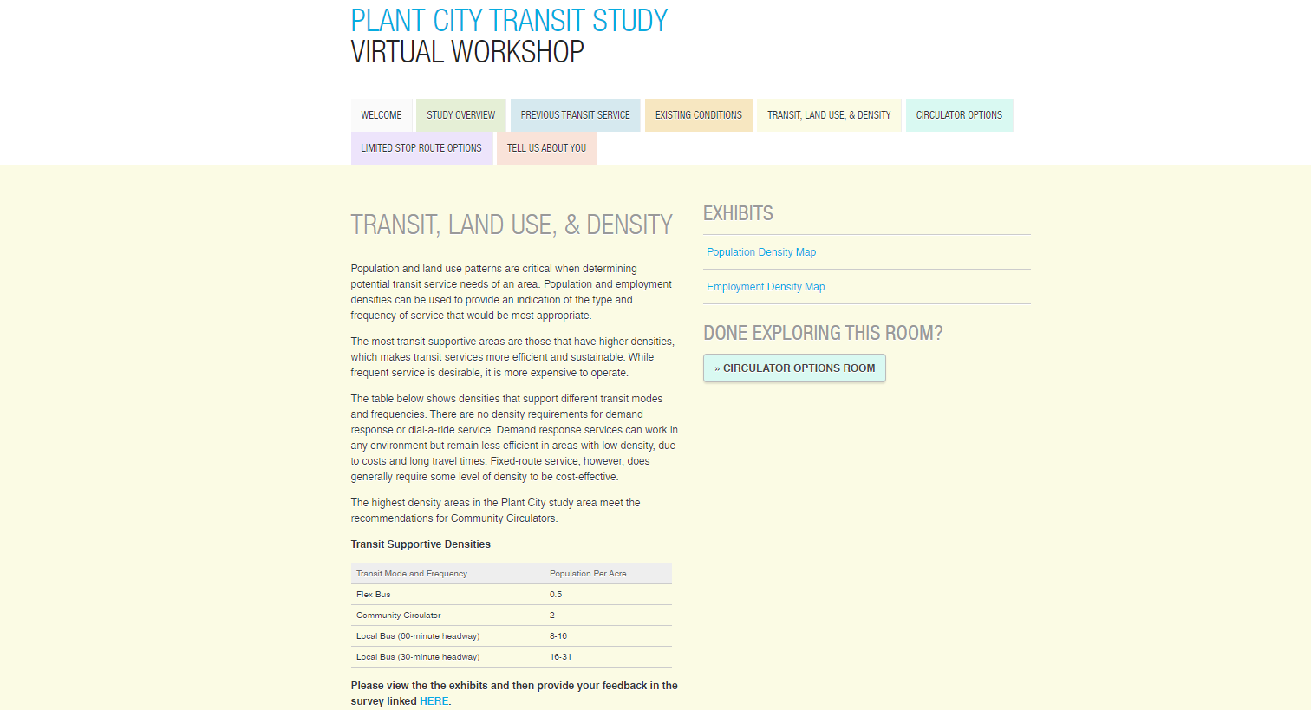
Survey
Notes:
This is how the Transit Land Use and Density tab will look like. Where you will get more idea about the population and employment patterns.

Slide 22
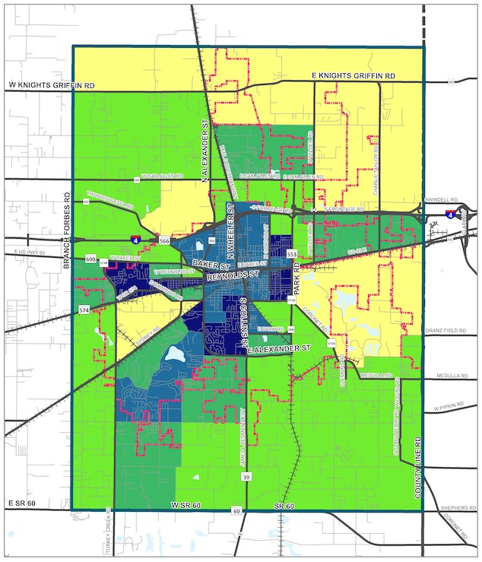
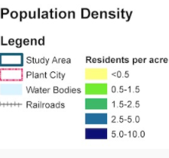
Population Density
39,156 residents, as of 2018 according to U.S. Census Bureau
One of the most important factors for a successful transit service
Mostly residential in the core of Plant City
Population density varies from 5 to 2.5 residents per acre, near downtown and reduces
Beyond the city, single family residential uses have about 1.5 residents per acre
Major corridors Park Rd, S Collins St, Alexander St, Reynolds St, and Baker St.
Notes:
AS of 2018, there are more than 39000 residents in PC. Population density is very essential to support transit service
The downtown core is mostly residential, and density varies from 5 to 2.5 residents per acre as you move away from downtown, it further reduces to 1.5 per acre beyond the city core.
Just FYI The Hillsborough MPO forecasts that by 2045, Plant City’s population may reach 75,400 people, a nearly 50 percent increase over present day figures

Slide 23
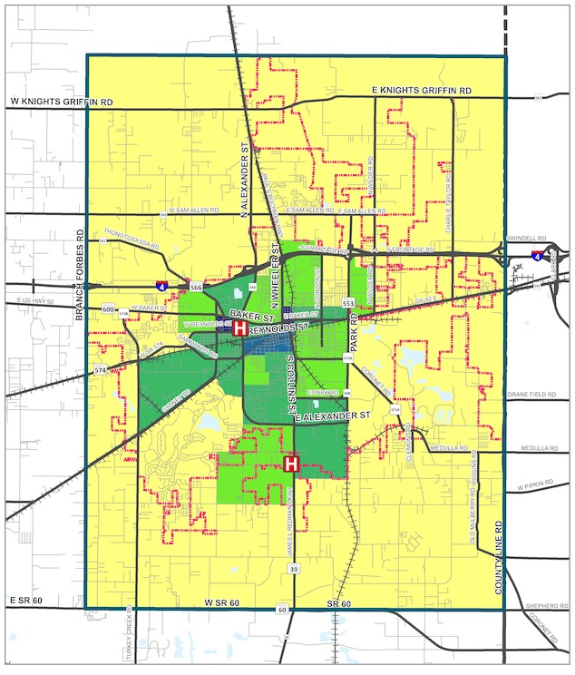
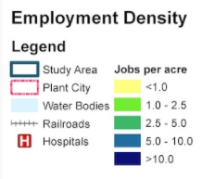
Employment Density
17,477 jobs as of 2018, according to U.S. Census Bureau
Employment areas concentrated in the center of the city
Highest concentration of jobs along Reynolds Street and biggest employer South Florida Baptist Hospital
Large cluster of warehouse employment activities along County Line Rd closer to Polk County.
Recommended transit supporting densities
8-16 for 60-minute headway (local bus)
16-31 for 30-minute headway (local bus)*
* Source: Transit Cooperative Research Program and Ohio Department of Transportation
Notes:
Over 17000 jobs as of 2018
Employment center concentrated in downtown core, and reduces from core.
Biggest employer is Hospital
Almost all of the areas along the Plant City boundary have employment densities of less than 1 employee per acre
The Hillsborough MPO forecasts that by 2045, Plant City’s employment may reach 88,400, an 80 percent increase over present day figures. Much of the growth is concentrated along the eastern boundary of the study area, and the eastern border of Hillsborough County.
From here we move on to the alternative analysis.
Moving to Vishaka

Slide 24
CIRCULATOR ALTERNATIVES
PLANT CITY TRANSIT STUDY
Notes:
Vishaka –
A local circulator service was one of the transit service options evaluated as part of this study. The alternatives evaluated were developed through input from stakeholders, the public, and research on the previous circulator service.

Slide 25
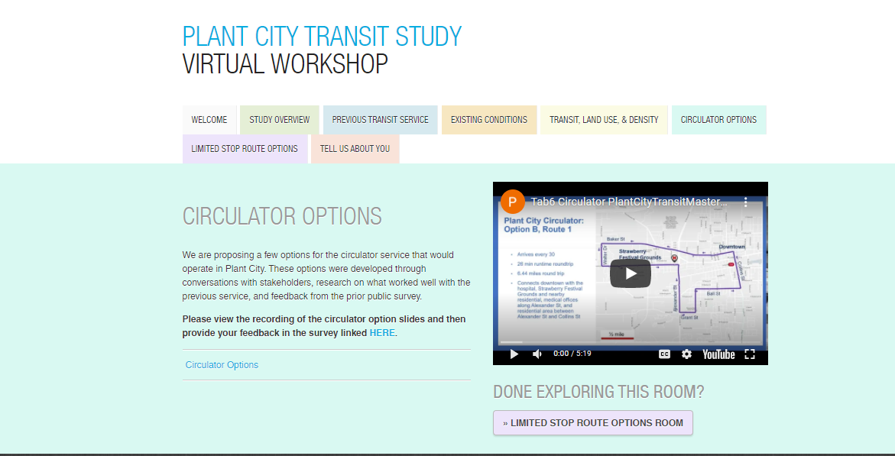
Survey
Notes:
This is the local circulator tab where you can see the various alternatives that the study team analyzed. Please provide your feedback at the bottom of the page

Slide 26
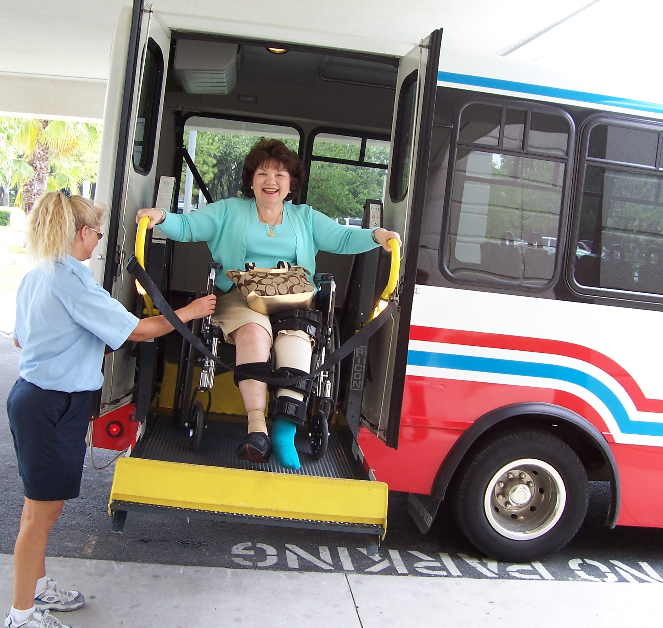
Transit Alternative Goals
Implement useful and reliable service for people who need it most (Communities of Concern & persons with disabilities)
Use transit to incentivize development downtown
Connect Plant City to Tampa and Lakeland/Polk County with transit
Notes:
Through stakeholder meetings and public input, these 3 goals were identified to help guide the identification of circulator route alternatives.

Slide 27
Assumptions
$600K capital cost for each new bus
Paratransit costs are an additional 12% of operating costs
Operates from 6 am to 10 pm
7 days/week
Note: All costs are planning-level cost estimates. Any route will require more in-depth analysis by HART staff for more detailed cost estimates.
Notes:
To evaluate the circulator options, the following assumptions were made
You will only qualify for paratransit if you have difficulty using public transportation because of your disability to provide door to door service.

Slide 28
Plant City Circulator: Option A
Baker St
Walter Dr
Strawberry Festival Grounds
Downtown
Knight St
Reynolds St
1 route
1 bus
Arrives every 60 min
50 min runtime roundtrip
10.7 miles round trip
Connects residential areas with hospital, medical facilities, downtown, and shopping plazas along Redman Pkwy
Redman Pkwy
½ mile
Walmart
Notes:
The first option evaluated, option A, is a combination of two of the more popular routes (70 and 71) from the previous service. This option would be one route with one bus that arrives every 60 minutes. The roundtrip runtime would be about 50 minutes and it would connect the residences and hospitals, downtown to the hospital, Strawberry Festival Grounds, and shopping plazas along Redman Pkwy.

Slide 29
Plant City Circulator – Option A
Baker St
Walter Dr
Strawberry Festival Grounds
Downtown
Performance Measures
Annual Operating Cost | $600 - $650K
Paratransit Cost | $72K-78K
Cost per Day | Weekday: $7K Weekend: $7K
Frequency | 60 min
Travel Time (round trip) | 50 min
Connection to other routes | Limited stop alternatives
# of people within ½ mile | 10,056
# of jobs within ½ mile | 4,942
% in poverty within ½ mile | 18.74
% minority within ½ mile | 64.7%
% seniors within ½ mile | 11.2%
% no vehicles within ½ mile | 9.0%
Knight St
Reynolds St
Redman Pkwy
½ mile
Walmart
Notes:
This service would cost roughly $600-650K per year with an additional paratransit cost of $72K to 78K per year.
It will serve 10,000 people within ½ mile radius.

Slide 30
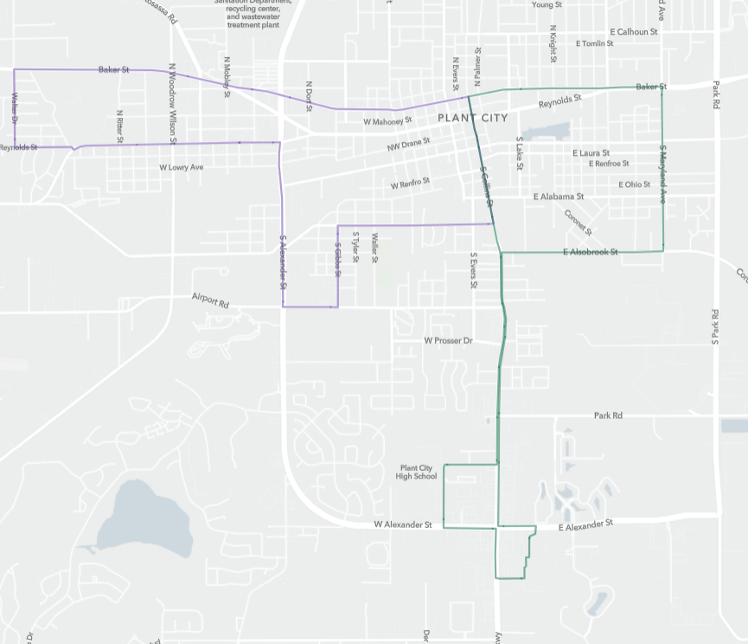
Plant City Circulator: Option B
Baker St
Walter Dr
Baker St
Strawberry Festival Grounds
Downtown
Collins St
Maryland Ave
Ball St
2 routes
1 bus per route
Splits Option A into 2 routes and covers more area
Alexander St
Alsobrook St
Grant St
Redman Pkwy
Plant City High School
Walmart
½ mile
Notes:
The second option splits the first option into two routes and expands the areas reached by transit service.

Slide 31
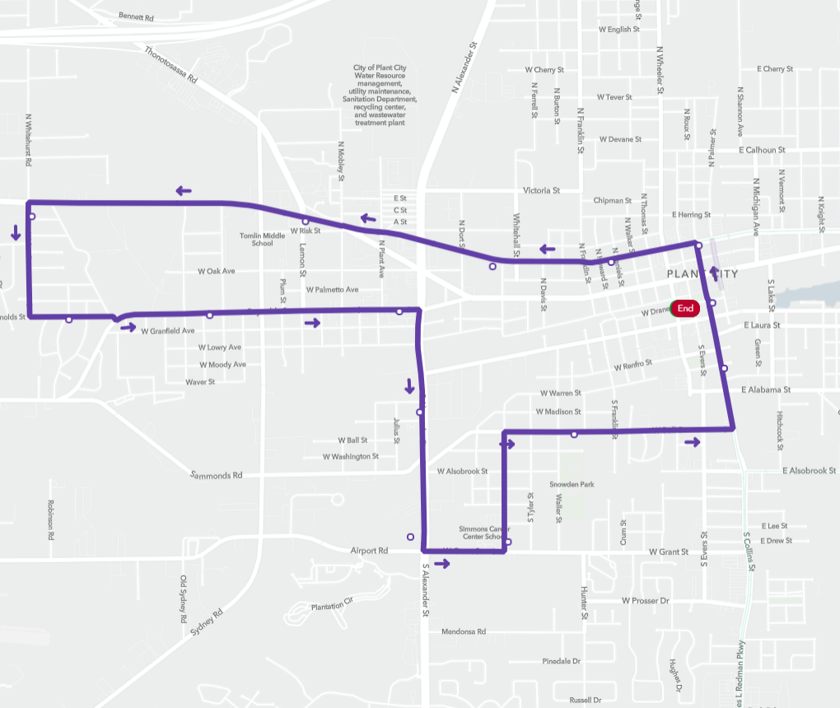
Plant City Circulator: Option B, Route 1
Baker St
Downtown
Walter Dr
Strawberry Festival Grounds
Arrives every 30 min
26 min runtime roundtrip
6.44 miles round trip
Connects downtown with the hospital, Strawberry Festival Grounds and nearby residential, medical offices along Alexander St, and residential area between Alexander St and Collins St
Collins St
Alexander St
Ball St
Grant St
½ mile
Notes:
The first route in Option B would start from downtown near McCall park and head west along Baker St toward the Strawberry Festival Grounds. And the residential area just to the west. It would loop back east passing by the hospital and the medical offices along Alexander St. It would cut back east towards downtown along Grant St and Ball St, and finally up Collins St to McCall Park.

Slide 32
Plant City Circulator: Option B, Route 1
Performance Measures
Annual Operating Cost | $600K - $650K
Paratransit Cost | $72-78K
Cost per Day | Weekday: $6K Weekend: $6K
Frequency | 30 min
Travel Time (round trip) | 26 min
Connection to other routes | Proposed circulator alternatives & limited stop alts.
# of people within ½ mile | 12,358
# of jobs within ½ mile | 5,521
% in poverty within ½ mile | 17.8%
% minority within ½ mile | 61.9%
% seniors within ½ mile | 12.5%
% no vehicles within ½ mile | 8.5%
Baker St
Downtown
Walter Dr
Strawberry Festival Grounds
Collins St
Alexander St
Ball St
Grant St
½ mile
Notes:
It would arrive every 30 min with a round trip travel time of 26 min. The annual cost of the service would be between $600-650K per year, plus paratransit costs of $72-78K annually.

Slide 33
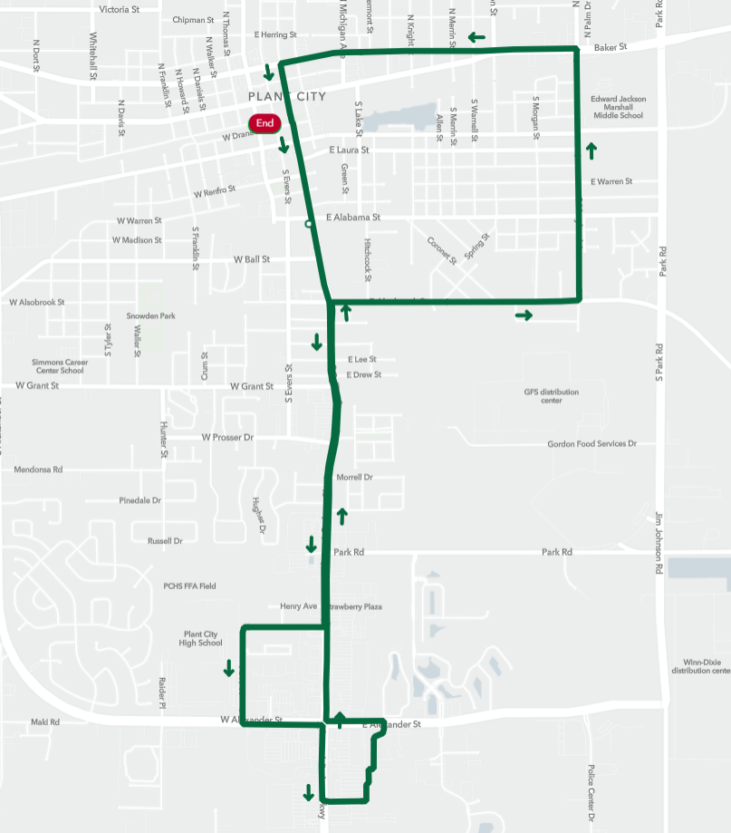
Baker St
Plant City Circulator: Option B, Route 2
Downtown
Maryland Ave
Collins St
Arrives every 40 min
30 min runtime roundtrip
7 miles round trip
Connects downtown, residential areas, and shopping plazas along Redman Pkwy to the Walmart on the south
Alsobrook St
Redman Pkwy
½ mile
Walmart
Notes:
The second route in option B would also start near McCall Park in downtown. It would head south down Collins St towards the shopping plazas along Redman Pkwy. It was deviated to pass more closely by Plant City High School and then back to Redman Pkwy to the Walmart. It would then head back up Redman Pkwy and head east along Alsobrook to reach the residential area between Maryland Ave and Collins St. It would then head west along Baker St and back down Collins St to McCall Park.

Slide 34
Plant City Circulator: Option B, Route 2
Baker St
Downtown
Performance Measures
Annual Operating Cost | $520K - $570K
Paratransit Cost | $62K-68K
Cost per Day | Weekday: $4,300 Weekend: $4,300
Frequency | 40 min
Travel Time (round trip) | 30 min
Connection to other routes | Proposed circulator alternatives & limited stop alts
# of people within ½ mile | 10,594
# of jobs within ½ mile | 3,959
% in poverty within ½ mile | 21.5%
% minority within ½ mile | 59.7%
% seniors within ½ mile | 14.8%
% no vehicles within ½ mile | 8.5%
Maryland Ave
Collins St
Alsobrook St
Redman Pkwy
½ mile
Walmart
Notes:
This route would arrive every 40 min with a round trip travel time of 30 min. The annual cost would be in the range of $520K to 570K with a paratransit cost of $62K-68K per year.

Slide 35
CIRCULATOR MATRIX
Performance Measures | Option A | Option B, Routes 1 & 2
Annual Operating Cost | $600 - $650K | $1.12M-$1.22M
Paratransit Cost | $72K-78K | $136K-146K
# of vehicles | 1 | 2
Frequency | 60 min | 30 min (route 1) 40 min (route 2)
Travel Time (round trip) | 50 min | 25 min (route 1) 30 min (route 2)
Connection to other routes | Limited stop alternatives | Limited stop alternatives
# of people within ½ mile | 10,056 | 18,741
# of jobs within ½ mile | 4,942 | 7,737
% in poverty within ½ mile | 18.74% | 19.2%
% minority within ½ mile | 64.7% | 61.5%
% seniors within ½ mile | 11.2% | 13.5%
% households w/no vehicles within ½ mile | 9.0% | 8.2%
Notes:
In comparing the two circulator options, Option A would cost about half as much as Option B. However Option B reaches a greater number of people and jobs within a half-mile radius.

Slide 36
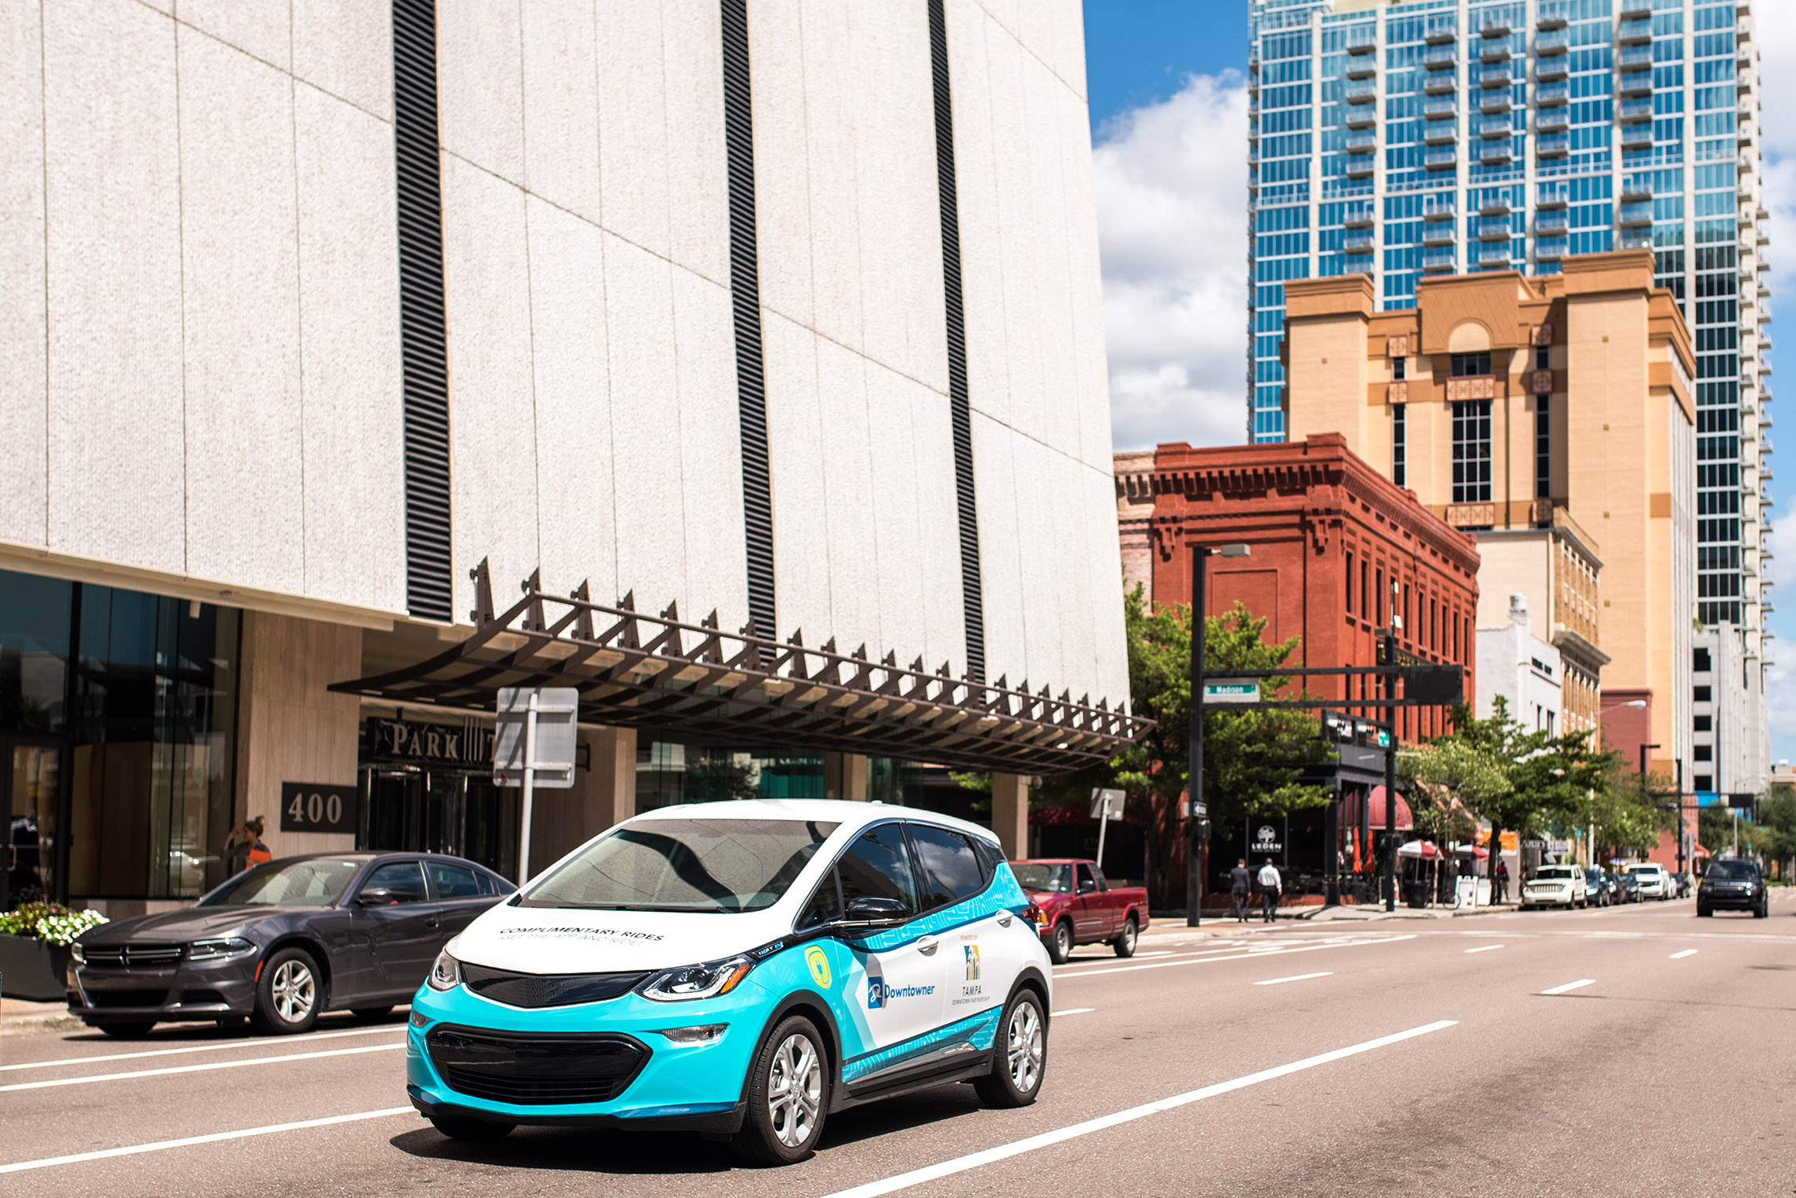
Option C: On-Demand Service
On-demand, point-to-point service
Case Study - Downtowner
Approx. $1.6M per year to operate 6 vehicles in an area the size of downtown Tampa
Metrics specific to downtown Tampa
Funded through a grant with 50% local match
14,010 passengers per month
$5.09 cost per passenger (paid by HART)
Avg wait time: 15 min
Notes:
A 3rd Option to consider is an on-demand flex route similar to the Downtowner in downtown Tampa. This was discussed through conversations and presentations with Plant City as an attractive alternative. For comparison, the Downtowner in Tampa costs approximately $1.6M per year to operate with 6 vehicles covering an area of 2 square miles. In Tampa, this service is partially funded with grant funds from FDOT.

Slide 37
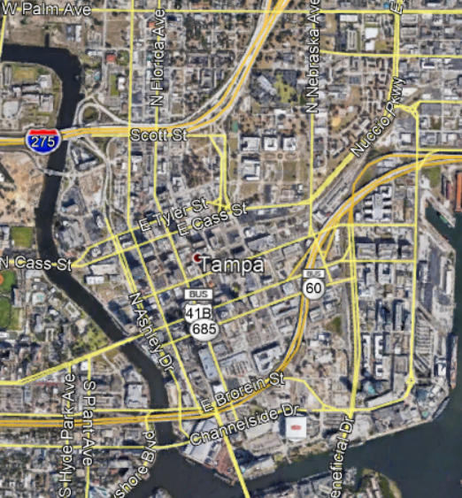
Downtowner Service Area Comparison
1 mile
Notes:
This is roughly the service area covered by the Downtowner in Tampa. – 2 sq miles

Slide 38
Overlay of Downtowner Service Area in
Plant City
1 mile
Notes:
This is the same size area at the same scale in Plant City if the downtowner were to operate in Plant City. By comparison, there is a much smaller number of people in this area than in downtown Tampa, so ridership would likely be lower than the Downtowner sees in Tampa. Expanding beyond these boundaries would add additional costs to the $1.6M per year operating cost.
If you have any questions at this time, we can take them.
Handing it over to Nicole.

Slide 39
LIMITED STOP ROUTE ALTERNATIVES
PLANT CITY TRANSIT STUDY
Notes:
Nicole will talk
A limited stop service was one of the transit service options evaluated as part of this study. The alternatives evaluated were developed through input from stakeholders, the public, and research on the previous circulator service.

Slide 40
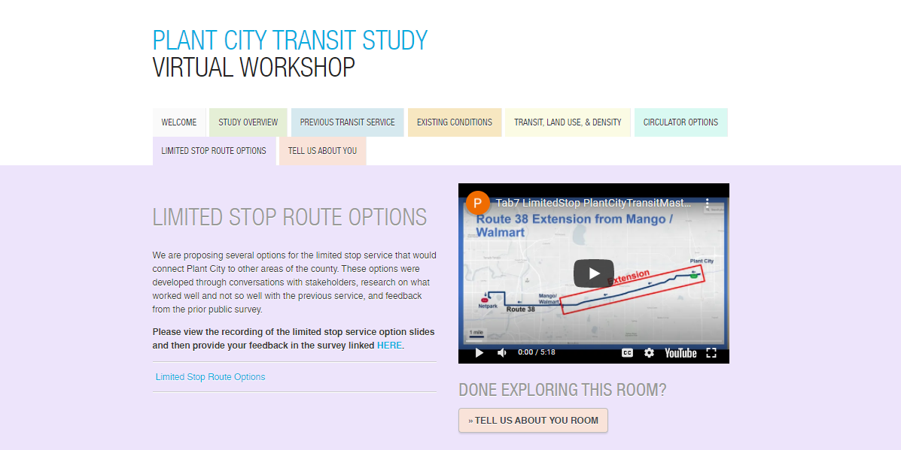
Survey
Notes:
This is how the limited options tab would look like. We evaluated 5 options to connect to Tampa from Plant City and an additional option that would connect to downtown Lakeland.

Slide 41
Transit Alternative Goals
Implement useful and reliable service for people who need it most (Communities of Concern & persons with disabilities)
Use transit to incentivize development downtown
Connect Plant City to Tampa and Lakeland/Polk County with transit
Notes:
Through stakeholder meetings, these 3 goals were identified to help guide the identification of route alternatives. Collective goals of transit
Quick service from PC to Tampa and possibly to Polk County/ Lakeland,
Help people access jobs and destinations in Tampa and Lakeland

Slide 42
Assumptions
$600K capital cost for each new bus
Each route would require 2 buses
Operates Monday – Friday
6:00 am to 8:00 pm
Sat/Sun
10:00 am to 8:00 pm
Note: All costs are planning-level cost estimates. Any route will require more in-depth analysis by HART staff for more detailed cost estimates.
Notes:
To evaluate the limited stop options, the following assumptions were made

Slide 43
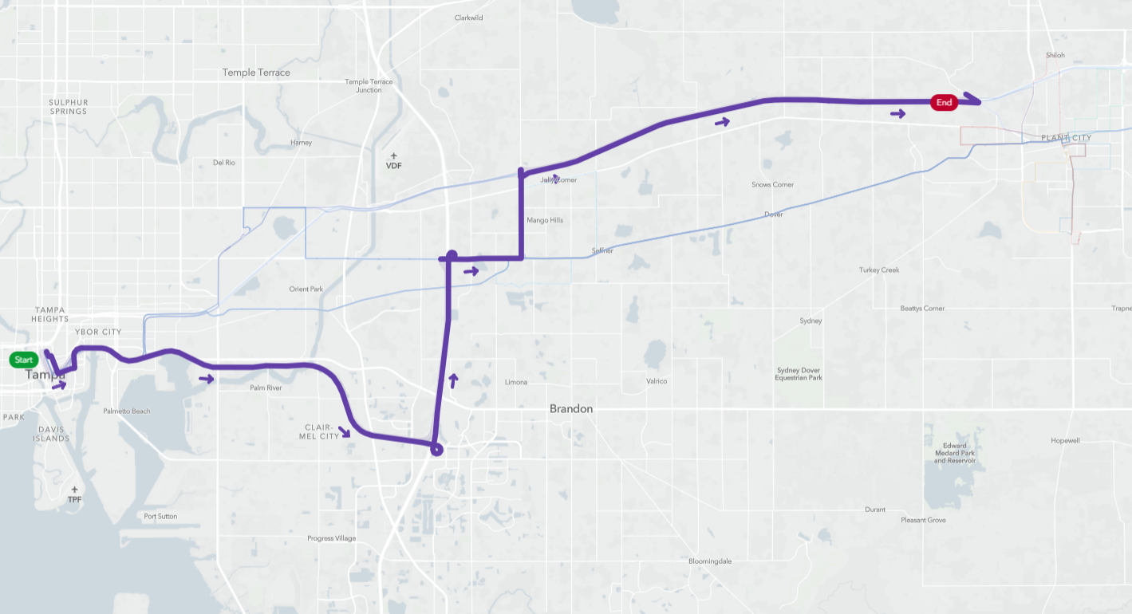
Route 28X
(Previous Service)
Plant City
Downtown Tampa
Notes:
The first route evaluated was the previous 28X park and ride service that picked up passengers off of Thonotasassa Rd. It connected south near Brandon and then west along the Selmon Expressway to downtown Tampa.

Slide 44
Route 28X
(Previous Service)
Plant City
Performance Measures
Annual Operating Cost | $950K-1.25M
Cost per Day | Weekday: $3,000 Sat/Sun: $2,228
Frequency | 45 min
Travel Time (one way) | 45 min
Distance Traveled; 2 veh (round trip) | 53.6 miles
Transfers to get to Downtown Tampa | 0
# of people within ½ mile | 44,596
# of jobs within ½ mile | 104,602
% in poverty within ½ mile | 20.6%
% minority within ½ mile | 55%
% seniors within ½ mile | 10.1%
% no vehicles within ½ mile | 9.9%
Downtown Tampa
Operates:
Monday – Friday 6 am to 8 pm
Sat/Sun - 10 am to 8 pm
Note: All costs are planning-level cost estimates. Any route will require more in-depth analysis by HART staff for more detailed cost estimates.
Notes:
This route is estimated to arrive every 45 min and have a one way travel time of 45 min. The service would cost roughly $950K-1.25M per year.

Slide 45
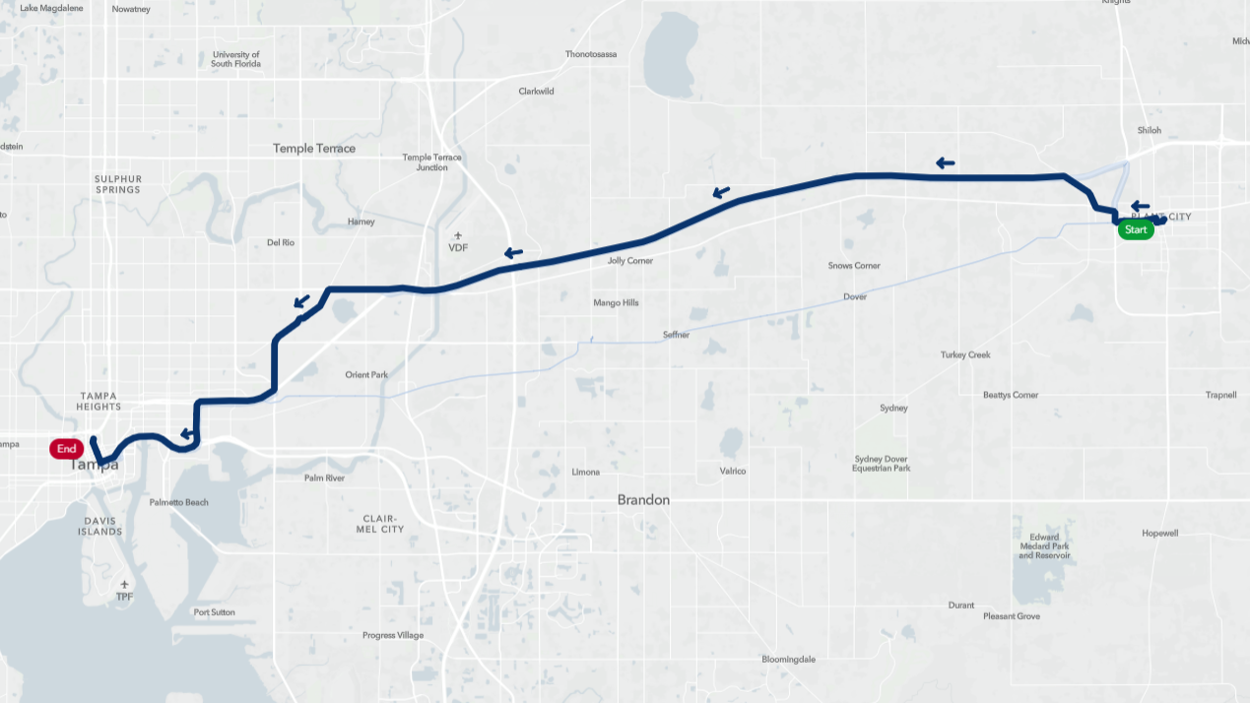
TPA > Plant City VIA I-4
Plant City
Netpark
Downtown Tampa
Notes:
The second limited stop option would connect Plant City to Tampa along I-4 with a stop at Netpark, which is a major transfer hub for HART. This would give Plant City residents access to other destinations around the county, besides downtown Tampa.

Slide 46
TPA > Plant City VIA I-4
Plant City
Performance Measures
Annual Operating Cost | $950K-1.25M
Cost per Day | Weekdays: $2,800 Sat/Sun: $2,800
Frequency | 45 min
Travel Time (one way) | 45 min
Distance Traveled; 2 veh (round trip) | 49.67 miles
Transfers to get to Downtown Tampa | 0
# of people within ½ mile | 15,509
# of jobs within ½ mile | 77,783
% in poverty within ½ mile | 24.7%
% minority within ½ mile | 58.6%
% seniors within ½ mile | 12.9%
% no vehicles within ½ mile | 13.6%
Netpark
Plant City
Downtown Tampa
Operates:
Monday – Friday 6 am to 8 pm
Sat/Sun - 10 am to 8 pm
Note: All costs are planning-level cost estimates. Any route will require more in-depth analysis by HART staff for more detailed cost estimates.
Notes:
This service would also roughly cost $950K to 1.25M per year to operated. It would arrive every 45 min and travel time from Plant City to Tampa would be roughly 45 min.

Slide 47
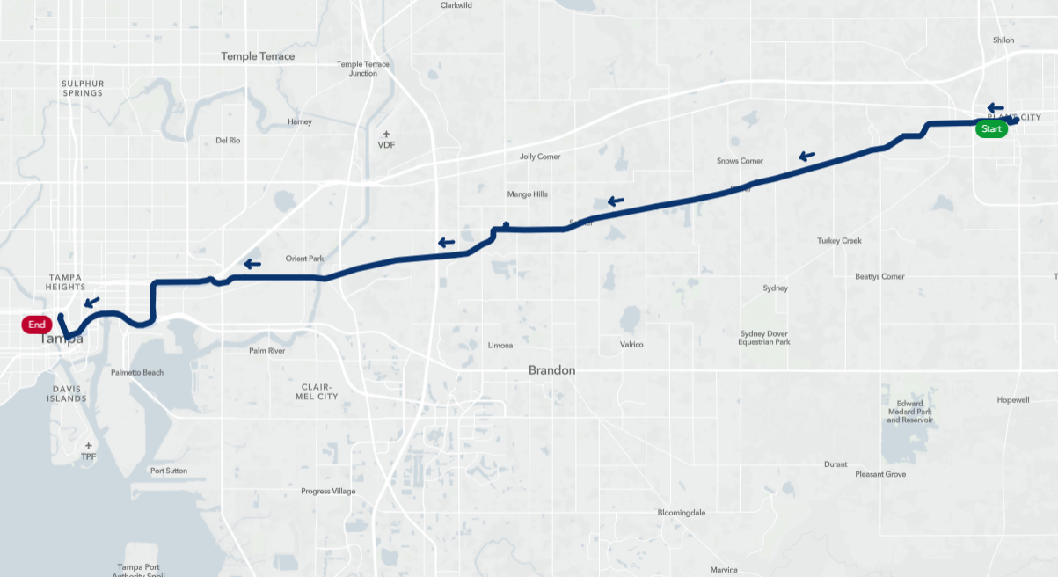
TPA > Mango > Plant City VIA MLK
Plant City
Mango/Walmart
50th St
Downtown Tampa
Notes:
A 3rd option would connect Plant city to downtown Tampa by a route along MLK. It would stop at the Walmart in Mango, which allows Plant City riders to transfer to Route 38 if not heading to downtown. It would then travel on along MLK to the Selmon Expressway and on to downtown Tampa

Slide 48
TPA > Mango > Plant City VIA MLK
Performance Measures
Annual Operating Cost | $900-950K
Cost per Day | Weekdays: $2,700 Sat/Sun: $2K
Frequency | 60 min
Travel Time (one way) | 50 min
Distance Traveled; 2 veh (round trip) | 46.3 miles
Transfers to get to Downtown Tampa | 0
# of people within ½ mile | 19,848
# of jobs within ½ mile | 70,672
% in poverty within ½ mile | 20%
% minority within ½ mile | 50.9%
% seniors within ½ mile | 10.5%
% no vehicles within ½ mile | 11.9%
Plant City
Mango/Walmart
Plant City
Mango
50th St
Downtown Tampa
Operates:
Monday – Friday 6 am to 8 pm
Sat/Sun - 10 am to 8 pm
Note: All costs are planning-level cost estimates. Any route will require more in-depth analysis by HART staff for more detailed cost estimates.
Notes:
This service would be slightly less than the previous two routes with an estimated annual cost of $990-950K. It would arrive every 60 min and have a one way travel time of 50 min.

Slide 49
Route 38 Extension from Mango / Walmart
Plant City
Extension
Mango/Walmart
Netpark
Route 38
1 mile
Notes:
A 4th option is an extension of the existing Route 38 which operates between the Netpark transfer facility to the Walmart in Mango. This extension would extend the route from the Walmart along MLK to downtown Plant City.

Slide 50
Route 38 Extension from Mango / Walmart
Performance Measures
Annual Operating Cost | $950K-1M
Cost per Day | Weekdays: $3K Sat/Sun: $2,250
Frequency | 60 min
Travel Time (one way) | 50 min
Distance Traveled; 2 veh (round trip) | 37.7 miles
Transfers to get to Downtown Tampa | 1
# of people within ½ mile | 6,644
# of jobs within ½ mile | 11,685
% in poverty within ½ mile | 19.4%
% minority within ½ mile | 62.1%
% seniors within ½ mile | 11.1%
% no vehicles within ½ mile | 9.0%
Plant City
Extension
Mango/Walmart
Netpark
Operates:
Monday – Friday 6 am to 8 pm
Sat/Sun - 10 am to 8 pm
Note: All costs are planning-level cost estimates. Any route will require more in-depth analysis by HART staff for more detailed cost estimates.
Notes:
This route would cost roughly $950K-1M per year to operate. It would arrive every 60 min with a 50 min one way travel time.. It would require Plant City riders to transfer either at the Mango Walmart or the Netpark facility to get to downtown Tampa or elsewhere in the county. Passengers make take 1 transfer if they have to come to downtown, but 2 transfer hubs.

Slide 51
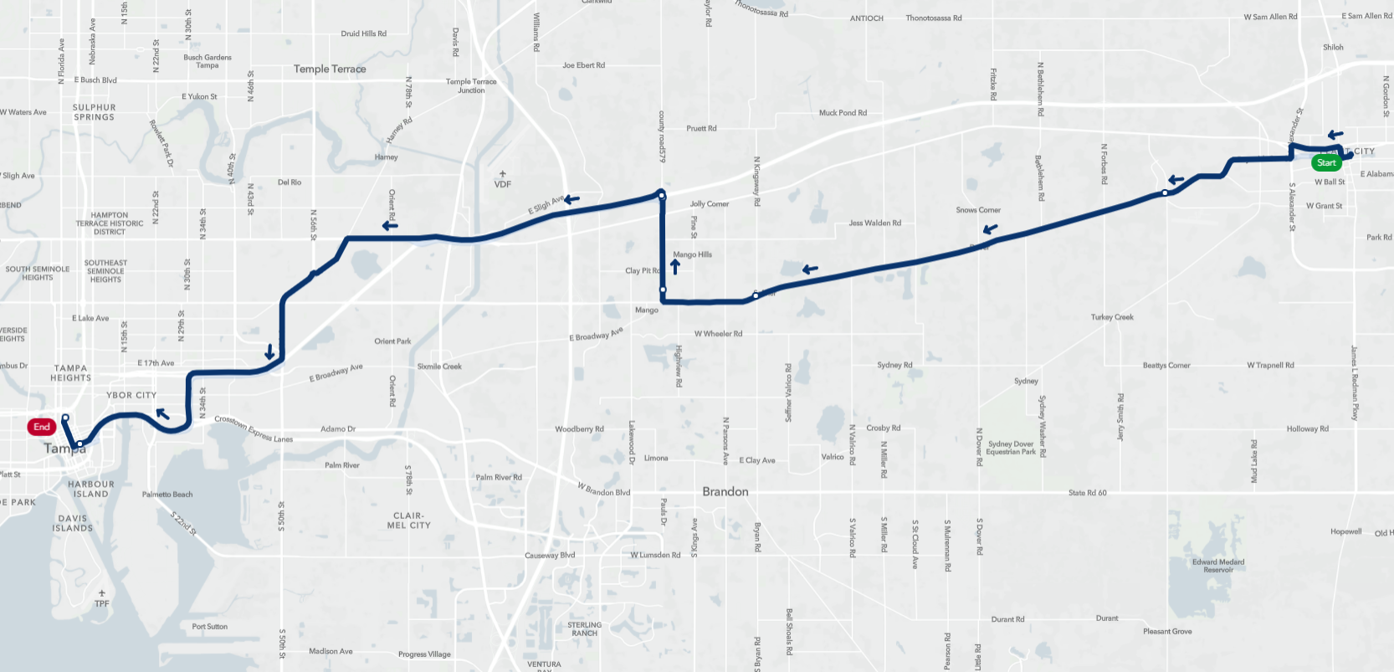
TPA > Plant City VIA I-4 & MLK
Netpark
Plant City
Mango/Walmart
Downtown Tampa
Notes:
A final option connecting Plant City to Tampa would be a mix of the I-4 and MLK routes. This route would head west from downtown Plant City along MLK towards the Mango Walmart. From there it would head north to I-4 where it would stop at Netpark. From Netpark it would head into downtown Tampa.

Slide 52
TPA > Plant City VIA I-4 & MLK
Performance Measures
Annual Operating Cost | $950K - $1M
Cost per Day | Weekdays: $3K Sat/Sun: $2,250
Frequency | 60 min
Travel Time (one-way) | 50 min
Distance Traveled; 2 veh (round trip) | 52.18 miles
Transfers to get to Downtown | 0
# of people within ½ mile | 20,734
# of jobs within ½ mile | 77,458
% in poverty within ½ mile | 21.5%
% minority within ½ mile | 55.7%
% seniors within ½ mile | 12.6%
% no vehicles within ½ mile | 12.9%
Netpark
Plant City
Mango/Walmart
Downtown Tampa
Operates:
Monday – Friday 6 am to 8 pm
Sat/Sun - 10 am to 8 pm
Note: All costs are planning-level cost estimates. Any route will require more in-depth analysis by HART staff for more detailed cost estimates.
Notes:
This route would also cost roughly $950K to 1M per year. It would arrive every 60 min and have a one way travel time of 50 min. No transfers to downtown, but they can connect at Netpark if needed to other places.

Slide 53
TPA> Plant City
Limited Stop Route Comparison
Performance Measures | 28X | I-4 | MLK | Rt. 38 Ext | I-4 + MLK
Annual Operating Cost | $950K-1.25M | $950K-1.25M | $900-950K | $950K-1M | $950K - $1M
Cost per Day | Weekday: $3K Sat/Sun: $2,228 | Weekdays: $2,800 Sat/Sun: $2,800 | Weekdays: $2,700 Sat/Sun: $2K | Weekdays: $3K Sat/Sun: $2,250 | Weekdays: $3K Sat/Sun: $2,250
Frequency | 45 min | 45 min | 60 min | 60 min | 60 min
Travel Time (one-way) | 45 min | 40 min | 50 min | 50 min | 50 min
Distance Traveled; 2 veh (round trip) | 53.6 miles | 49.67 miles | 46.3 miles | 37.7 miles | 52.18 miles
Transfers to get to Downtown Tampa | 0 | 0 | 0 | 1 | 0
# of people within ½ mile | 44,596 | 15,509 | 19,848 | 6,644 | 20,734
# of jobs within ½ mile | 104,602 | 77,783 | 70,672 | 11,685 | 77,458
% in poverty within ½ mile | 20.6% | 24.7% | 20% | 19.4% | 21.5%
% minority within ½ mile | 55% | 58.6% | 50.9% | 62.1% | 55.7%
% seniors within ½ mile | 10.1% | 12.9% | 10.5% | 11.1% | 12.6%
% no vehicles within ½ mile | 9.9% | 13.6% | 11.9% | 9.0% | 12.9%
Notes:
A side-by-side comparison of the limited stop options shows the costs of each, which are all roughly in the same ballpark. Some routes would arrive more frequently and have fewer stops, while others may be more costly but reach more people and jobs.
Limited stop
28x: 53.6 mi; 2 vehicles
Via I-4: 49.67 mi; 2 vehicles
Via MLK: 46.3 mi 2 vehicles
Rt 38 extension: 37.7 mi; 2 vehicles
Via I-4+MLK: 52.18 mi; 2 vehicles

Slide 54
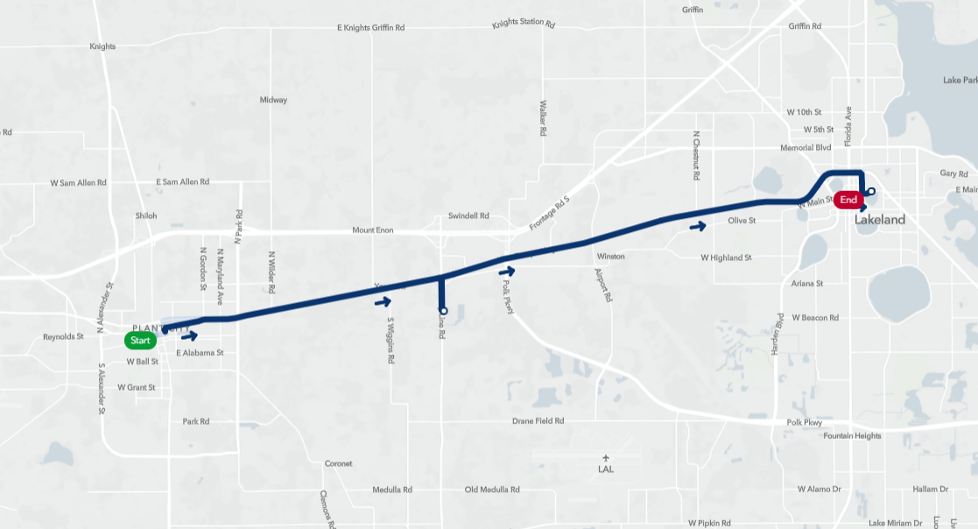
Plant City > Amazon > Lakeland
Lakeland
Plant City
Notes:
Lastly, for comparison purposes, we evaluated a route that connects downtown Plant City to downtown Lakeland, with a stop at the Amazon distribution center in between. Implementation of this route would require the coordination of HART, Plant City, and Citrus Connection in Polk County.
Would have to be coordinated with Citrus Connection

Slide 55
Plant City > Amazon > Lakeland
Performance Measures
Annual Operating Cost | $460K - $510K
Cost per Day | Weekday: $1,400 Sat/Sun: $1K
Frequency | 60 min
Travel Time (one way) | 25 min
Distance Traveled; 1 veh (round trip) | 24.84 miles
Connection to other routes | Circulators, limited stop routes
# of people within ½ mile | 4,955
# of jobs within ½ mile | 8,416
% in poverty within ½ mile | 23.3%
% minority within ½ mile | 47.1%
% seniors within ½ mile | 17.1%
% no vehicles within ½ mile | 19.5%
Lakeland
Plant City
Operates:
Monday – Friday 6 am to 8 pm
Sat/Sun - 10 am to 8 pm
Note: All costs are planning-level cost estimates. Any route will require more in-depth analysis by HART staff for more detailed cost estimates.
Notes:
This route, operating at the same days and times as the previous limited stop options, would cost roughly $460K-510K per year. It would arrive every 60 min and have a one way travel time of 25 min.

Slide 56
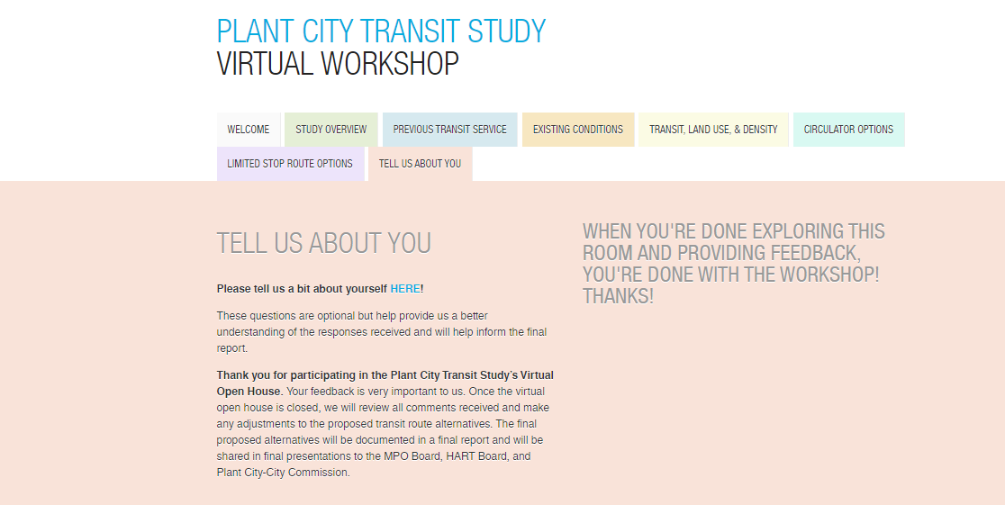
Notes:
Your feedback is very important.
Please take your time to take this survey.
You can contact us for more questions.

Slide 57
Thank you
Please provide your feedback at the link below
https://tinyurl.com/PlantCityTransitStudy
Vishaka Shiva Raman
ShivaRamanV@plancom.org
813.273.3774 × 350
Nicole McCleary
McClearyN@gohart.org
813.384.6358
Notes:
Thank you.
Contact info is provided for any additional info.
Please provide your feedback at the link given.
We can take any questions if you have.

