Slide 1

MPO Regional Coordination Structure & Best Practices Research
Ramond Chiaramonte, FAICP
Executive Director

Slide 2
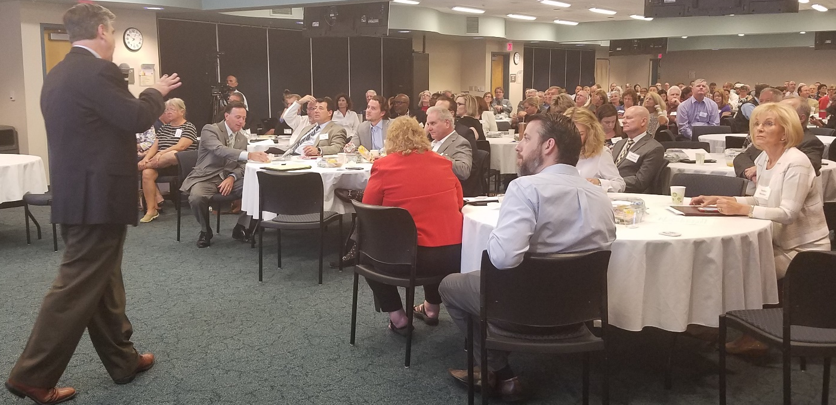
Study Overview
Builds on results of May 2017 Collaborative Labs workshop;
Define what successful regional coordination means for Tampa Bay;
Identify the barriers to its execution;
Examine feasibility of MPO merger;
Develop viable options; and,
Build consensus on a preferred regional coordination framework
www.pedbikeimages.org/Laura Sandt

Slide 3
Study Overview: Three Phases
Phase I
Outline existing conditions; and
Phase II
Phase III
Validate project parameters/goals;
Identify relevant peer regions and MPOs;
Develop case studies
Project Symposium(s) to build support for viable options;
Refine and screen alternatives;
County and State Level Policy Characterizations
Develop implementation guidance for best options
www.pedbikeimages.org/Laura Sandt

Slide 4
Phase I (in process)
Outline the existing conditions and regional coordination process
Summarize key areas of interest from May 2017 workshop
Hold MPO Listening Sessions with Directors and elected officials:
How are projects identified and prioritized?
Structure of governance – municipal, county and regional
Funding sources and uses – benefits and drawbacks
www.pedbikeimages.org/Laura Sandt

Slide 5
Phase II (February to April ‘18)
Case Studies and Best Practices
Use results from Collaborative Workshop I and Research Phase I to:
A. Compare coordination efforts and outcomes with peer regions to Tampa Bay, and their MPO structures;
B. Highlight key findings according to principles and definition of success from Workshop I;
C. Outline several options for a stronger regional coordination framework, and MPO merger
www.pedbikeimages.org/Laura Sandt

Slide 6
Phase III: Bringing It All Together (May to Nov. ‘18)
Second Collaborative Workshop tentatively scheduled for May 18, 2018
  Present and review results of Research Phases I and II;
  Build consensus around viable options for a regional coordination framework and implementation procedures;
Follow up on recommendations with remote polling on key concerns, likes/dislikes, etc.;
A third workshop (September 2018) to follow on implementation oriented issues and concerns for preferred alternatives.
www.pedbikeimages.org/Laura Sandt

Slide 7
Results (Dec. ’18)
Pending results, the Stakeholder Committee, MPOs, FDOT, TBARTA, etc., representatives would gather to discuss revised structures and implementation steps.
Ultimately, any changes in MPO Board composition or geographic area are up to each respective MPO Board to decide, and to reach agreement with the Governor.
www.pedbikeimages.org/Laura Sandt

Slide 8
Study Management Team
A non-voting project advisory group to
  Review and provide feedback on project deliverables;
  Assist TBARTA with agency coordination and communication;
Allows for a larger perspective of MPOs in the Tampa Bay Region, as well as economic development with the Tampa Bay Partnership; and, land development with the Urban Land Institute
Base map source: MPOAC, 2014

Slide 9
2018 SMT Meeting Schedule
January 25, 2018, 1pm to 3pm
February 16, 2018
March 30, 2018
April 20, 2018
May 18, 2018 (Collaborative Workshop #2; location to be decided)
June 22, 2018
July 2018 - Recess
August 17, 2018
September 14, 2018 (Collaborative Workshop #3, if needed; location to be decided)
October 19, 2018
November 16, 2018
December 14, 2018 (Project Closeout Meeting)
MPO Policy Review
Data and Regionalism
All meetings are located at the TBARTA office, from 10am to 12pm, unless otherwise noted

Slide 10
What are We Working On Now?
Phase I: Context, Issues, Structures, Regionalism
Who are the MPOs?
MPO Statutes (Federal & State)
Agencies & Partners
Regional Coordination Now
Core MPO Profiles (boards, staffing, voting/bylaws, etc.)
Define Regionalism
Demographics
Travel Patterns
Geopolitical Boundaries
Regional Structures in Place
Common Issues & Concerns
MPO Policy Review
Data and Regionalism
Results to be reviewed and discussed with SMT on Jan 25, and TBARTA Board on Jan 26, 2018
Notes:
MPO Statutes Related to Organizational Structures and Staffing – federal and state
Transportation Agencies and Responsibilities in Tampa Bay Area
Other Stakeholders
Current Regional Coordination Structures for Entire Tampa Bay Area
Core MPO Profiles (Forward Pinellas, Hillsborough MPO, Pasco County MPO)
MPO History/Background
Demographic/Boundary Information
MPO Governing Board Structure
MPO Committees
MPO Staffing
MPO Funding
Public Participation
MPO Role in Land Use and Economic Development Decision-Making

Slide 11
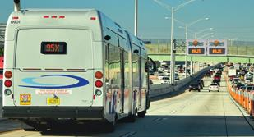

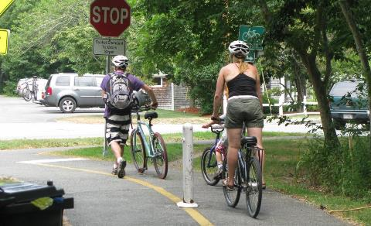
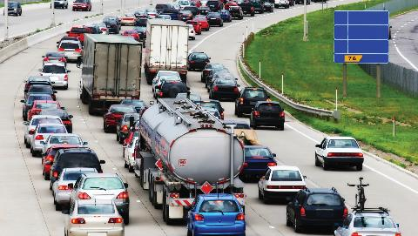
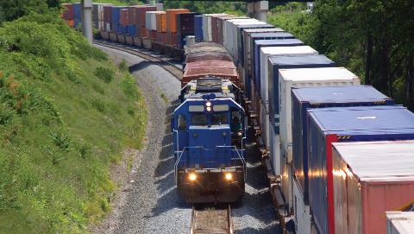
Questions
www.pedbikeimages.org/Laura Sandt

