Slide 2
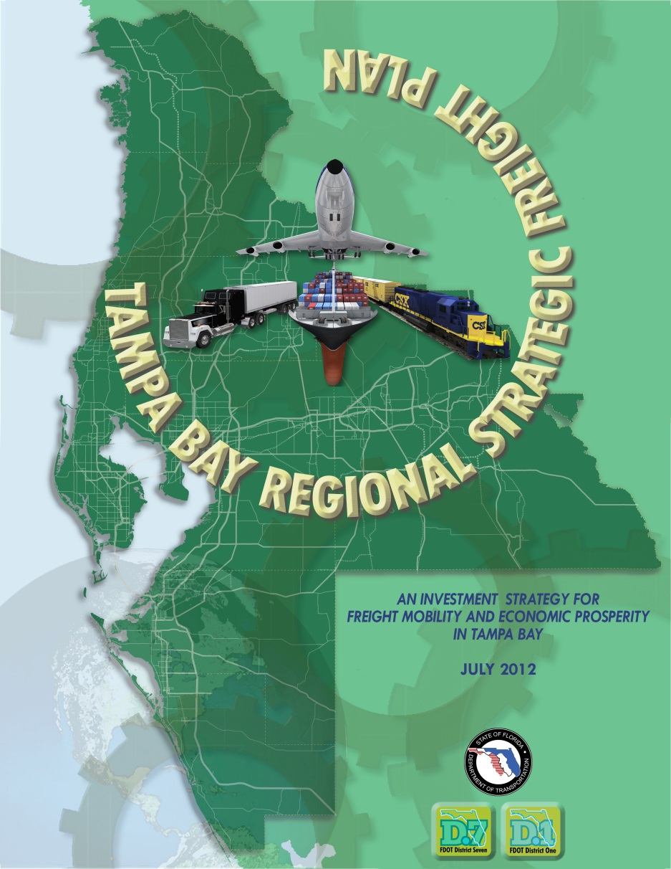
Tampa Bay Regional Strategic Freight Plan
Completed in 2012 with collaboration from MPOs and Local Municipalities from Crystal River to Sarasota.
Currently being updated to reflect current freight industry practices and new local plans i.e. Hillsborough – Polk FLZ Strategic Plan
Guides Implementation from planning to construction
www.tampabayfreight.com

Slide 3
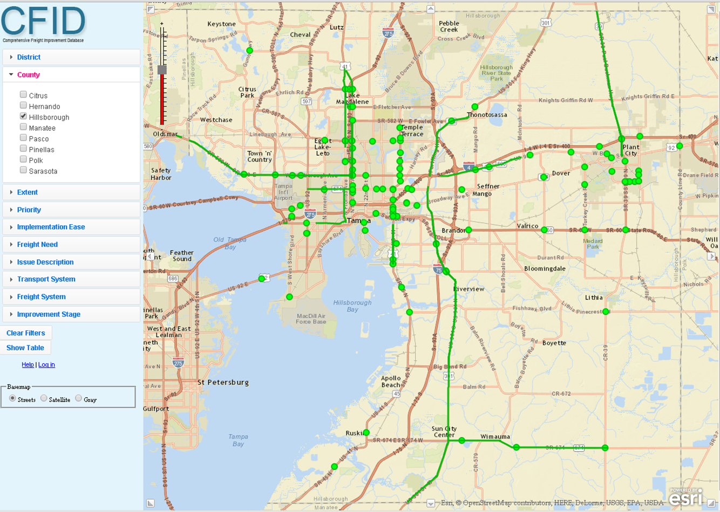
CFID Comprehensive Freight Improvement Database
Database of freight mobility conditions and issues
Allows for queries of freight planning data
Supports planning and project implementation
Issues are collected from Commercial Vehicle Operators in the region

Slide 4
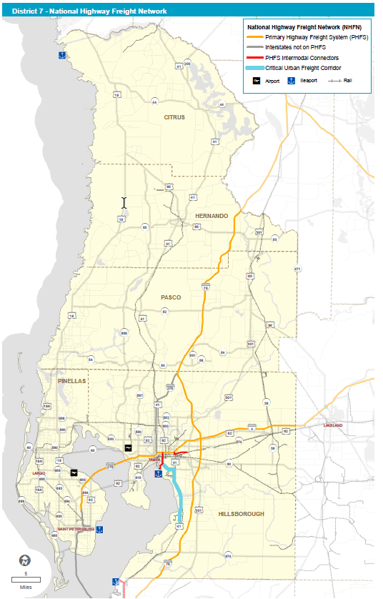
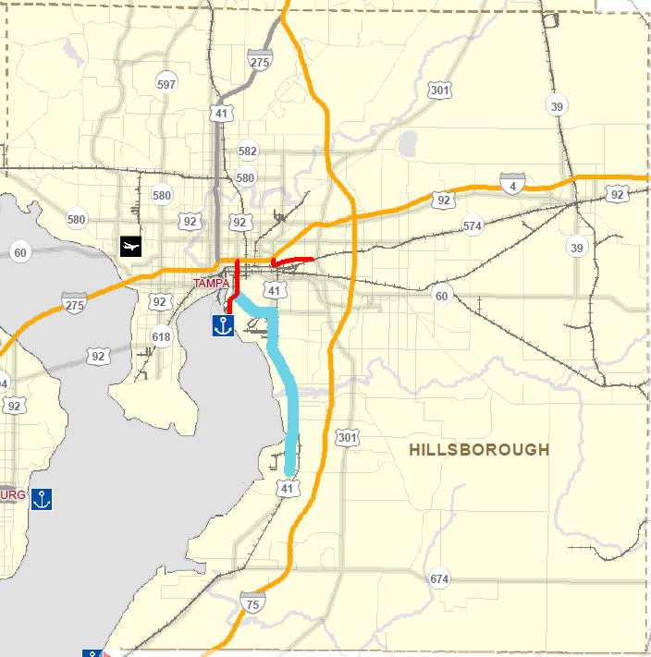
National Highway Freight Network

Slide 5
National Highway Freight Program
Florida Freight Advisory Committee
Eric Lindstrom from Hillsborough County Economic Development – Member
Projects Selected:
I-75 SB Hillsborough County Rest Area Reconstruction and Expansion
I-75 NB on-ramp from US 301
US 41 @ CSX South of Causeway Blvd Grade Separation
Project is now fully funded

Slide 6
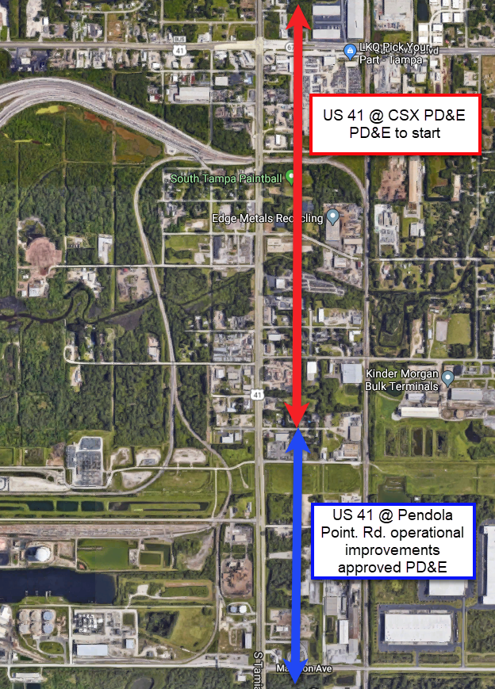
US 41 Freight Improvements
Two projects:
US 41 @ South of Causeway Blvd / CSX RR Crossing
US 41 @ Pendola Point
Public Outreach:
Port of Tampa
City of Tampa
CSX
Hillsborough County
MPO
HART
Local businesses

Slide 7
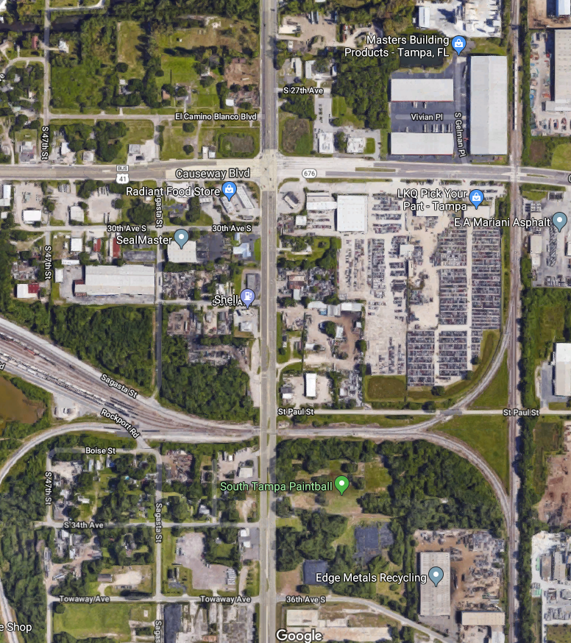
US 41 @ South of Causeway Blvd Project Overview
FPID# 440749-1-22-01
Re-evaluation of Recommendations from 1994 Environmental Document
Add capacity and improve operations at two key intersections near Port Tampa Bay:
New Interchange – US 41 @ Causeway Blvd
New Overpass – US 41 @ CSX RR Crossing
PD&E- FY 2018
Design- FY 2020
Right of Way- FY 2022
Construction- FY 2026

Slide 8
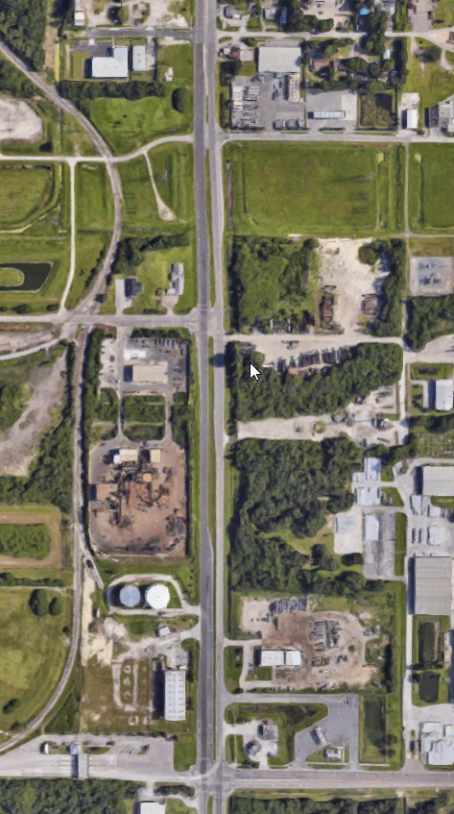
US 41 @ Pendola Point / Madison Ave Project Overview
FPID# 430056-1-22-01 (PD&E)
Recommendations to improve safety and operations near Pendola Point/Madison Ave:
Widening US 41 from 4 lanes to 6 lanes between Denver St and Pendola Point (approximately 0.5 mile).
Bike lanes & Sidewalks in project area
Intersection improvements at Pendola Point
PD&E- Completed in FY 2017
Design- Funded FY2023
Right of Way- unfunded
Construction- unfunded

Slide 9
US 41 @ Pendola Point Rd./ Madison Ave. (Proposed Improvements)
PD&E 430056-1-22-01 approved 01/2017

Slide 10
Questions?
Brian Hunter
Freight Coordinator
brian.hunter@dot.state.fl.us
813-975-6436
Lilliam Escalera
EMO Project Manager
lilliam.escalera@dot.state.fl.us
813-975-6445
tampabayfreight.com
freightmovesflorida.com

