Slide 1
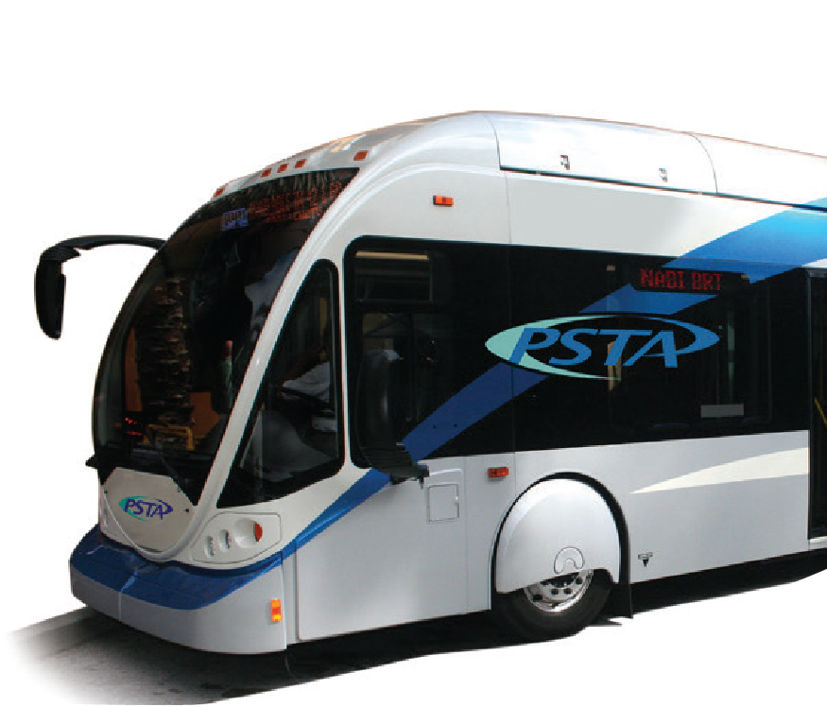
Central Avenue Bus Rapid Transit
Hillsborough MPO
January 10, 2018

Slide 2
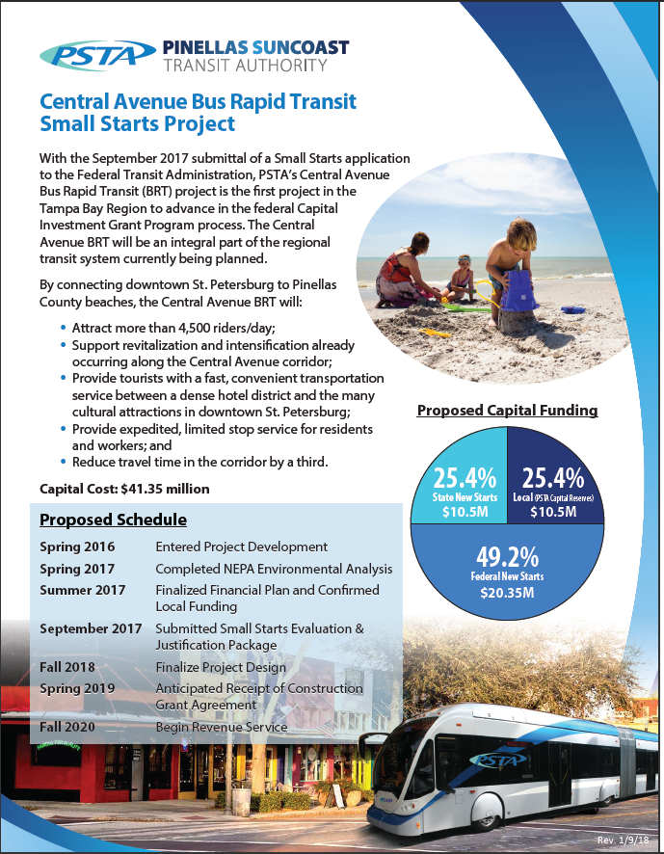
Central Ave BRT Overview
Identified as a future premium transit route in 2003
Included in the MPO’s Long Range Transportation Plan
Currently in the Federal Project Development process
50% federal funds
25% state, 25% local
Broadly supported
Notes:
The Central Ave Corridor has long been identified as a top corridor for premium transit in Pinellas County. It is currently included in the MPO’s LRTP and is in the federal Project Development process which will allow for us to apply for federal funds for 50% of the capital funds, to be matched by 25% state and 25% PSTA. Support from chambers, USF, City of St. Petersburg,

Slide 3
Planning Started 2 Years Ago with $500K from FDOT

Slide 4
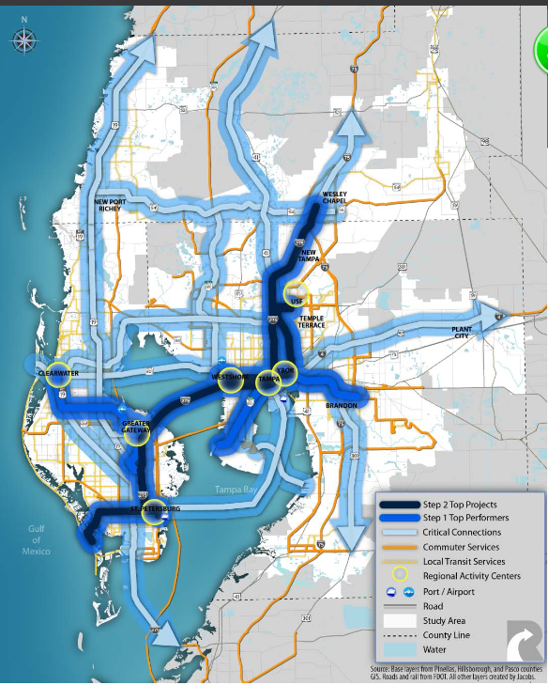

Slide 6
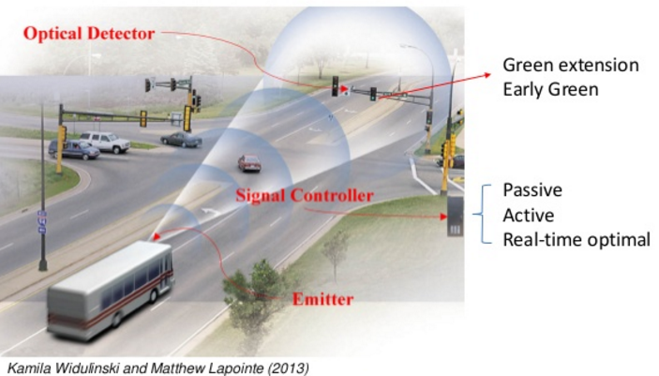
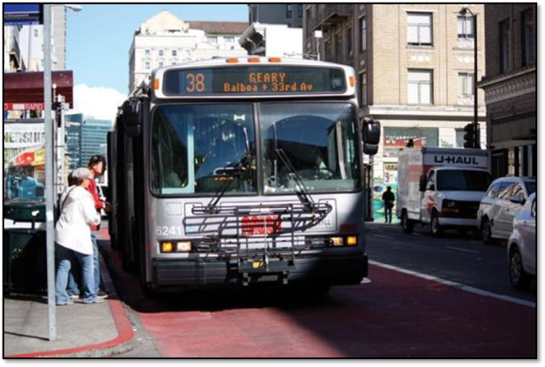
Central Ave BRT Key Features
17 Stations
35 minute trip
60’ Articulated Vehicles
Transit Signal Priority
Left side running on 1st Aves
Designated Business Access and Transit Lane
Notes:
The Central Ave Corridor has long been identified as a top corridor for premium transit in Pinellas County. It is currently included in the MPO’s LRTP and is in the federal Project Development process which will allow for us to apply for federal funds for 50% of the capital funds, to be matched by 25% state and 25% PSTA. Support from chambers, USF, City of St. Petersburg,

Slide 7
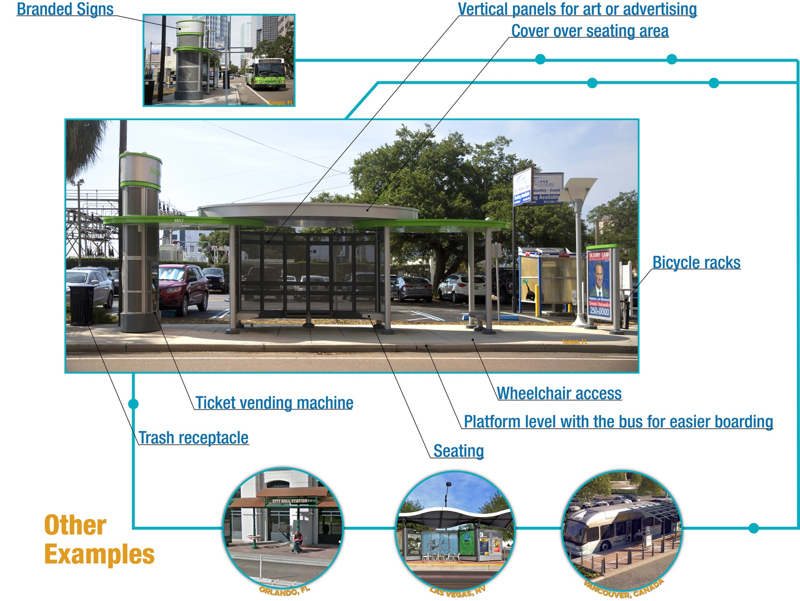
Station Example

Slide 8
Vehicle Example

Slide 9
BAT Lanes

Slide 10
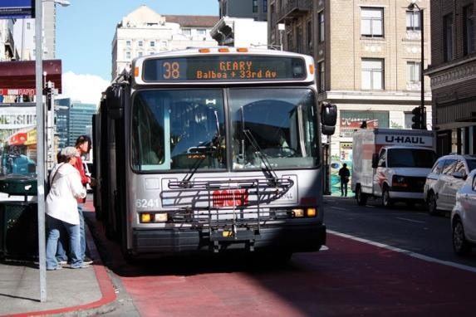
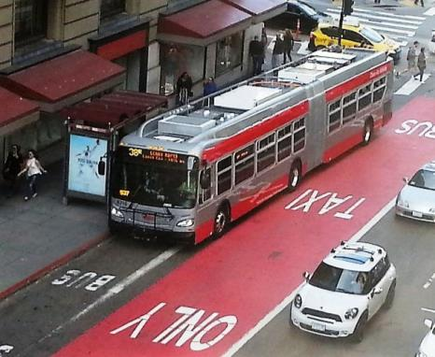
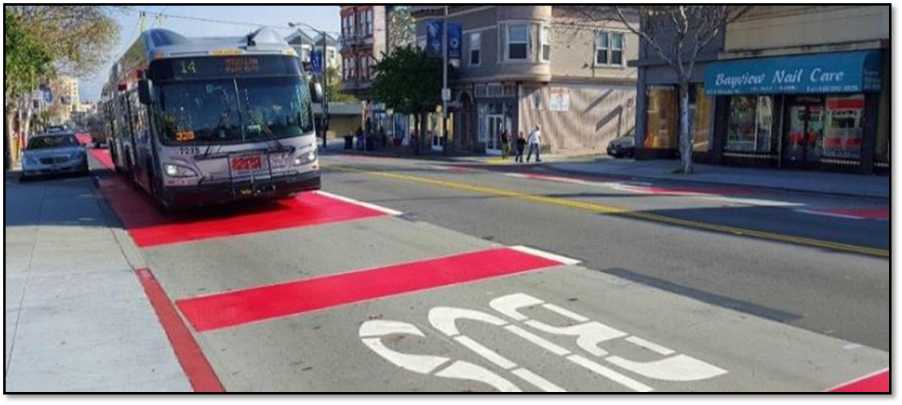
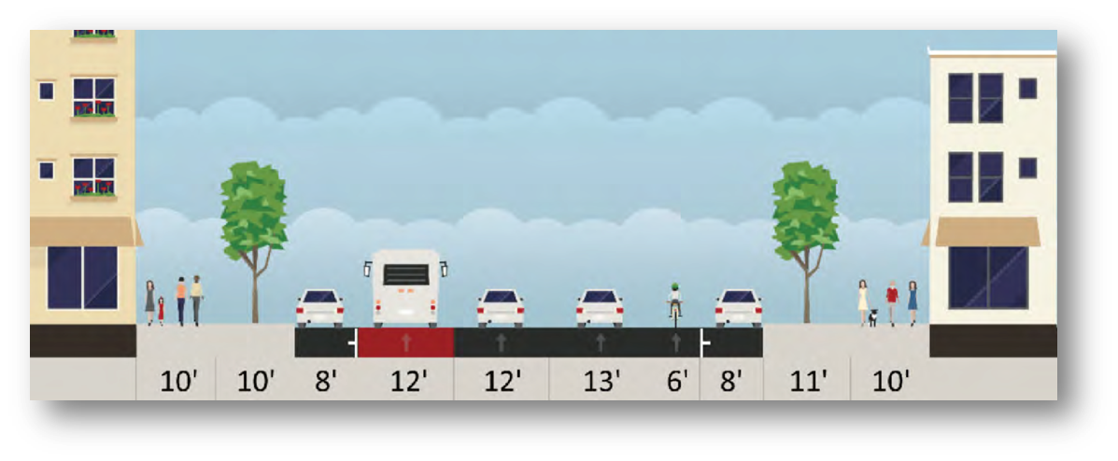
Painted BRT Lane

Slide 11
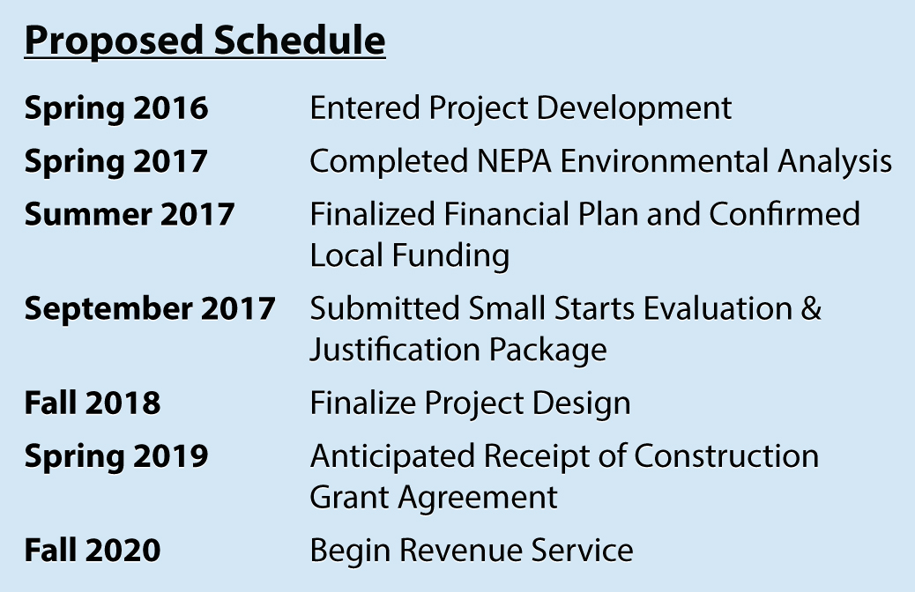
GOAL: To get project funding in FY 2019 Federal Budget:

Slide 12
GOAL: Construction in 2019 – Open in 2020
Inclusion in President’s Recommended FY19 Budget
Funded in Federal Approved FY19 Budget – 9/2018
Construction in 2019
Begin Operations in 2020

Slide 13
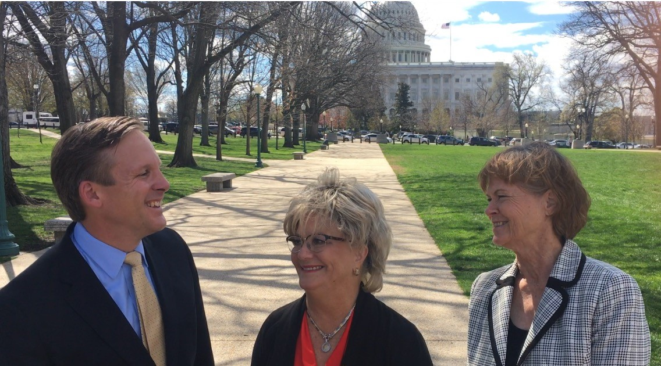

Slide 14
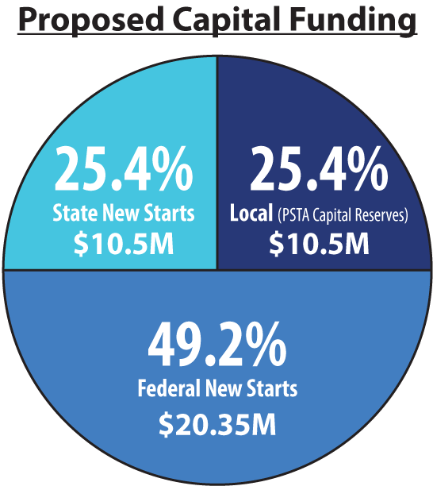
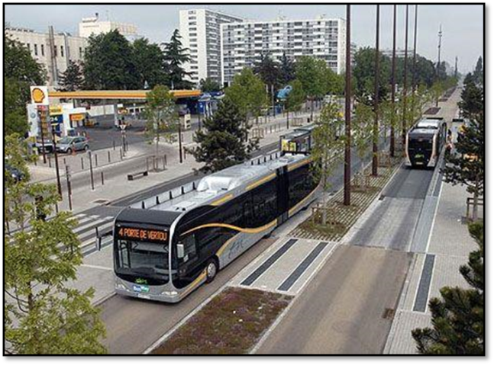
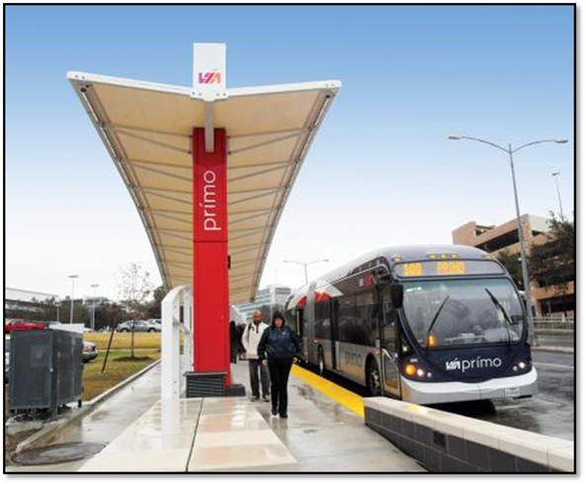
Key Funding Partners
Local (25%)
PSTA - $5M
City of St. Pete - $4M
Private and SPB - $1.5M

Slide 15
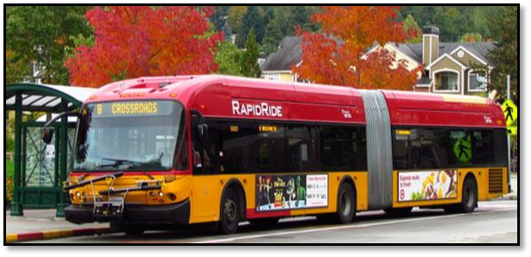
Central Avenue BRT Success
Successful Transit Corridor
Supports Economy and Development
Part of Regional Plan
Local Cooperation
Shared Local Funding

