Slide 1
Innovation District
Gateway Concept Study
November 13, 2015

Slide 2
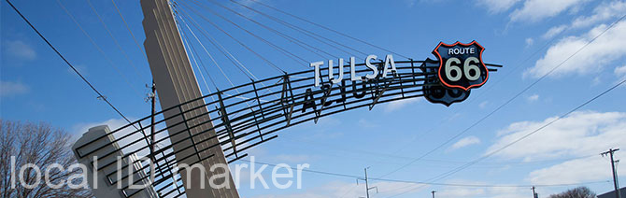
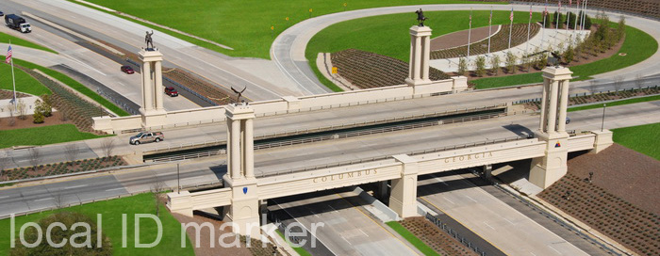
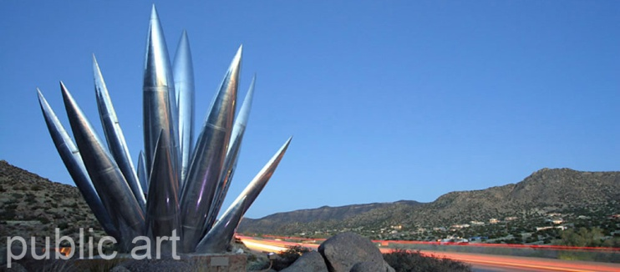
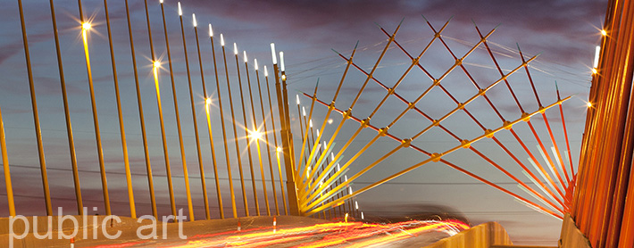
Recap │ Project Schedule
September 21: Initial Inquiry Meeting FDOT D7
PPM Chapter 9: Landscape and Community Aesthetic Features
Public Art/Local ID Marker
Maintenance by Local Government Entity
September 24: Gateway Study Pre-Meeting City of Tampa
“Lights on Tampa”
Irrigation Access Available/Texas Phoenix Palm Decline
Low Maintenance
September 24: Innovation Alliance Kick-off Meeting
Inspire People
Sense of Arrival
“Global Citizen” Theme

Slide 3
Theme │ Global Citizen
Statement: Combining the aspects of environmental stewardship and aesthetic/innovative design to create a large scale gateway that is visually stunning and sensitive to functionality.
What it means: “…a way of living that recognizes our world is an increasingly complex web of connections and interdependencies. One in which our choices and actions may have repercussions for people and communities locally, nationally or internationally.” www.ideas-forum.org.uk
“…nurtures personal respect and respect for others; encourages individuals to think deeply and critically about what is equitable and just, and what will minimize harm to our planet.” www.ideas-forum.org.uk
“An ethic of care for the world” -Hannah Arendt

Slide 4
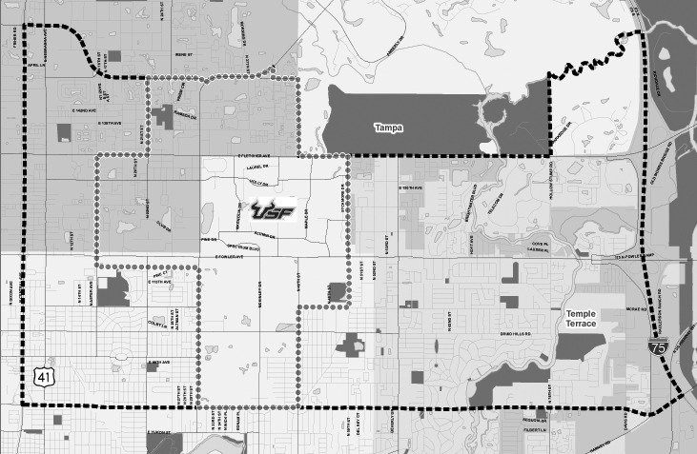
Boundary │ Innovation District
N
NOT TO SCALE

Slide 5
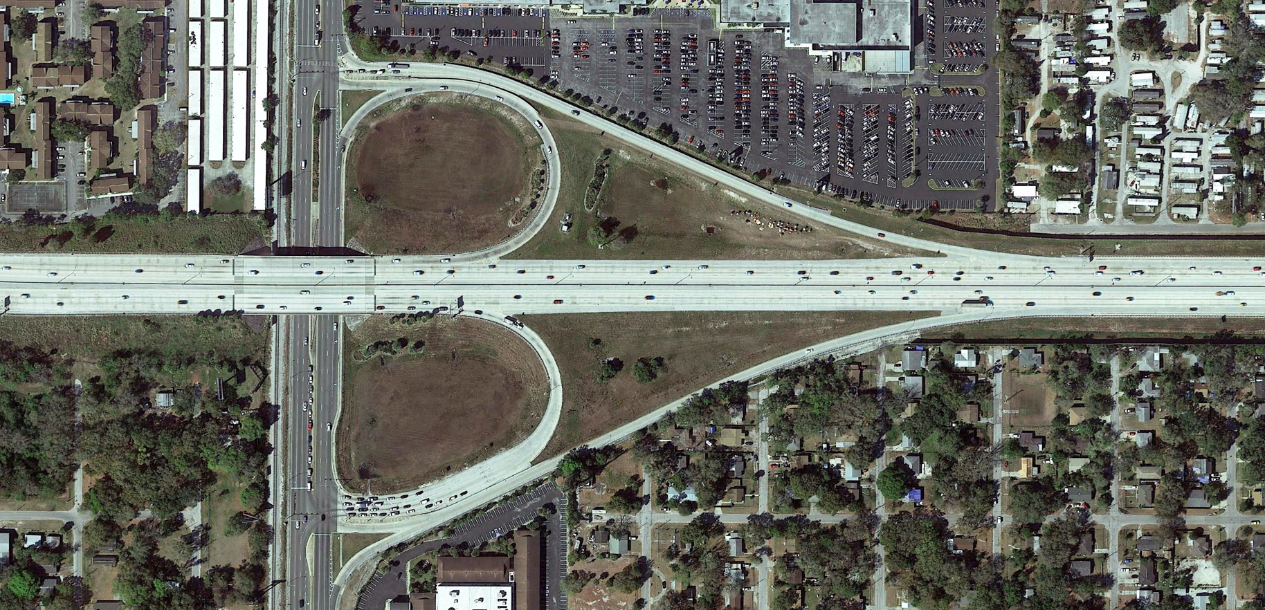
Context │ Busch Blvd.
Busch Blvd.
I-275
N
NOT TO SCALE

Slide 6
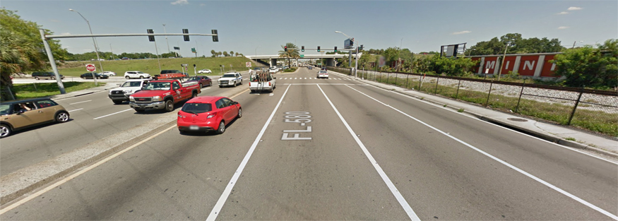
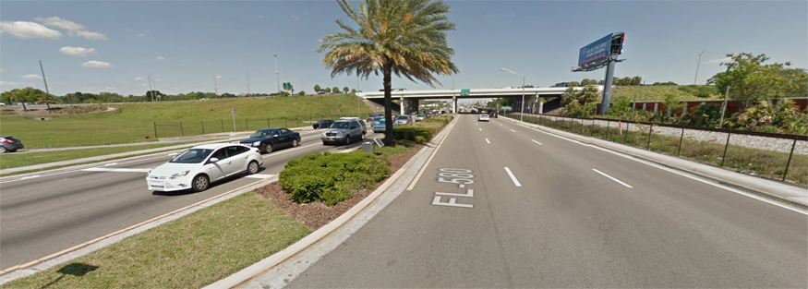
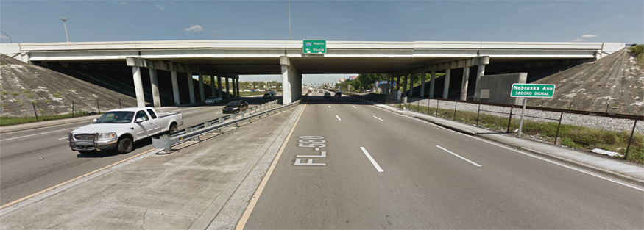
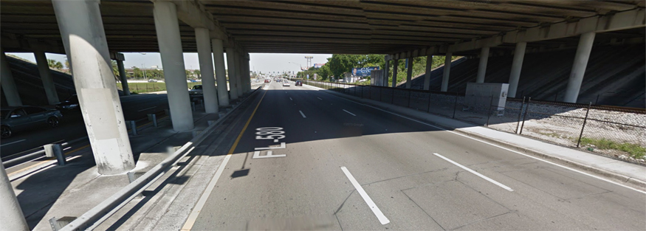
Existing Conditions │ Busch Blvd.
Eastbound Busch Blvd. at Exit Ramp Intersection
Eastbound Busch Blvd. approaching I-275 Overpass
▲
▲
Eastbound Busch Blvd. at I-275 Overpass
Eastbound Busch Blvd. under I-275 Overpass
▲
▲

Slide 7
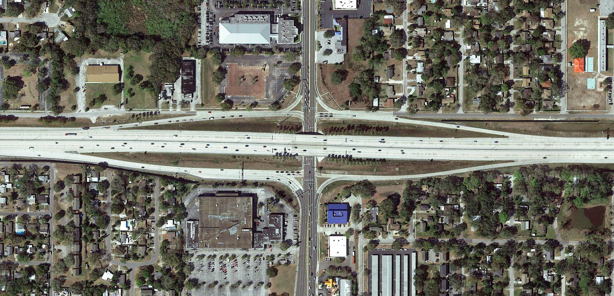
Context │ Fowler Ave.
Fowler Ave.
I-275
N
NOT TO SCALE

Slide 8
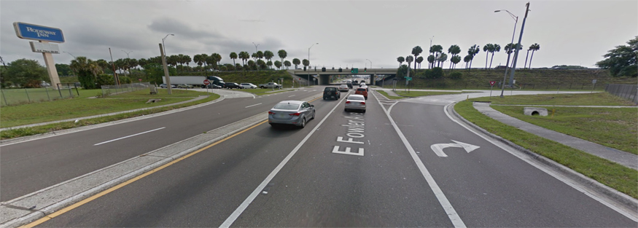
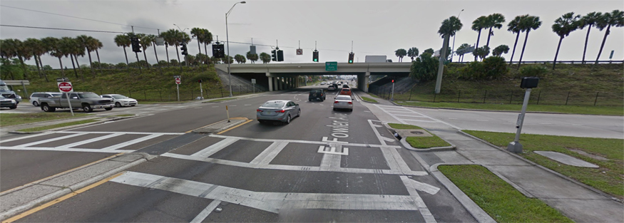
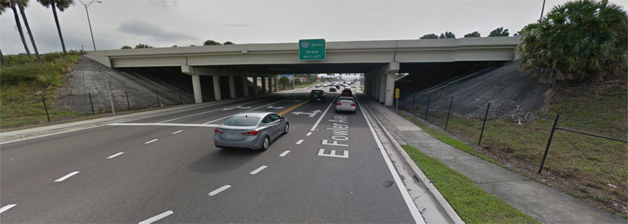
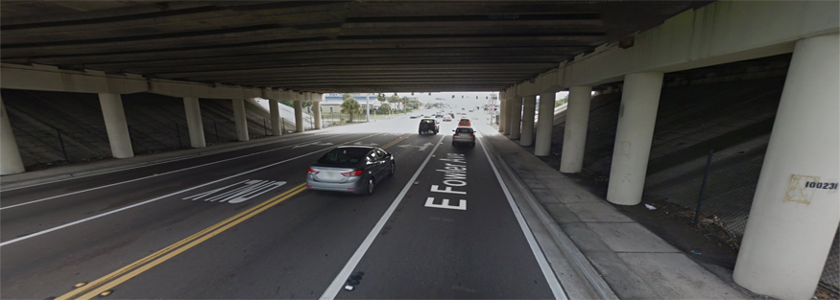
Existing Conditions │ Fowler Ave.
Eastbound Fowler Ave. near Central Ave. Intersection
Eastbound Fowler Ave. at Central Ave. Intersection
▲
▲
Eastbound Fowler Ave. at I-275 Overpass
Eastbound Fowler Ave. under I-275 Overpass
▲
▲

Slide 9
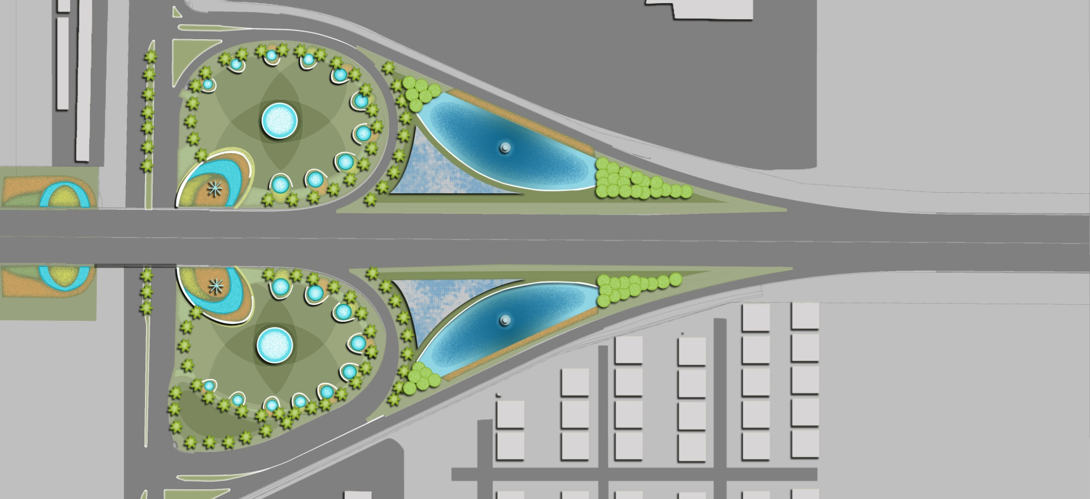
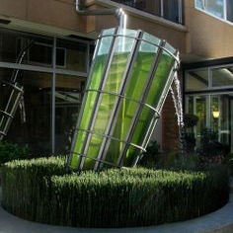
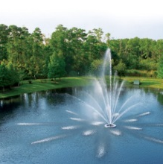
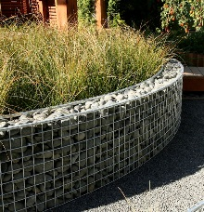
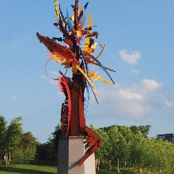
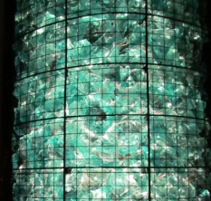
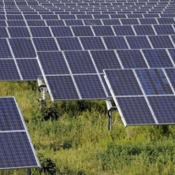
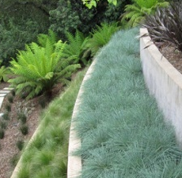
Concept 1 │ Busch Blvd. Art Sculpture
A
Art Sculpture
B
Recycled Glass Rock Gabion Feature
B
C
Groundplane Concrete Band
K
D
Native Groundcover Massing
E
C
E
Stormwater w/ Underground Cistern
F
Pond Retaining Wall
F
G
Stormwater Pond Fountain
D
H
Solar Panels
I-275
I
Cypress Tree Stand
J
Streetscape Palm
A
K
Accent Retaining Wall
M
I
H
L
Sod
G
M
Streetscape Improvements Under
Bridge
L
CSX Rail
Busch Blvd.
J
N
NOT TO SCALE

Slide 10
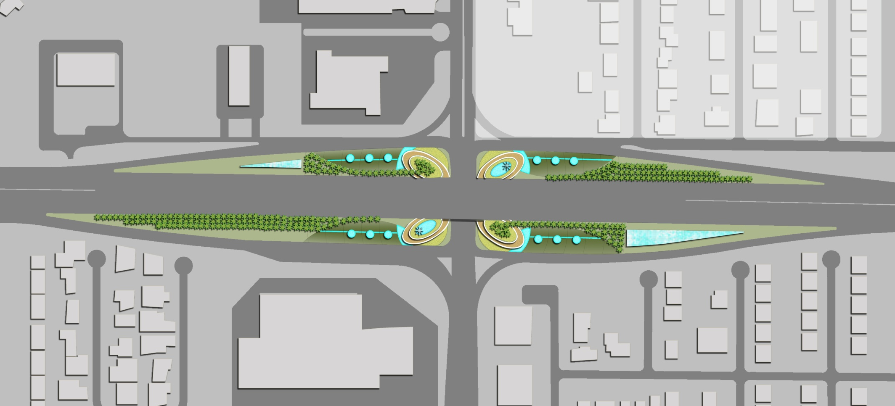
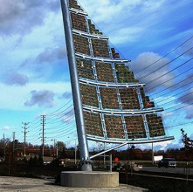
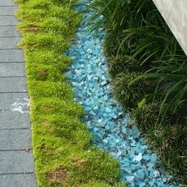
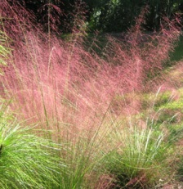
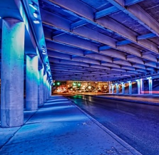
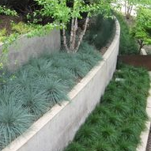
Concept 1 │ Fowler Ave. Art Sculpture
A
G
Solar Panels
Art Sculpture
B
H
Linear Palm Tree Stand
Recycled Glass Rock Gabion Feature
C
I
Sod
Groundplane Glass Rock Band
D
J
Streetscape Improvements
Under Bridge
Native Groundcover Massing
E
Stormwater w/ Underground Cistern
F
Accent Retaining Wall
B
F
E
H
A
J
G
I
C
D
N
NOT TO SCALE

Slide 11
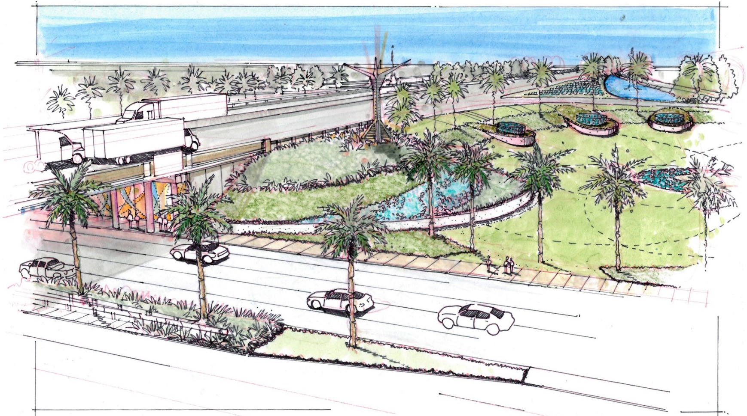
Concept 1 │ Character Sketch Art Sculpture

Slide 12
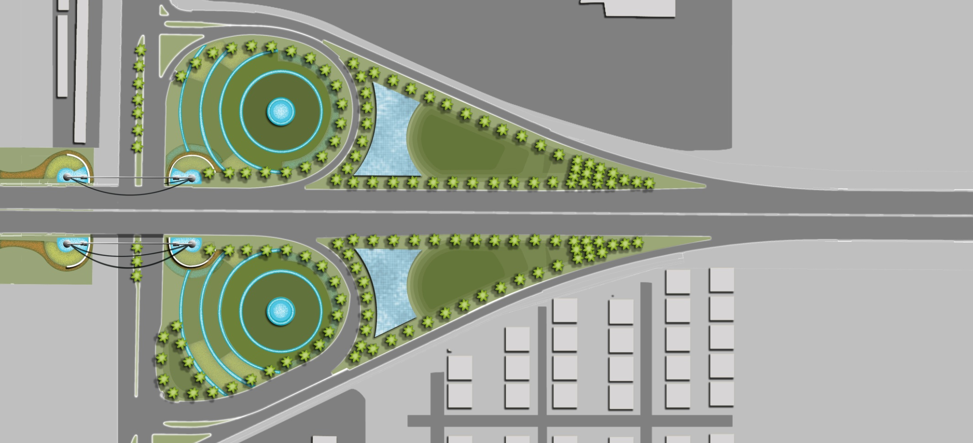
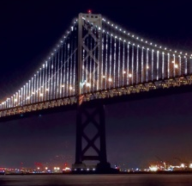
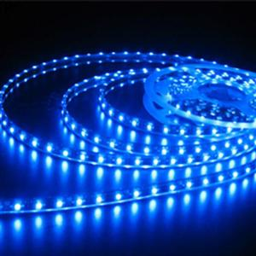
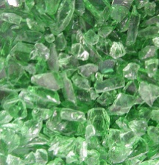
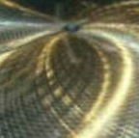
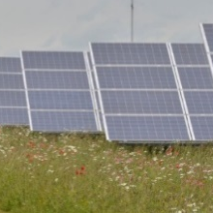
Concept 2 │ Busch Blvd. Bridgeway Arch
A
Bridgeway Arch
B
Recycled Glass w/Underground Cistern
C
Accent Retaining Wall
D
Native Groundcover Massing
B
E
Stormwater Facility
F
Solar Panels
C
E
G
Recycled Glass Rock Accent Band
D
F
A
H
Streetscape Palm
I-275
I
Sod
J
J
Streetscape Improvements Under
Bridge
G
CSX Rail
I
Busch Blvd.
H
N
NOT TO SCALE

Slide 13
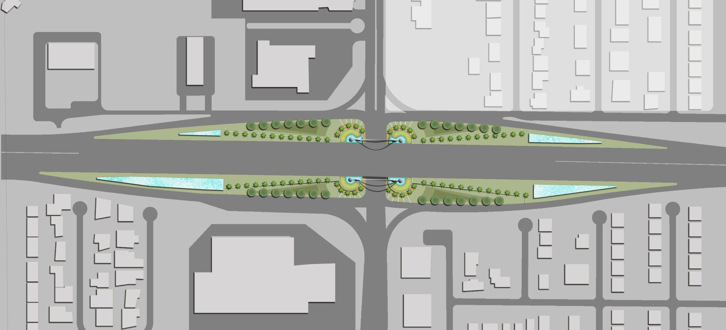
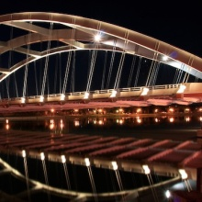
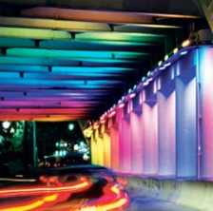
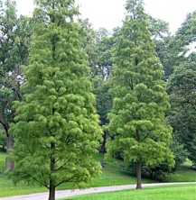
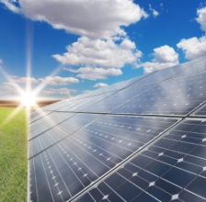
Concept 2 │ Fowler Ave. Bridgeway Arch
A
Bridgeway Arch
G
Streetscape Palm
B
Accent Retaining Wall
H
Recycled Glass Rock Accent Band
C
Recycled Glass Rock under Arch
I
Streetscape Palm
D
Native Groundcover Massing
J
Canopy Tree
E
Stormwater Facility
K
Sod
F
Solar Panels
L
Streetscape Improvements Under
Bridge
B
A
C
G
L
F
D
K
E
J
N
NOT TO SCALE

Slide 14
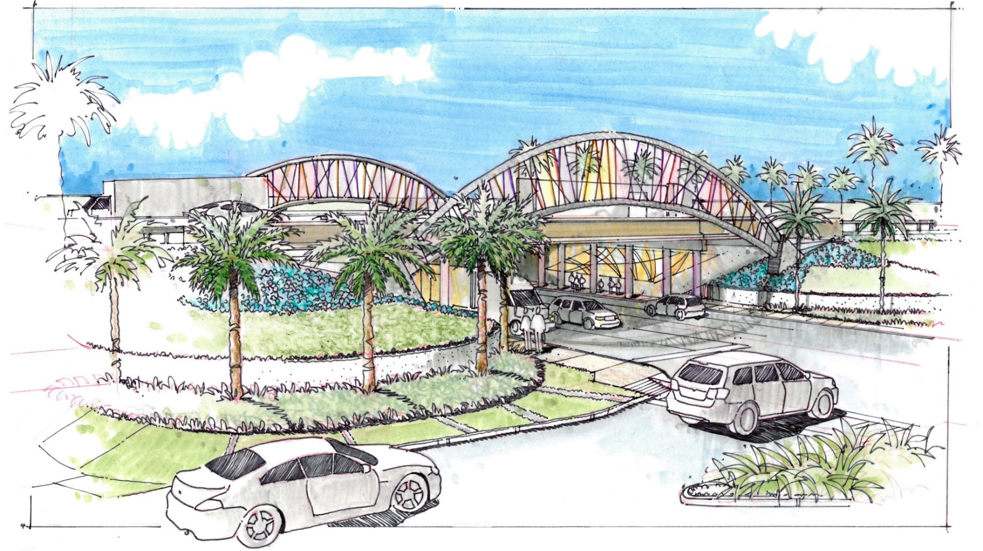
Concept 2 │ Character Sketch Bridgeway Arch

Slide 15
Comment Sheet:
  Overall which concept do you prefer?
    Concept 1: Art Sculpture
    Concept 2: Bridgeway Arch
    What elements did you like/dislike?
    Any additional comments?
Innovation District
Gateway Concept Study

