Slide 1
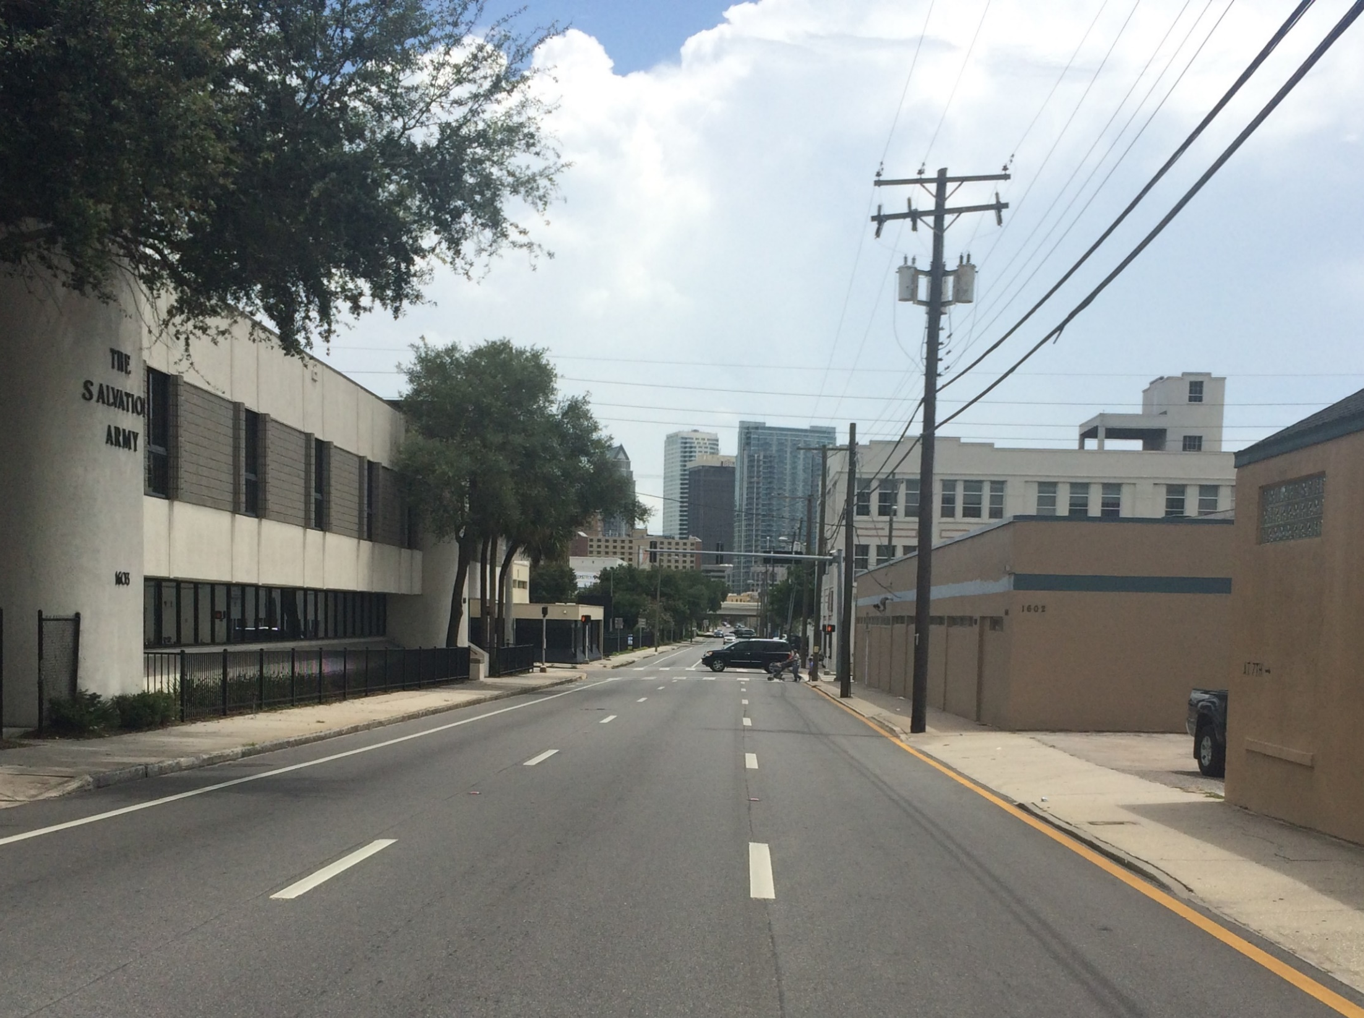
Florida Avenue and Tampa Street/ Highland Avenue Corridor Study
Project Advisory Group Meeting #3
Identify/Define Alternatives
October 28, 2015

Slide 2
Study Purpose
Florida Ave & Tampa St/Highland Ave Corridor Study
Identify and evaluate alternative configurations to determine how to best meet the needs of a wide range of users – current and future.

Slide 3

Study Objectives
Florida Ave & Tampa St/Highland Ave Corridor Study
Look at how alternatives can:
  Provide safe access between Downtown and Neighborhoods for drivers, transit users, pedestrians, and bicyclists
    Commercial and neighborhood access
  Support the InVision Plan’s vision of the corridor as a neighborhood “main street” and commercial district
  Contribution to the City’s public realm
  Role in the larger transportation network

Slide 4
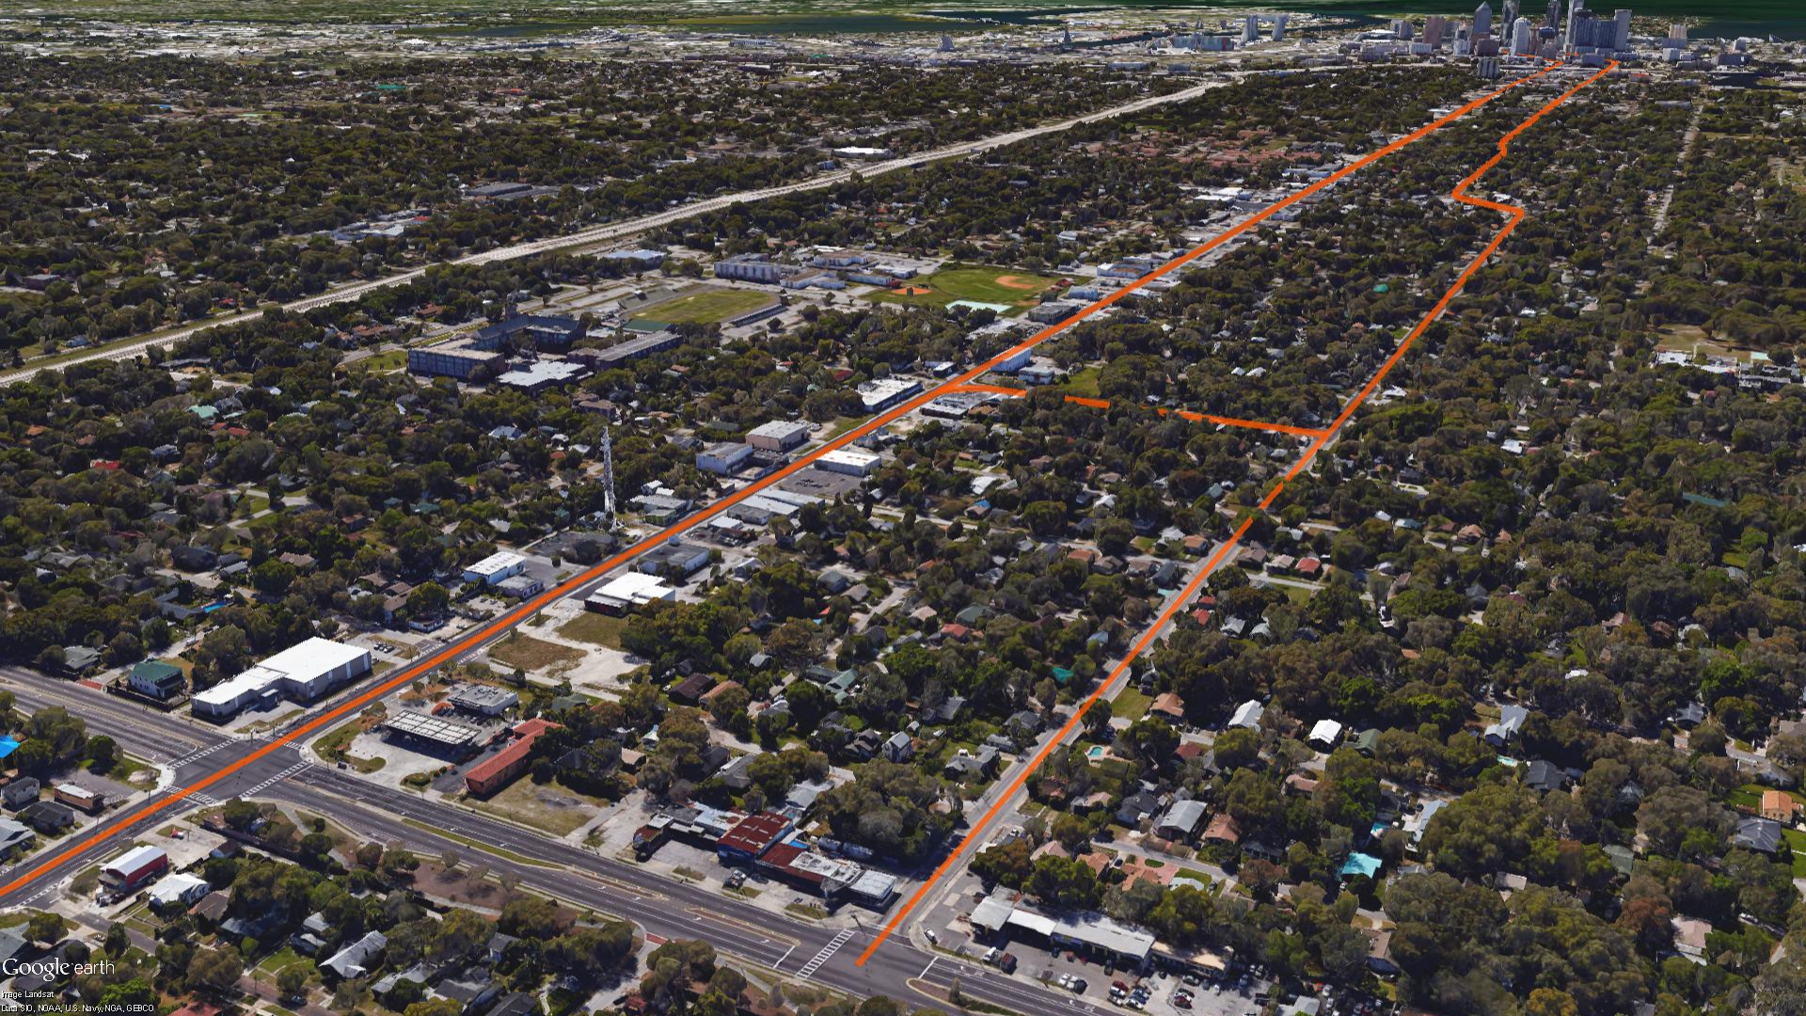
Project Timeline
Florida Ave & Tampa St/Highland Ave Corridor Study
Timeline of PAG Meetings:
Study Area, Model Assumptions, & Evaluation Criteria
Existing Conditions
Identify Alternatives
Review Alternatives Evaluation
Evaluation Outcomes
#1
#2
#3
#4
#5

Slide 5
PAG Meeting #3
Florida Ave & Tampa St/Highland Ave Corridor Study
Meeting Objectives:
  Define the “No Build” alternative
    Include I-275 Express Lanes
  Choose up to four “Build” alternatives
✓
✓
✓
✓
✓

Slide 6

Evaluation Process
Florida Ave & Tampa St/Highland Ave Corridor Study
Multiple Step Evaluation Process:
Reasonability Test
Initial Evaluation
Final Evaluation

Slide 7
Evaluation Criteria
Florida Ave & Tampa St/Highland Ave Corridor Study
If we do ____, then….
Traffic & Corridor Function
System-Wide Function
Pedestrian & Bicycle Infrastructure
Safety
Transit
Community Impacts
Other

Slide 8
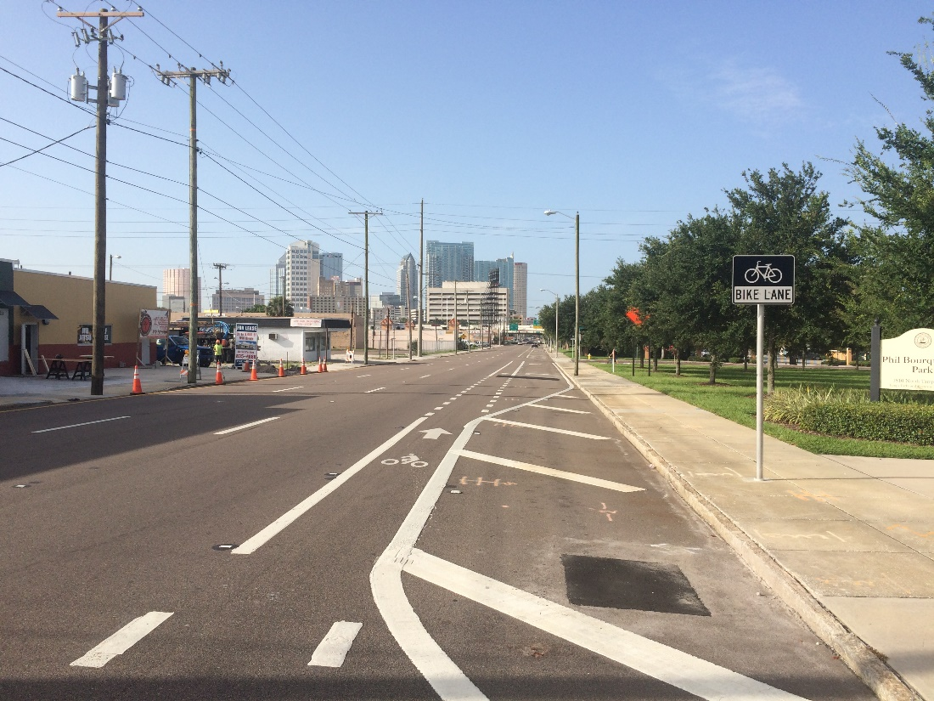

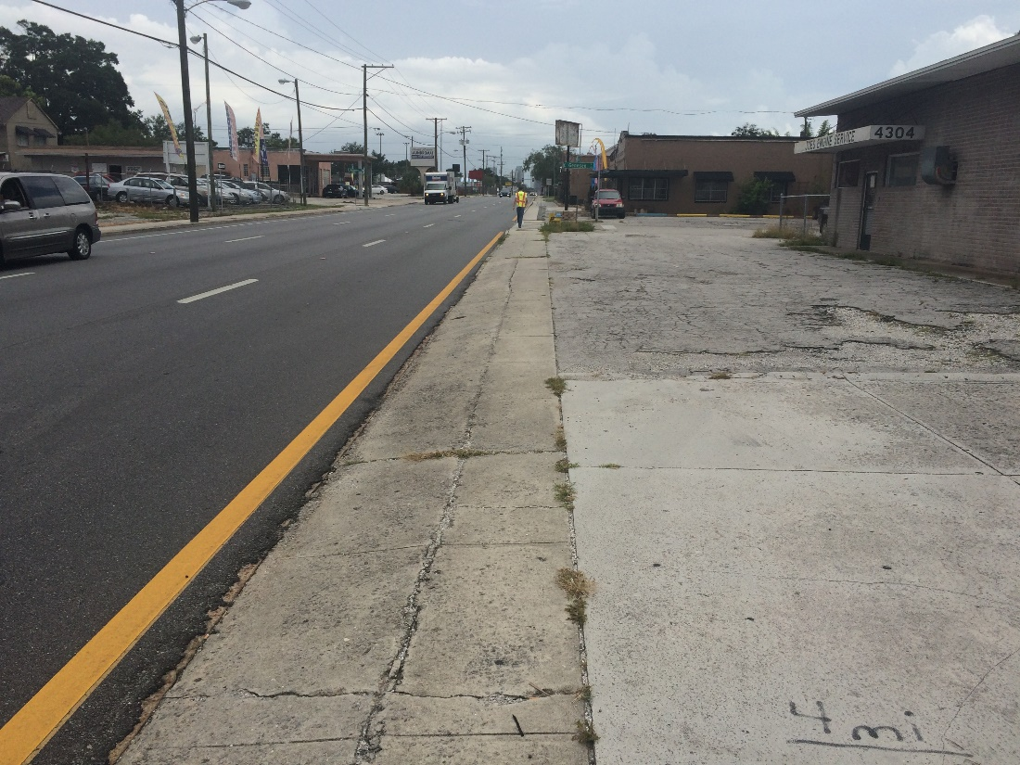
No Build Alternative
Florida Ave & Tampa St/Highland Ave Corridor Study
Tampa Street
Florida Avenue

Slide 9
“No Build” Alternative
Florida Ave & Tampa St/Highland Ave Corridor Study
No change to existing lane configuration/ fundamental operating characteristics.
Consider infrastructure enhancements
    Example – sidewalk improvements, additional crossing opportunities, bus stop enhancements, and other minor operational, safety, or aesthetic enhancements.
Used to compare “build” alternatives

Slide 10
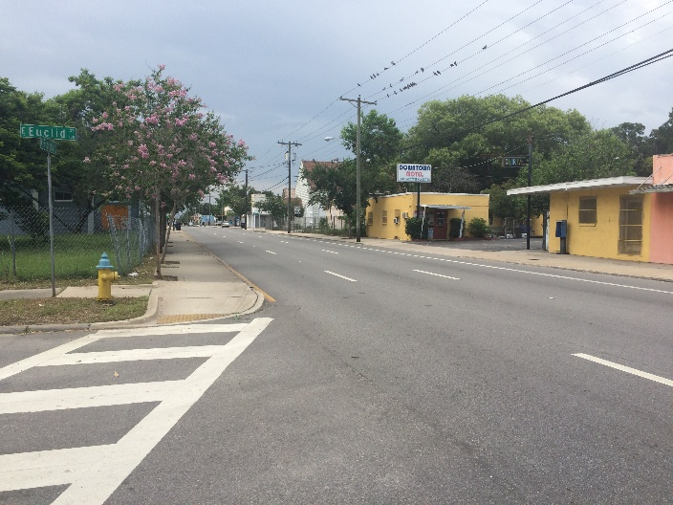
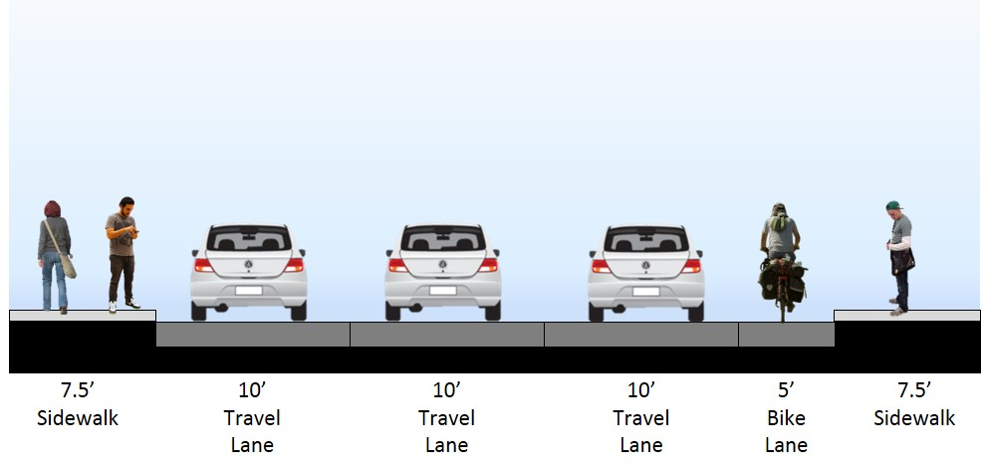
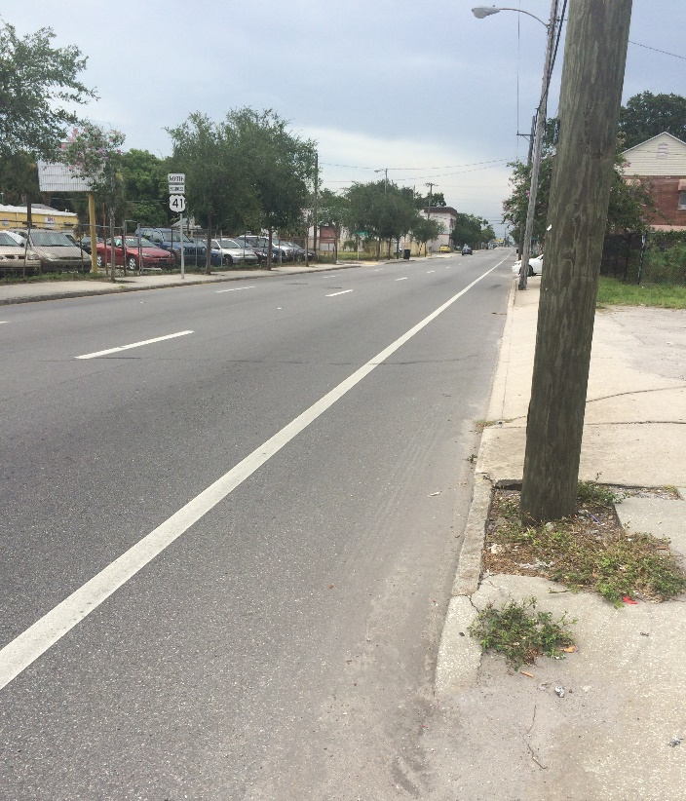
“No Build” Alternative
Florida Ave & Tampa St/Highland Ave Corridor Study
Florida Avenue:
Palm Ave to Floribraska Ave
ROW = 50’

Slide 11
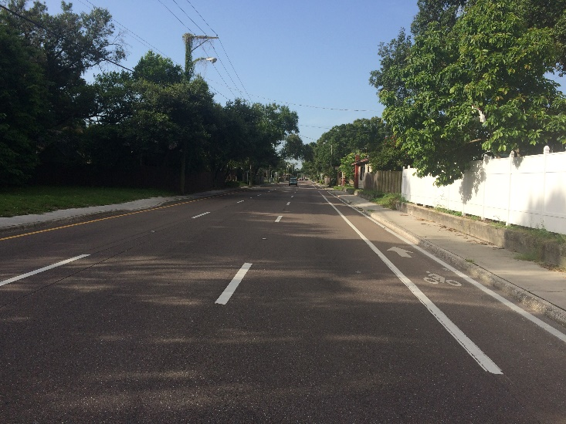
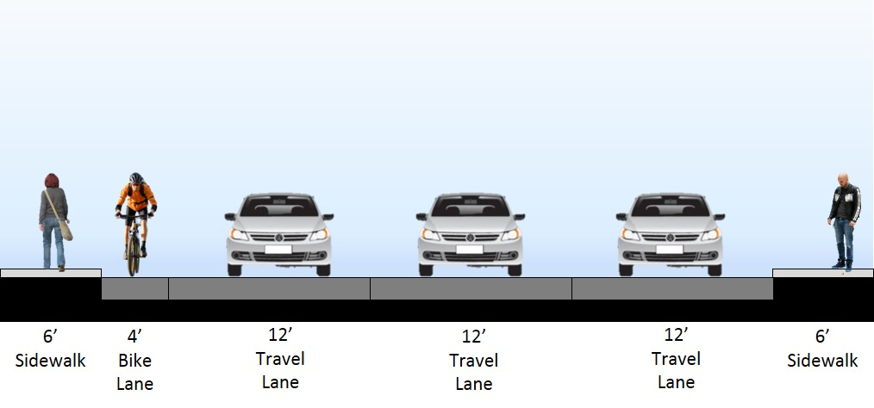
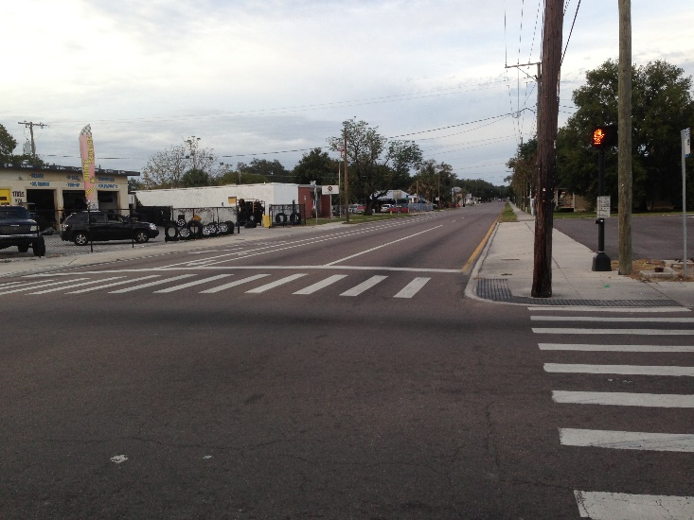
“No Build” Alternative
Florida Ave & Tampa St/Highland Ave Corridor Study
Tampa Street/Highland Avenue:
Columbus Dr to MLK Blvd
ROW = 52’

Slide 12
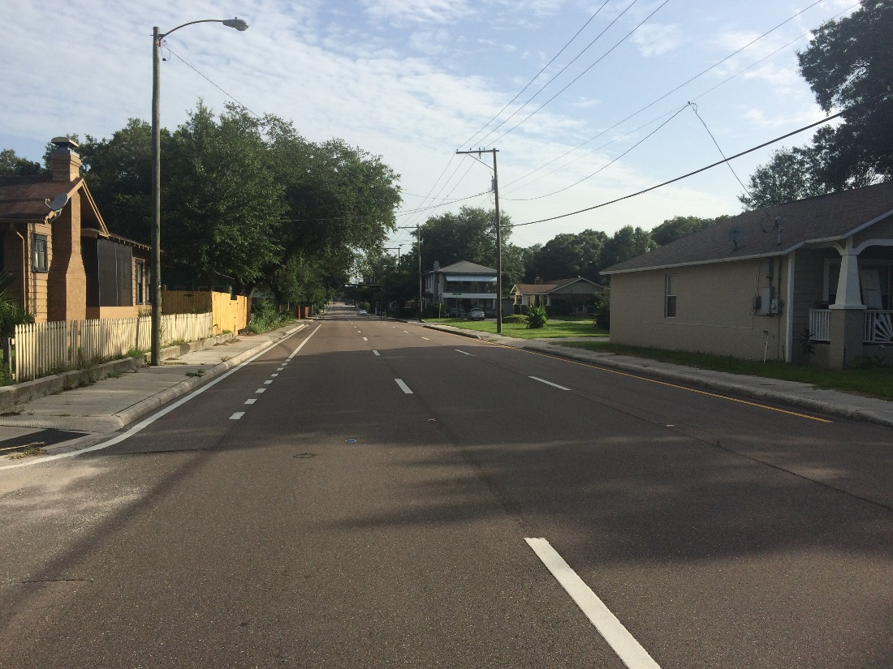
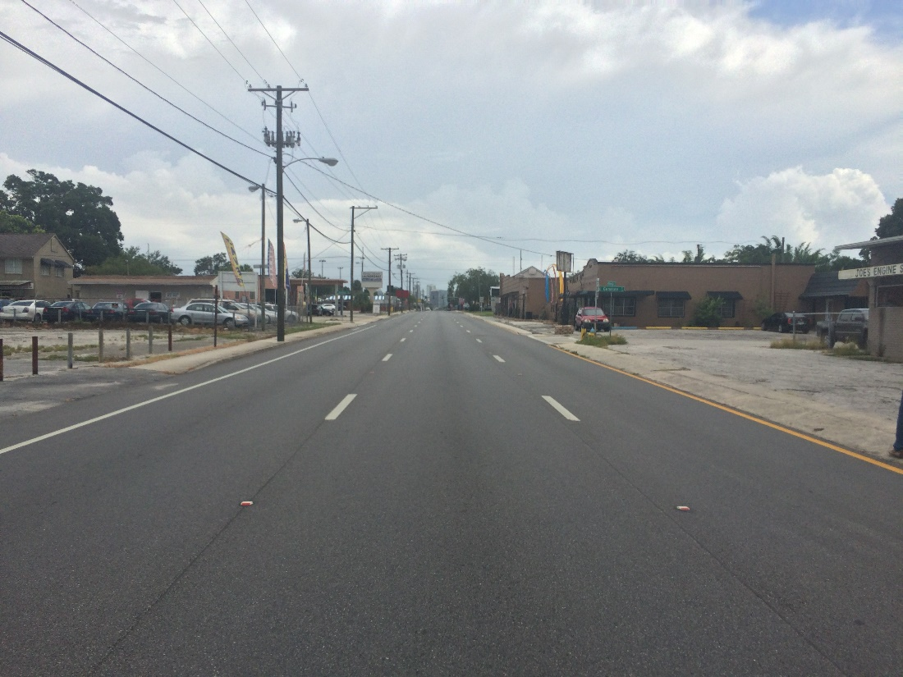
“Build” Alternatives
Florida Ave & Tampa St/Highland Ave Corridor Study
Tampa Street
Florida Avenue

Slide 13
“Build” Alternatives
Florida Ave & Tampa St/Highland Ave Corridor Study
Project scope mentioned the following:
  Two-way throughout study area
  One-way pair with lane reduction and corridor enhancements
  Two-way for portion of study area
  Dynamic lane assignment by time of day

Slide 14
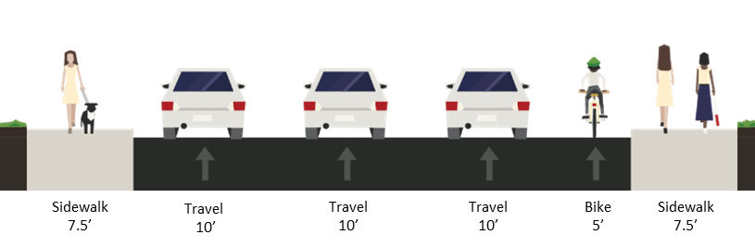
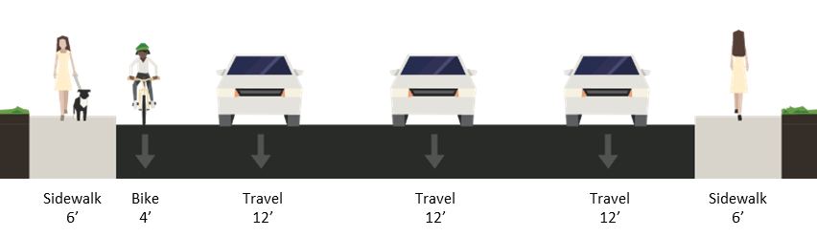
Alternatives “Family Tree”
Florida Ave & Tampa St/Highland Ave Corridor Study
Existing
Two-Way Conversion
Lane Reduction
Hybrid
Dynamic Lanes

Slide 15
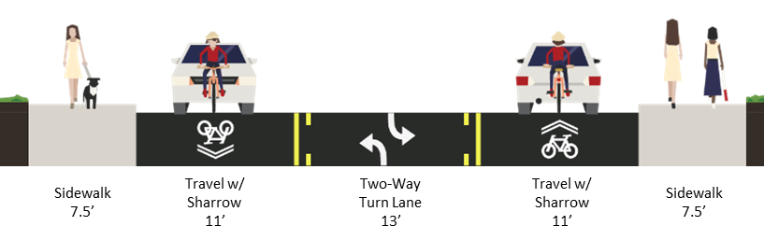
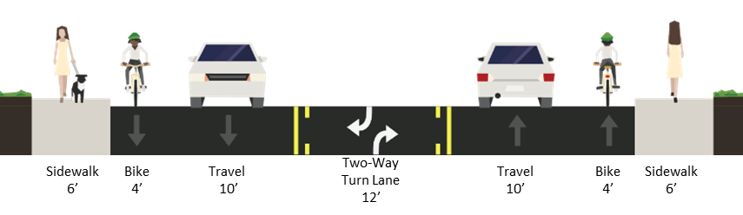
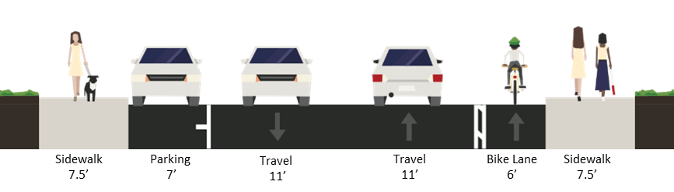
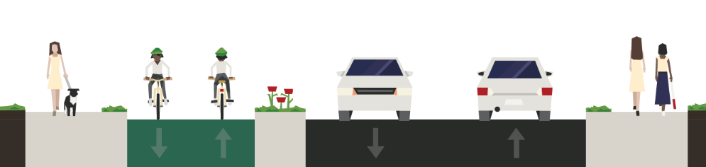
Two-Way Conversion
Florida Ave & Tampa St/Highland Ave Corridor Study
Two-Way Conversion
Florida Ave
Tampa St
Florida Ave
Tampa St
Sidewalk & Buffer
8’
Cycle Track & Buffer
14’
Travel
11’
Travel
11’
Sidewalk & Buffer
8’

Slide 16
Two-Way Conversion
Florida Ave & Tampa St/Highland Ave Corridor Study
Traffic Level of Service | Traffic Safety | Community Impact
Slight decline in overall LOS, more noticeable at signalized intersections. Significant decline in peak hour LOS, particularly within the PM peak along Florida Ave. | Potential increase in traffic safety, particularly severity of crashes, as a result of reduced speeds and potential median refuge. | One-way to two-way street conversions have been shown to have positive impacts on community factors, both economically and from an overall livability standpoint.
Pedestrian Environment | Bicycle Environment | Transit
Limited opportunity to enhance the physical pedestrian environment, especially along Florida Ave. As a result of slower traffic, the pedestrian environment may feel more comfortable. However, introducing two-way traffic may introduce new challenges for pedestrians. | Some opportunity to provide enhanced bicycle facilities, particularly along Tampa St, but two-way conversion may require removing the existing bicycle lanes, especially along Florida Ave. | Transit service would most likely shift to one of the roadways, which could lead to some routing efficiencies. Slower traffic could effect bus operations and stopped buses could occasionally impact the flow of traffic.

Slide 17
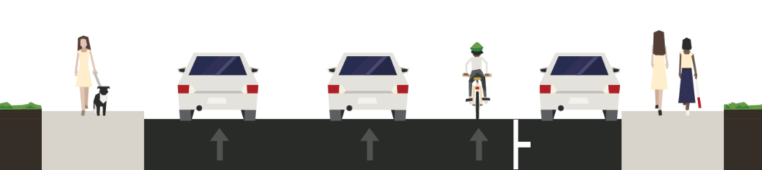
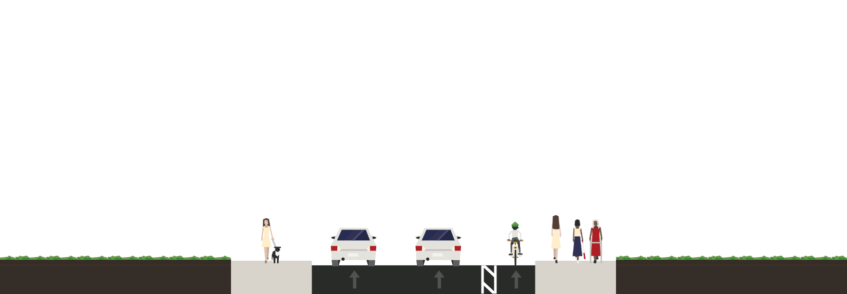
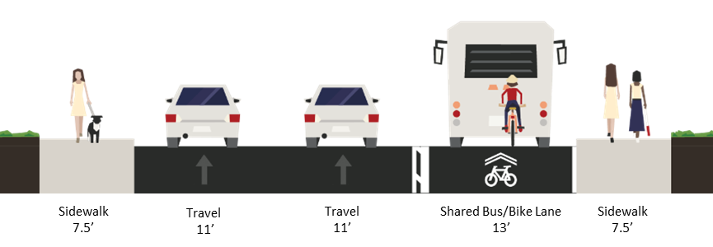
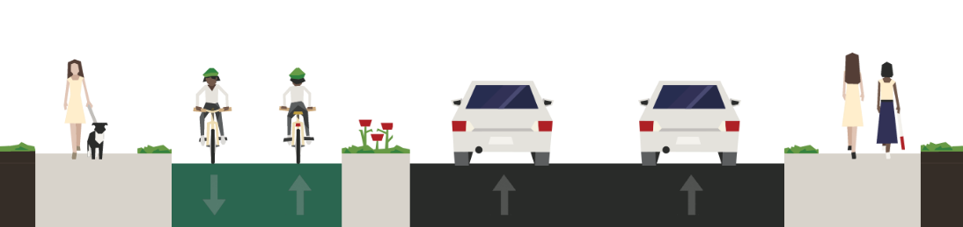
Lane Reduction
Florida Ave & Tampa St/Highland Ave Corridor Study
Lane Reduction
Florida Ave
Sidewalk
7.5’
Travel
11’
Travel
11’
Bike Lane
5’
Parking
8’
Sidewalk
7.5’
Florida Ave
Sidewalk
10.5’
Travel
11’
Travel
11’
Buffered Bike
7’
Sidewalk
10.5’
Florida Ave
Tampa St
Sidewalk & Buffer
8’
Cycle Track & Buffer
14’
Travel
11’
Travel
11’
Sidewalk & Buffer
8’

Slide 18
Lane Reduction
Florida Ave & Tampa St/Highland Ave Corridor Study
Traffic Level of Service | Traffic Safety | Community Impact
May experience slight decline in LOS, particularly within the PM peak along Florida Ave. | Slight increase in overall traffic safety as a result of the reduction in the number of lanes and potentially reduced travel speeds. | Dependent on the designation of the “flex” space. Space could be used to provide on-street parking, landscaping, or enhanced pedestrian/bike/transit environment.
Pedestrian Environment | Bicycle Environment | Transit
Opportunity to enhance pedestrian, bicycle, and/or transit environment exists within the “flex” space. This space could be used to provide for a wider sidewalk, provide buffered/separated bicycle lanes or a cycle track. The space could also be used as an envelope for future transit enhancements along the corridor.

Slide 19
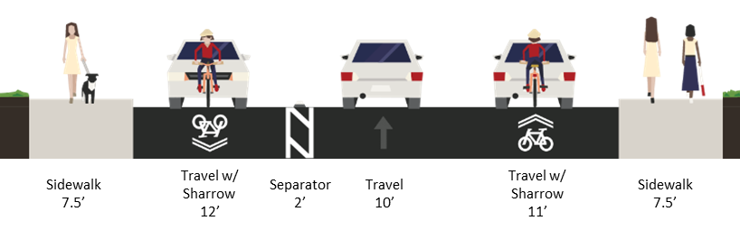
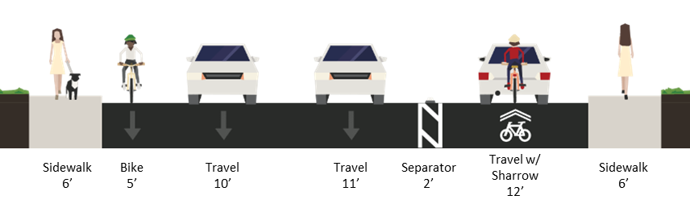


Alternatives “Family Tree”
Florida Ave & Tampa St/Highland Ave Corridor Study
Hybrid
Florida Ave
Tampa St
Florida Ave
Sidewalk
7.5’
Travel
11’
Travel
11’
Hybrid
Parking, Travel, Bike
13’
Sidewalk
7.5’
Florida Ave
Sidewalk
7.5’
Travel
12’
Travel\
Center Turn Lane
11’
Travel
12’
Sidewalk
7.5’

Slide 20
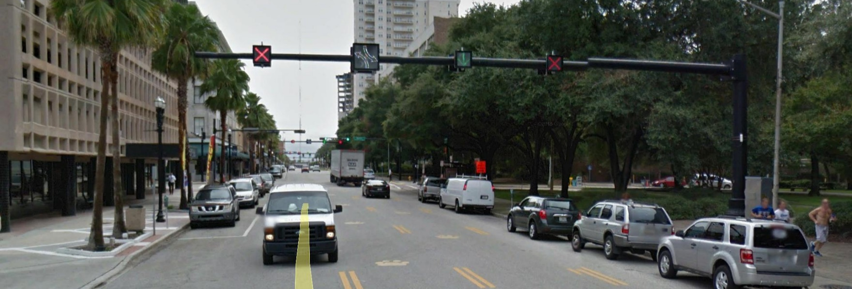
Reversible Traffic Lanes
Florida Ave & Tampa St/Highland Ave Corridor Study
Provide added directional capacity during periods of elevated traffic congestion.
Good signage is critical.
May generate neighborhood concerns (Phoenix).
E Bay St, Jacksonville, FL

Slide 21
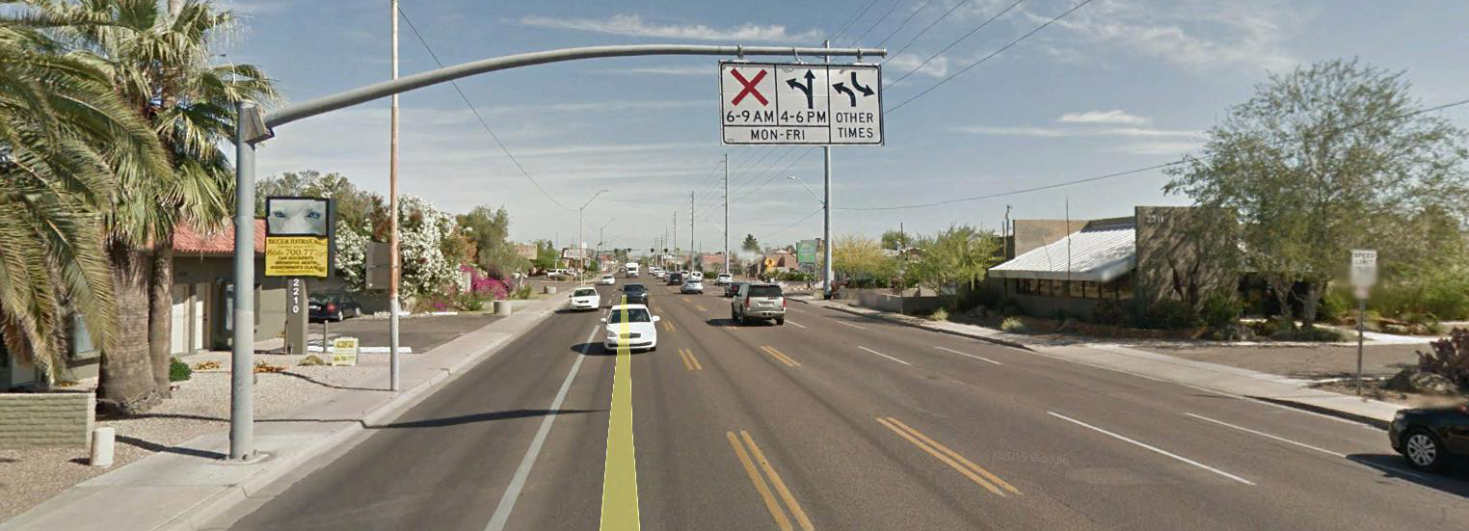
Reversible Traffic Lanes
Florida Ave & Tampa St/Highland Ave Corridor Study
Potential Concerns:
  Perception of less concern about pedestrians and safety of the local residents/businesses – more emphasis on travel speed.
  Left turns can be problematic – may increase cut-through traffic.
  Increase in crashes, particularly head-on and sideswipe crashes (Washington DC & Charlotte)
7th Avenue, Phoenix, AZ

Slide 22
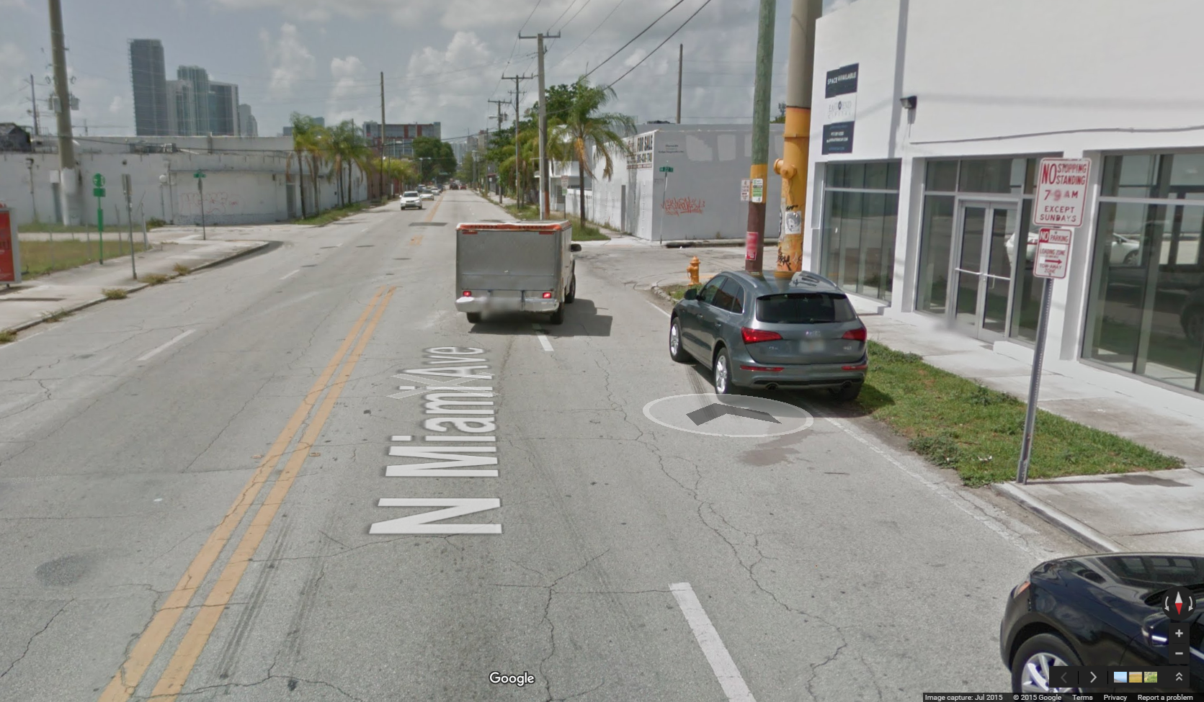
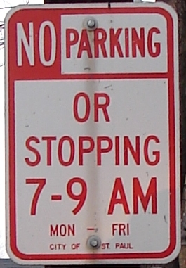
Time of Day Parking Restrictions
Florida Ave & Tampa St/Highland Ave Corridor Study
Allow for on-street parking during off-peak traffic conditions
Require a good signage and strong enforcement program
N Miami Ave, Miami, FL

Slide 23

Define the Alternatives
Florida Ave & Tampa St/Highland Ave Corridor Study

Slide 24
Define the Alternatives
Florida Ave & Tampa St/Highland Ave Corridor Study
No Build
Tampa Street/Highland Avenue
Florida Avenue

Slide 25
Define the Alternatives
Florida Ave & Tampa St/Highland Ave Corridor Study
1. Two-Way Both
Tampa Street/Highland Avenue
Florida Avenue

Slide 26
Define the Alternatives
Florida Ave & Tampa St/Highland Ave Corridor Study
2. Lane Reduction Both
Tampa Street/Highland Avenue
Florida Avenue

Slide 27
Define the Alternatives
Florida Ave & Tampa St/Highland Ave Corridor Study
3. Two-Way Tampa/Highland, Lane Reduction Florida
Tampa Street/Highland Avenue
Florida Avenue

Slide 28
Define the Alternatives
Florida Ave & Tampa St/Highland Ave Corridor Study
4. Two-Way Tampa/Highland, Dynamic Lanes Florida
Tampa Street/Highland Avenue
Florida Avenue

Slide 29
Define the Alternatives
Florida Ave & Tampa St/Highland Ave Corridor Study
4A. Two-Way Tampa/Highland, Reversible Lanes Florida
Tampa Street/Highland Avenue
Florida Avenue
AM
Mid-Day
&
Night
PM
-OR-

Slide 30
Define the Alternatives
Florida Ave & Tampa St/Highland Ave Corridor Study
4B. Two-Way Tampa/Highland, Parking Lane Florida
Tampa Street/Highland Avenue
Florida Avenue
P
AM
Mid-Day
&
Night
P
PM

Slide 31
Define the Alternatives
Florida Ave & Tampa St/Highland Ave Corridor Study
5. Dynamic Lanes Both
Tampa Street/Highland Avenue
Florida Avenue

Slide 32
Define the Alternatives
Florida Ave & Tampa St/Highland Ave Corridor Study
5. Dynamic Lanes Both
Tampa Street/Highland Avenue
Florida Avenue
AM
Mid-Day
&
Night
PM
-OR-

Slide 33
Define the Alternatives
Florida Ave & Tampa St/Highland Ave Corridor Study
5. Dynamic Lanes Both
Tampa Street/Highland Avenue
Florida Avenue
P
AM
Mid-Day
&
Night
P
PM

Slide 34

Build Alternatives Selection
Florida Ave & Tampa St/Highland Ave Corridor Study

Slide 35

Model Data Needs
Florida Ave & Tampa St/Highland Ave Corridor Study
Necessary data to evaluate the alternatives

Slide 36
Next Steps
Florida Ave & Tampa St/Highland Ave Corridor Study
Evaluate Alternatives
Summarize and Document Final Evaluation

Slide 37
Next PAG Meeting
Florida Ave & Tampa St/Highland Ave Corridor Study
Study Area, Model Assumptions, & Evaluation Criteria
Existing Conditions
Identify Alternatives
Review Alternatives Evaluation
Evaluation Outcomes
#1
#2
#3
#4
#5

Slide 38
Review Evaluation of Alternatives
Florida Ave & Tampa St/Highland Ave Corridor Study
Evaluate each alternative for its impacts to multimodal mobility and traffic safety/operations
  Preliminary outcomes of the evaluation criteria/measures of effectiveness for each alternative
  Adjust MOEs/weighting criteria, as appropriate

Slide 39





Florida Avenue and Tampa Street/Highland Avenue Corridor Study

