Slide 1
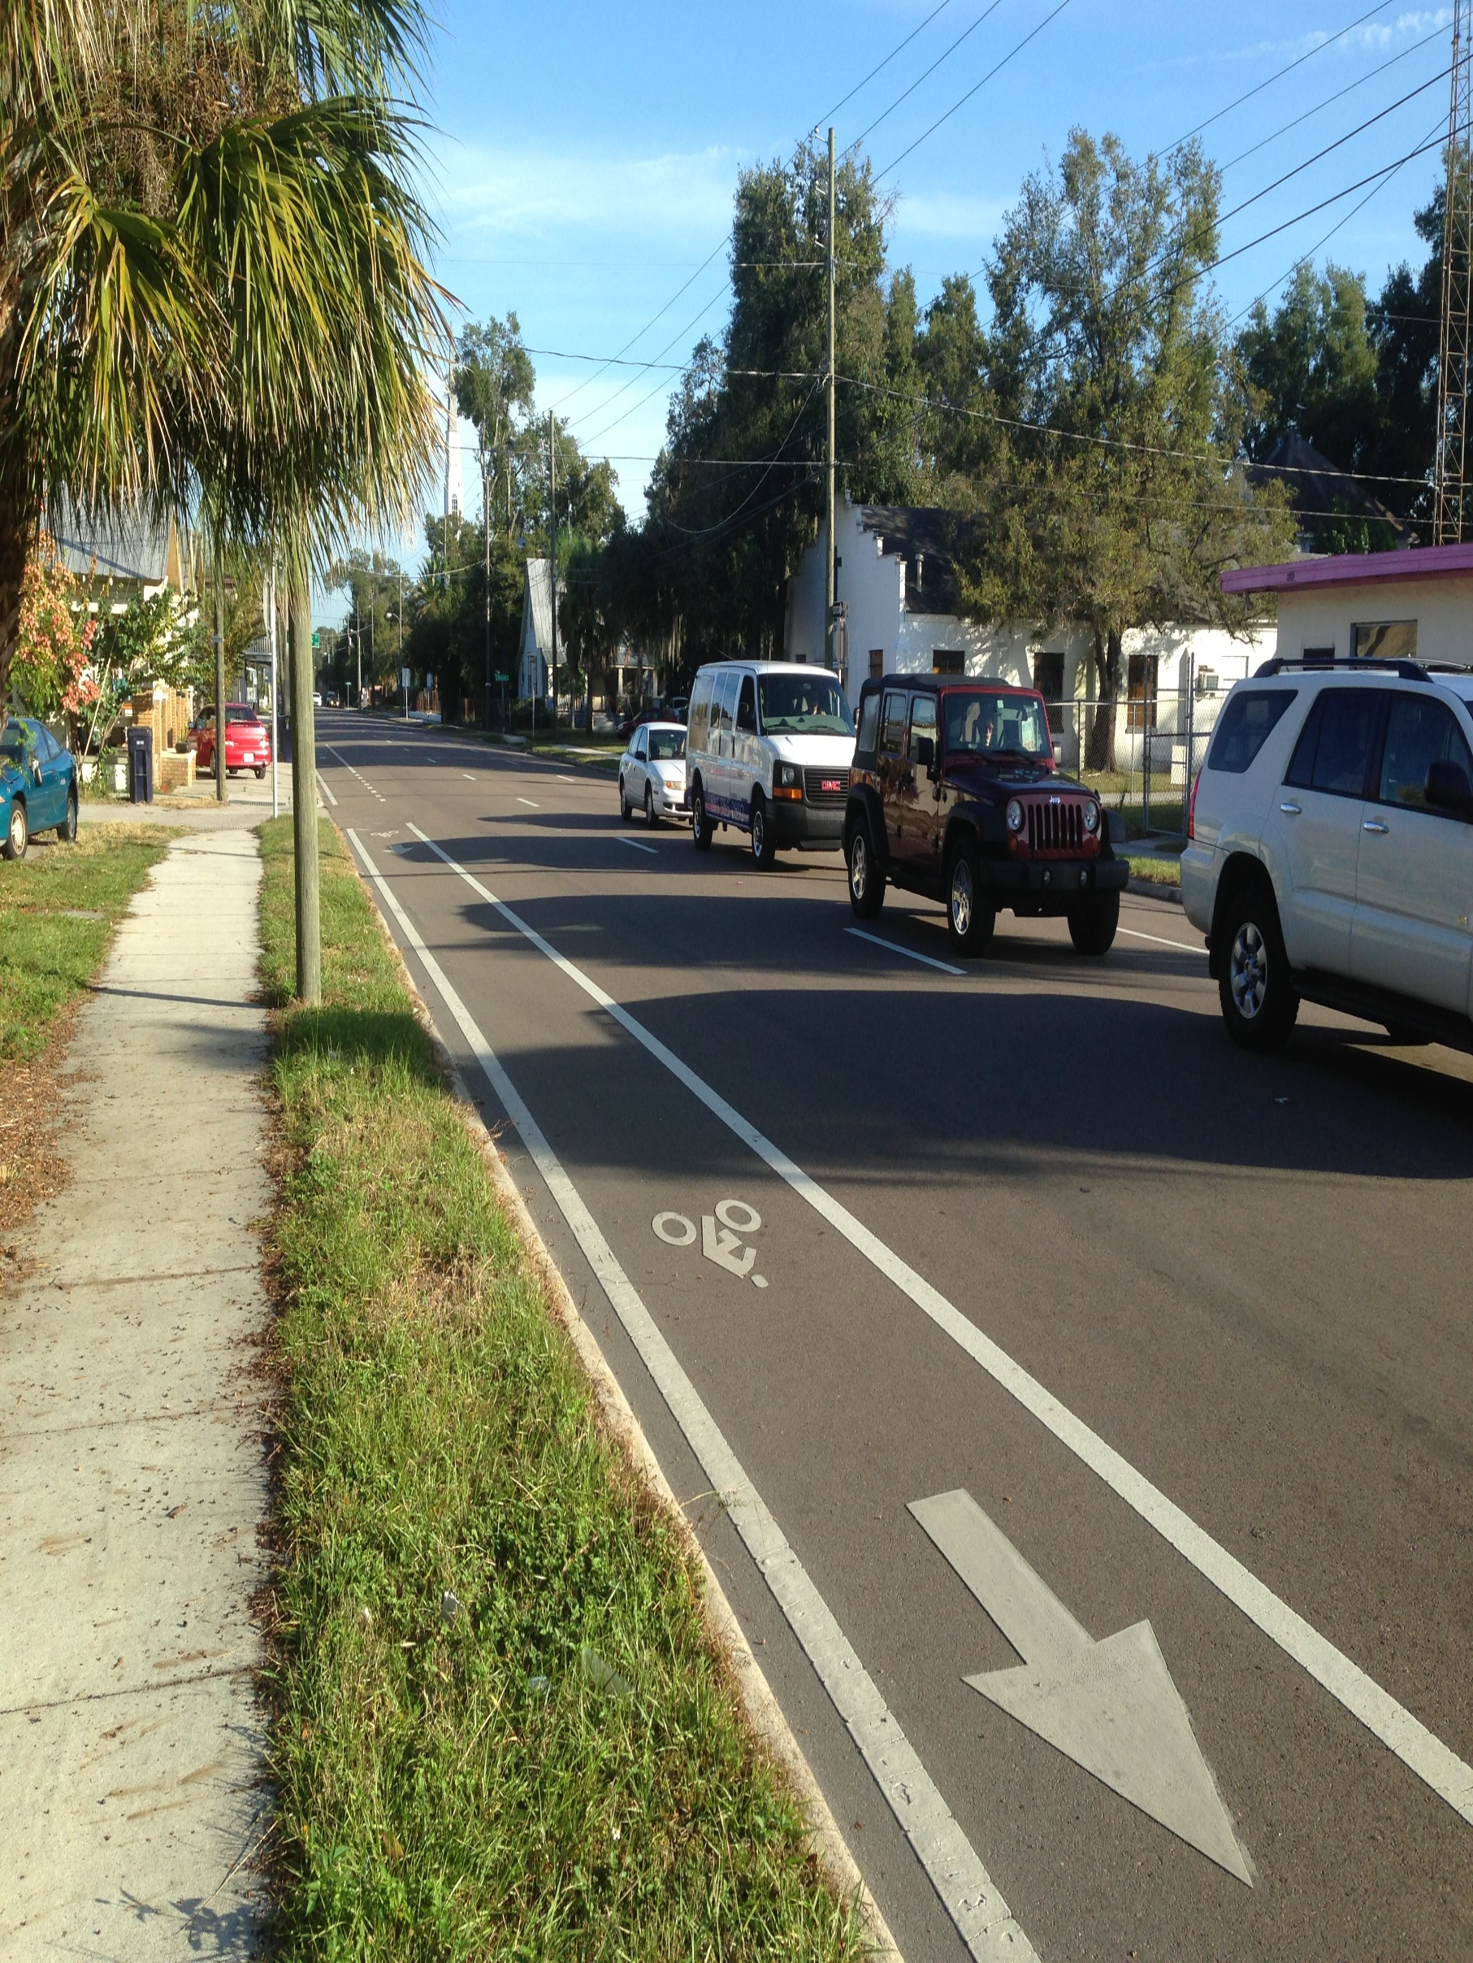
Florida Avenue and Tampa Street/ Highland Avenue Corridor Study
Project Advisory Group Meeting #2
Existing Conditions
August 10, 2015

Slide 2
Study Purpose
Florida Ave & Tampa St/Highland Ave Corridor Study
Identify and evaluate alternative configurations to determine how to best meet the needs of a wide range of users – current and future.
Goal is NOT to provide a definitive recommendation, but to define criteria/performance measures for the corridor to test potential alternatives.

Slide 3
Study Objectives
Florida Ave & Tampa St/Highland Ave Corridor Study
Look at how alternatives can:
  Provide safe access between Downtown and Neighborhoods for drivers, transit users, pedestrians, and bicyclists
    Commercial and neighborhood access
  Serve as a neighborhood “main street” and commercial district
  Serve as a regional transportation corridor
  Contribution to the City’s public realm
  Role in the larger transportation network

Slide 4
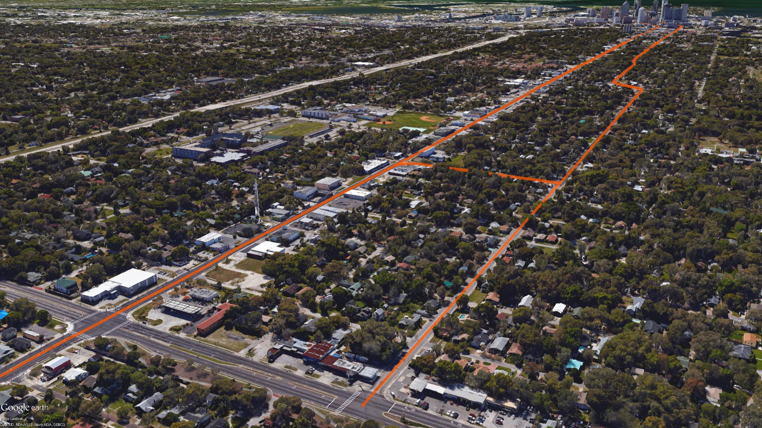
Project Timeline
Florida Ave & Tampa St/Highland Ave Corridor Study
Timeline of PAG Meetings:
Study Area, Model Assumptions, & Evaluation Criteria
Existing Conditions
Identify Alternatives
Review Alternatives Evaluation
Evaluation Outcomes
#1
#2
#3
#4
#5

Slide 5
Project Status Update
Florida Ave & Tampa St/Highland Ave Corridor Study
Status Update:
  MPO Committee Meetings (July)
  Other recent happenings…

Slide 6
PAG Meeting #2
Florida Ave & Tampa St/Highland Ave Corridor Study
Meeting Objectives:
  Work out any modeling inconsistencies
  Review existing conditions

Slide 7
Modeling
Florida Ave & Tampa St/Highland Ave Corridor Study
Status Update

Slide 8
Existing Conditions
Florida Ave & Tampa St/Highland Ave Corridor Study
Purpose:
Existing condition analysis serves as a means to identify and document the “existing conditions” within the corridor that will ultimately serve as the basis for the evaluation of the conceptual corridor alternatives.

Slide 9
Existing Conditions
Florida Ave & Tampa St/Highland Ave Corridor Study
Five Sections:
Existing Roadway/Traffic Conditions
Multimodal Network Inventory
Transit Service Evaluation
Crash History Analysis
Land Use/Socioeconomic Evaluation

Slide 10
Existing Roadway/Traffic Conditions
Florida Ave & Tampa St/Highland Ave Corridor Study

Slide 11
Existing Roadway/Traffic Conditions
Florida Ave & Tampa St/Highland Ave Corridor Study
Existing Roadway Classification
Existing Typical Sections
Existing Volumes
Intersection LOS

Slide 12
Existing Roadway/Traffic Conditions
Florida Ave & Tampa St/Highland Ave Corridor Study
Functional Classification: Urban Minor Arterials
Access Classification 7 (1/4 mile signal spacing)
Posted Speed Limit:
  South of Columbus Dr 35 MPH
  North of Columbus Dr 40 MPH

Slide 13
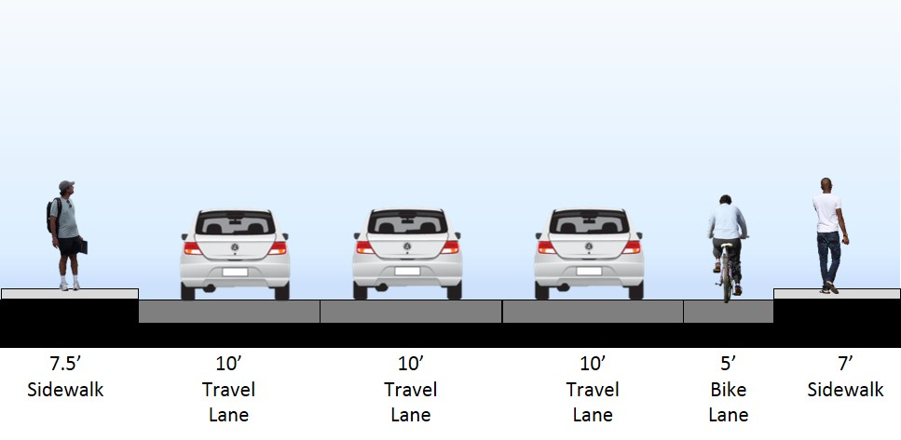
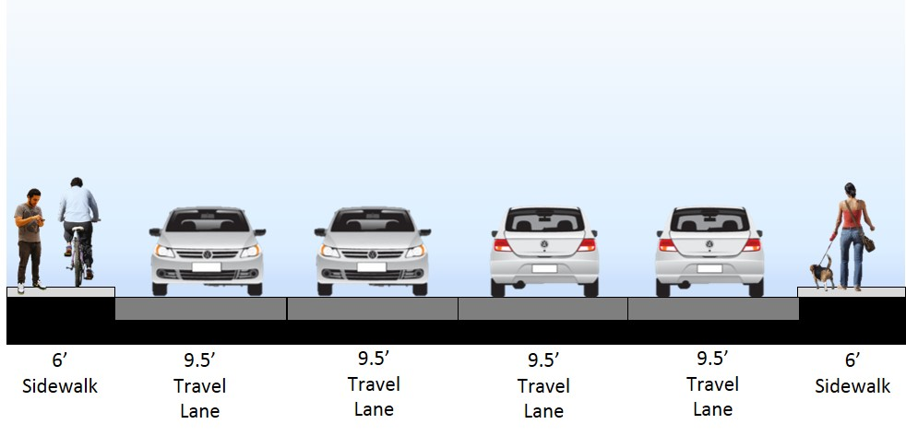
Existing Roadway/Traffic Conditions
Florida Ave & Tampa St/Highland Ave Corridor Study
Existing Typical Sections:
Florida Ave from Scott St to Henderson Ave
Florida Ave from Violet St to Hillsborough Ave

Slide 14
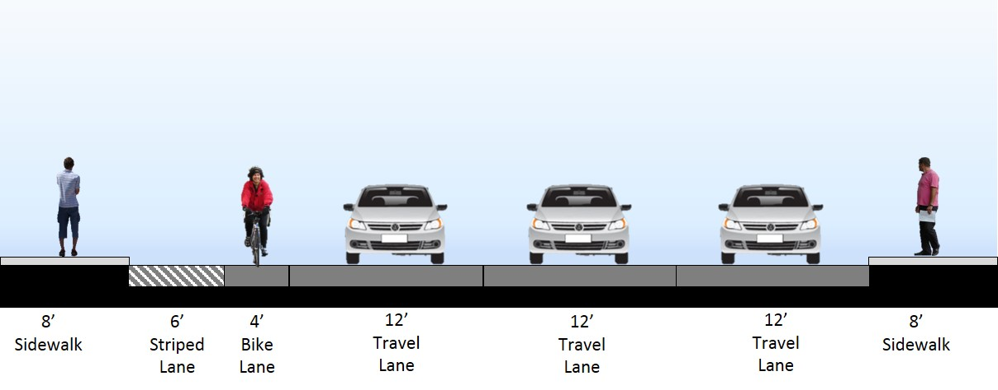
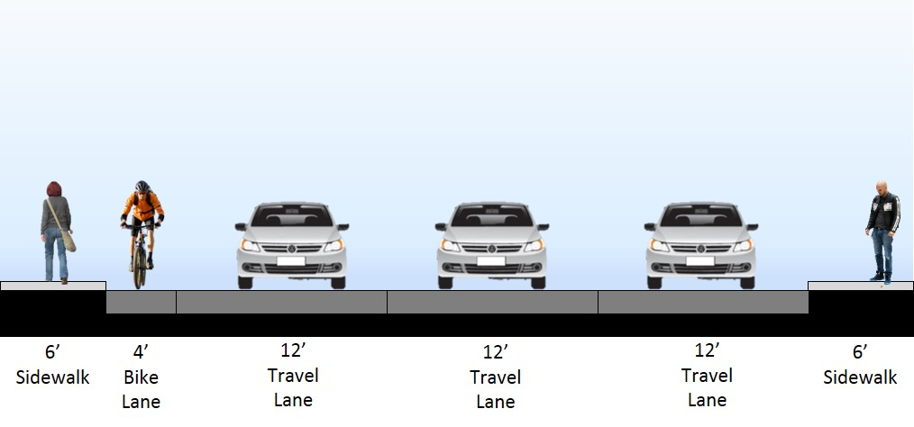
Existing Roadway/Traffic Conditions
Florida Ave & Tampa St/Highland Ave Corridor Study
Existing Typical Sections:
Tampa St from Henderson Ave to Columbus Dr
Tampa St from Columbus Dr to Dr M L King Jr Blvd

Slide 15
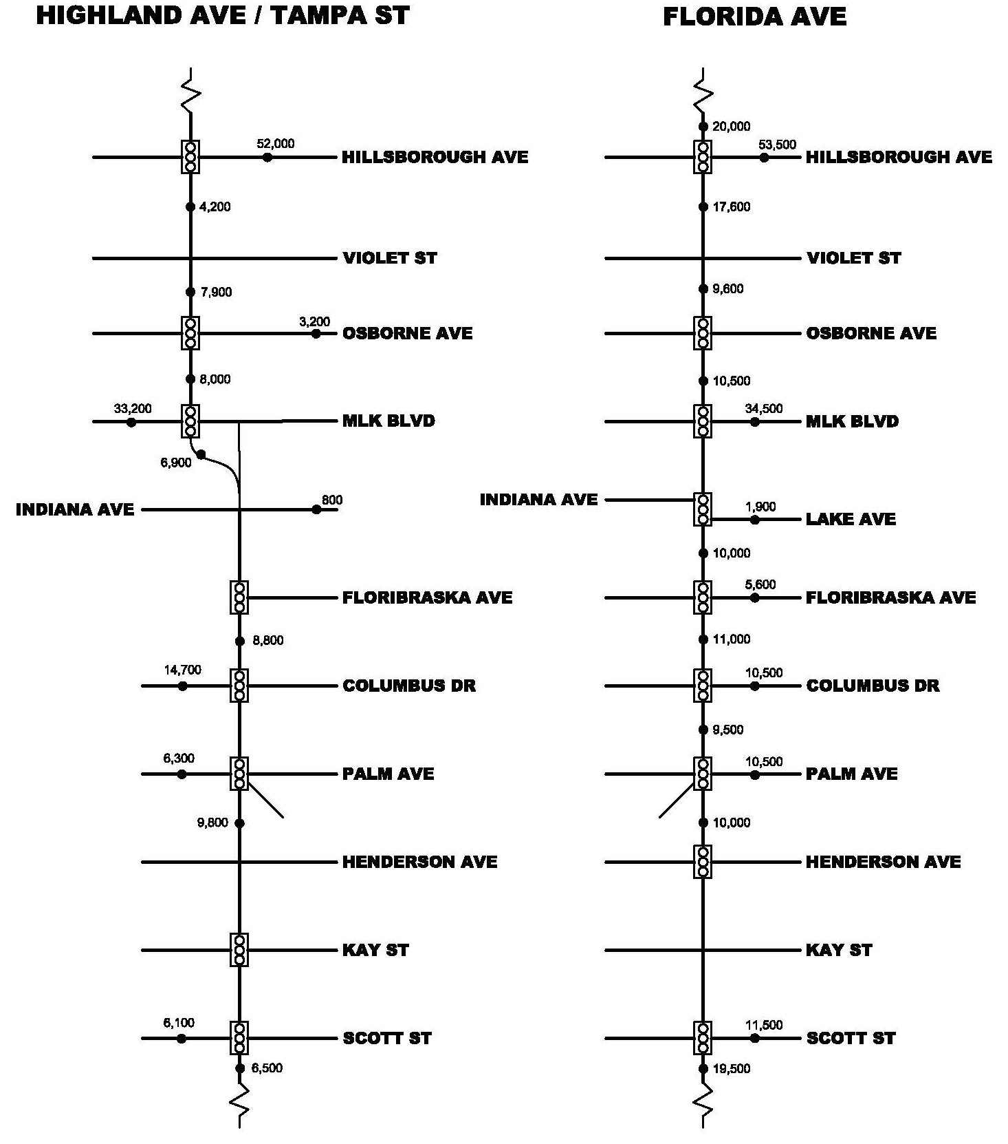
Existing Roadway/Traffic Conditions
Florida Ave & Tampa St/Highland Ave Corridor Study
AADT:
20,000
10,000
19,500

Slide 16
Existing Roadway/Traffic Conditions
Florida Ave & Tampa St/Highland Ave Corridor Study
Historical AADTs:
Florida Ave south of Palm Ave
Tampa St south of Palm Ave
10,000
9,800
Florida Ave north of MLK Blvd
Highland Ave north of MLK Blvd
8,000
10,500

Slide 17
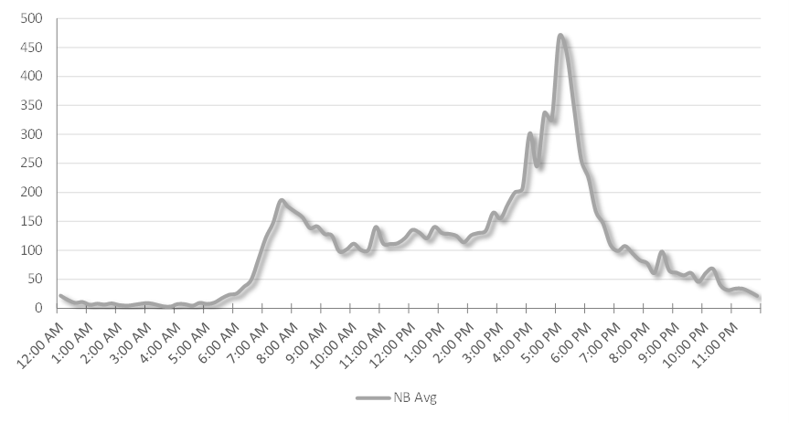
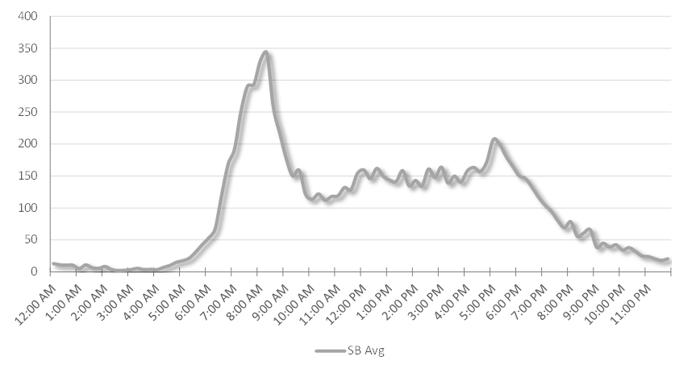
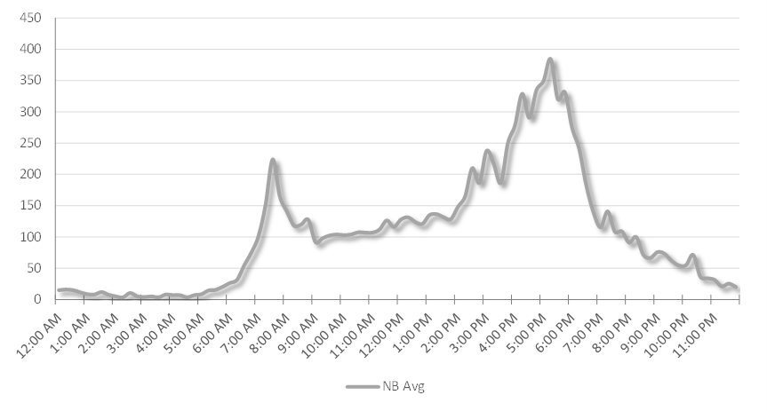
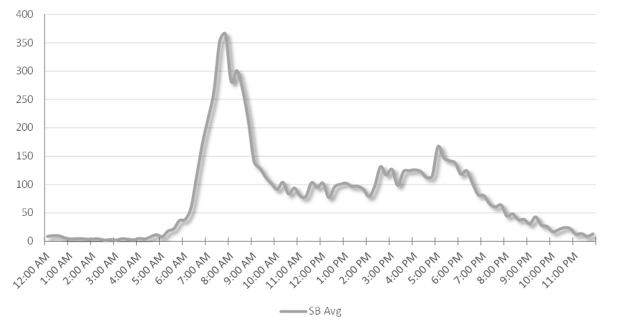
Existing Roadway/Traffic Conditions
Florida Ave & Tampa St/Highland Ave Corridor Study
Daily Traffic Volume:
Florida Ave south of Palm Ave
Tampa St south of Palm Ave
Florida Ave north of MLK Blvd
Highland Ave north of MLK Blvd

Slide 18
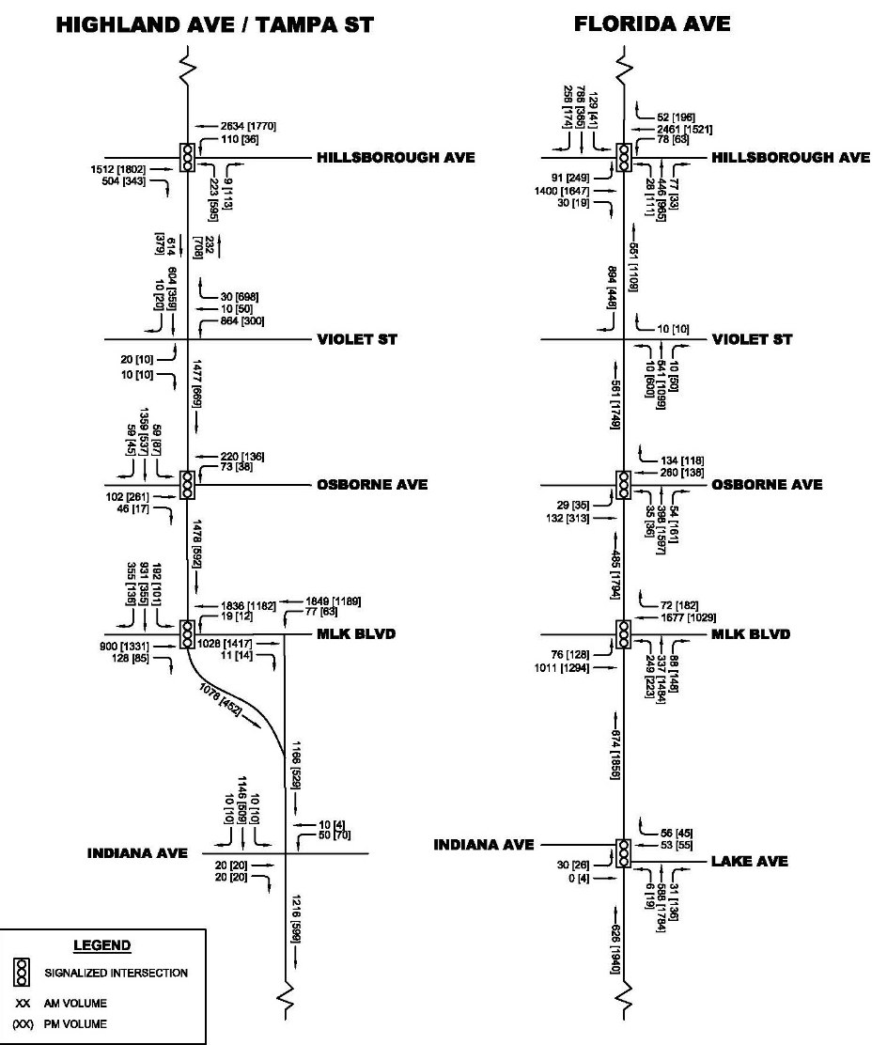
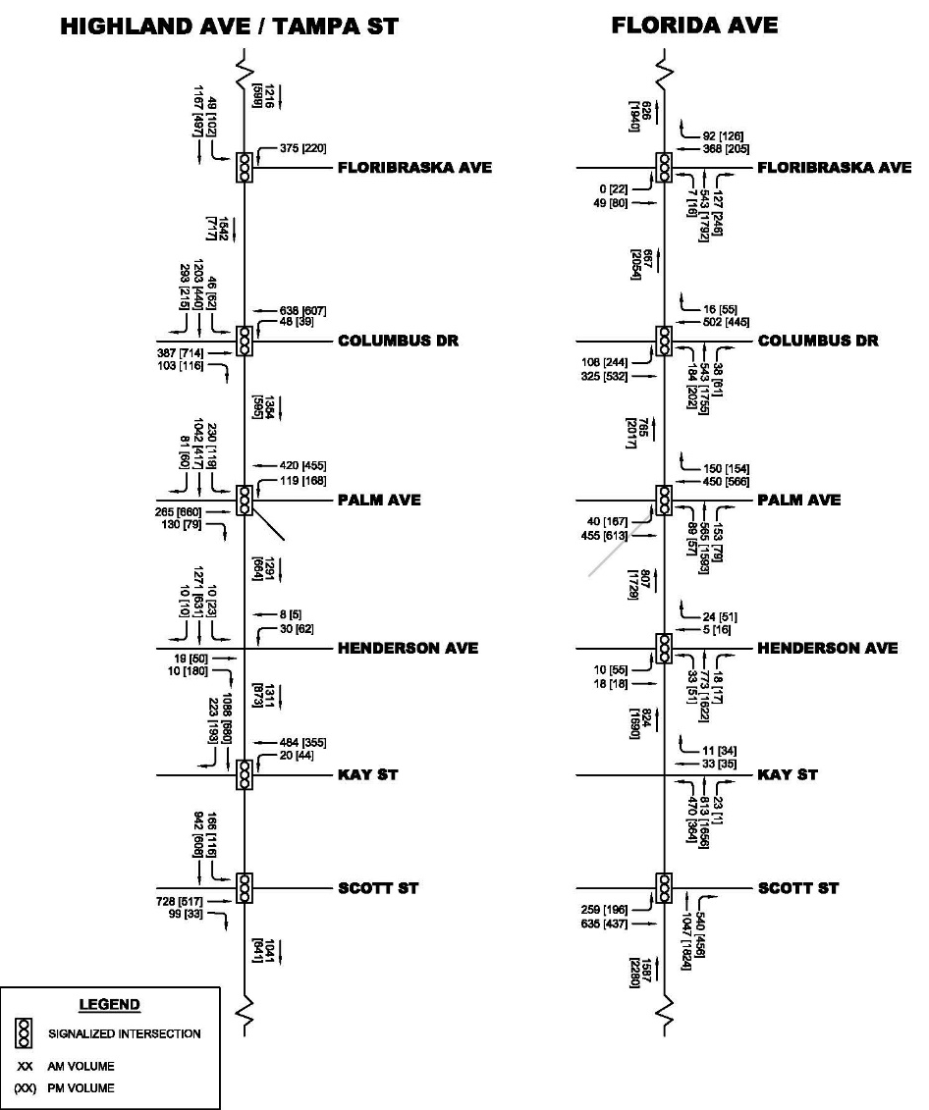
Existing Roadway/Traffic Conditions
Florida Ave & Tampa St/Highland Ave Corridor Study
Turning Movements:

Slide 19
Existing Roadway/Traffic Conditions
Florida Ave & Tampa St/Highland Ave Corridor Study
Turning Movements:
  Florida Ave at Scott St (PM) → 20% Right-Turns
  Florida Ave at Kay St (PM) → 18% Left-Turns
  Florida Ave at Violet St (PM) → 34% Left-Turns
  Florida Ave at Hillsborough Ave (PM NB) → 87% Thru
  Tampa St at Columbus Dr (AM) → 19% Right-Turns
  Tampa St at Kay St (AM) → 17% Right-Turns

Slide 20
Existing Roadway/Traffic Conditions
Florida Ave & Tampa St/Highland Ave Corridor Study
Existing Signalized Intersection Analysis:

Slide 21
Multimodal Network Inventory
Florida Ave & Tampa St/Highland Ave Corridor Study

Slide 22
Multimodal Network Inventory
Florida Ave & Tampa St/Highland Ave Corridor Study
Existing Facilities
Existing Q/LOS
Existing Conditions
  Field Inventory

Slide 23
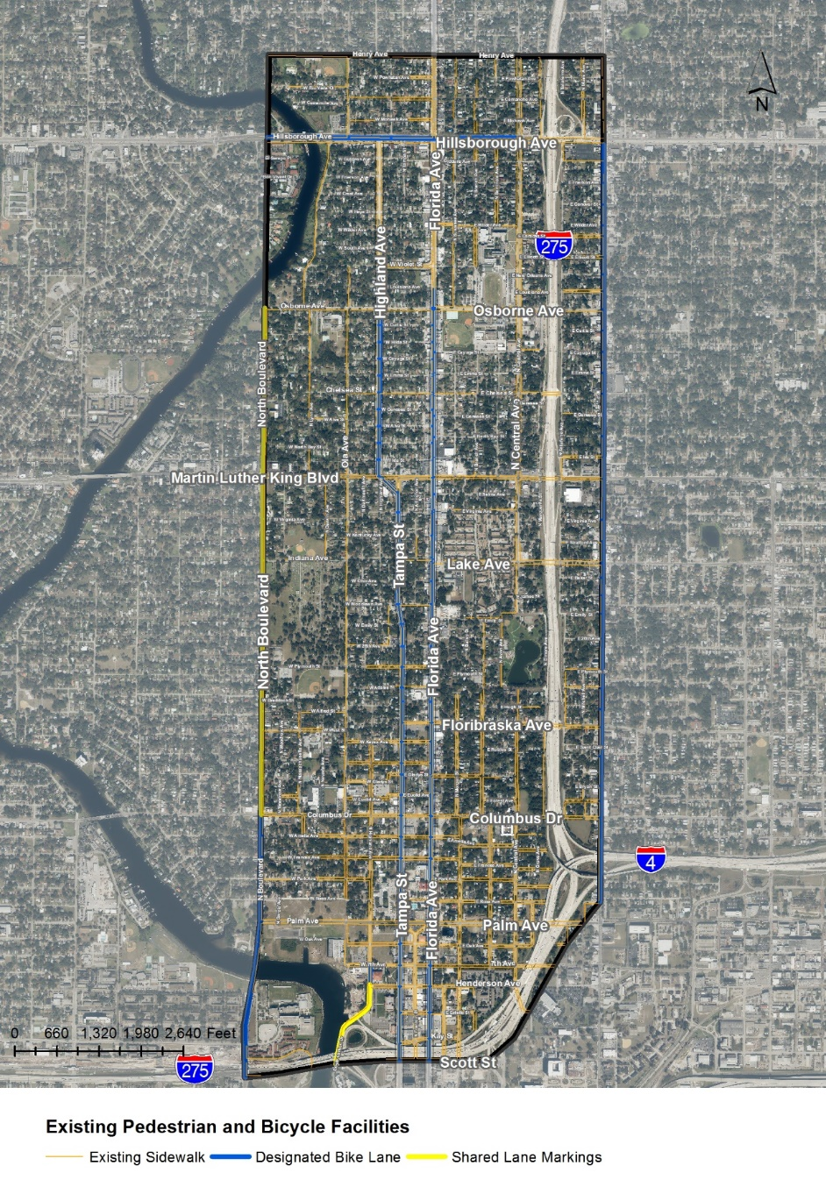
Multimodal Network
Florida Ave & Tampa St/Highland Ave Corridor Study
Sidewalks
Bicycle Facilities
  Bike Lanes
  Shared Lane Markings

Slide 24
Existing Facilities
Florida Ave & Tampa St/Highland Ave Corridor Study
Q/LOS:
Developed in ARTPLAN

Slide 25
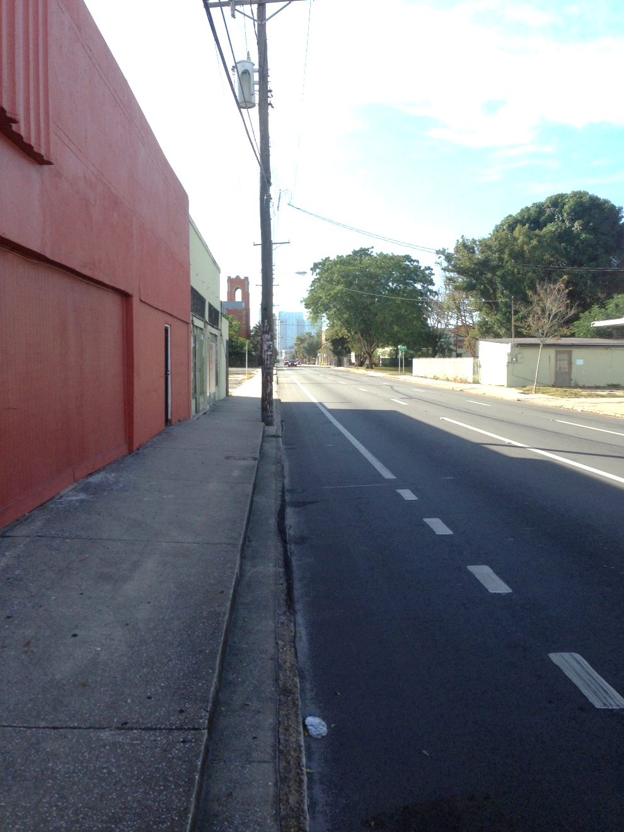
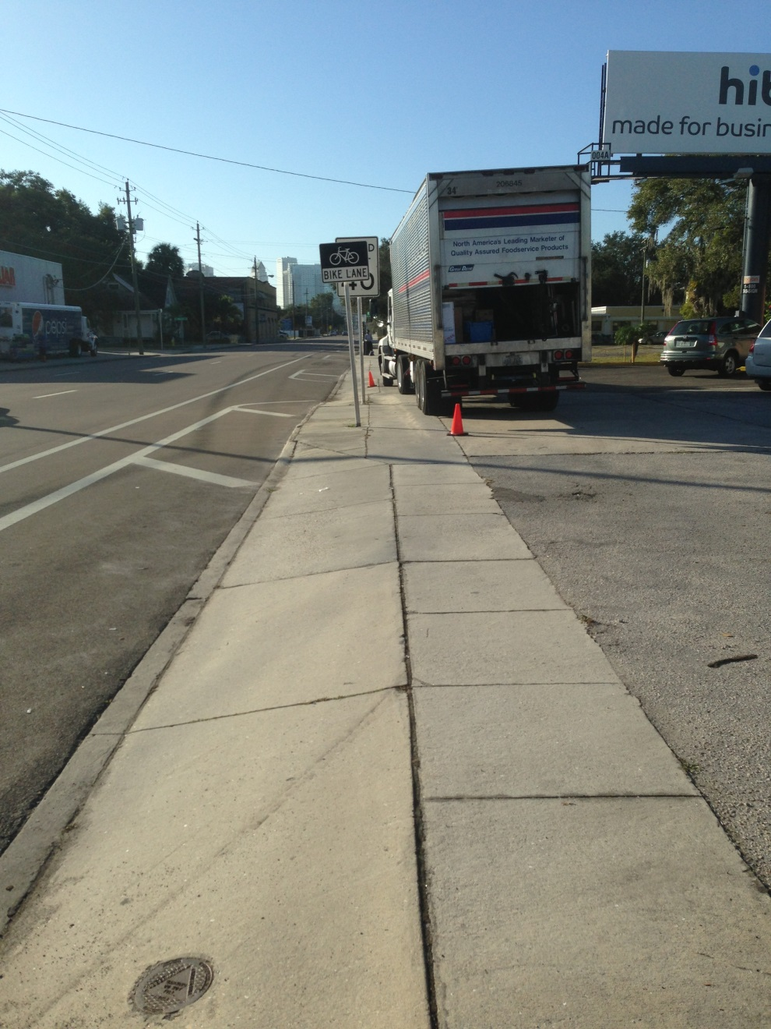
Field Inventory
Florida Ave & Tampa St/Highland Ave Corridor Study

Slide 26
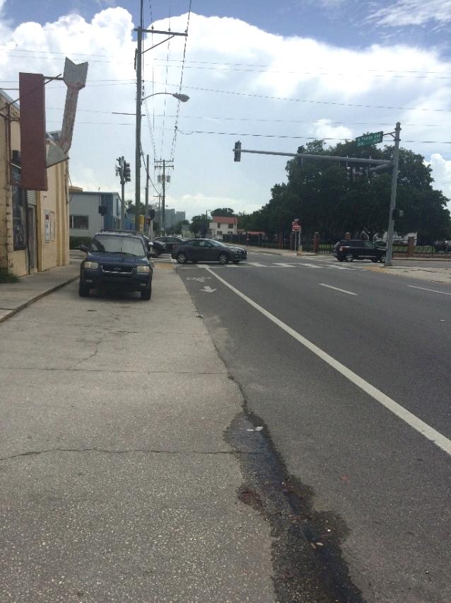
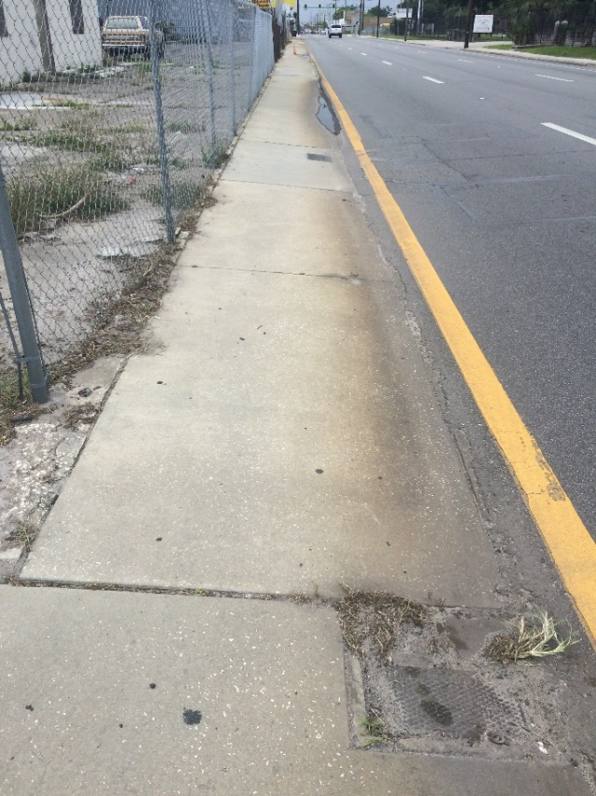
Field Inventory
Florida Ave & Tampa St/Highland Ave Corridor Study
Vertical Structure
Slope
Drainage

Slide 27
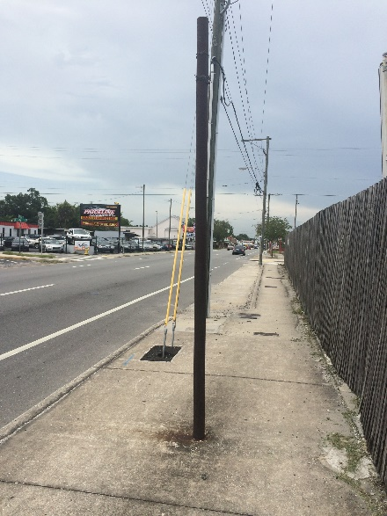
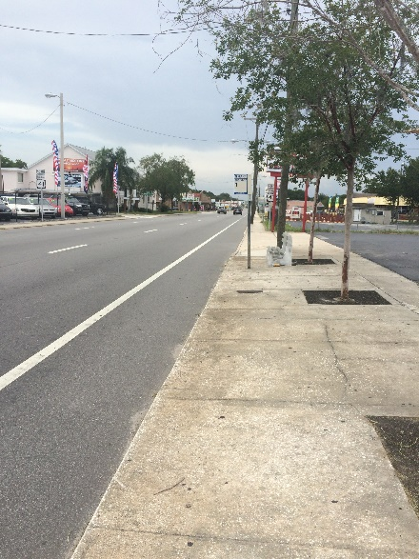
Field Inventory
Florida Ave & Tampa St/Highland Ave Corridor Study

Slide 28
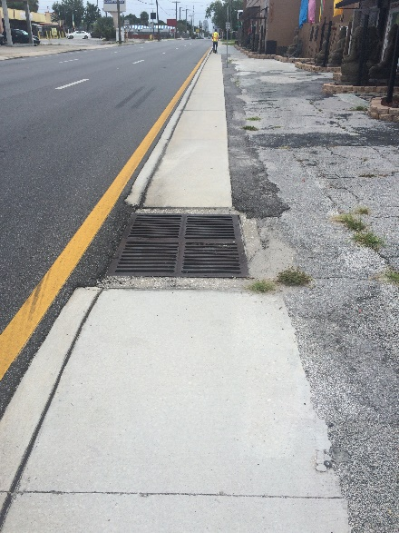
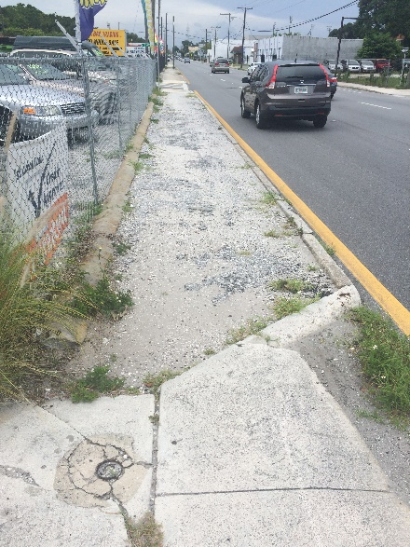
Field Inventory
Florida Ave & Tampa St/Highland Ave Corridor Study

Slide 29
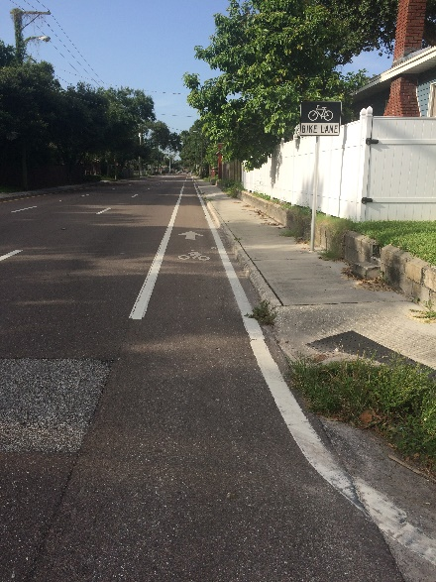
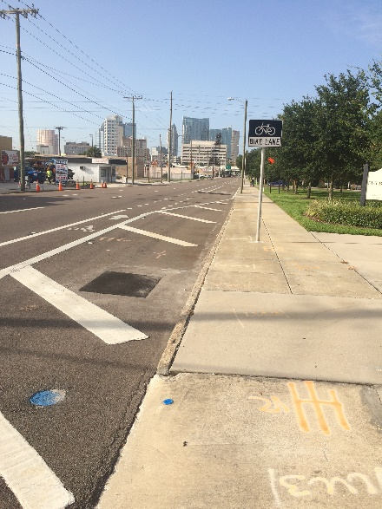
Field Inventory
Florida Ave & Tampa St/Highland Ave Corridor Study

Slide 30
Transit Service Evaluation
Florida Ave & Tampa St/Highland Ave Corridor Study

Slide 31
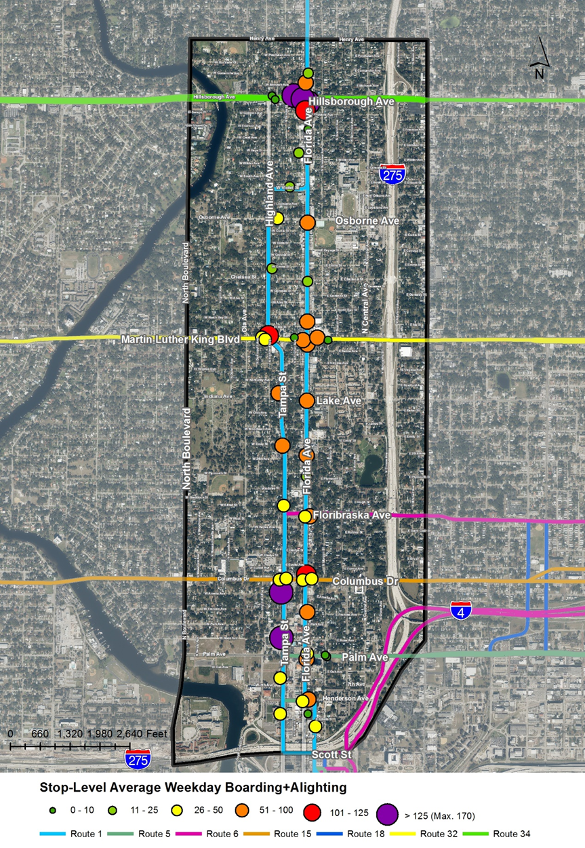
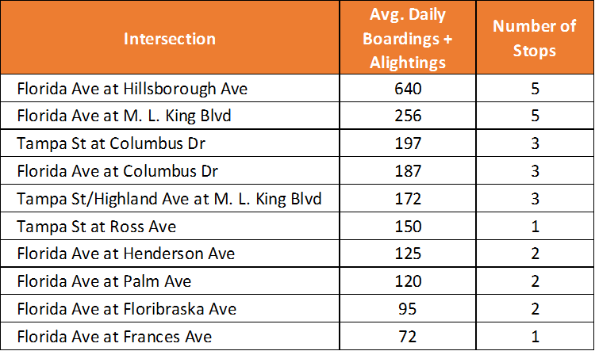
Transit Service Evaluation
Florida Ave & Tampa St/Highland Ave Corridor Study

Slide 32
Crash History Analysis
Florida Ave & Tampa St/Highland Ave Corridor Study

Slide 33
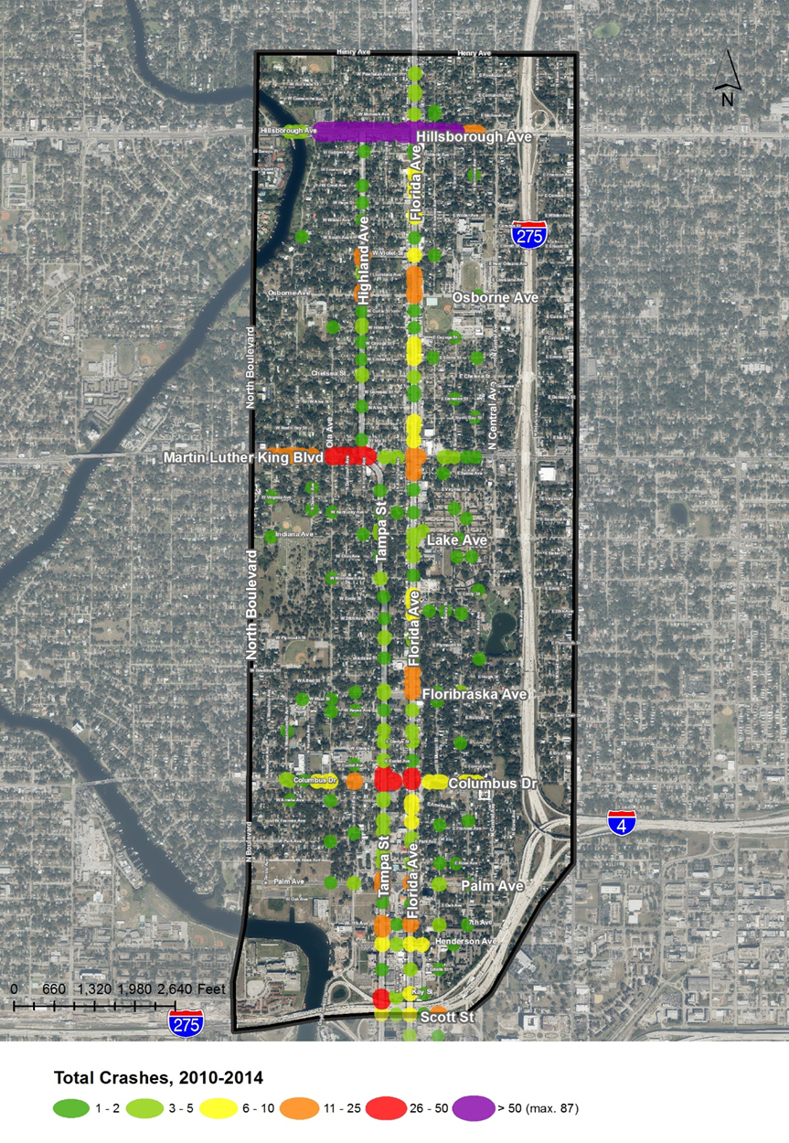
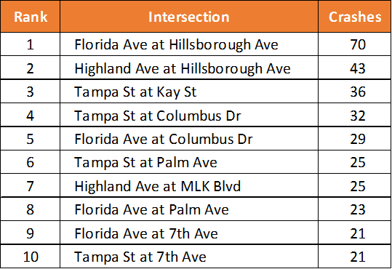
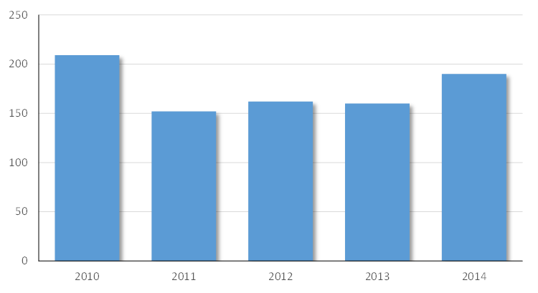
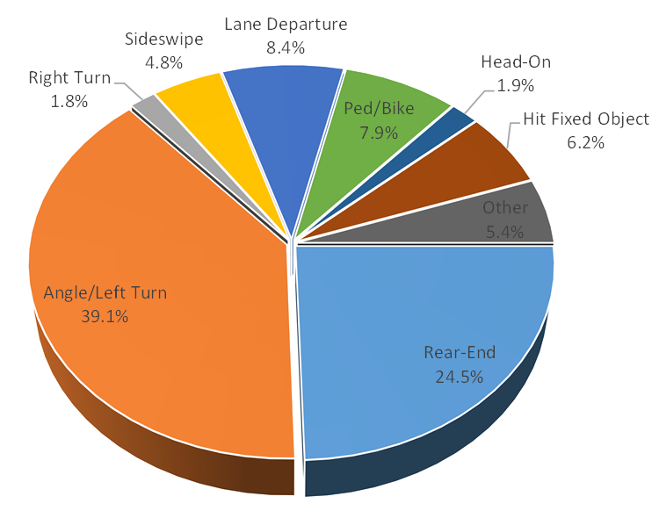
Crash History Analysis
Florida Ave & Tampa St/Highland Ave Corridor Study

Slide 34
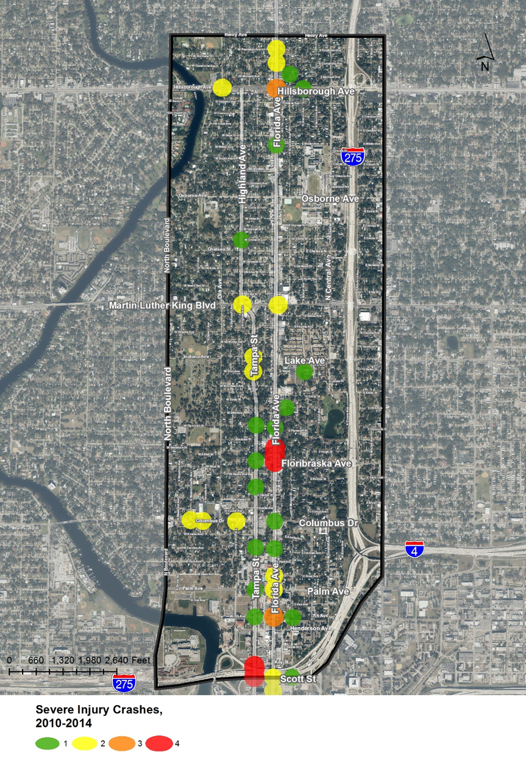
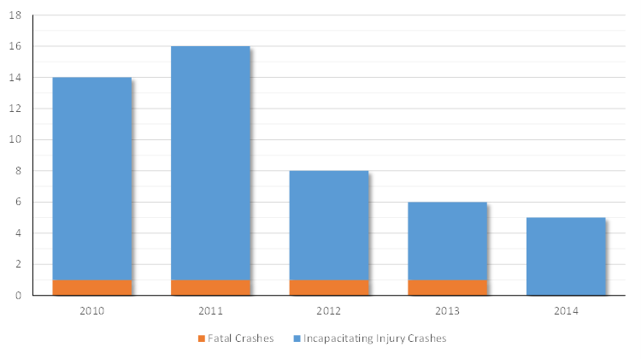
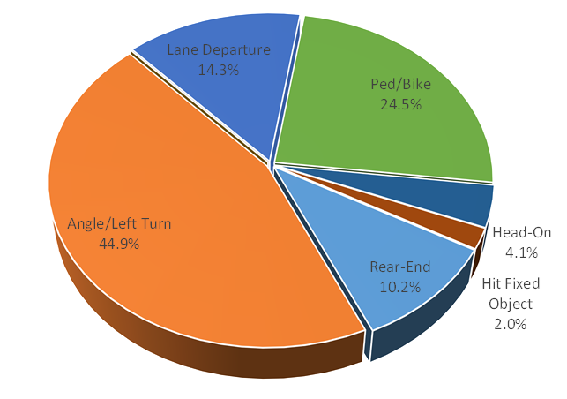
Crash History Analysis
Florida Ave & Tampa St/Highland Ave Corridor Study

Slide 35
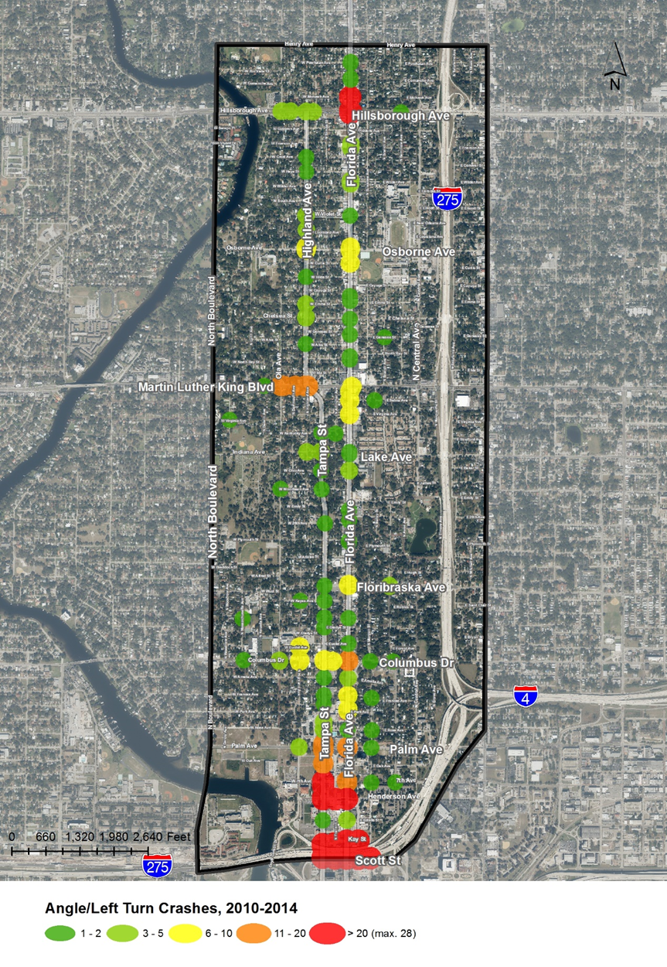
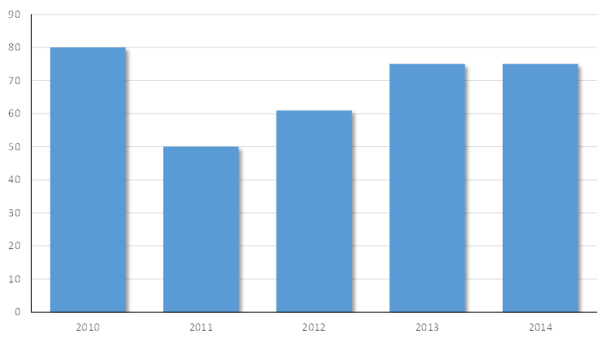
Crash History Analysis
Florida Ave & Tampa St/Highland Ave Corridor Study

Slide 36
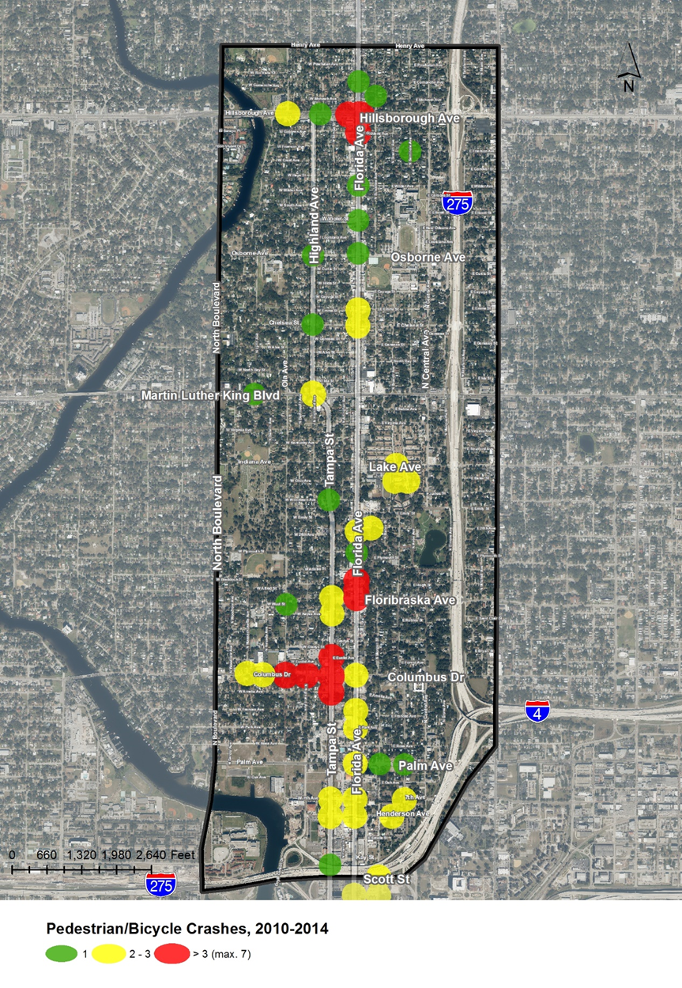
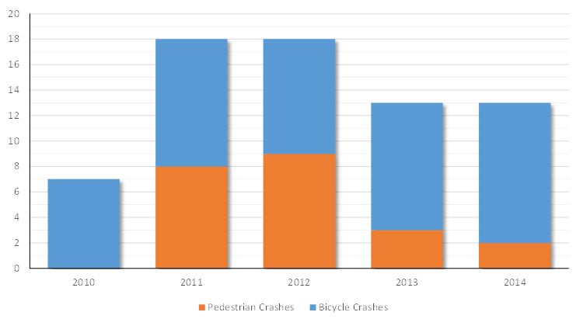
Crash History Analysis
Florida Ave & Tampa St/Highland Ave Corridor Study

Slide 37
Land Use/Socioeconomic Evaluation
Florida Ave & Tampa St/Highland Ave Corridor Study

Slide 38
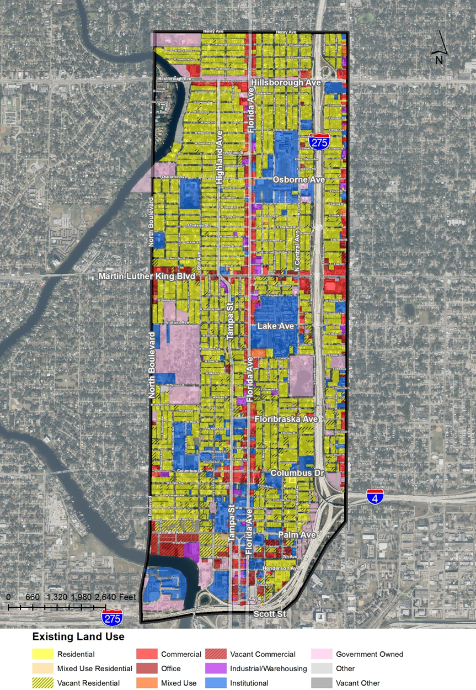
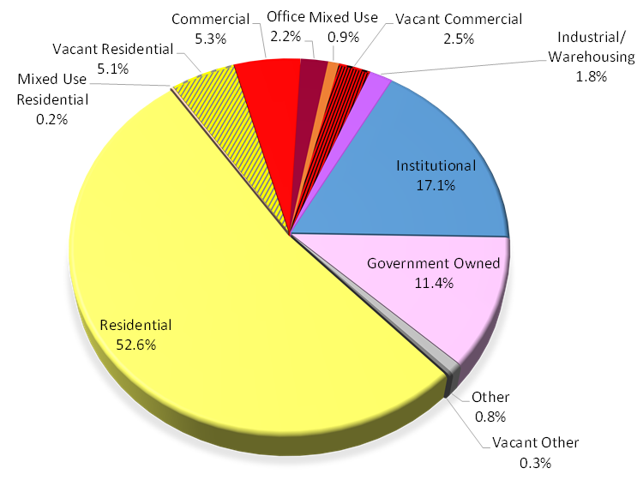
Land Use/Socioeconomic Evaluation
Florida Ave & Tampa St/Highland Ave Corridor Study
Existing Land Use:

Slide 39
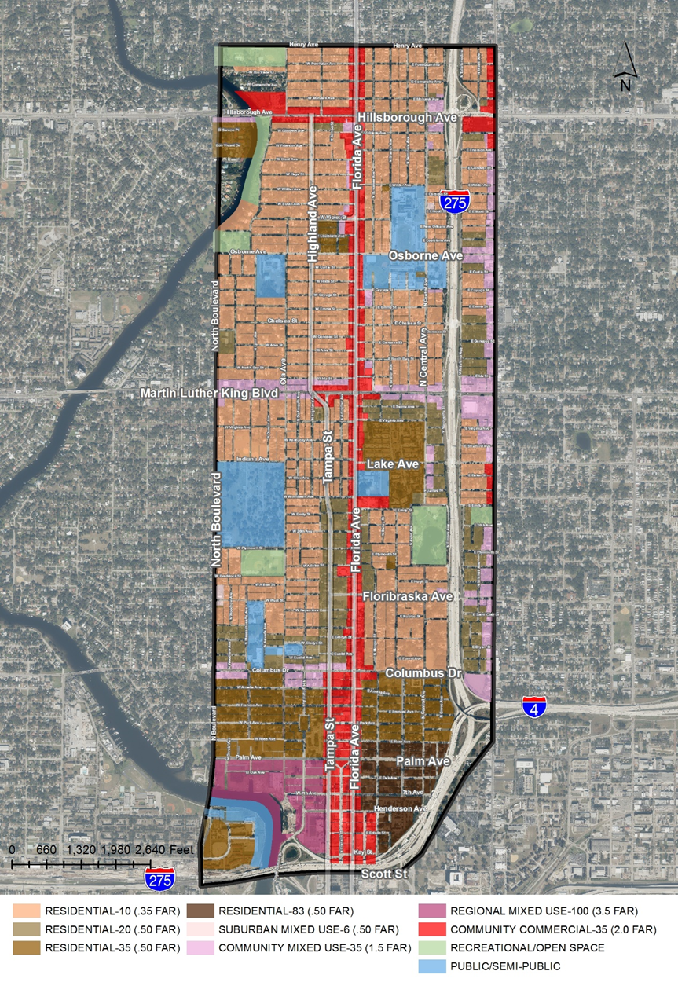
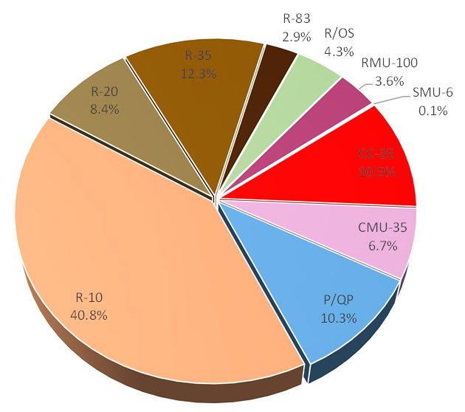
Land Use/Socioeconomic Evaluation
Florida Ave & Tampa St/Highland Ave Corridor Study
Future Land Use

Slide 40
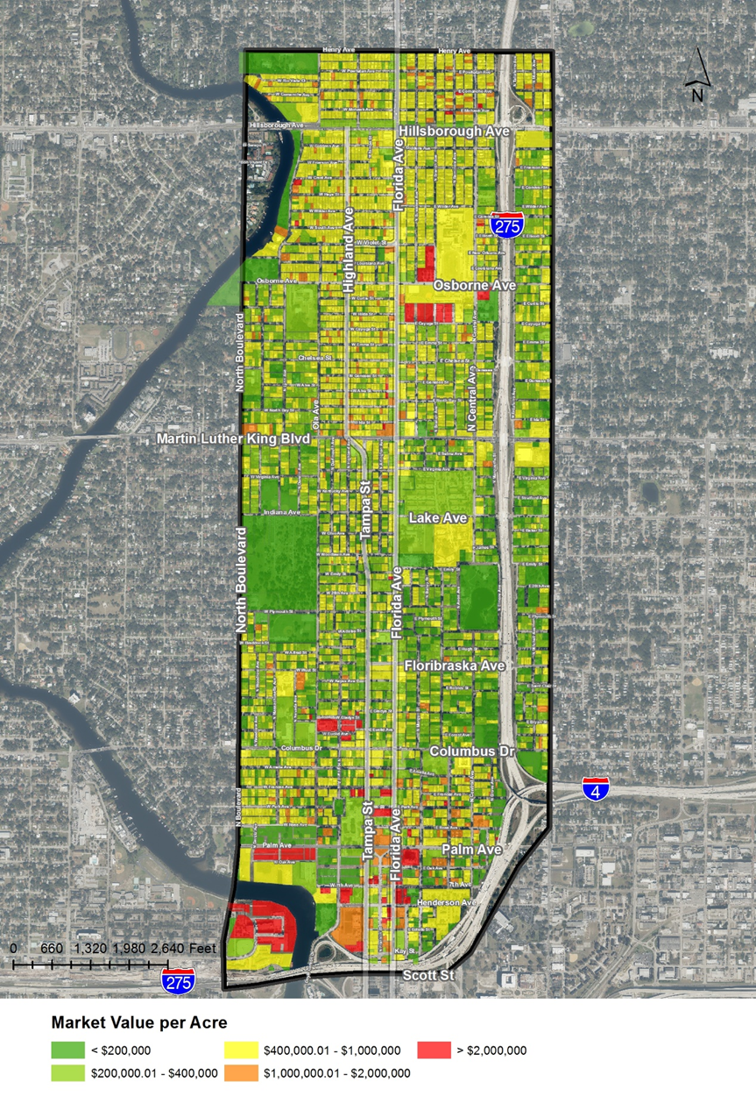
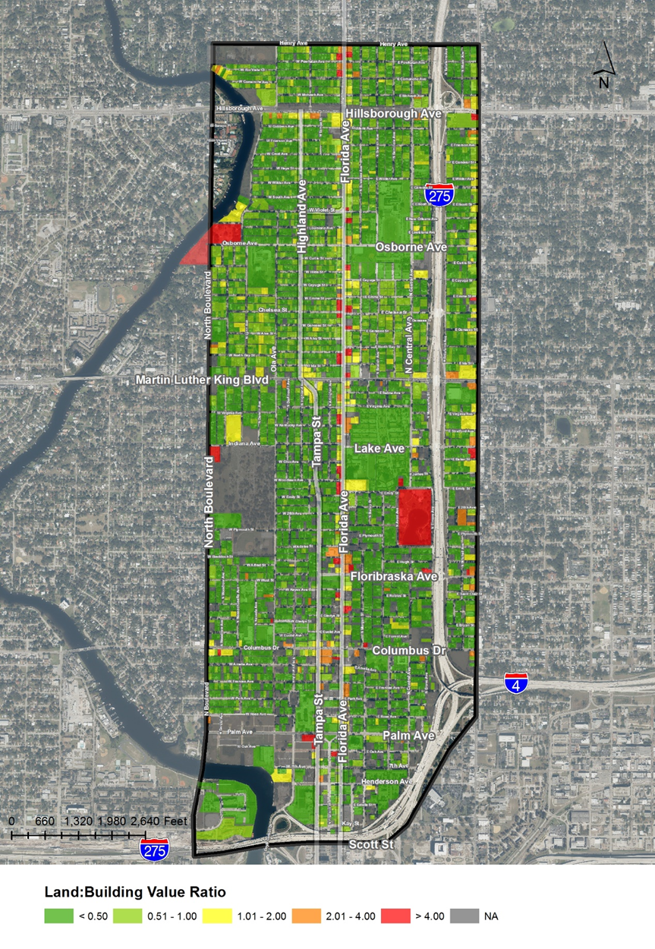
Land Use/Socioeconomic Evaluation
Florida Ave & Tampa St/Highland Ave Corridor Study

Slide 41
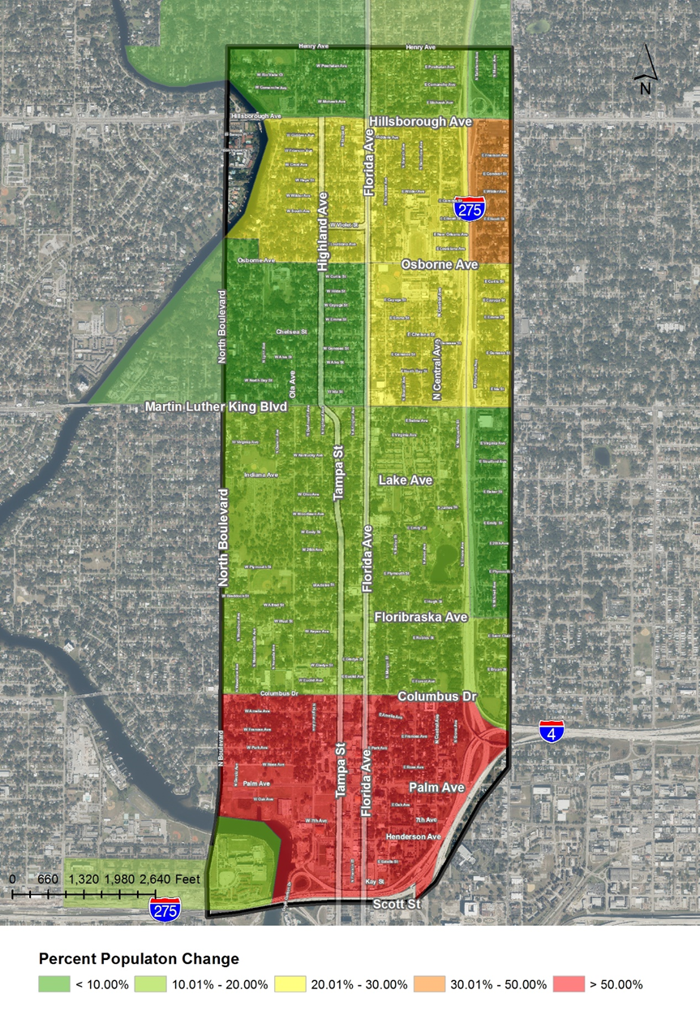
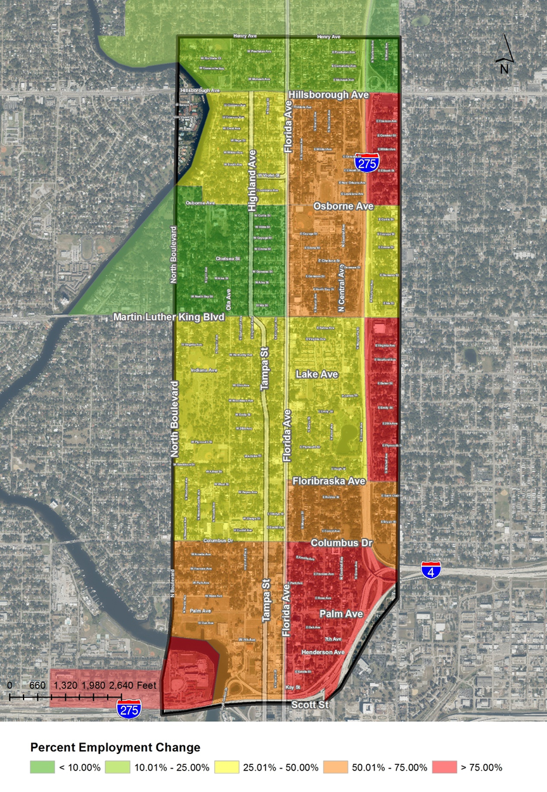
Land Use/Socioeconomic Evaluation
Florida Ave & Tampa St/Highland Ave Corridor Study

Slide 42
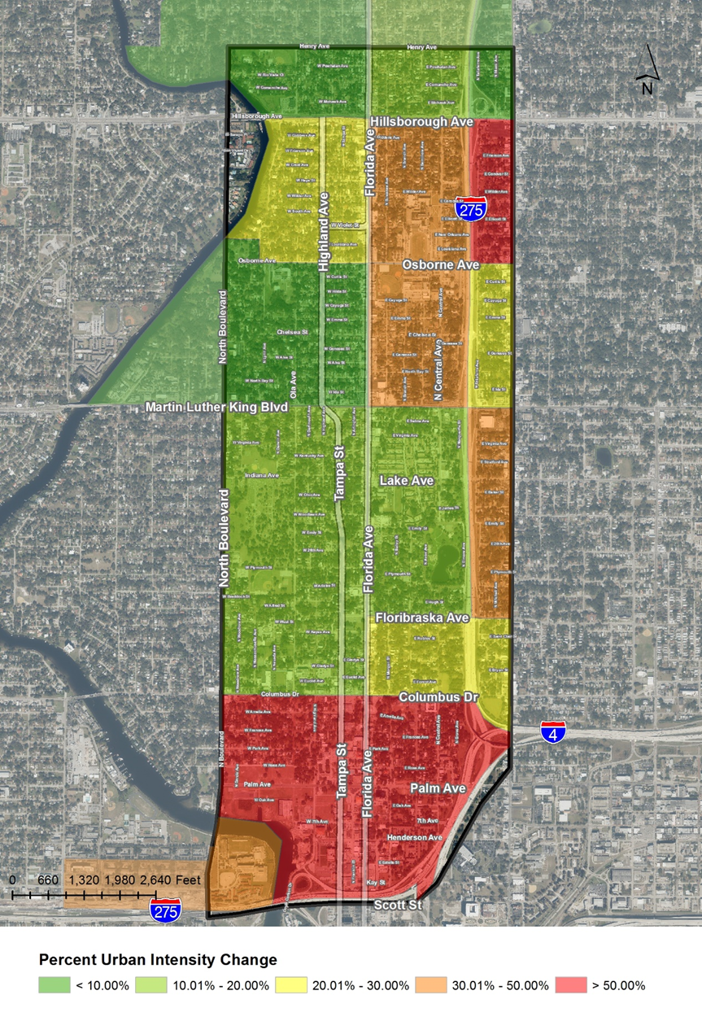
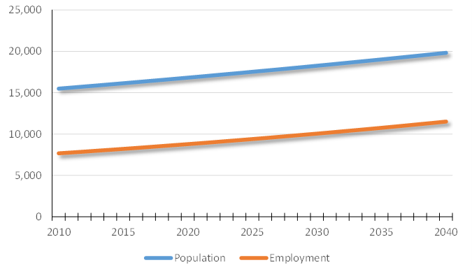
Land Use/Socioeconomic Evaluation
Florida Ave & Tampa St/Highland Ave Corridor Study

Slide 43
Next Steps
Florida Ave & Tampa St/Highland Ave Corridor Study
Develop Corridor Alternatives
Evaluate Alternatives
Refine MOEs and Weighting
Summarize and Document Final Evaluation

Slide 44
Develop Corridor Alternatives
Florida Ave & Tampa St/Highland Ave Corridor Study
Identify up to four Build Alternatives for evaluation.
  We’ll present a No Build and up to six Build Alternatives at the next PAG Meeting.
  Potential Alternatives:
    One-way pair with lane reduction and corridor enhancements
    Two-way for portion of study area
    Two-way throughout the study area
    Dynamic lane assignment by time of day

Slide 45
Next PAG Meeting
Florida Ave & Tampa St/Highland Ave Corridor Study
Study Area, Model Assumptions, & Evaluation Criteria
Existing Conditions
Identify Alternatives
Review Alternatives Evaluation
Evaluation Outcomes
#1
#2
#3
#4
#5

Slide 46





Florida Avenue and Tampa Street/Highland Avenue Corridor Study

