Slide 1
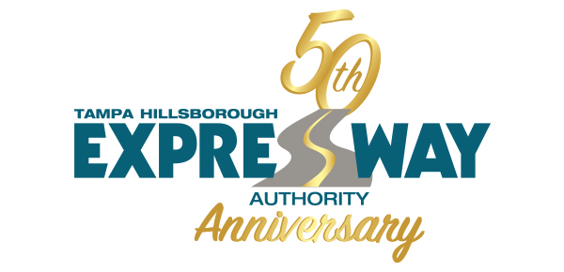
THEA Overview

Slide 2
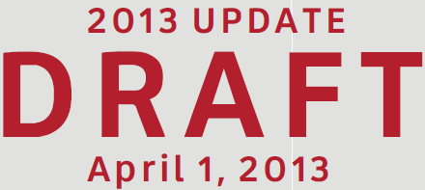
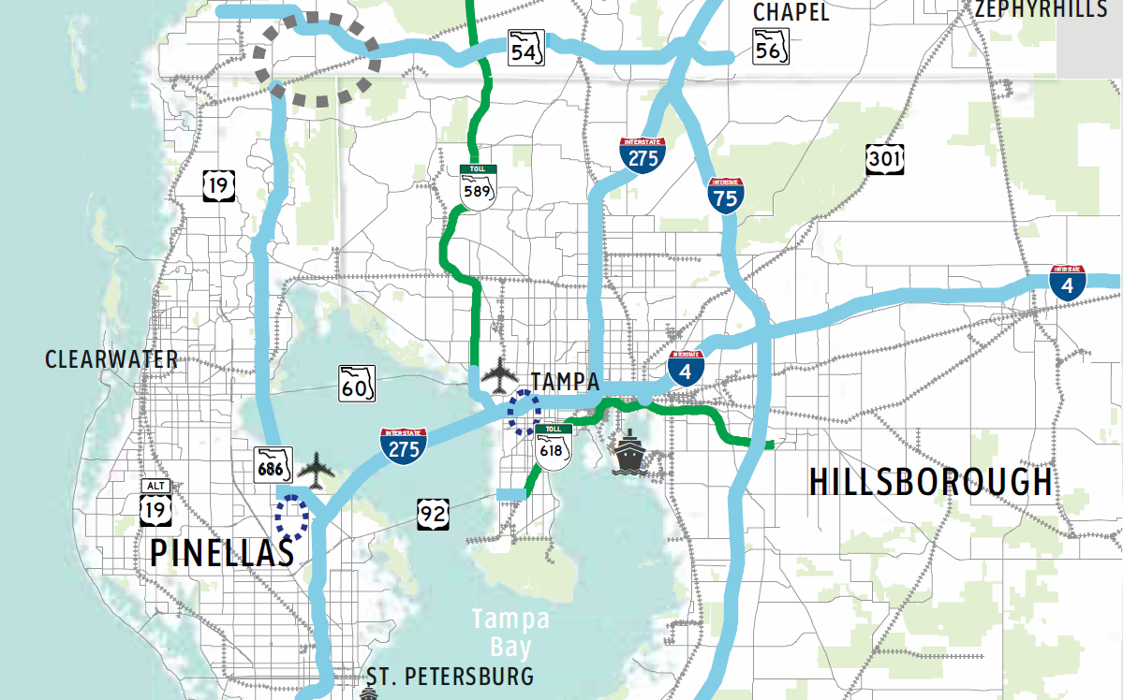
(Excerpt for Hillsborough County)
Notes:
Opportunity:
Ridership and revenue potential is large.
This regional plan shows over 200 miles of managed lanes in the Tampa Bay Region being planned by FDOT
BTL Network #1 = 65 miles – estimated revenue of $3.5 billion (conservative)
BTL is a Public Partnership (P2) Local/State/Federal – it is a financing concept that would preserve revenue as means to fund transit operating and maintenance costs rather than just covering P3 financing of construction costs.
Retains control of revenue for use by local jurisdictions (tolls and bus fares paid by commuters)
Provides funds to enhance mobility over time as congestion grows

Slide 3
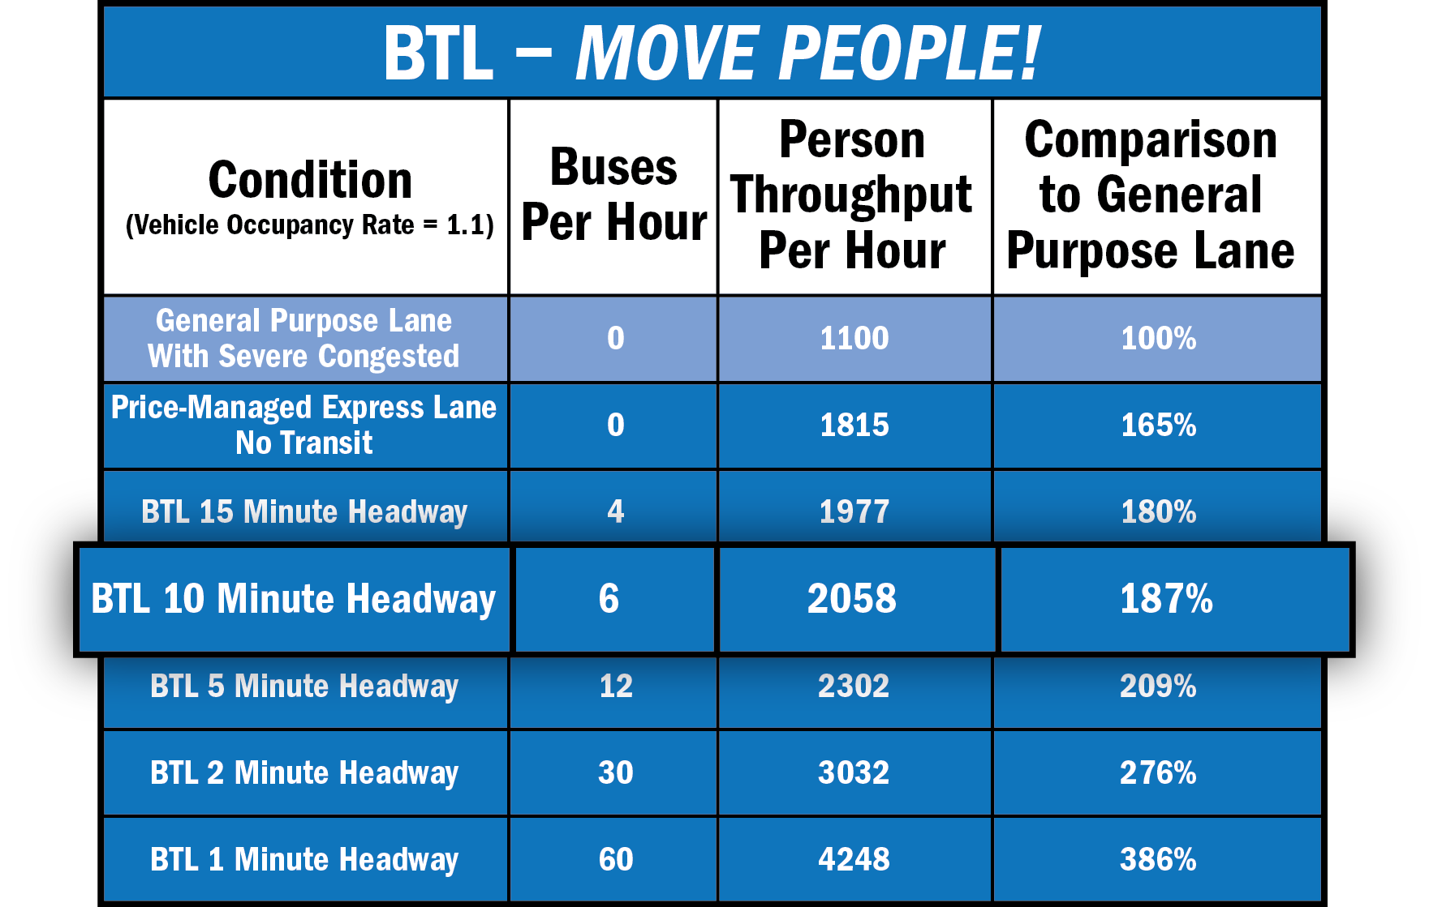
Price-Managed Lanes
Comparison to Other Lane Types
Notes:
This table lists other types of public-transportation managed-lane concepts and the comparative service and financial benefits.
BTL’s provide the same or better service with greater financial benefits

Slide 4
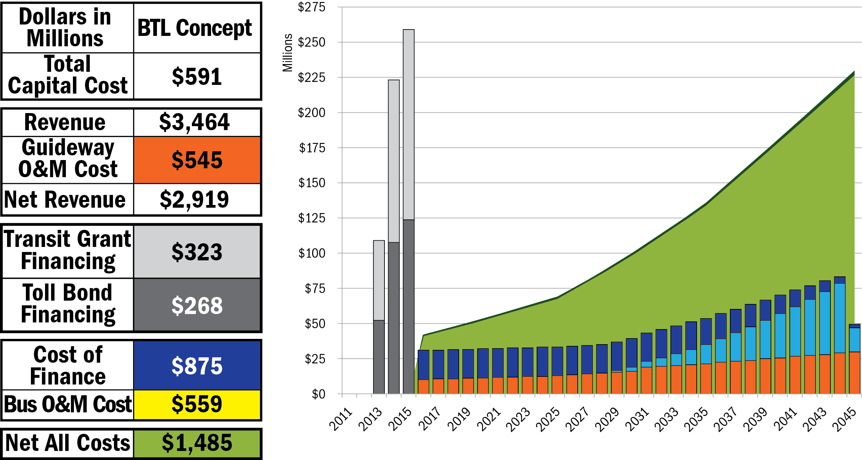
Traditional Funding Challenges
Price Managed Lane
Dollars in Millions | Fixed Guideway
Guideway Capital Cost | $560
Toll Revenue | $3,406
Guideway O&M Cost | $545
Net Revenue | $2,861
Toll Bond Financing | $268
Cost of Finance | $858
Net All Costs | $2,003
Unfunded Capital | ($292)
The Tolling Challenge

Slide 5
Traditional Funding Challenges
Price Managed Lane
Premium Bus Service
Dollars in Millions | Fixed Guideway
Guideway Capital Cost | $560
Toll Revenue | $3,406
Guideway O&M Cost | $545
Net Revenue | $2,861
Toll Bond Financing | $268
Cost of Finance | $858
Net All Costs | $2,003
Unfunded Capital | ($292)
Dollars in Millions | New Premium Bus
Bus Capital Cost | $31
Bus Revenue | $58
Bus O&M Cost | $559
Net Revenue | ($501)
Unfunded Operating | ($501)
The Transit Challenge
The Tolling Challenge
Notes:
Here we add the M&O cost (including Major Maintenance - bumps) to support that service - as shown by the yellow bars
That cost is $559 million over the thirty year period.
The $58 million of farebox revenue falls $501 million short of cost.
Support for transit O&M over 30-years is many times more costly than the capital cost investment.
This is typical of public transportation – no matter what form. Toll roads may be an exception to the rule – but not every transportation need can be addressed by tolls
This demonstrates the real challenge for public transportation.

Slide 6
Bus Toll Lane Concept
A Transit Concept
Combining Transit and Toll Finance Elements
Transit Pays to Help Build The New Express Lanes
Price Managed for Service – Keep Highway Speed
Buses Have First Call On Express Lane
Drivers Willing To Pay Toll Use the Express Lane
Helps “Free” Lanes too
Assure Trip Time and Schedule Reliability
Makes Transit a Competitive Choice
Provides Revenue to Grow Future Mobility
Notes:
BUS Toll Lanes is THEA’s new idea to help us find new transit resources and address our future Transportation needs efficiently
WE are Inviting Transit to the Toll business
Provide Transit with Competitive Edge
Basic Definition: Transit solution using BRT and price managed lanes – capacity above that needed for BRT is available to drivers willing to pay a toll.
The Difference is we want the Transit Agency – not just the Toll Agency – to be an owner. This would entitle them to excess revenue based on their equity investment.
Combining tolling and BRT Can give Transit a Service and Revenue Benefit
Since Transit built the Express Lane, Transit would get the net revenues from the cars paying the toll.
The Express Lane Transit Service could pay for itself
This Express Lane could help fund other transit-related projects

Slide 7
Bus Toll Lane Concept - Funding
BTL 1 CONCEPT
Toll Bond | $268
Transit Grant | $323
Notes:
Using the same bond structure discussed earlier, the revenue could provide $268 million, or 45% of the capital cost for the BTL network.
This toll-bond financing now serves as a new source of local matching funds to the transit grant, which here provides
$323 million to complete funding of capital cost to implement the BTL as a premium transit service. Those funds would come from traditional transit grant sources at the federal, state and local level.
This $323 million is the equity investment that makes the transit agency the 100% owner of the revenue stream in this scenario – which allows the remaining $2 Billion to be used for…

Slide 8
BTL 1 Concept - Funding
BTL 1 CONCEPT
Toll Bond | $268
Transit Grant | $323

Slide 9
BTL 1 Concept - Funding
BTL 1 CONCEPT
Toll Bond | $268
Transit Grant | $323

Slide 10
Bus Toll Lane 1 Sources of Capital ($591 Million)

Slide 11
Bus Toll Lane 1 Use of Revenue Value = $3,463 Million 30 Year Forecast
($268 Million Bonds)

