Slide 1
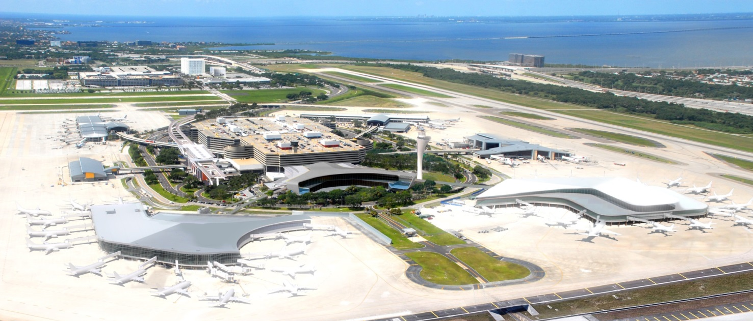
Tampa Bay Regional Transportation Summit
October 10, 2013

Slide 2
Airport Master Plan Process
A Master Plan update is required by the FAA every 5 to 7 years. Last TPA Master Plan was done in 2005.
Master Plan are required to ensure that appropriate planning and funding strategies are in place.
This plan has had extensive input from all stakeholders, including our governor board, airlines and the public.
The plan was formally adopted by our Board of Directors in April.

Slide 3
20-Year Passenger Forecast

Slide 4
Major Findings
Main terminal: Nearing maximum capacity
Rental cars: At capacity today
Curbside: Nearing maximum capacity
Roadways: Nearing maximum capacity
Long-term parking: At maximum capacity

Slide 5
Recommendations
Main terminal area needs to be decongested as soon as possible
Major source of congestion is curbside rental car facilities. Moving these facilities provides solution to:
Rental Car Growth
Curbside Congestion
Roadway Congestion
Parking Capacity
Once main terminal area is decongested it can grow to handle passengers for the next 20 years.

Slide 6
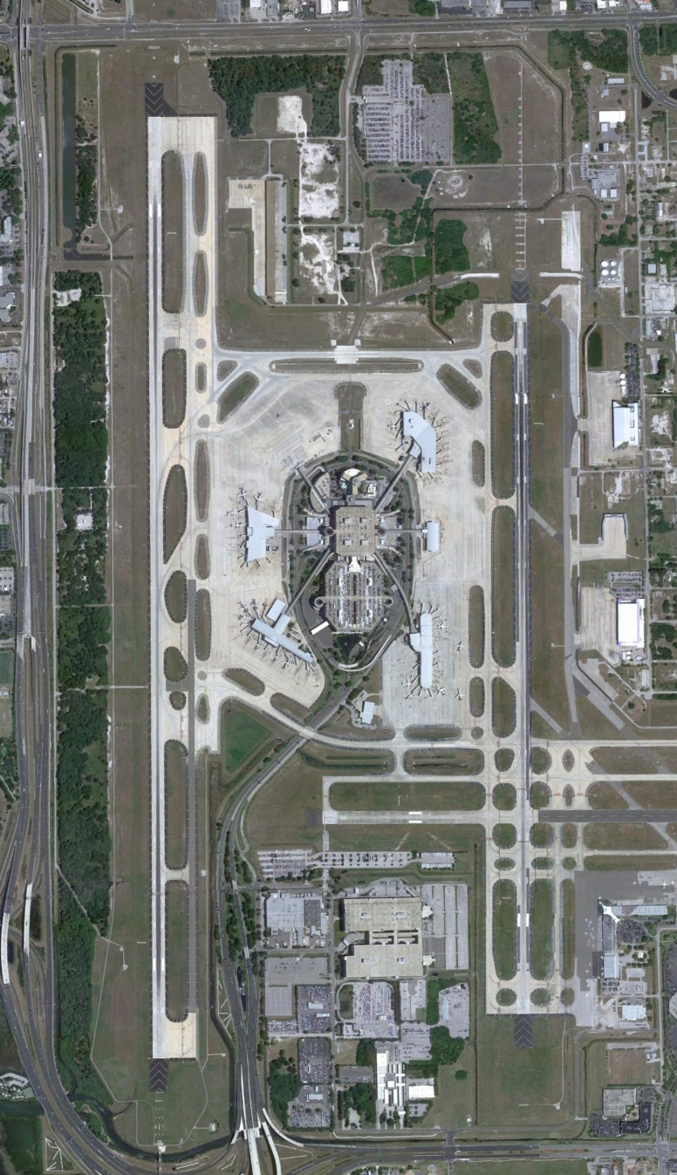
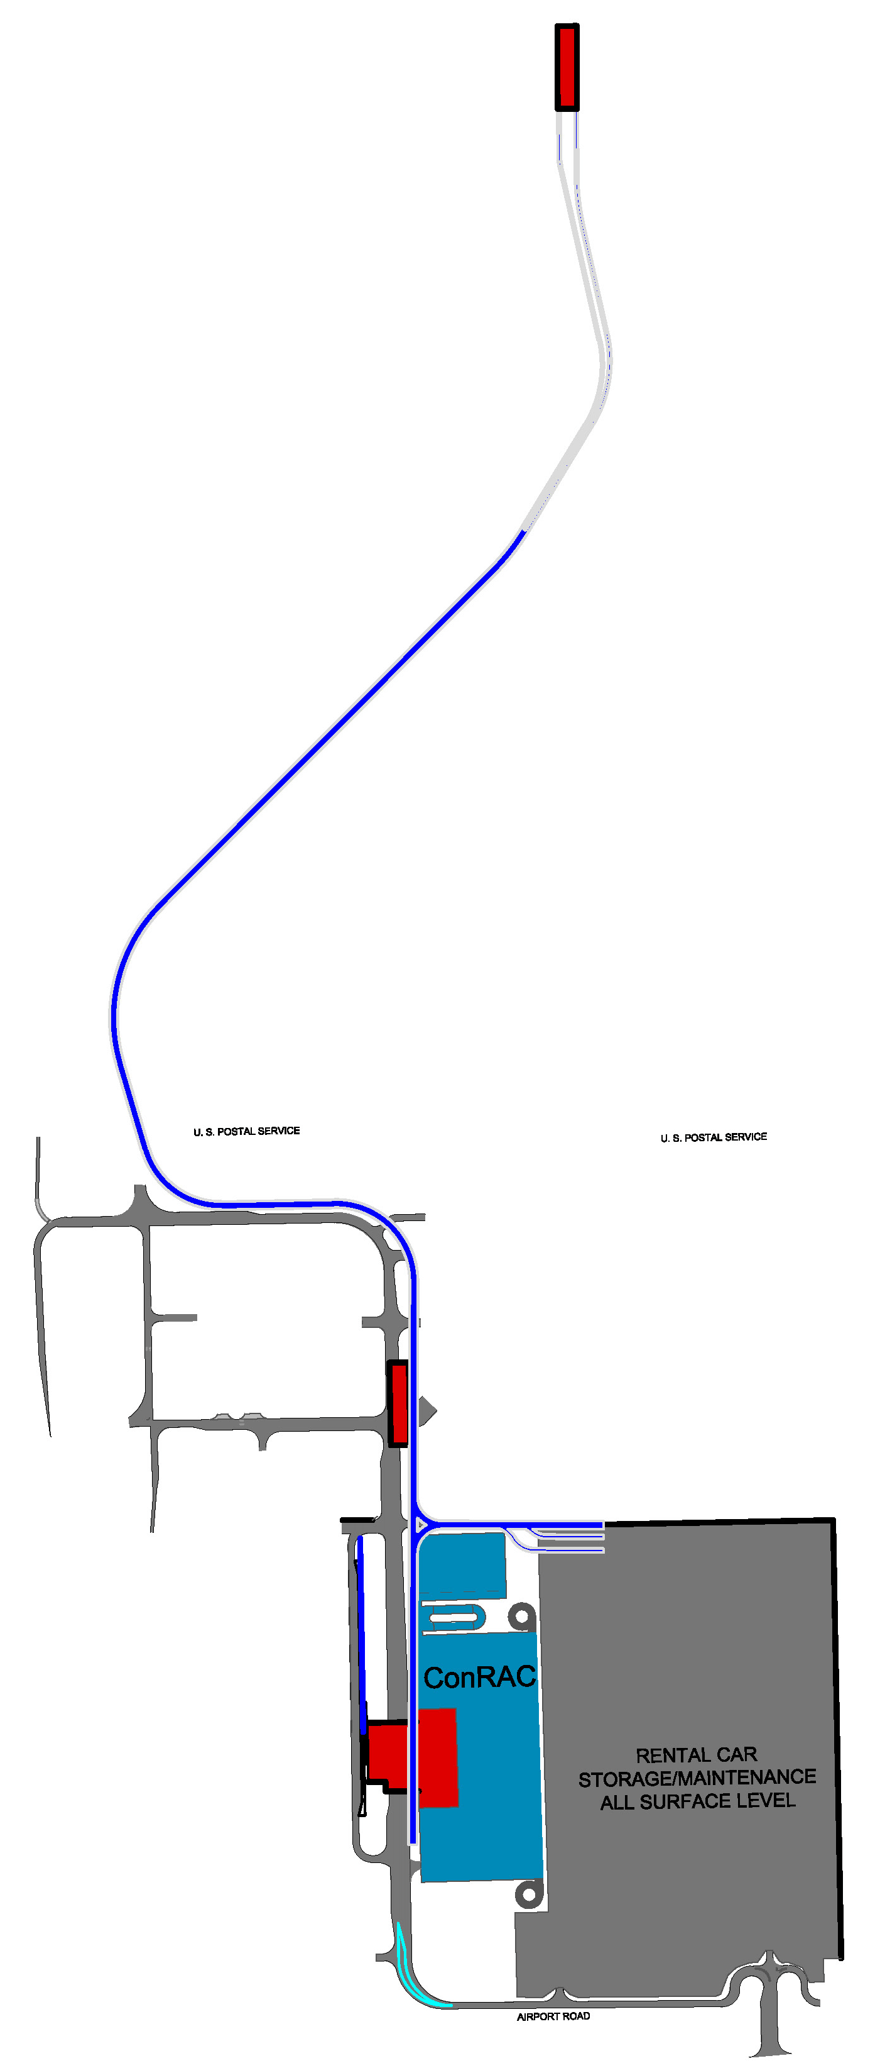
Master Plan Phase 1
Estimated Cost: $935 million
Jobs created: More than 10,000
Timeline: 2014-2017
Projects:
2.3 million-square-foot consolidated rental car center
1.3‐mile Automated People Mover connecting rental car center to main terminal
Transfer level expansion
Benefits:
Removes cars and buses from airport roadways and curbsides
Allows rental car companies to grow
Adds 2,414 spaces to long-term parking garage
Includes bus rapid transit station

Slide 7
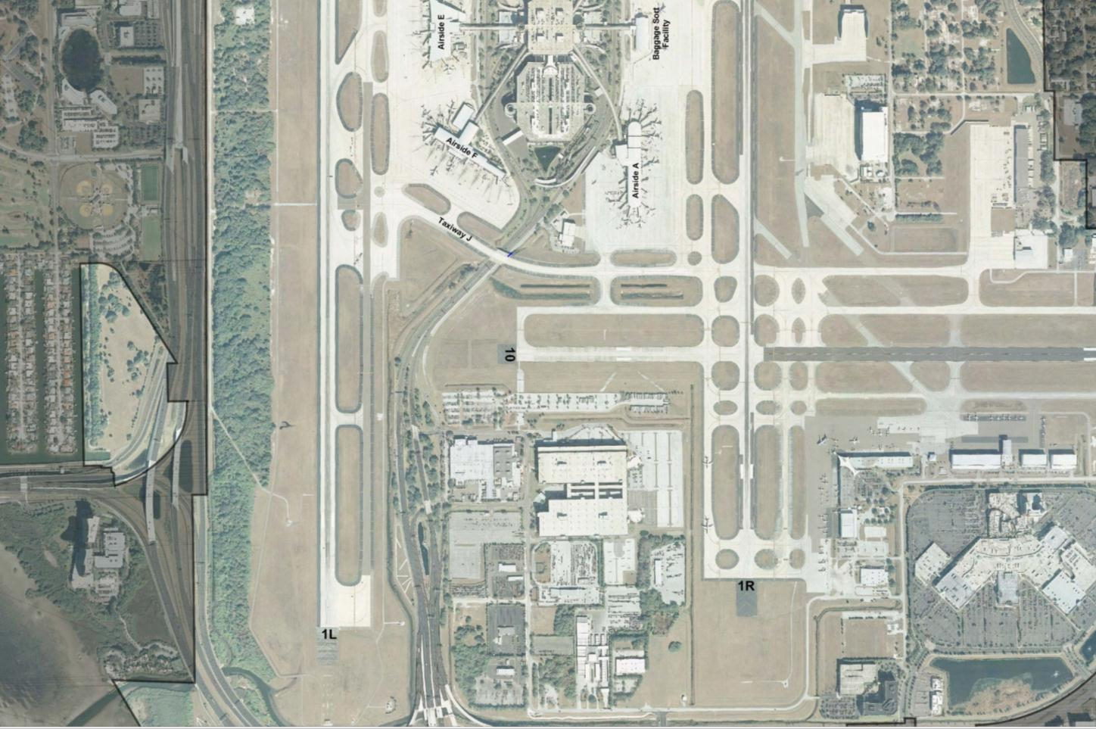
Master Plan Phase 1: Decongestion
Terminal APM
Station
APM Alignment
Economy Garage
APM Station
ConRAC APM
Station with Bus,
Rapid Transit
Station
APM MAINT
ConRAC
RENTAL CAR STORAGE/MAINT.

Slide 8
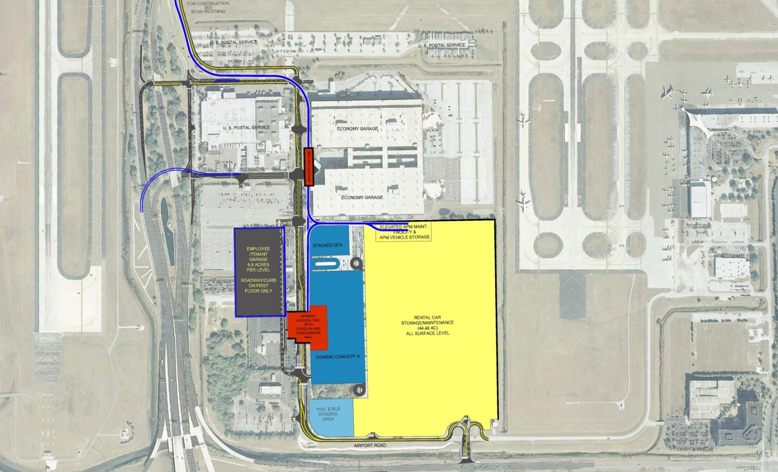
Master Plan Phase 1: Decongestion
Multi-Level ConRAC
Future Employee
Parking
APM Station with BRT
22g

Slide 9
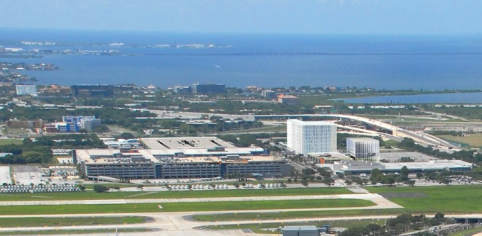
Master Plan Phase 1: Decongestion
Commercial development at Tampa Gateway Center

Slide 10
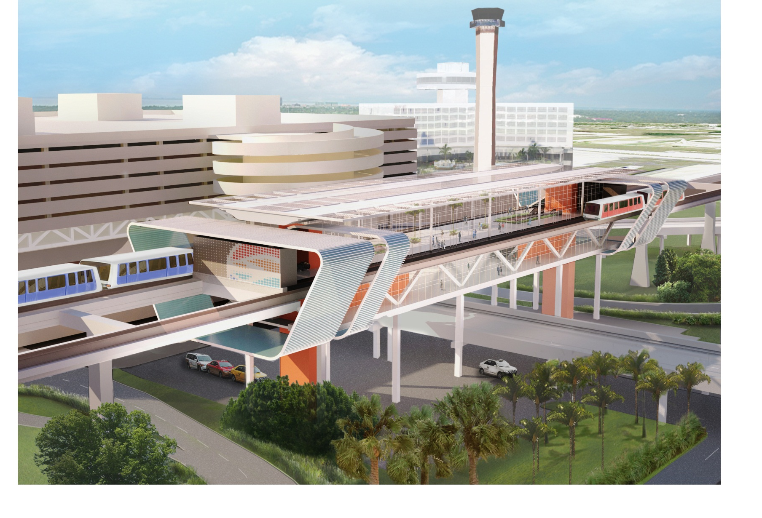
Master Plan Phase 1: Decongestion
Rendering of APM station at main terminal

Slide 11
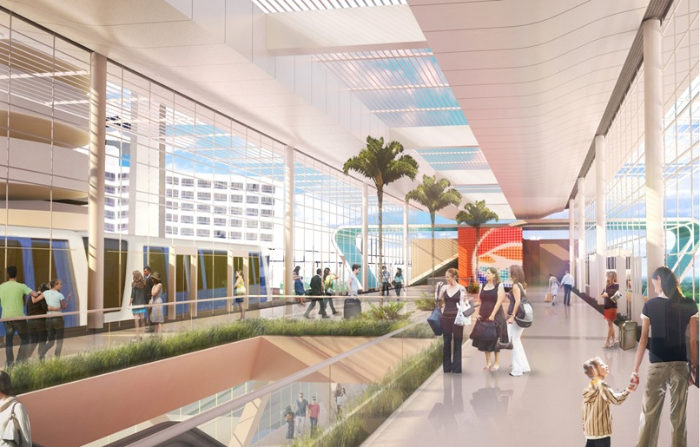
Master Plan Phase 1: Decongestion
Rendering of APM station at main terminal

Slide 12
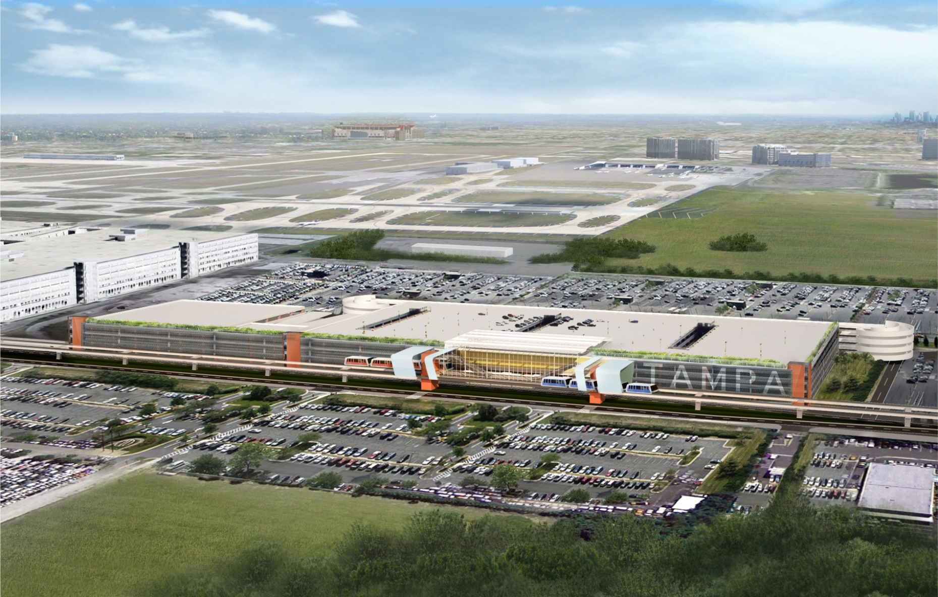
Master Plan Phase 1: Decongestion
Rendering of Consolidated Rental Car Center

Slide 13
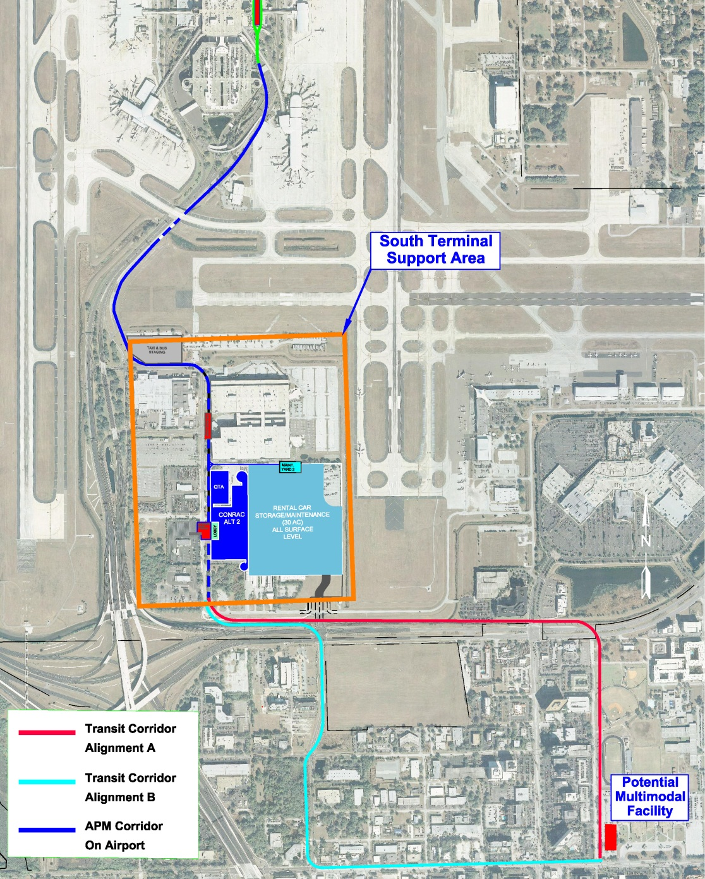
Connecting to the Region
APM Alignment to Tampa International Airport/Westshore multimodal center
Tampa International Airport passengers come from throughout the region
35% - Hillsborough
28% - Pinellas
8.4% - Pasco
8% - Sarasota

Slide 14
Connecting to the Region
Conceptual Rendering from Westshore Master Plan:
Cypress Street looking east at Westshore Blvd.

Slide 15
Tampa Bay Regional Transportation Summit
October 10, 2013

