Slide 1






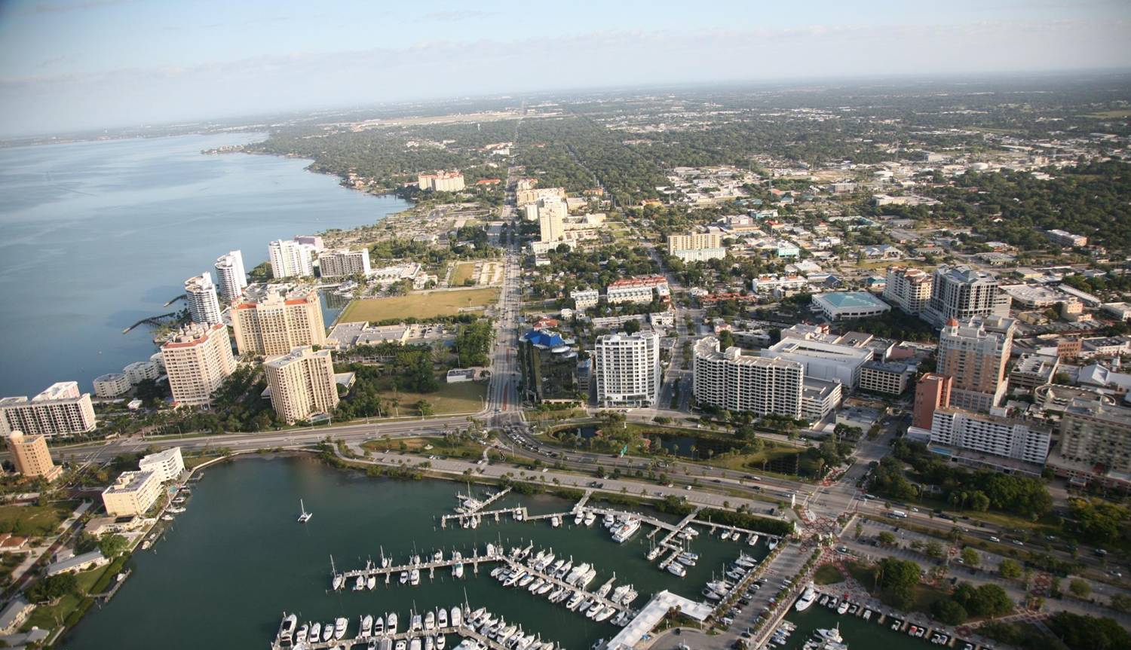
US 41 Multimodal Emphasis Corridor
M
E
C
Tampa Bay Regional Transportation Summit
October 10, 2013

Slide 2
Introduction
Adopted 2035 LRTP
Allocated specific funds to multimodal transportation improvement projects on US 41 corridor
  $2.5 M allocated annually to Manatee County (FY 16/17 DOT Work Plan)
  $4.42 M allocated annually to Sarasota County (FY 16/17 DOT Work Plan)

Slide 3
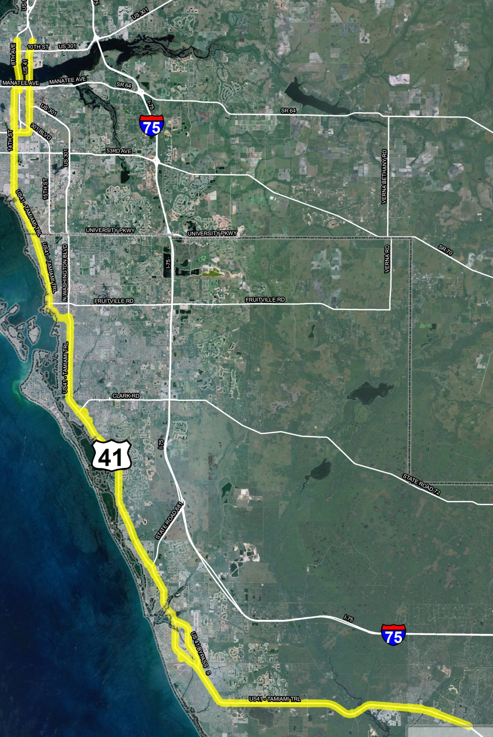
Introduction
Limits:
Entirety of US 41 in Sarasota
In Manatee County from the Sarasota County line to 17th Street in Palmetto

Slide 4




Guiding Principles
Must address two or more mobility, connectivity, or congestion needs.

Slide 5
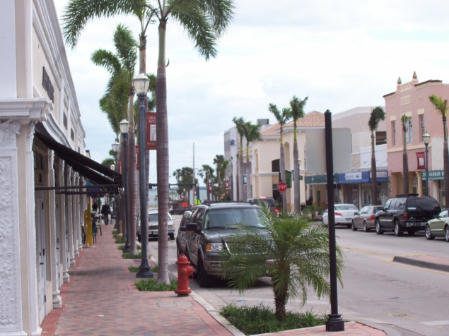

Guiding Principles
Must be appropriate for the context of adjacent existing or planned land uses
Must have local support

Slide 6
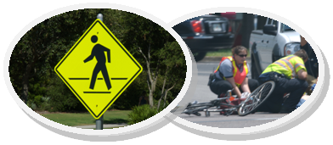
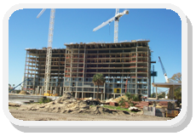
Guiding Principles
Must improve safety for vulnerable users
Should encourage economic development or revitalization

Slide 7
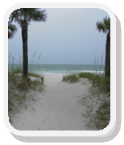

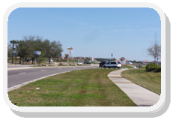
Guiding Principles
Should not have significant unmitigated negative environmental impacts
Should have efficient management and operational strategies identified
Should emphasize the preservation and maintenance of the existing transportation system

