Slide 1
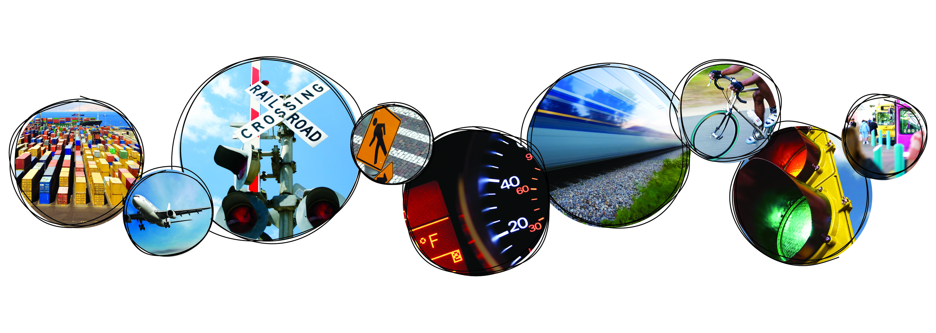
I-4 Master Plan Implementation
Tampa Bay Regional Transportation Summit
October 10, 2013
Harold W. Barley
Executive Director

Slide 2
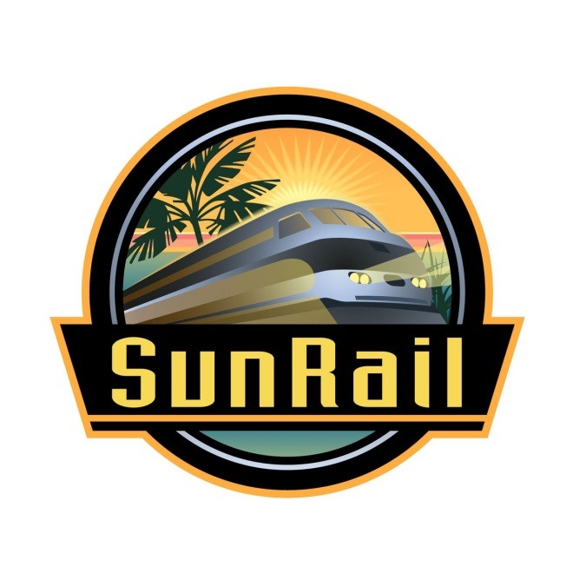
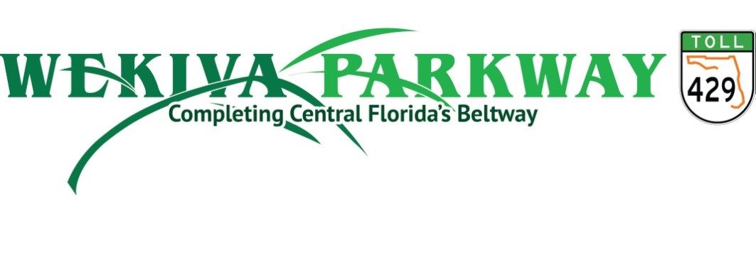
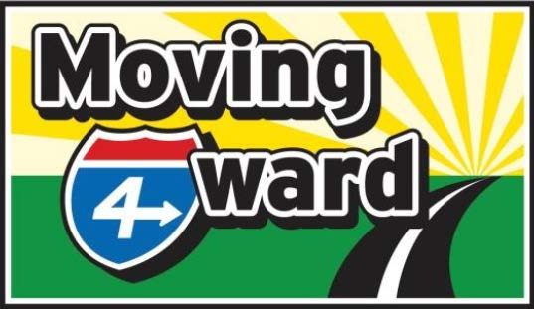
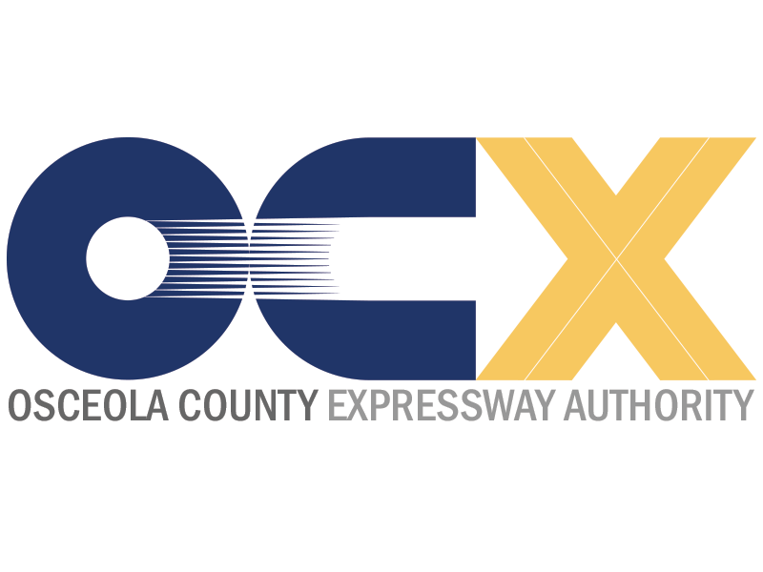
Transformational Projects

Slide 3
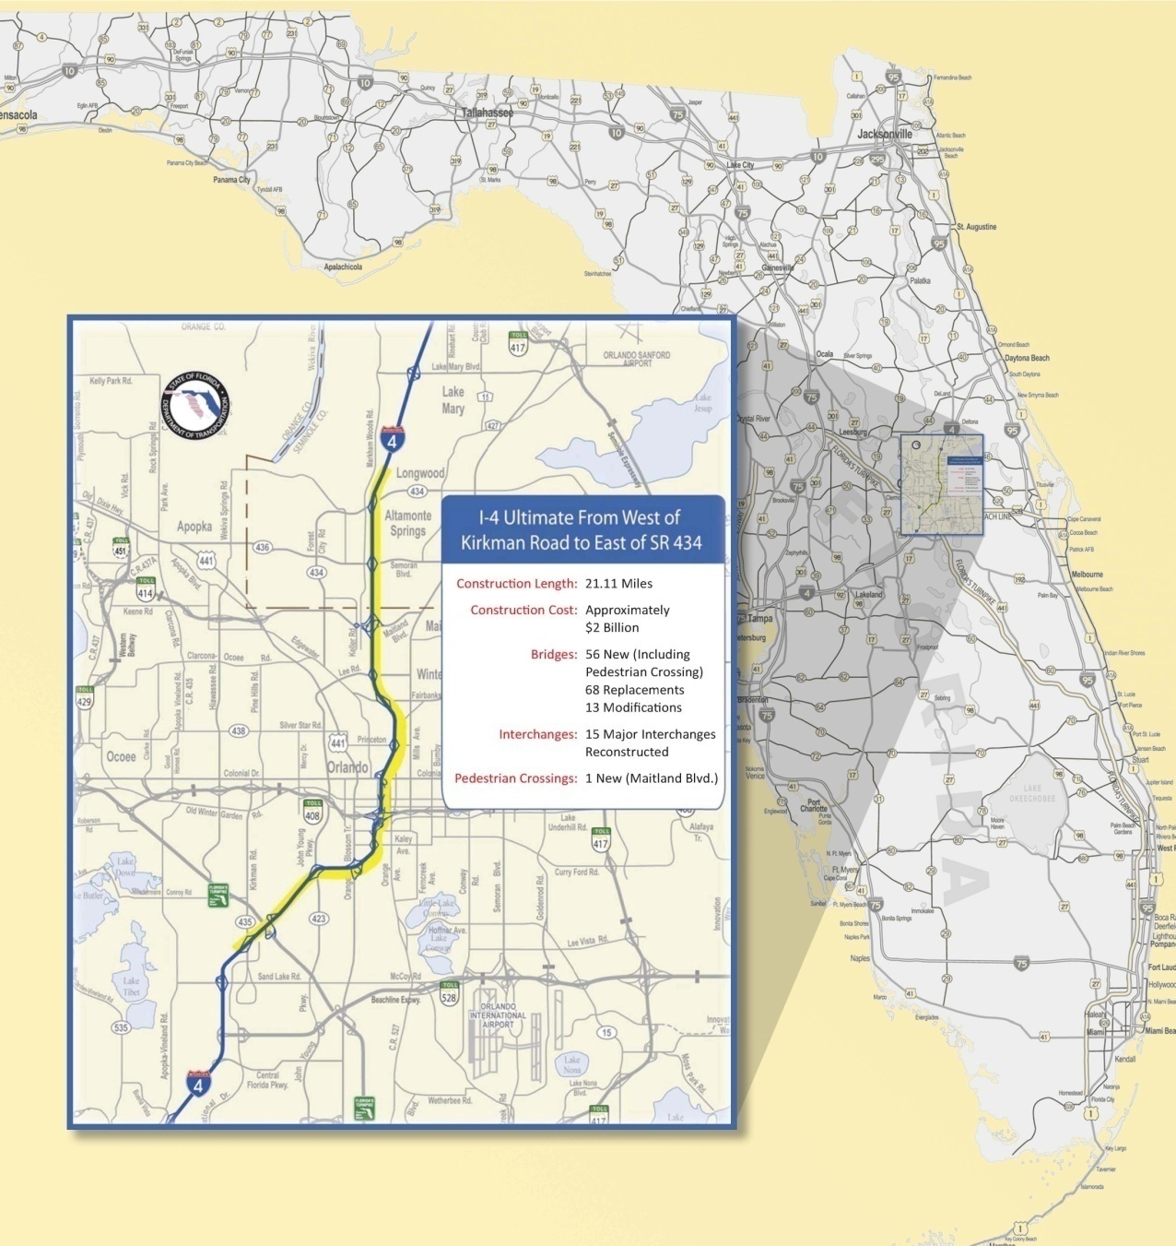
OVERVIEW OF I-4 ULTIMATE IMPROVEMENTS
Length: Over 21 miles from West of Kirkman Rd. to East of SR 434.
Cost: $2.1 Billion in Design/Construction Costs
What: Reconstruction of Mainline & Interchanges
What: Addition of 4 Managed Lanes
Duration: ~ 6 years
Notes:
To tell you more about the I-4 Ultimate project, it covers 21.11 miles from West of Kirkman Road in Orange County traveling east (or north) to east of SR 434 in Seminole County. It goes through downtown orlando and crosses another major roadway, the SR 408 East West Expressway. This portion of I-4 see 140 to 200 thousand vehicles daily.
The construction costs have been estimated to be just over 2 billion dollars.
The plan calls for a complete reconstruction of the mainline, this is necessary to design the corridor to current standards, flattening some of the curves and hills, and improving the sight distance.

Slide 4
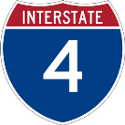
I-4 ULTIMATE
Interstate 4 Typical Section
4 Managed Lanes (2 each direction)
6 General Use Lanes (GUL) + Auxiliary Lane
Managed Lanes

Slide 5
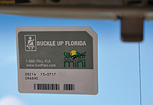
I-4 ULTIMATE
Planned Access to Managed Lanes
Toll risk to remain with FDOT
Access to and from the tolled managed lanes will be limited.
Slip Ramp Access
Direct Ramp Access
Considering Alternatives
Intended for longer trips
Dynamic Tolling
All Electronic Tolling
No toll by plate
Everyone Pays
No Trucks

Slide 6
Public-Private Partnerships
Value Proposition
P3 Seeks to Achieve 5 Primary Goals
To provide capacity improvements much sooner than possible under traditional pay-as-you go approach
To eliminate project phasing and advance the overall project
To capitalize on the private sector’s innovation and access to capital markets
Transfer of appropriate risk items to private partner
To enhance long-term, lifecycle cost efficiency and service quality

Slide 7
I-4 ULTIMATE
Funding
Federal, state, local, partners and tolling
$2.4 billion capital cost
+ Operations and maintenance costs
+ Renewal and replacement costs
$7 billion total from 1996-2054

Slide 8
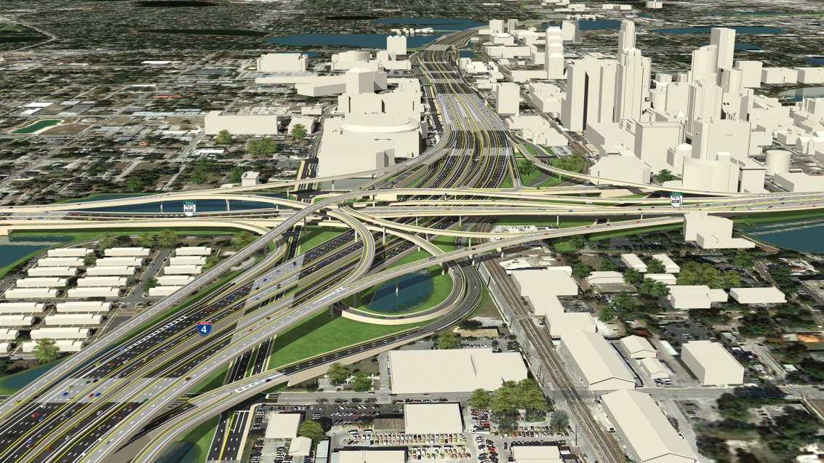
I-4 ULTIMATE

Slide 9
