Slide 1
Greenlight Pinellas Plan
October, 10 2013

Slide 2
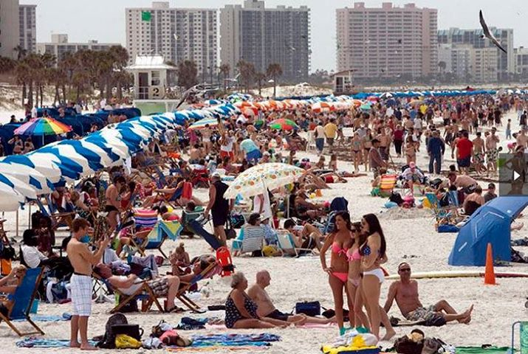
How Much Will This Cost Me?
PSTA Property Tax Will Be Eliminated:
$180K Median Owner-Occ. House: $94.89 in 2011
2011 IRS Sales Tax Cost Estimate:
Clearwater Median Family: $104.33 in 2011
1/3 of Total Pinellas Sales Tax Paid by Tourists.

Slide 3
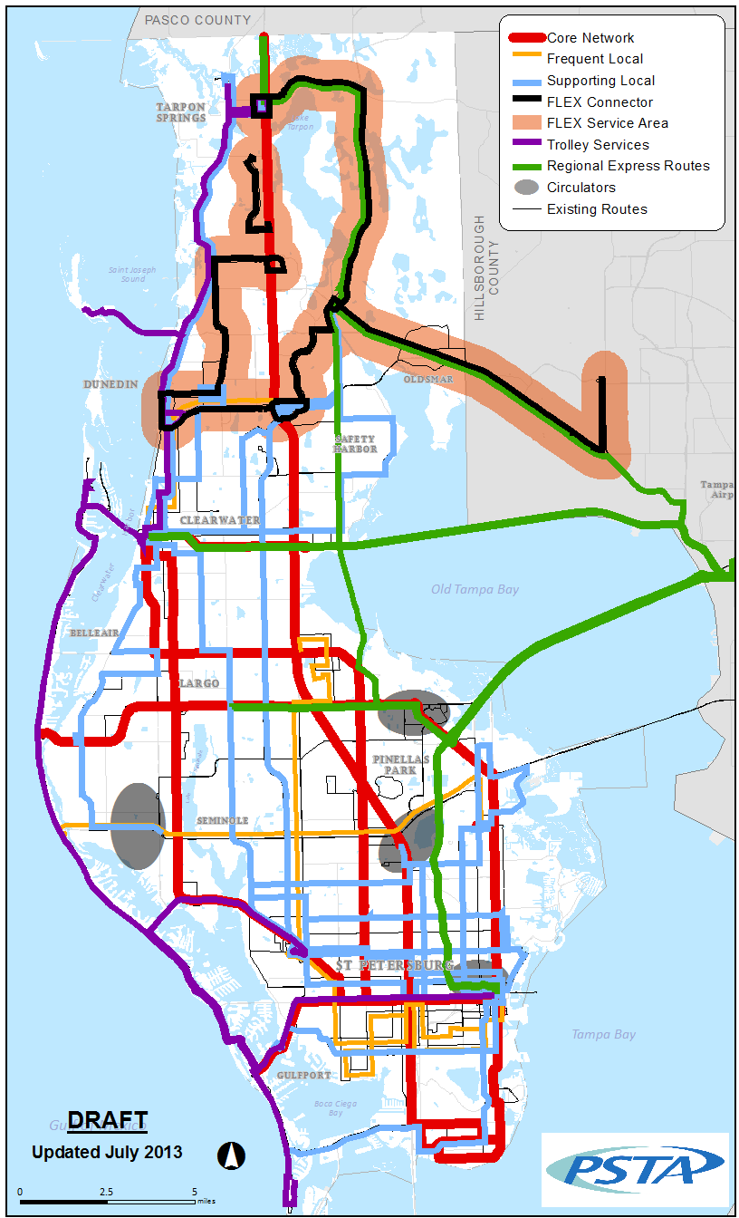
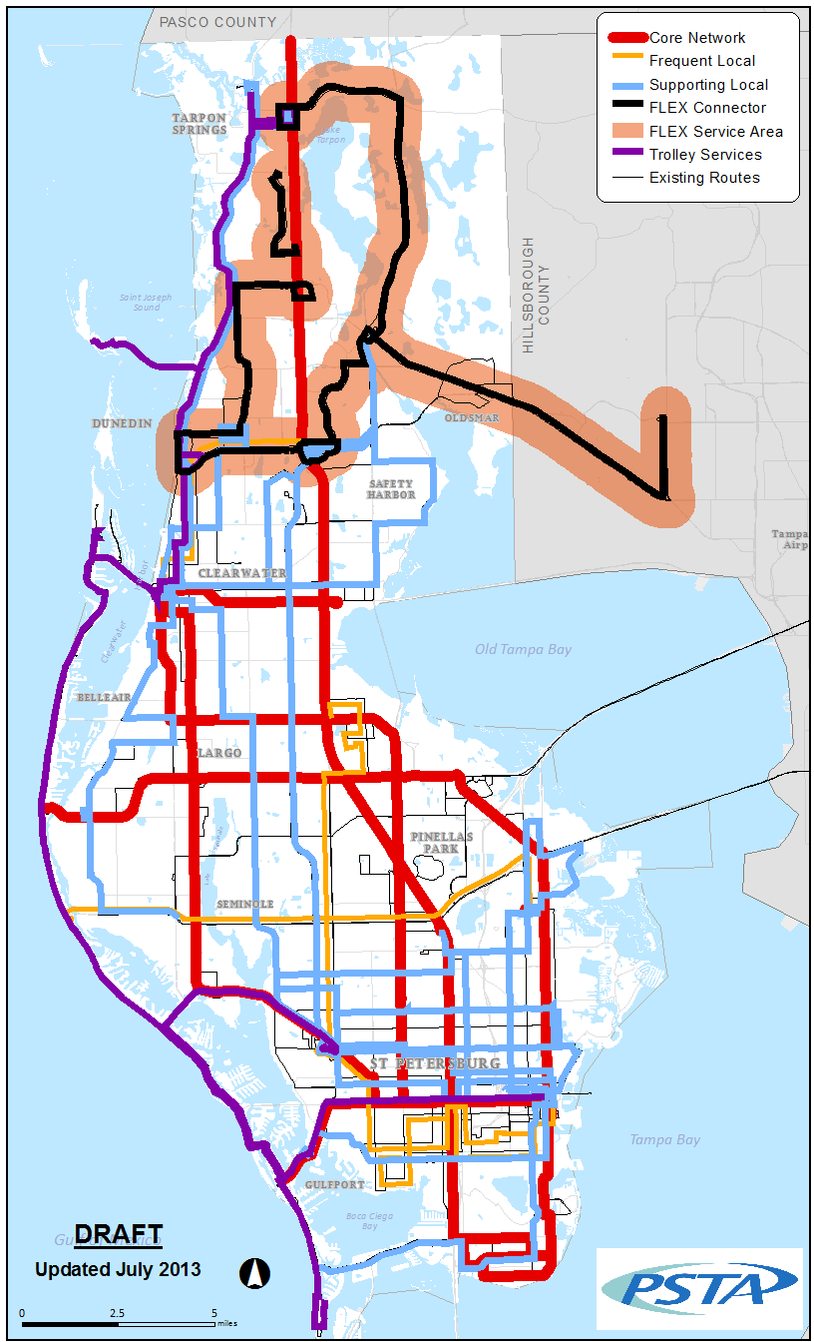
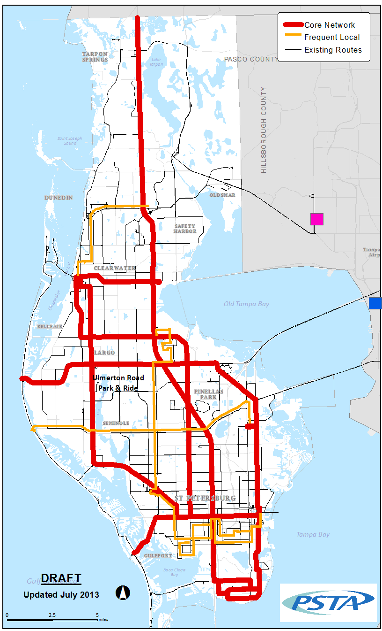
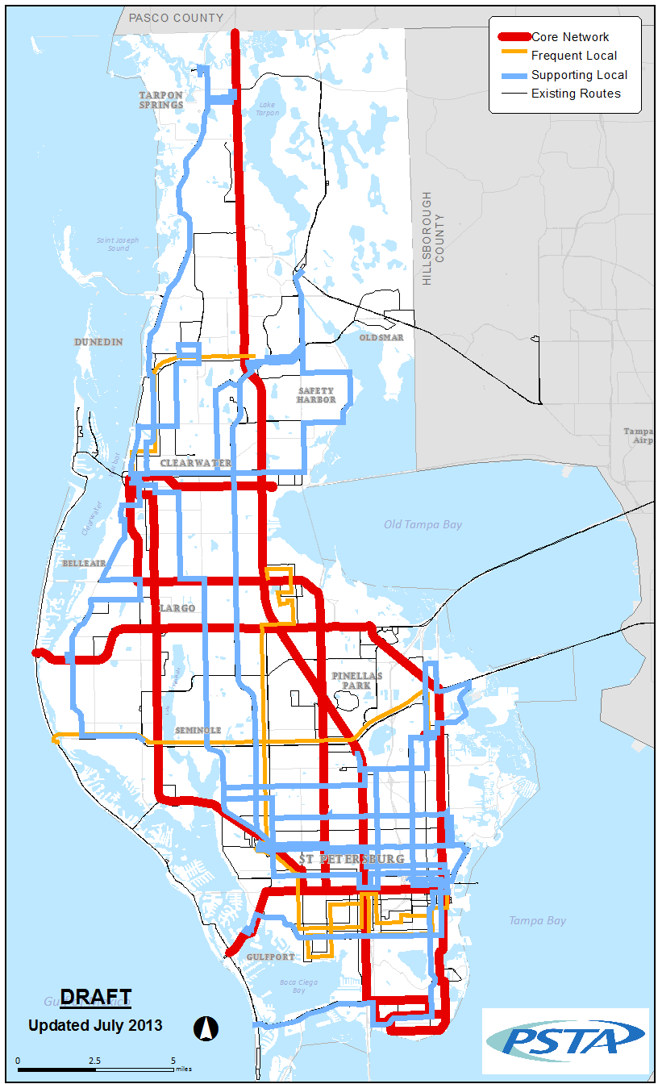
Bus Improvements
Layered service specific to travel market
Complete transformation of bus transportation system compared to today.
Hub to Grid System

Slide 4
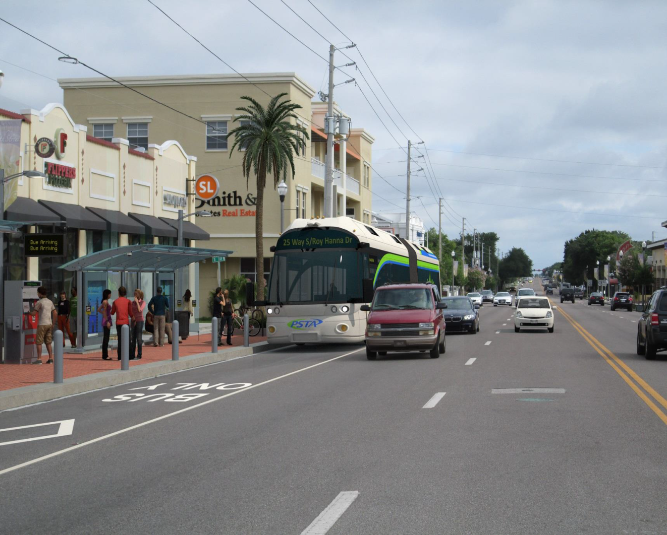
Greenlight Plan: Rapid Corridors
Major arterials of the transit network
Create BRT and Rapid Corridors on the Core Network
Connects major employment and activity centers across the County along the Core Network

Slide 5
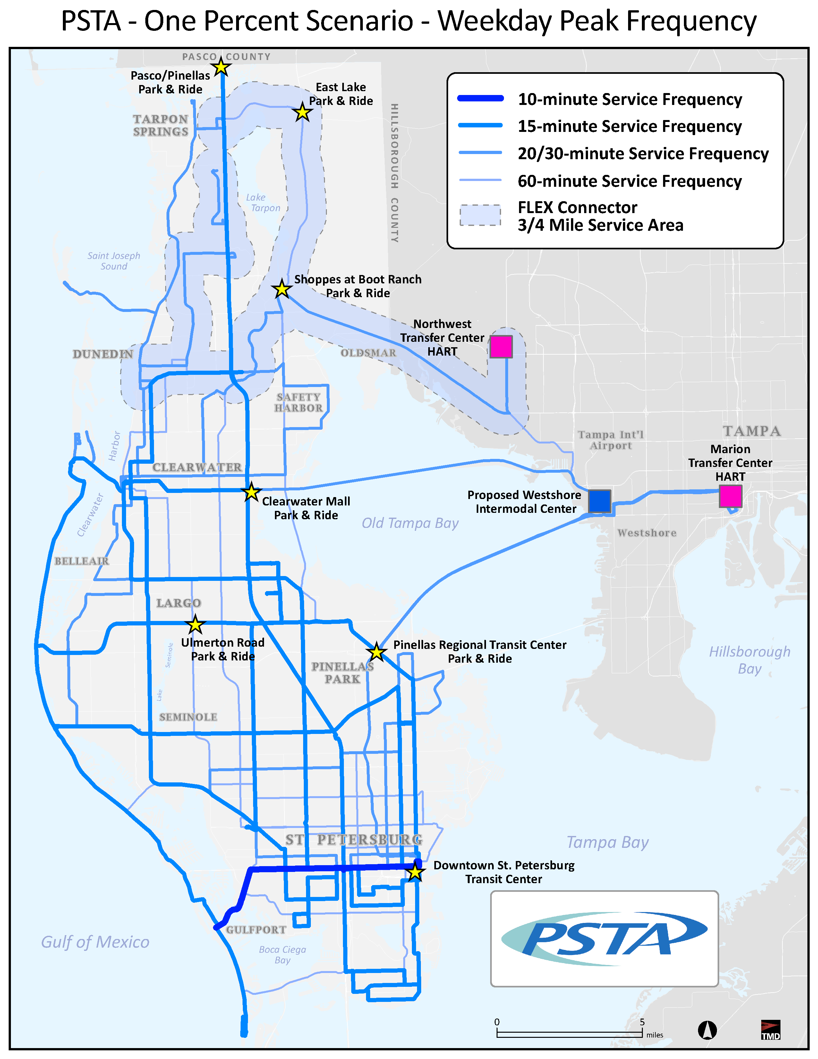
Greenlight Plan: Bus Frequency
Frequent Service throughout the network enables spontaneous use
Service operating at 10- and 15-minute headways along Core and Frequent Networks
30-minute and limited 60-minute service will complete the transit network
Addition of community circulators

Slide 6
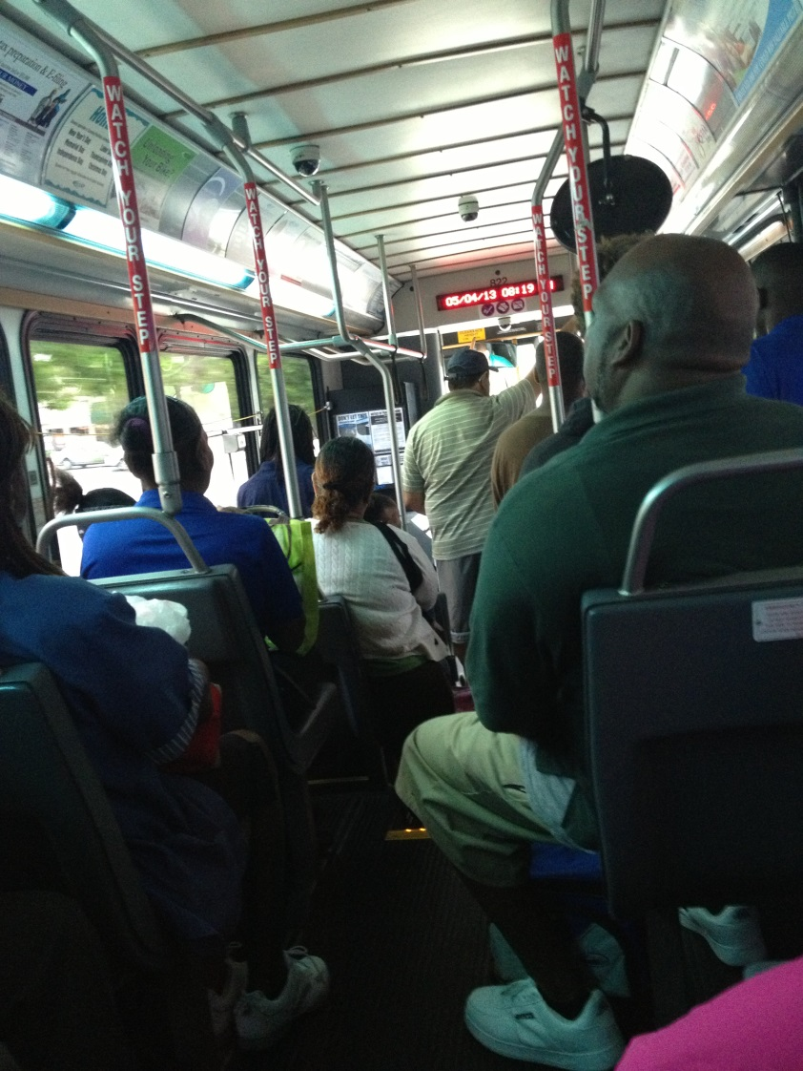
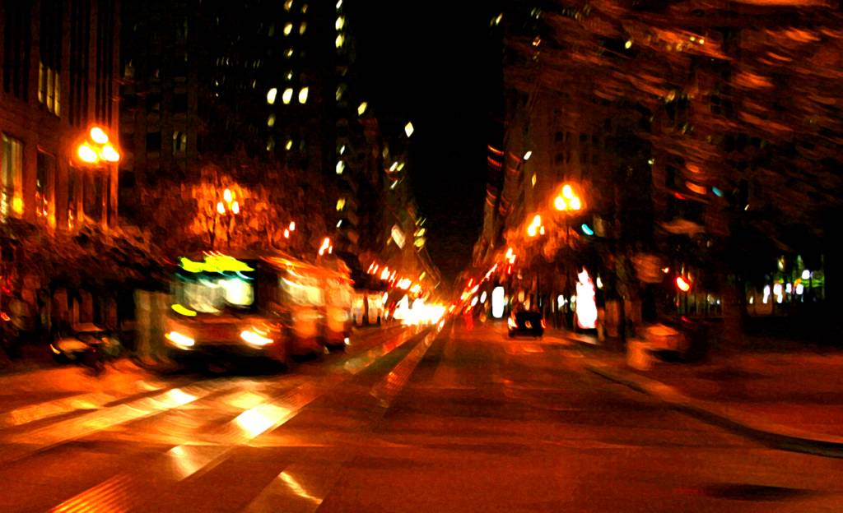
Extended Night /Weekends
Extended Service Span
Frequent network until midnight
Supporting network until at least 10pm
Tailored span for trolley services
Weekend Service
Increased by over 80 percent
Spontaneous-use frequency on Core routes
Sat. 8 AM Central Ave. Trolley Heading to St. Pete Beach

Slide 7
Greenlight Plan: Rail

Slide 8
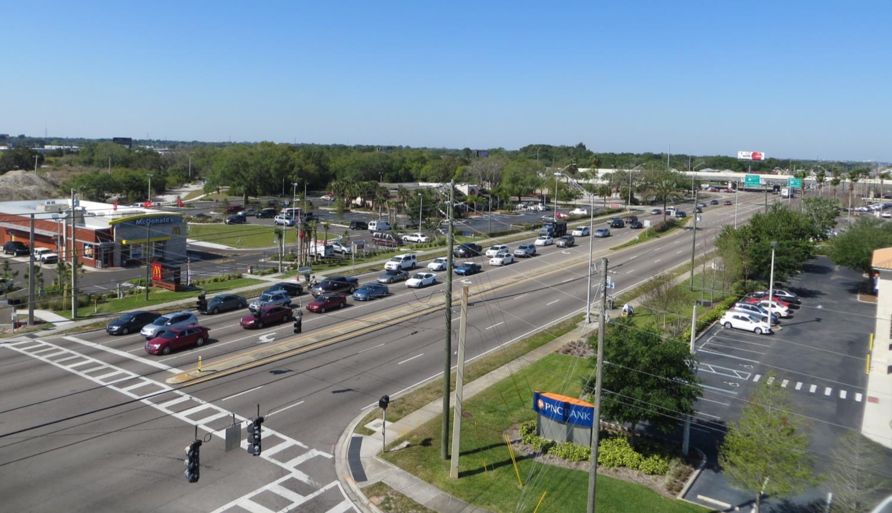
Greenlight Plan: Land Use
Today…
Looking Southwest on East Bay Dr. towards US 19

Slide 9
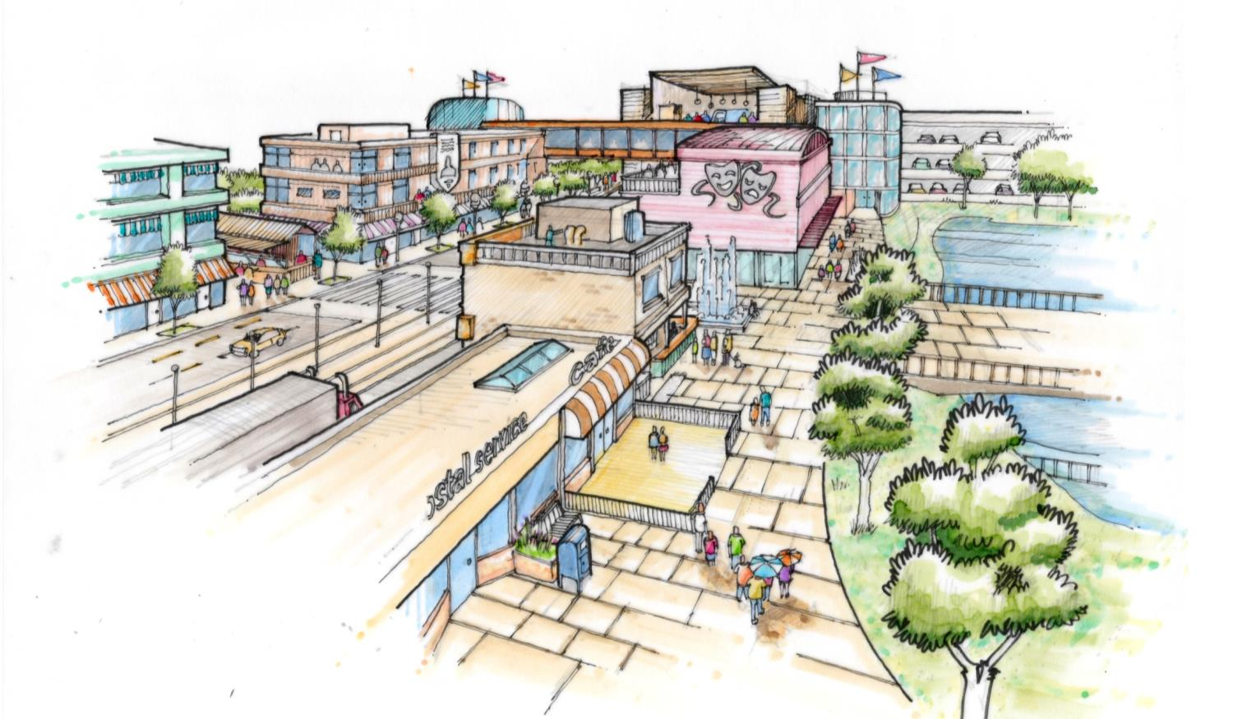
Greenlight Plan: Land use
Future Vision…
Business and Resident Concept

Slide 10
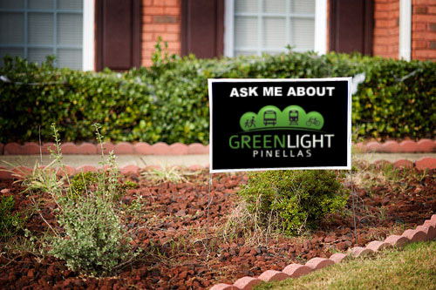
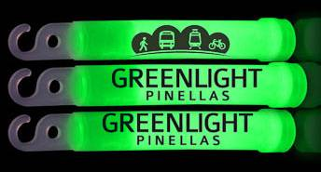
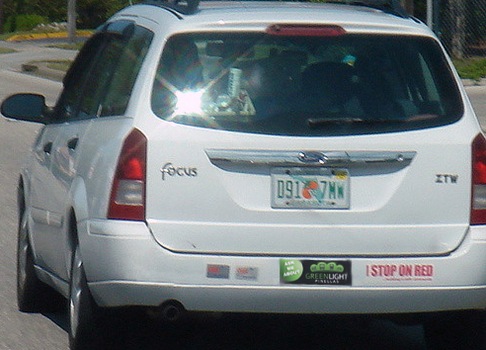
Greenlight Plan: Process
Notes:
Greenlight is an experience

Slide 11
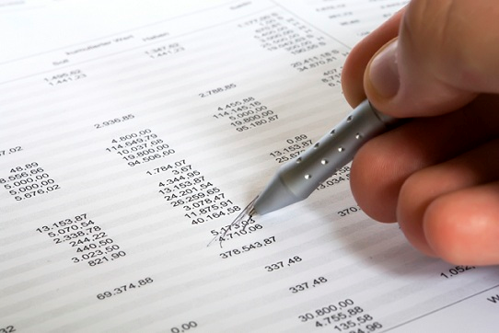
Greenlight Plan: Due Diligence
More Detailed Financial Planning
Develop long-term, FTA compliant financial plan
Refine work completed

Slide 12
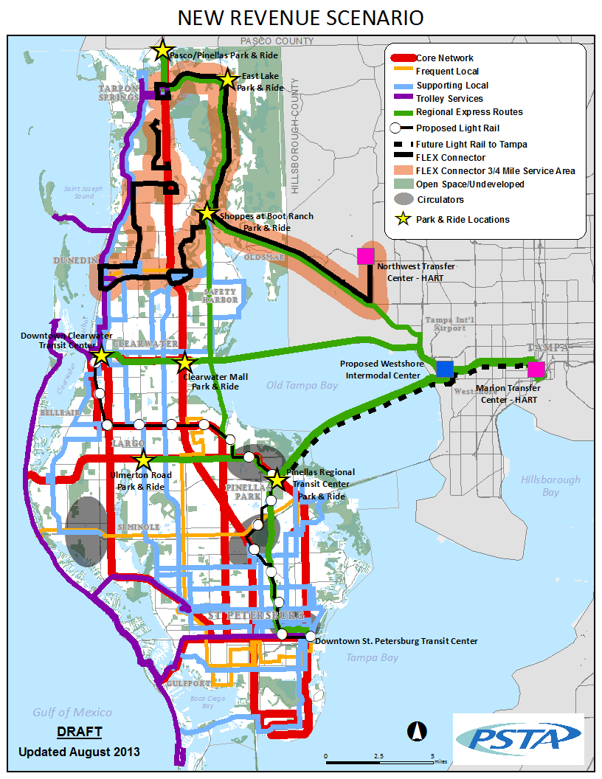
ENDORSE THE GREENLIGHT PLAN
Countywide Bus Service Transformation
Frequency
Night Service
Weekends
Implementation of Rail
Coordination of Land Use
Connections to Tampa

