Slide 1
FDOT District Seven
District Secretary Paul Steinman, P.E.
Regional Transportation Summit
October 2013

Slide 2
Overview
FDOT Vision
Implementation
Challenges
Citrus
Hernando
Pasco
Hillsborough
Pinellas
Notes:
This outline will give a brief overview of the topics I will touch on today

Slide 3
FDOT Vision
Develop business clusters that:
Efficiently uses existing infrastructure
Investment that drives smart growth
Ensures system reliability
Notes:
Vision – using strategic transportation investment to drive the economy
Done at the:
Federal
State
Regional
Local level

Slide 4
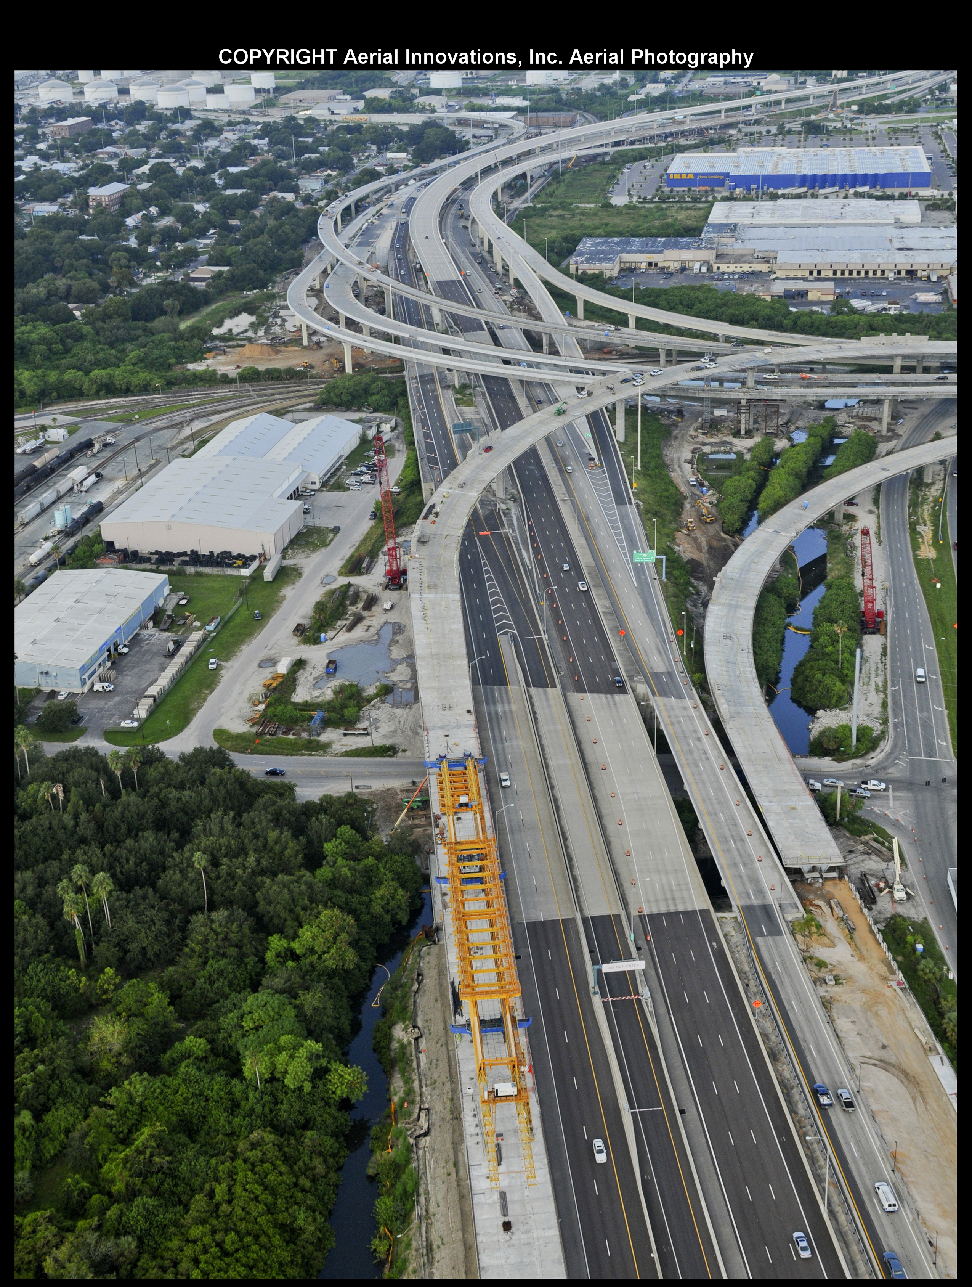
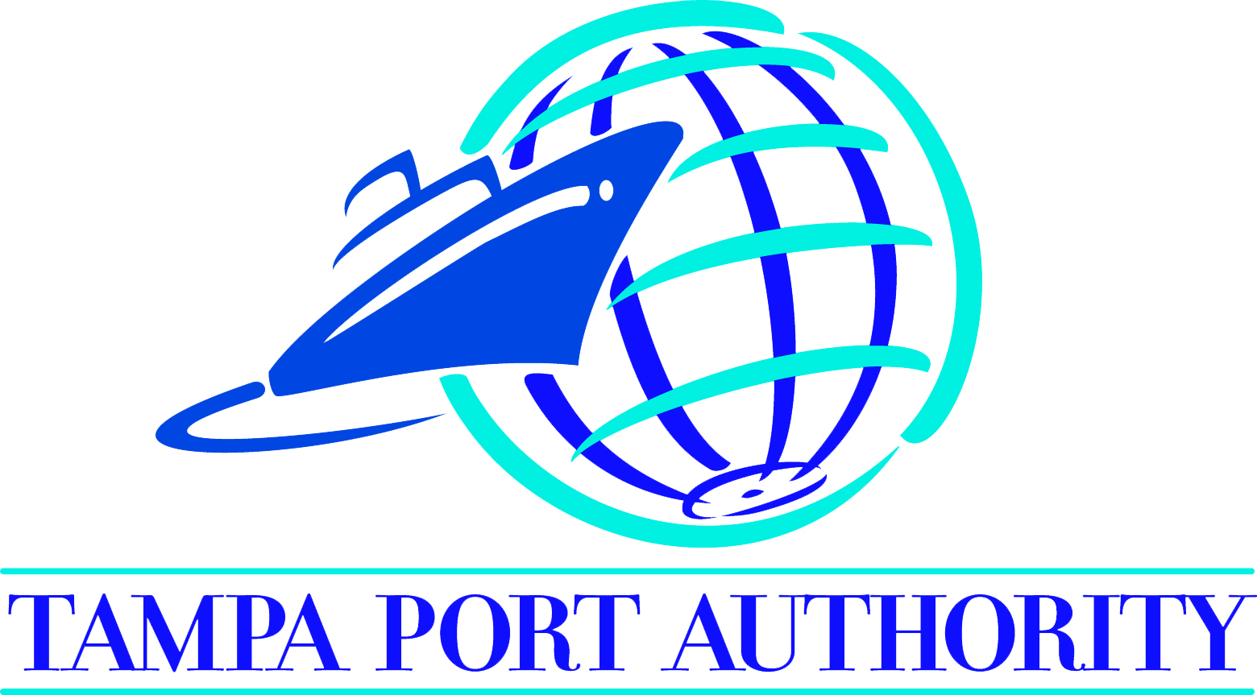
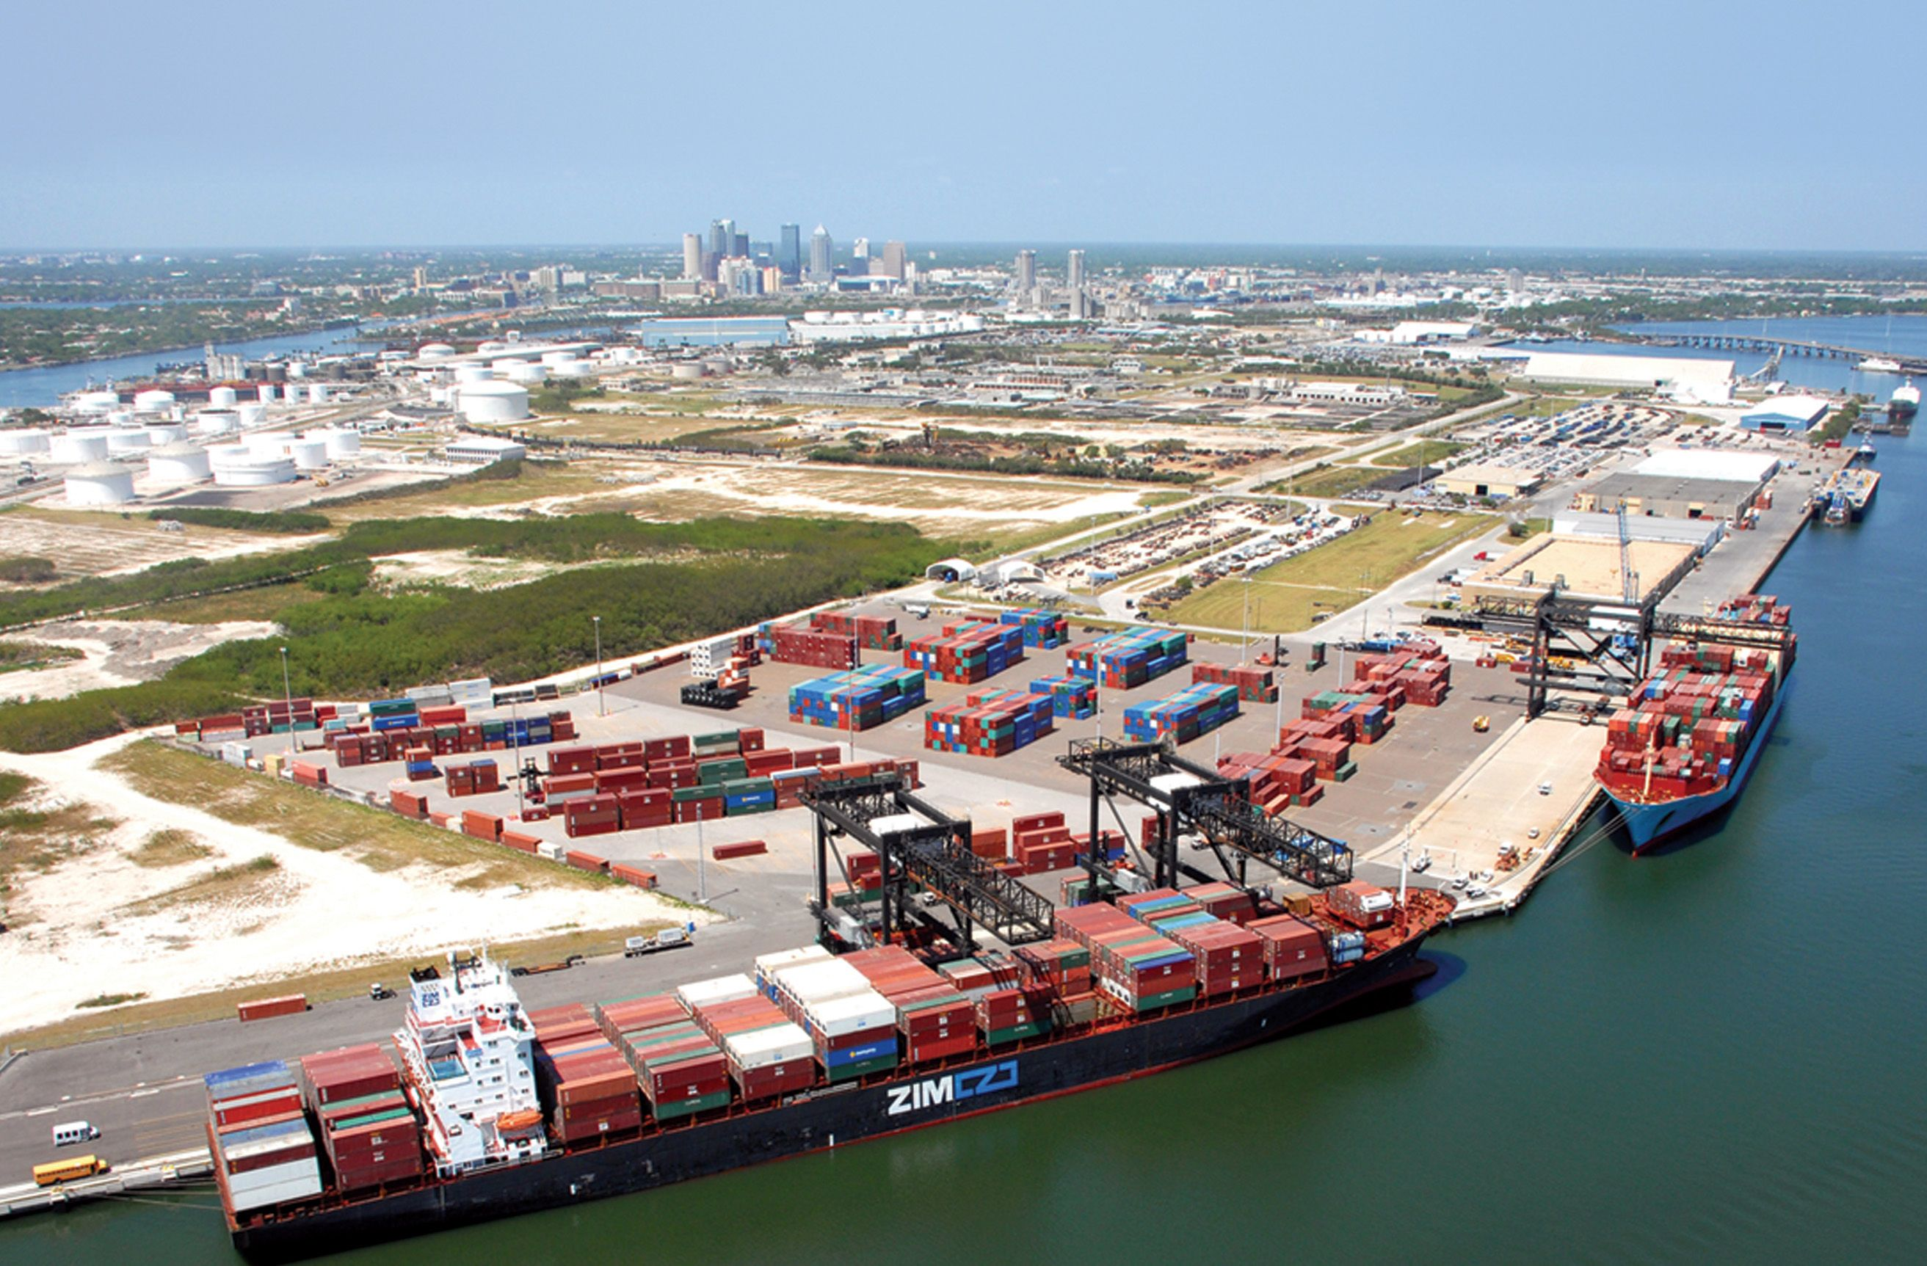
Opportunities
Panama Canal Expansion
Port of Tampa/I-4 Selmon Expressway Connector
Tampa International Airport
High tech/High skill clusters
I-4 Selmon Expressway Connector
Notes:
How is this different from the past?
Focus on transportation’s role in growing business in Florida
We must work together to develop business clusters that allow for more efficient use of the existing transportation system to move freight, services and staff.
Port of Tampa/I-4 Selmon Expressway Connector (traffic on Connector by end of year)
Tampa International Airport Master Plan
Panama Canal Expansion – completed in late 2015 (new opportunity)
$246 million to add lanes and reconstruct I-75 from the Georgia state line to the Tampa Bay region
$143 million to add lanes and rehab pavement on I-75 in Pasco

Slide 5
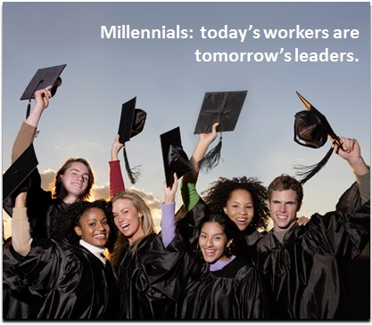
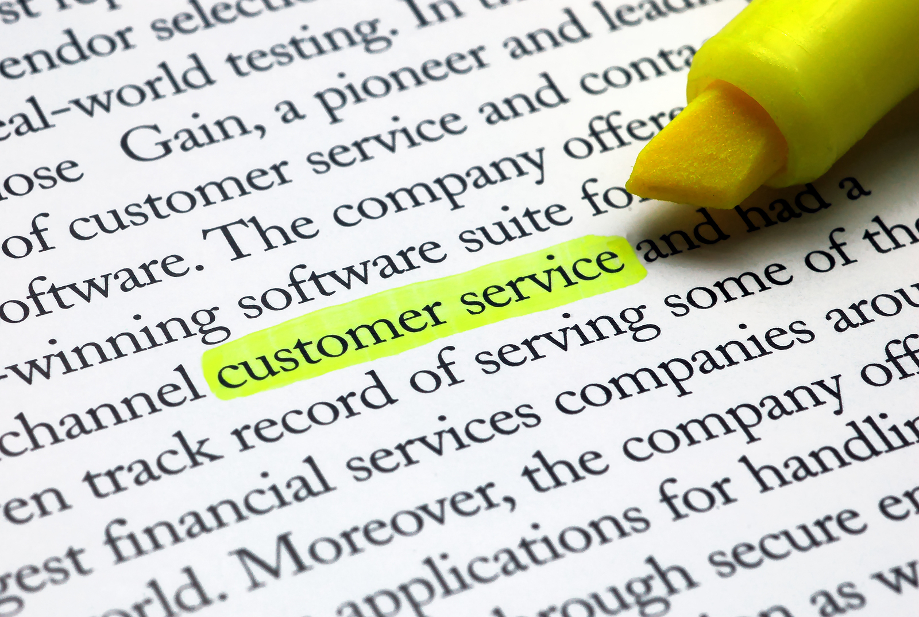
Customer Expectations
Regional Transportation system
System Reliability
Mobility Options
System Design
Notes:
Focus on business clusters of high tech/high skill industries creating long term good-paying jobs
Change in customer expectations
System Reliability
Driving Patterns and system design – millennial generation
We must provide system reliability that drives transportation costs down allowing Florida businesses to compete locally, regionally, nationally, and internationally

Slide 6
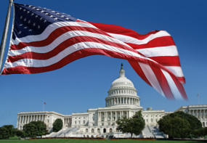
Working Together
Government
Federal
State
Local
Industry
Private Sector
Notes:
To be successful, we must improve how we work together. We must forge partnerships at all levels: Federal, state and local
We must regionalize our transportation priorities.

Slide 7
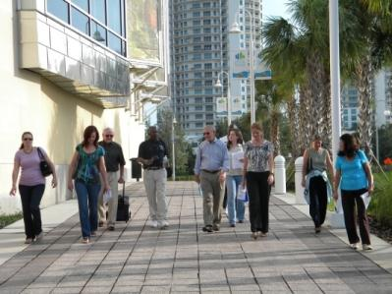
Regional Coordination
In order to make this region more competitive in getting large -scale projects funded, everyone in the region must work together to establish and maintain a set of common top priorities and be willing to pool our resources to help fund them.
Notes:
Regional coordination has been a hot topic for the Tampa Bay region. The region needs to have one set of priorities.
In the past three decades, the Tampa Bay regional area has seen the number of commuters increased exponentially with our population more than doubled and employment more than tripled.
An important fact is the traveling public, your customers and clients, have no idea where the county lines are – they just care how they are going to get there and how long it takes them.
Each group must do their part by understanding the vision and where they fit in. Everyone must come to the table with ideas and funding.
Must focus on modal connections to ensure a smooth, seamless connection.
Be good stewards of limited transportation funds.

Slide 8
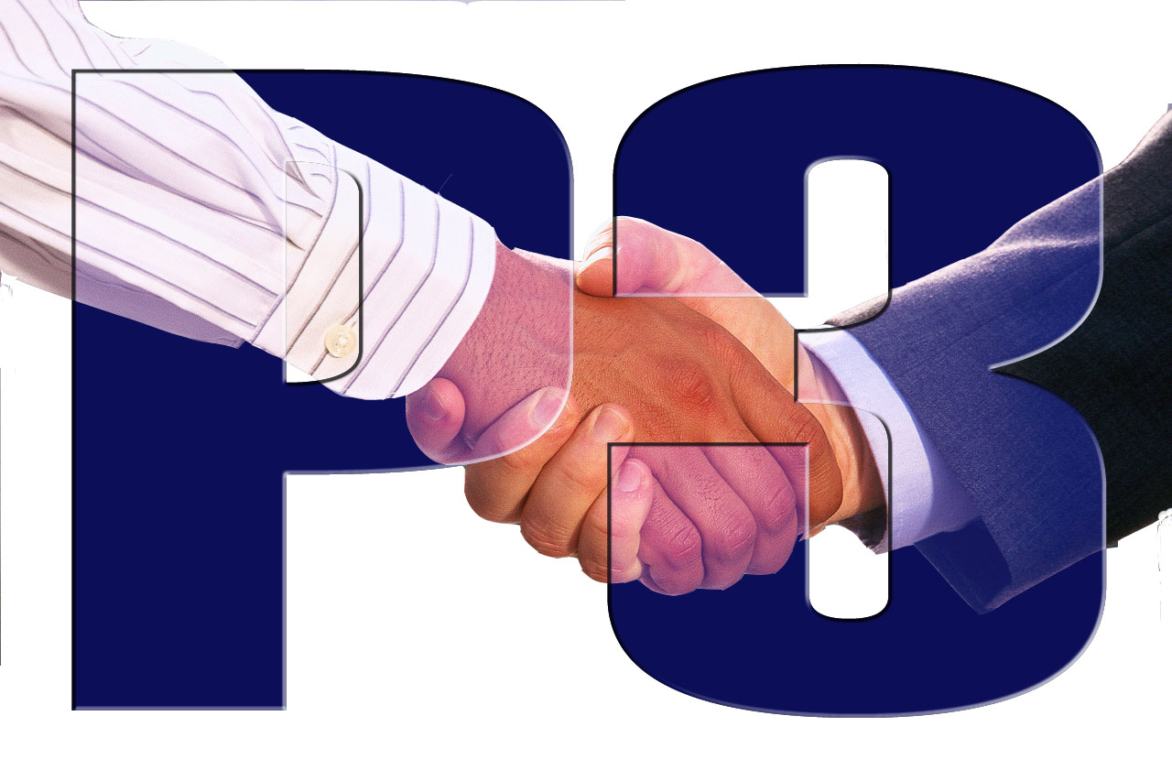
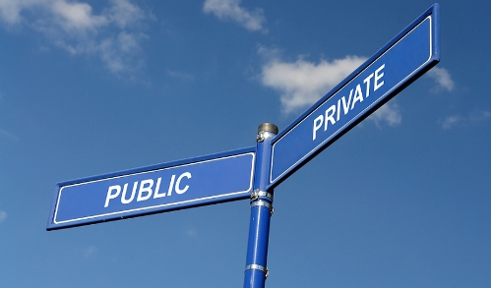
Implementing the Vision
Traditional government funding
Public Private Partnerships
Alternative Contracting methods
Private financed
Notes:
Industry – Public/Private Partnerships
Private Sector – example – unsolicited bid – SR 54/SR56
All Aboard Florida in SE Florida
We must move at the speed of business
Use alternative contracting options – Design/Build, P3, Unsolicited bids

Slide 9
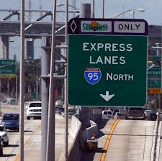
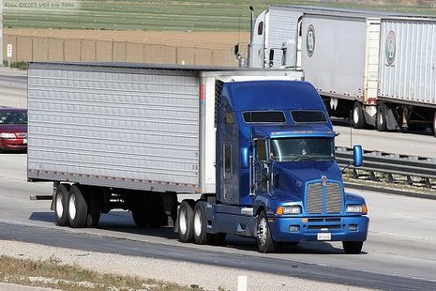
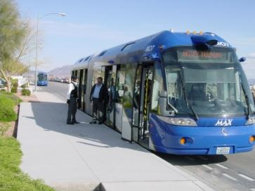
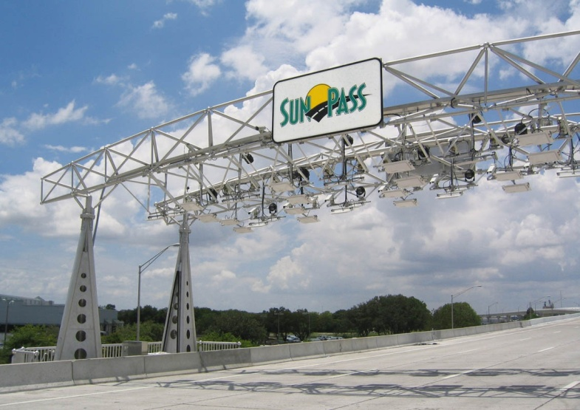
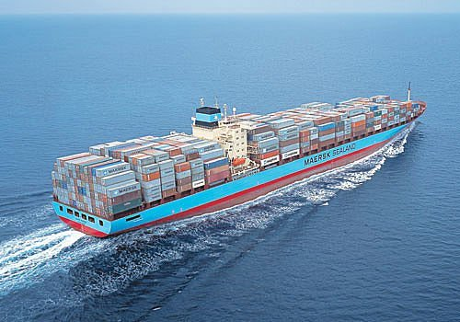
Modal Choices
High Speed tolls system
Managed Lanes
Premium Transit
Modal connections
Freight
Notes:
Customers Driven :
Movement of Freight
Consolidation of Back Office Functions for simplified fare collection
Managed Lanes – Gateway first managed lanes in the Tampa Bay area
Premium Transit Options – BRT
Tolling Options for system expansion

Slide 10
Managed Lanes
Notes:
Managed Lanes help with congestion management and provide enhanced transit advantage, while at the same time provide alternative funding opportunity for other projects.
Managed Lanes provide more reliable travel times than General Use Lanes. They also benefit the existing General Use Lanes by diverting traffic to the Managed Lanes.
Our goal is to move people and goods more effectively and efficiently through managed lanes or other alternatives throughout the state.
95 Express in Miami is a very successful project. It provides reliable travel for customers in the managed lanes and increases travel speed for drivers in general purpose lanes.

Slide 11
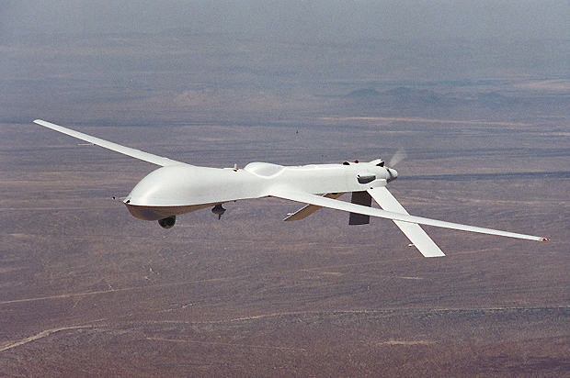
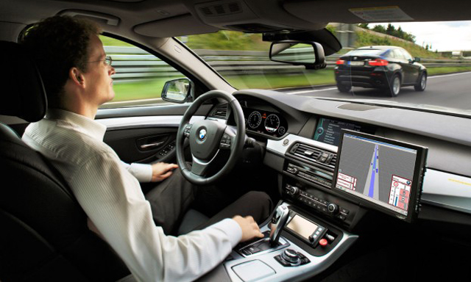
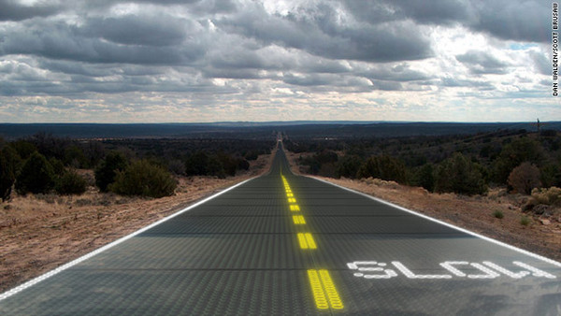
Bold Innovative Mindset
Use of new technology:
Autonomous vehicles
Hybrid/electric vehicles
GPS
Smart roads
Unmanned aerials
Notes:
Use of new technology :
Autonomous vehicles
GPS
V21
V2V
Unmanned aerial systems
Will this region move into the future of new technologies?

Slide 12
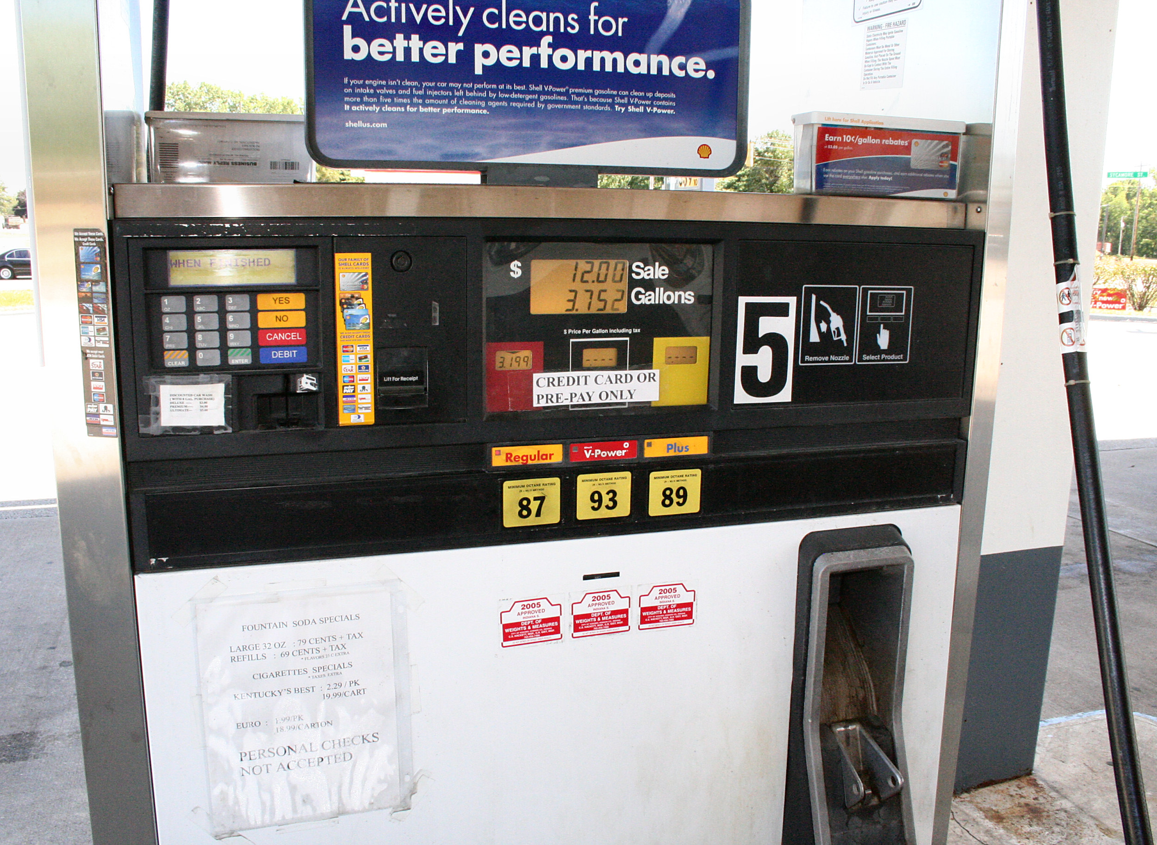
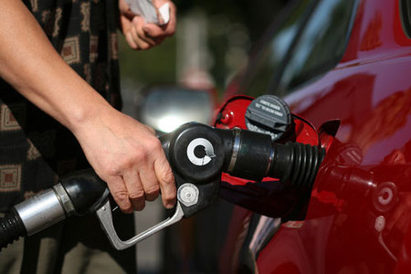
Challenges
Gas tax funding unsustainable
User based funding structure concerns
Changes in land use patterns and modeling
Changes in driving patterns and expectations
Implementation and protection of technology
Public acceptance and legal requirements
Notes:
Challenges
Gas tax has been the source of transportation funding for over 50 years.
MAP 21
Increased state funding – proposal to roll back tag and title which would reduce overall funding
Changes in how business is done – land use and traffic model planning
Other concerns – insurance coverage and hacking of the computer systems

Slide 13
Paul J. Steinman, P.E.
District Seven Secretary
Florida Department of Transportation
813-975-6039
paul.steinman@dot.state.fl.us

