Slide 1
Rusty Roberts, Vice President – Corporate Development
Florida East Coast Industries
Tampa Bay Regional Transportation Summit
Thursday, October 10, 2013
Notes:
Introduction
1

Slide 2
TRANSFORMING FLORIDA
COMMERCIAL REAL ESTATE
LOGISTICS SOLUTIONS
ROW MANAGEMENT
PASSENGER RAIL

Slide 4
EXPRESS INTERCITY PASSENGER RAIL
55M
Orlando
19M+
POPULATION
West Palm Beach
50M+
Fort Lauderdale
Miami
39M
EXPERIENCE CHALLENGING
TRANSPORTATION OPTIONS
Notes:
4

Slide 5
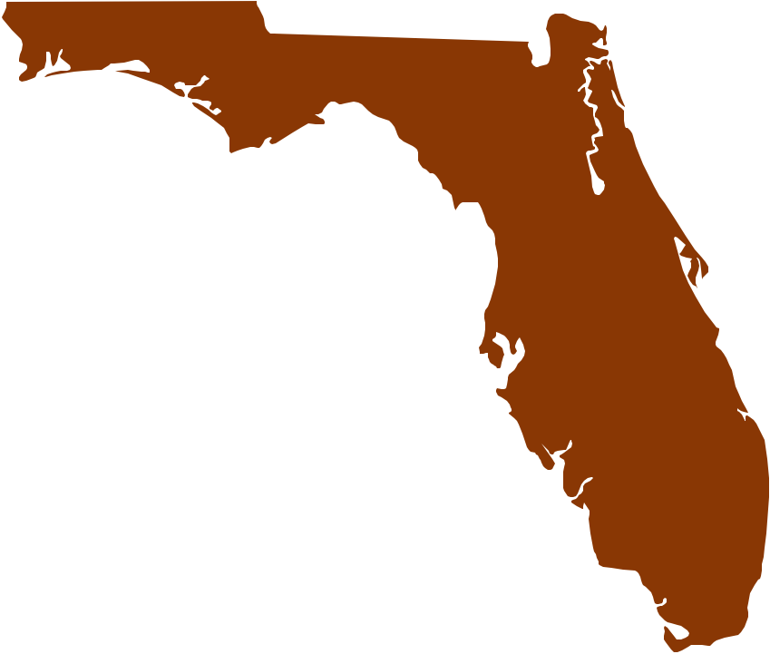
IMAGINE A FASTER, RELIABLE & MORE CONVENIENT WAY TO TRAVEL
3
EXISTING TRANSPORTATION CORRIDOR
HOUR TRAVEL TIME
ADVANCED, CONVENTIONAL TECHNOLOGY

Slide 6
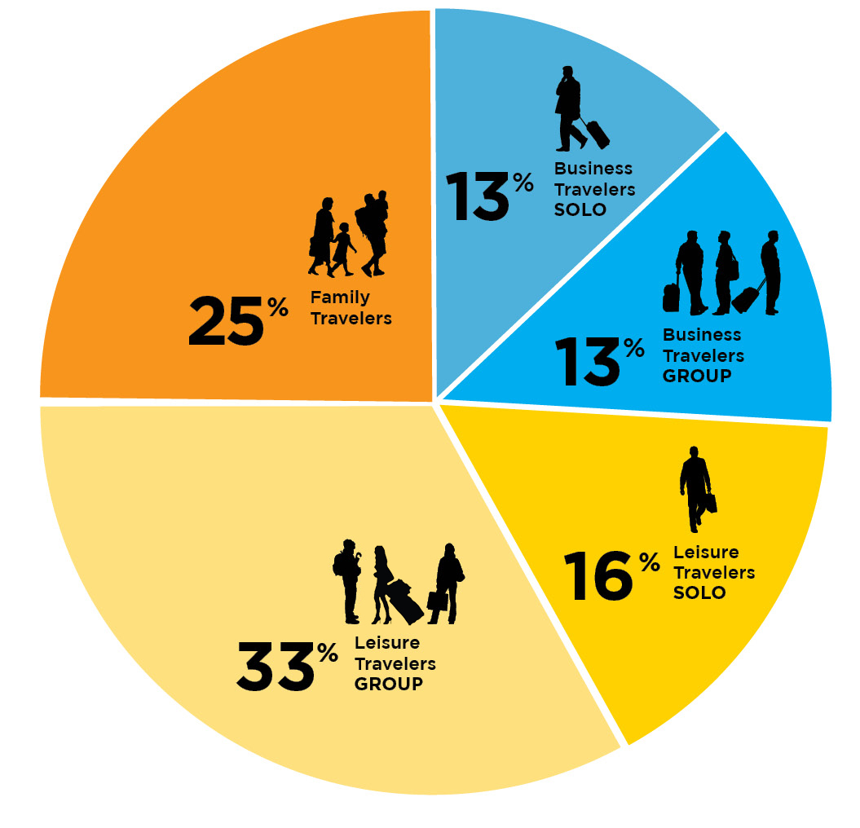
DIVERSE MARKET

Slide 7
A product designed
specifically for a targeted
market combining
TRAVEL, LEISURE &
ENTERTAINMENT
Center city locations
Custom designed coaches & services
Intermodal connectivity

Slide 8
STRATEGIC STATION LOCATIONS

Slide 9
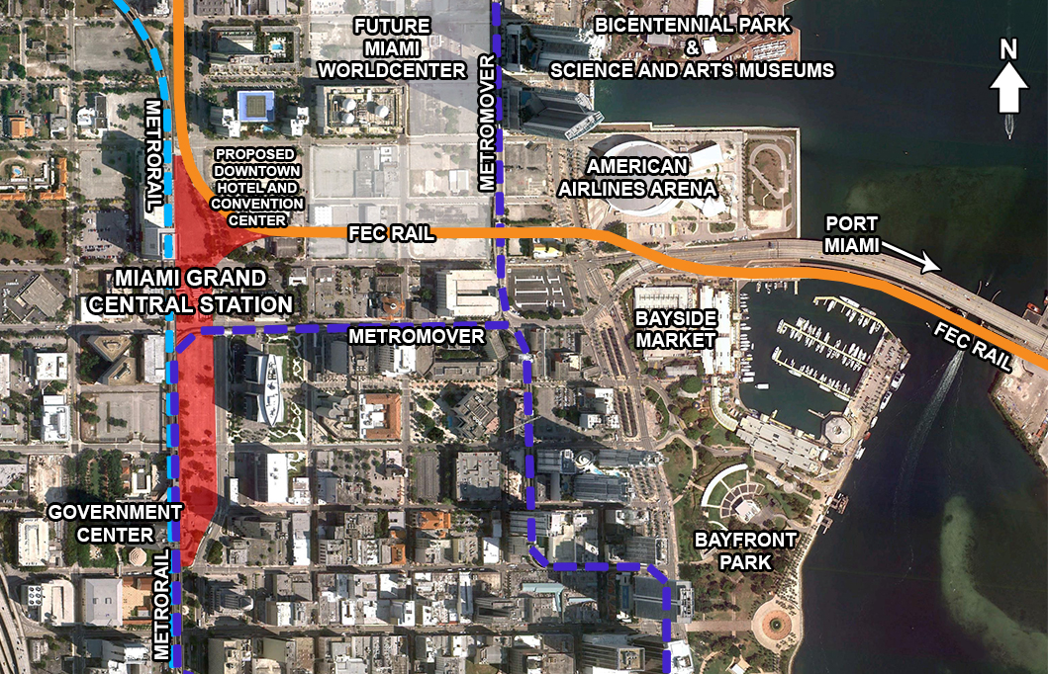
MIAMI – TRANSFORMING DOWNTOWN
Notes:
Rob input re: New maps
Highlight routes – emphasize rail connectivity with other transportation systems
Highlight landmarks
Reference new maps provided by client

Slide 10
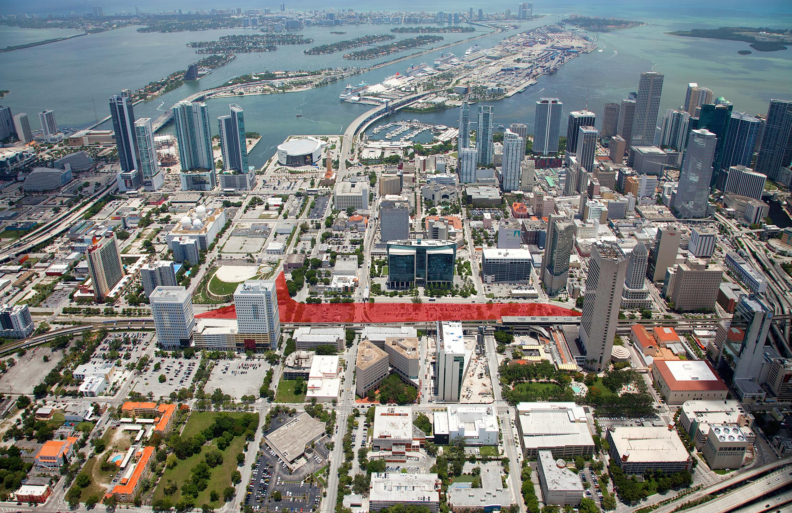
MIAMI

Slide 11
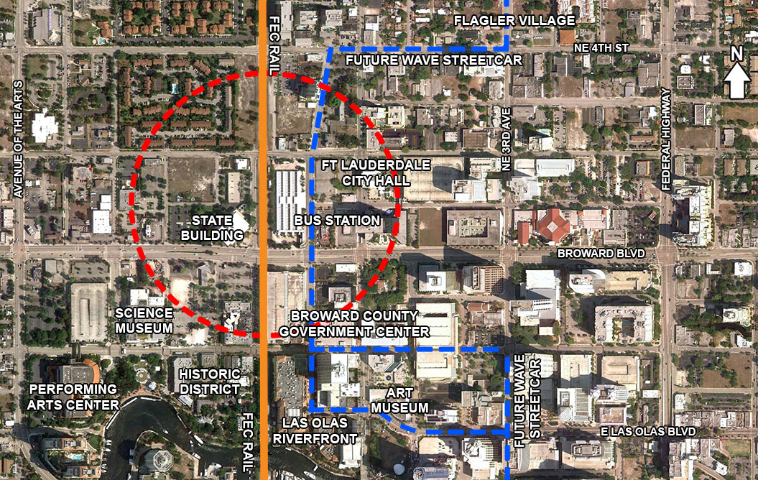
FORT LAUDERDALE-
REVITALIZING NORTH OF BROWARD BOULEVARD
Notes:
Rob input re: New maps
Highlight routes – emphasize rail connectivity with other transportation systems
Highlight landmarks
Reference new maps provided by client

Slide 12
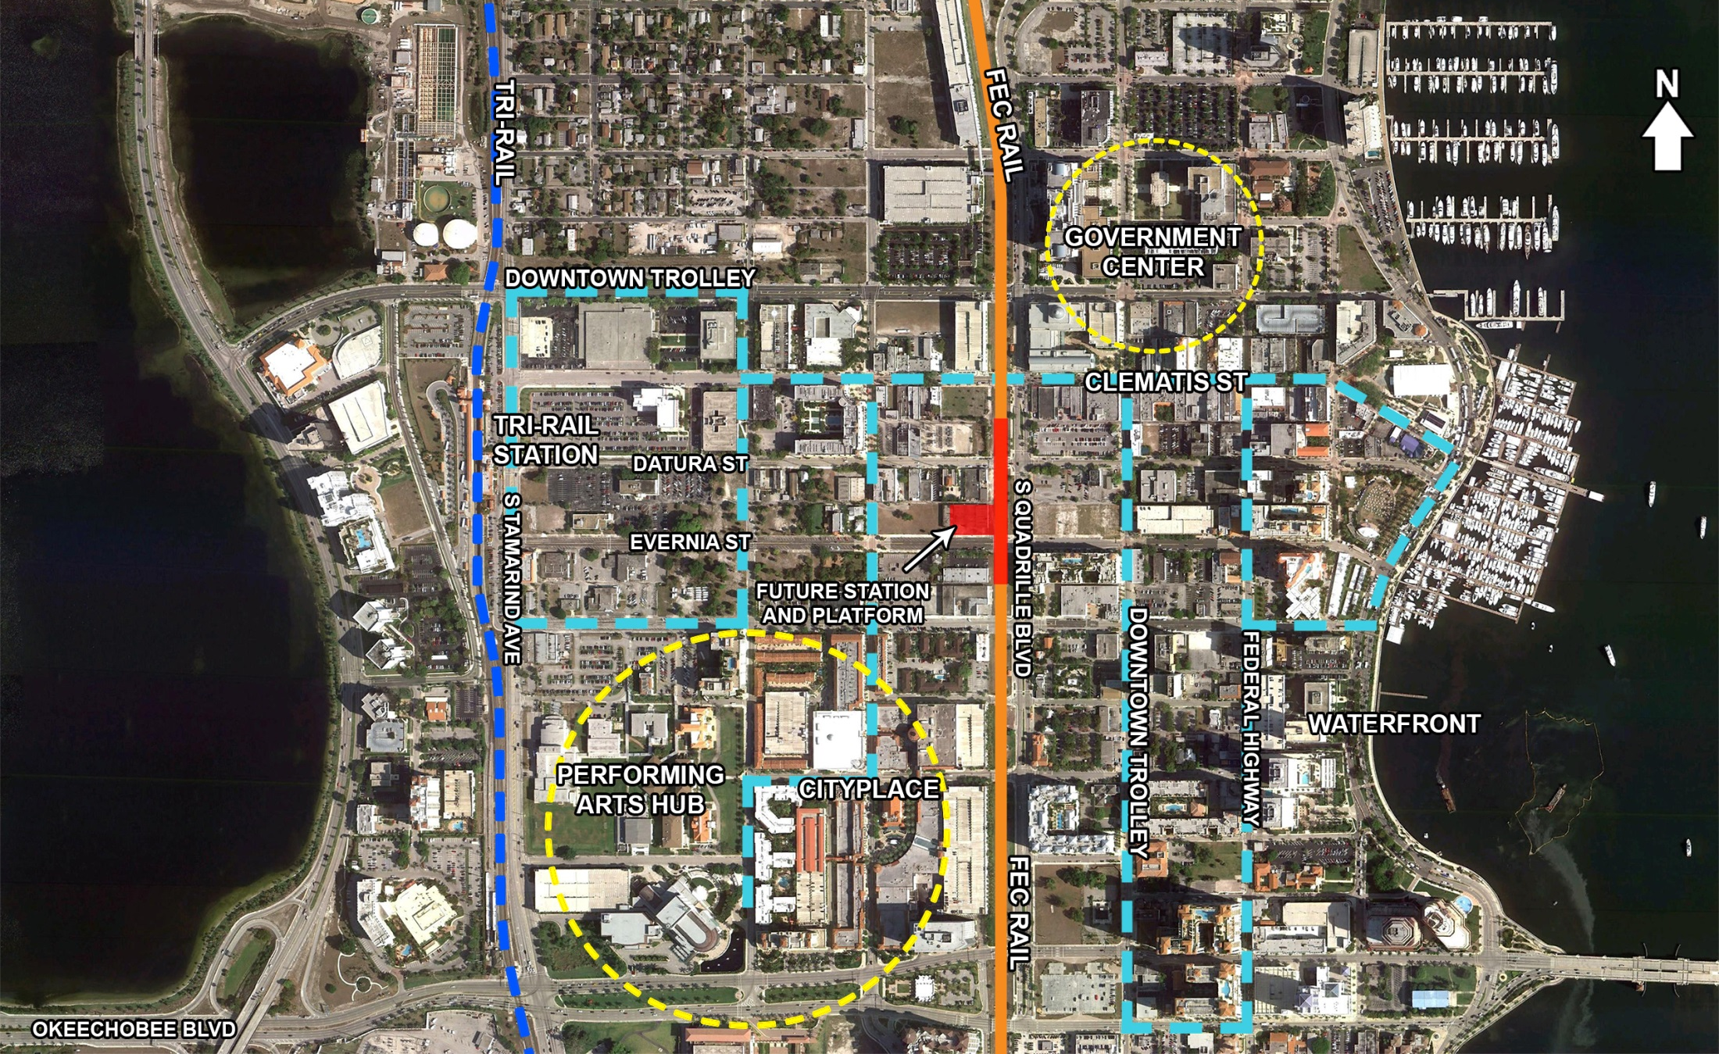
CONNECTING TWO MAJOR DOWNTOWN DESTINATIONS
WEST PALM BEACH –
11
Notes:
Rob input re: New maps
Highlight routes – emphasize rail connectivity with other transportation systems
Highlight landmarks
Reference new maps provided by client

Slide 13
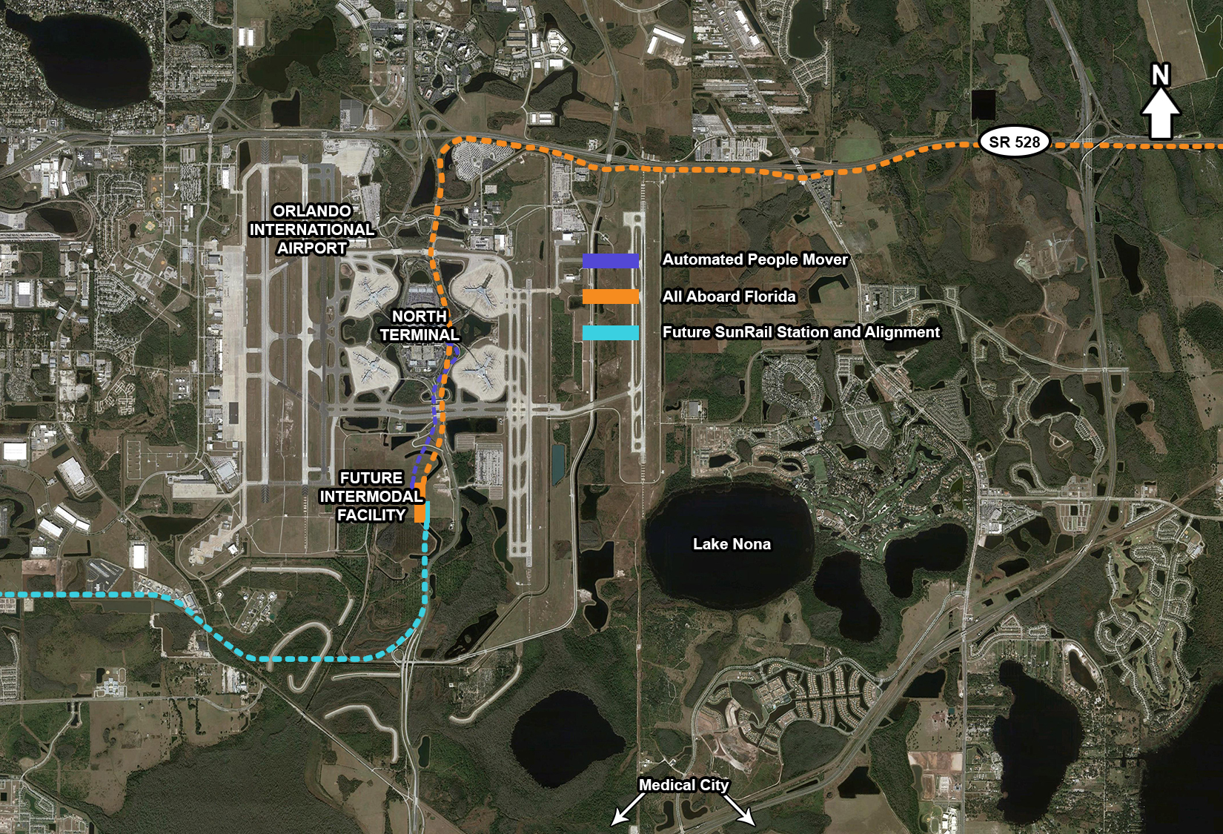
ORLANDO – INTERMODAL FACILITY
Notes:
Rob input re: New maps
Highlight routes – emphasize rail connectivity with other transportation systems
Highlight landmarks
Reference new maps provided by client

Slide 14
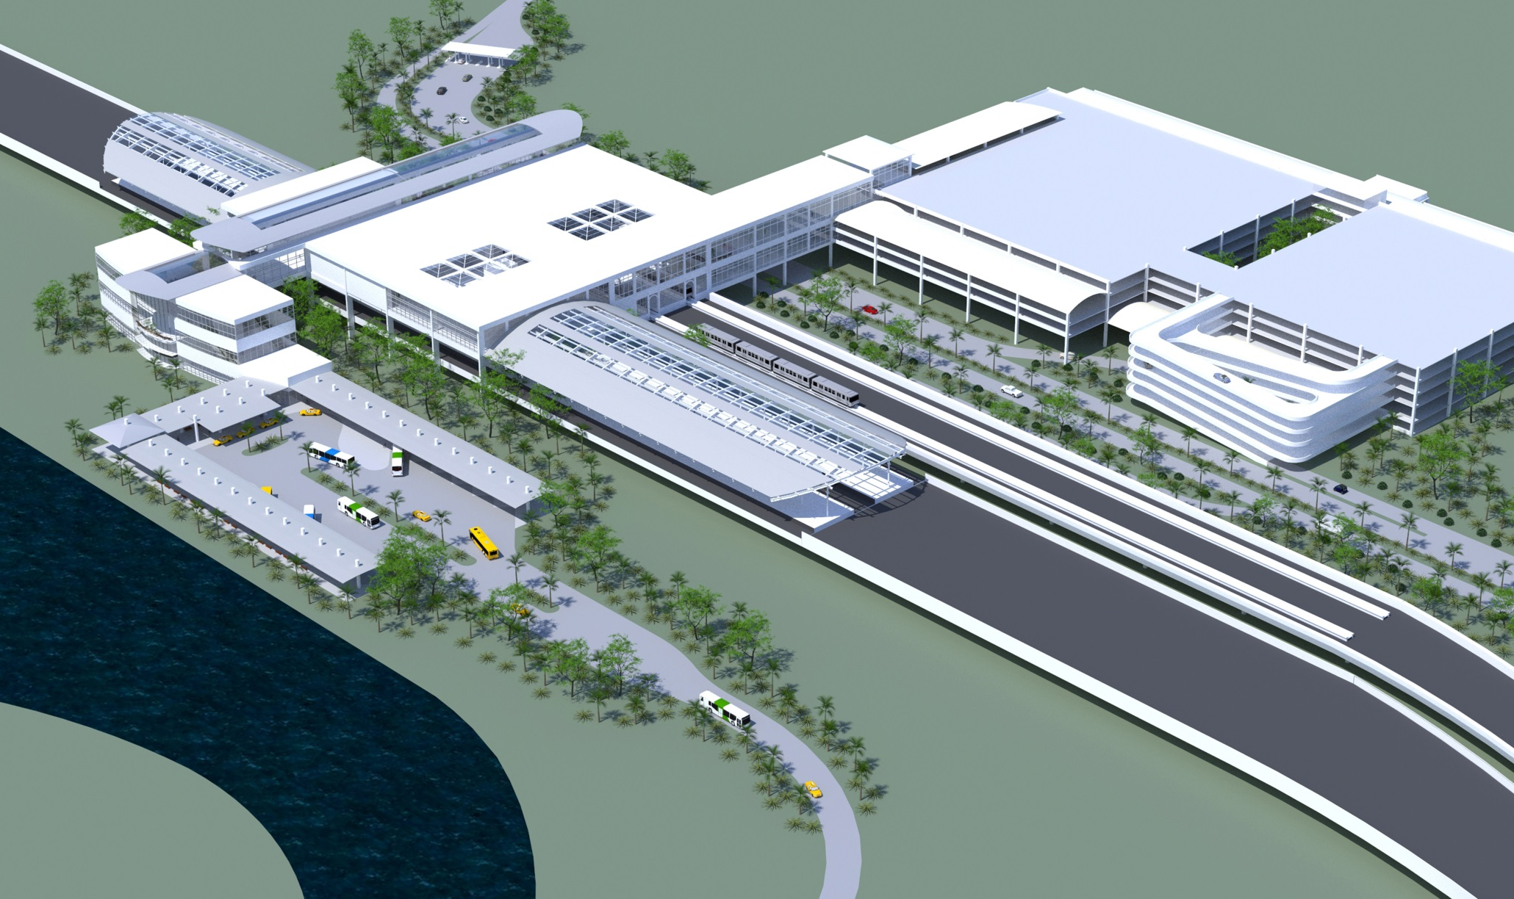
ORLANDO – INTERMODAL FACILITY

Slide 15
MOVING FORWARD
COMPLETED ACTIVITIES
Finalized investment grade ridership study, engineering and environmental reviews
Selected master planner and environmental engineering firms
Completed Environmental Assessment for Miami to West Palm Beach segment and received Finding of No Significant Impact Statement
Hired key management
Finalized negotiations with FDOT and OOCEA for access to SR 528
ONGOING ACTIVITIES
Environmental Impact Statement Process between Miami and Orlando
Determine financing structure
Announce new brand
Select rolling stock provider
Engage third party operating partner
Begin rail infrastructure and station construction

Slide 16
ALL ABOARD FLORIDA WILL…
Revitalize the economy
and spur economic development
Remove up to three million cars from Florida’s roads annually and offer a convenient transportation alternative
Create thousands of jobs
Ignite the entrepreneurial spirit
through a privately funded,
operated and maintained business
model
Notes:
Erica – orange background

Slide 17
WHAT MAKES US DIFFERENT
TRAVEL
UNINTERRUPTED
Every moment of your time is valuable.
You’re free to use it as you want.
TRAVEL
UNBURDENED
Carry less and worry less. We take the
stress out of travel.
TRAVEL
UNBUCKLED
Stretch out and move around with a new level of onboard freedom.
TRAVEL
UNCOMPLICATED
A door-to-door trip that’s so easy you’ll
never miss your car.

Slide 18
www.allaboardflorida.com
Notes:
Introduction
18

