Slide 1
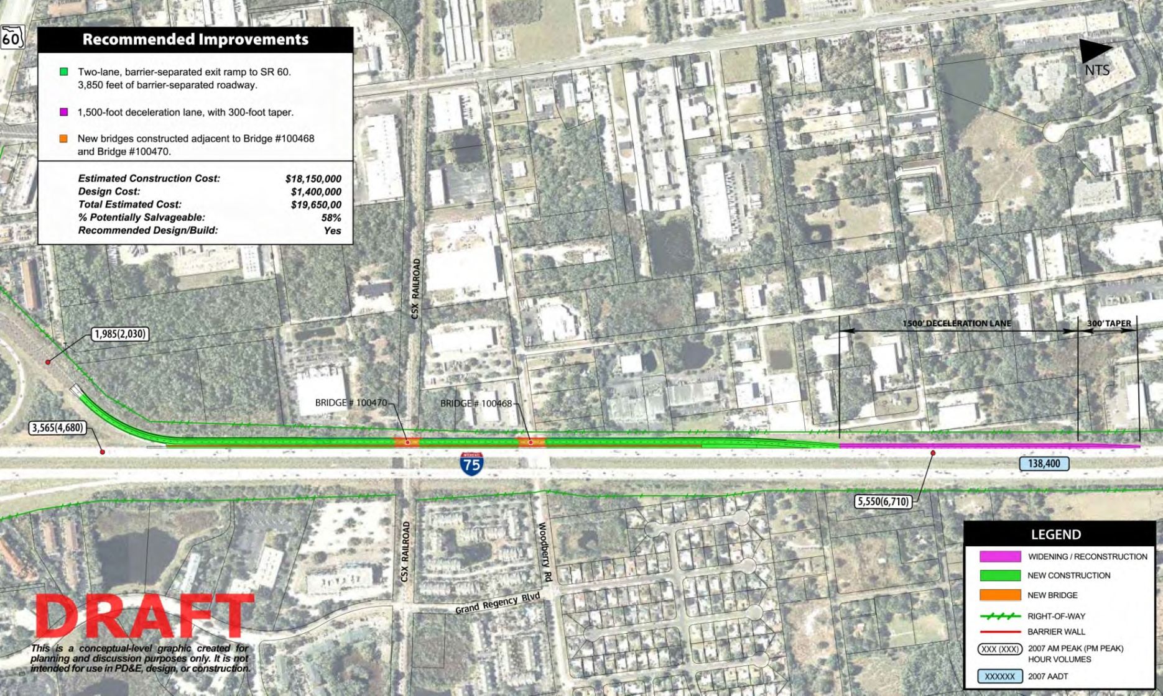
I-75 / SR 60 Interchange
6
Project Description:
2-lane SB I-75 barrier separated exit ramp
Project Timeline:
PD&E – Completed
PE – Completed April 2013
CON – April 2013 to June 2014
Funding/Cost:
FDOT/$14.13 Million
Status:
Construction Ongoing

