Slide 1
Hillsborough County Metropolitan Planning Commission (MPO) Walk/Bike Safety Action Plan
Task 1: Findings of Crash Data and Field Review
Hillsborough County Bicycle/Pedestrian Advisory Committee (BPAC)
January 11, 2012
Prepared for:
Hillsborough County MPO
Prepared by:
URS Corporation

Slide 2
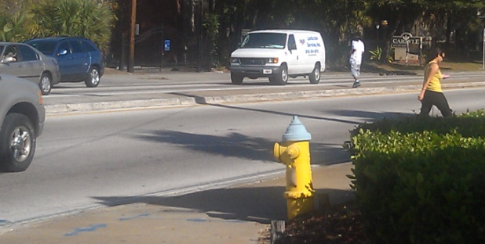
Agenda
Purpose
Study Areas and Corridors
General Observations
Priority Ranking
Next Steps

Slide 3
Purpose
The need for a balanced, multi-modal transportation with strategic “enhancements” to provide safer, more convenient and comfortable travel for all users including bicyclists, pedestrians, transit patrons, children, seniors and persons with disabilities.

Slide 4
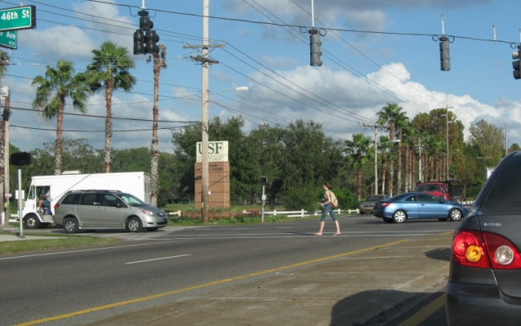
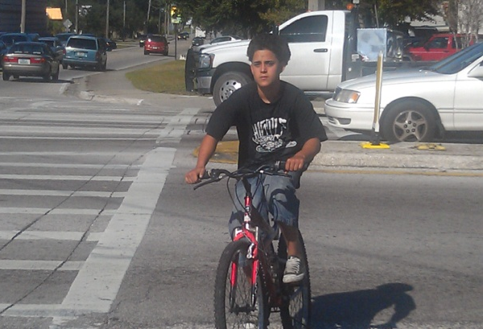
Study Areas and Corridors
USF Area
56th Street - Fowler Avenue to Fletcher Avenue
42nd Street - Fletcher Avenue to Bruce. B. Downs Boulevard
46th Street/Skipper Road – Fletcher Avenue to Bruce B. Downs Boulevard
Bruce B. Downs Boulevard – Fletcher Avenue to City Limits
Carrollwood Area
Fletcher Avenue – North Boulevard to Nebraska Avenue
Northdale Boulevard – Dale Mabry Highway to Lakeshore Road
Bearss Avenue – Dale Mabry Highway to 22nd Street
Town N’ Country / Egypt Lake Area
Waters Avenue – Sheldon Road to Florida Avenue
Sligh Avenue / Pinecrest Manor – Benjamin Road to Dale Mabry Highway
Lambright Road / Sligh Avenue – Dale Mabry Highway to Armenia Avenue
Hanley Road – Hillsborough Avenue to Waters Avenue
Sheldon Road – Hillsborough Avenue to Linebaugh Avenue

Slide 5
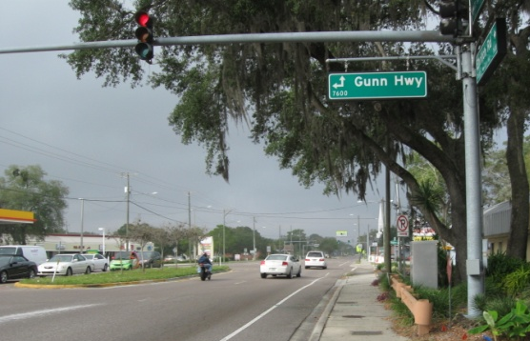
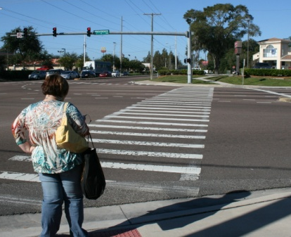
Study Areas and Corridors (Continued)
Palm River Area
78th Street – Madison Avenue to Lee Roy Selmon Expressway
Maydell Drive – Causeway Boulevard to Adamo Drive
Citrus Park Area
Gunn Highway – Ehrilich Road to Citrus Park Drive
Gunn Highway – Citrus Park Drive to Henderson Road
Gunn Highway – Tarpon Springs Road to Van Dyke Road
Brandon Area
Parsons Avenue – SR 60 to Martin Luther King Jr. Boulevard
Mango Road (CR 579) - Martin Luther King Jr. Boulevard to N. of I-4
Providence Road – Bloomingdale Avenue to SR 60
Bloomingdale Avenue – US 301 to Lithia Pinecrest Road

Slide 6
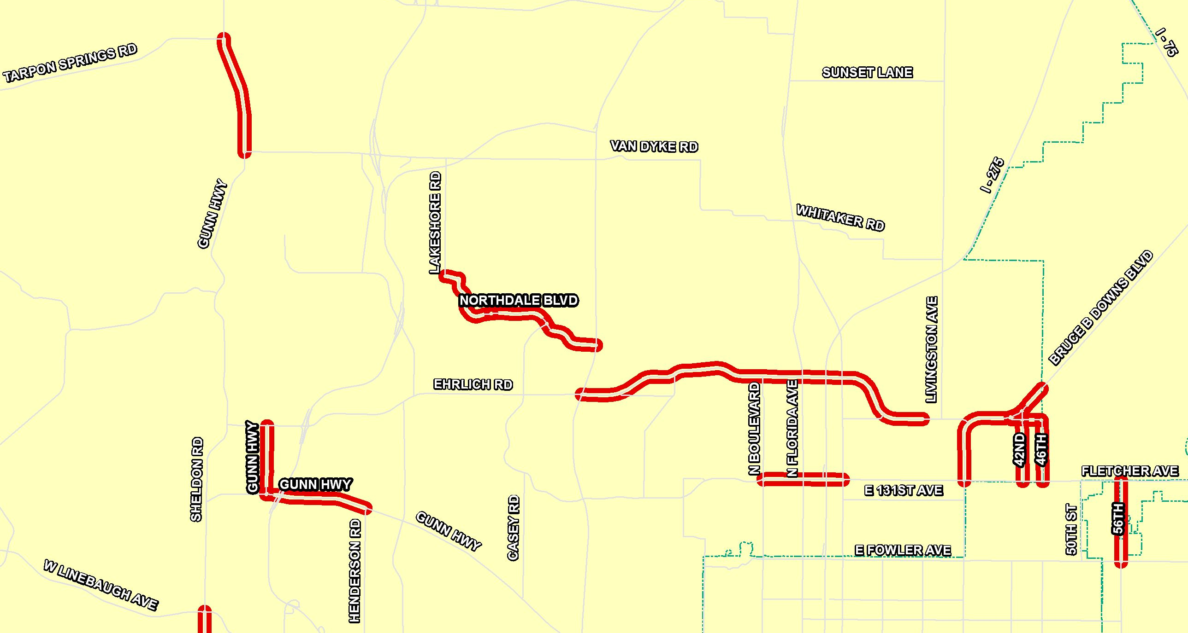
NTS
Citrus
Carrollwood
USF
Citrus
Study Corridor
Northwest Hillsborough County

Slide 7
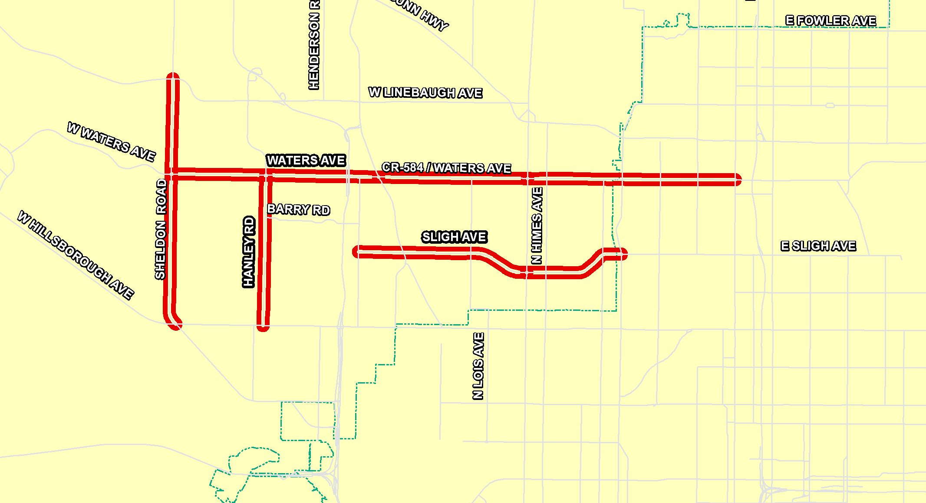
NTS
Town N’ Country
Study Corridor
West Central Hillsborough County

Slide 8
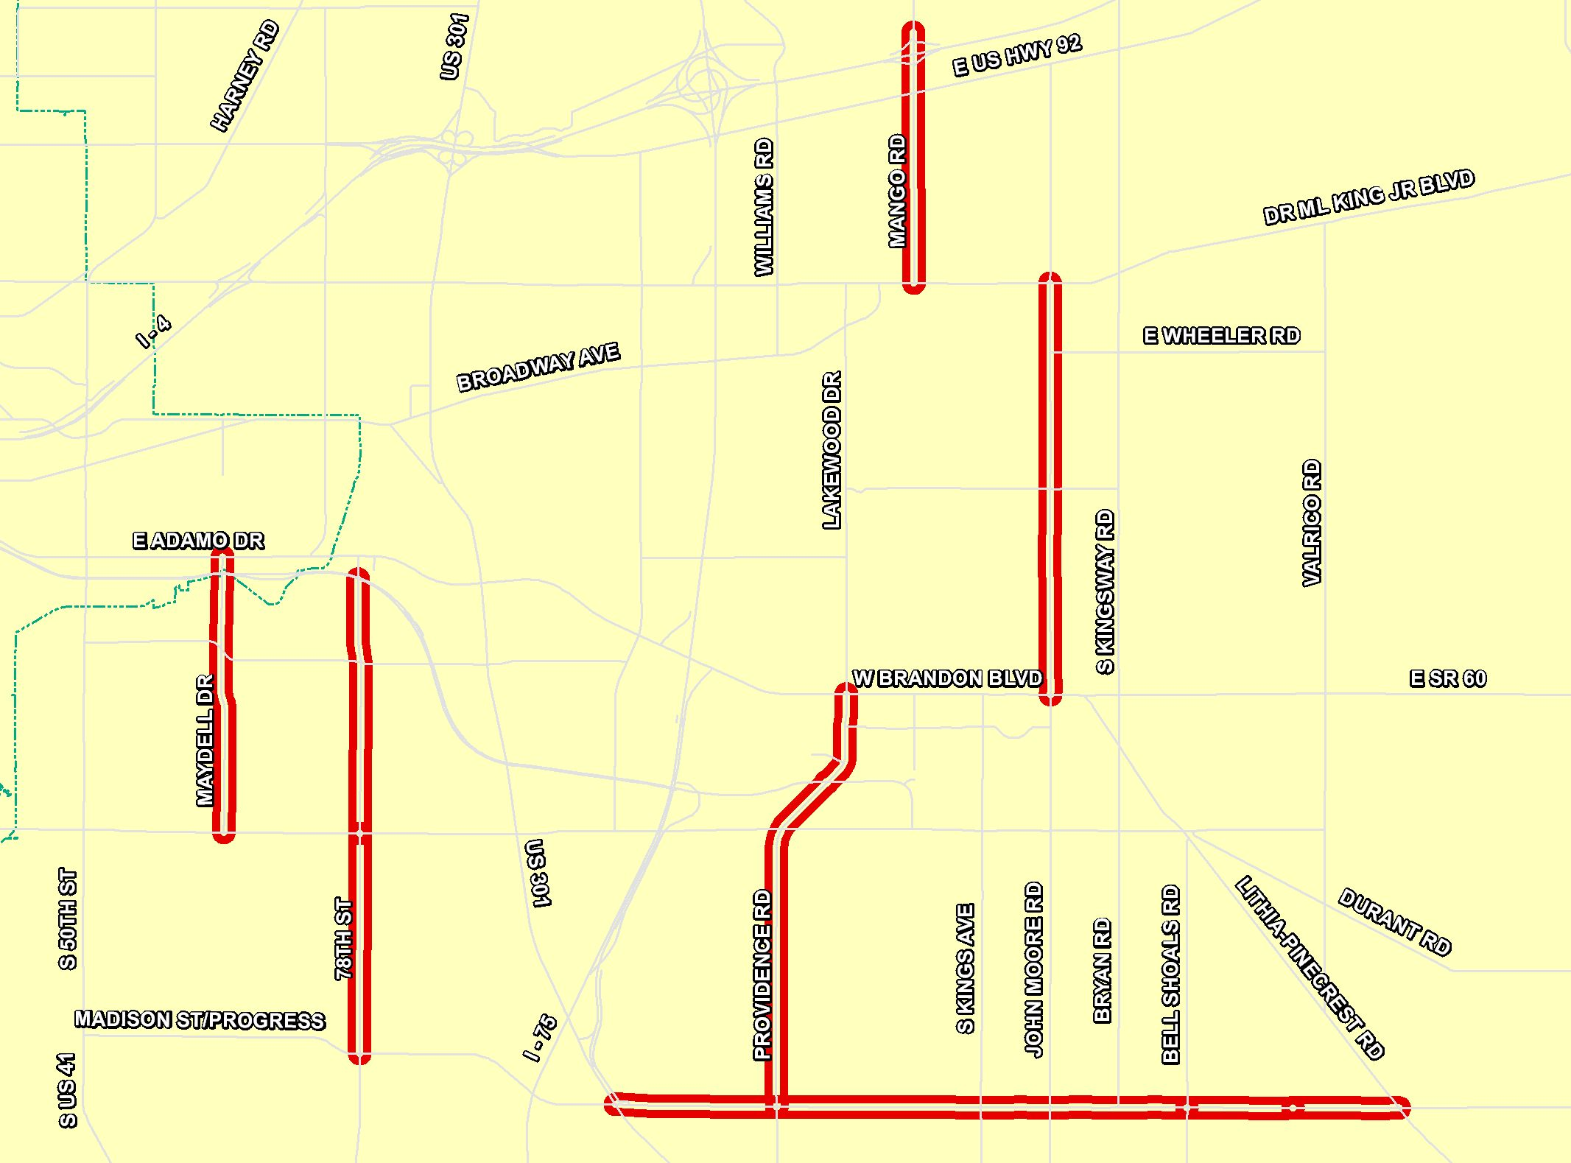
NTS
Palm
River
Brandon
Study Corridor
Southeast Hillsborough County

Slide 9
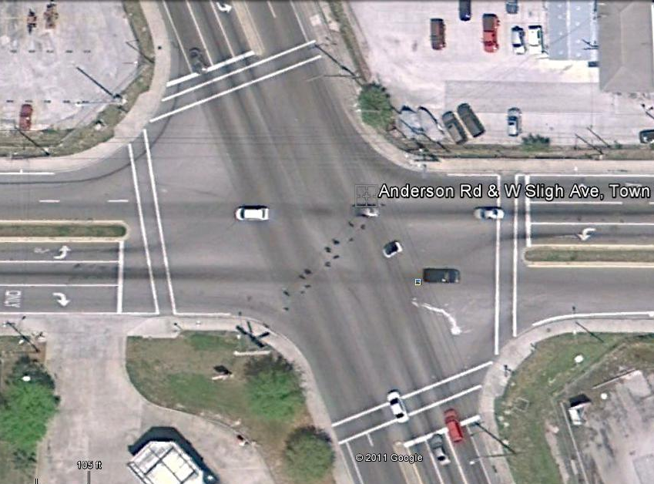
General Observations
Intersection Approach Crosswalks
Unless proven otherwise, include crosswalks at all intersection approaches
Place crosswalks as close to the intersection as possible
Parallel to adjacent street
Ladder crosswalks

Slide 10
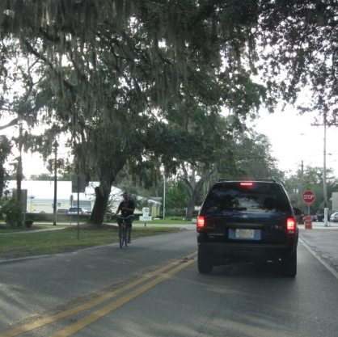
General Observations (continued)
Pedestrian Lighting
Important to maximize pedestrian visibility
Bike Lane Markings
Inconsistent bike lane markings are confusing for both motorists and pedestrians; should be consistent with MUTCD
Bike Parking at Bus Stops
Observed bikes locked to signs, etc.
Debris and Vegetation
Bike lanes and roadways should be kept clear of debris

Slide 11
Lighting
Generally insufficient
Roadway lighting does not necessarily equate to a well lit roadway for pedestrians
Vehicle lighting versus Pedestrian lighting
Areas of dark and light
FDOT Painted Pavement Markings (PPM) and Lighting Standards

Slide 12
Substandard Lighting

Slide 13
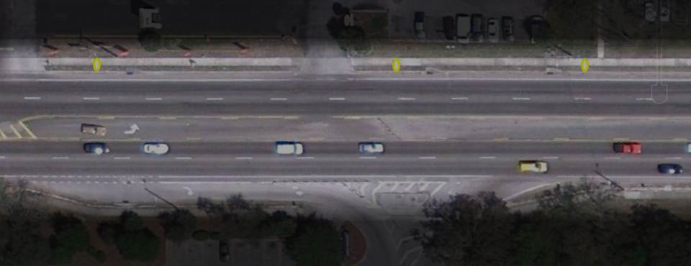
Standard Lighting

Slide 14
Lane Striping
As related to Night Time Visibility
Research supports improving roadway striping to reduce all crashes
Hypothesis: enhanced striping allows motorists to devote more attention to what is happening in the environment and less to maintaining lane position

Slide 15
Corridor Priority Ranking
Facility | From | To | 2010 | Crash Data 2006-2011 |  |  |  | Priority Ranking
 |  |  |  | No. of Crashes | Crashes Per Mile Ratio | Crashes Per 10,000 AADT | Lighting (Dark, Dark-Lighted, Dark-Not Lighted, Dusk) | Composite Factor | Within Area Ranking | Overall Ranking
USF Area
56th St | Fowler Ave | Fletcher Ave | 28,100 | 14 | 13.73 | 4.98 | 43% | 11.54 | 3 | 9
42nd St | Fletcher Ave | Bruce B. Downs | N/A | 13 | 14.61 | N/A | 62% | 14.61 | 2 | 6
46th St/Skipper Rd | Fletcher Ave | Bruce B. Downs | 15,100 | 6 | 5.13 | 3.97 | 33% | 4.84 | 4 | 20
Bruce B. Downs Blvd | Fletcher Ave | City Limit | 60,600 | 41 | 22.40 | 6.77 | 34% | 18.49 | 1 | 4
Carrollwood Area
Fletcher Ave | North Boulevard | Nebraska Ave | 39,200 | 31 | 31.00 | 7.91 | 32% | 25.23 | 1 | 1
Northdale Blvd | Dale Mabry Hwy | Dawnview Dr | 7,700 | 8 | 11.11 | 10.39 | 50% | 10.93 | 3 | 11
 | Dawnview Dr | Claywell Elementary | 7,700 | 2 | 2.63 | 2.60 | 0% | 2.62 | 4 | 26
 | Claywell Elementary | Lakeshore Rd | 7,700 | 0 | 0.00 | 0.00 | 0% | 0.00 | 5 | 28
Bearss Ave | Dale Mabry Hwy | 22nd St | 51,000 | 59 | 12.69 | 11.57 | 31% | 12.41 | 2 | 8
Town N' Country / Egypt Lake
Waters Ave | Sheldon Rd | Anderson Rd | 34,100 | 62 | 22.38 | 18.18 | 2% | 21.33 | 1 | 2
 | Anderson Rd | Dale Mabry Hwy | 45,900 | 31 | 15.58 | 6.75 | 48% | 13.37 | 4 | 7
 | Dale Mabry Hwy | Florida Ave | 33,000 | 58 | 20.86 | 17.58 | 40% | 20.04 | 2 | 3
Sligh Ave/Pinecrest Manor | Benjamin Rd | Dale Mabry Hwy | 14,300 | 9 | 3.88 | 6.29 | 22% | 4.48 | 7 | 22
Lambright Rd/Sligh Ave | Dale Mabry Hwy | Armenia Ave | 25,900 | 8 | 5.93 | 3.09 | 25% | 5.22 | 6 | 19
Hanley | Hillsborough Ave | Waters Ave | 30,500 | 39 | 19.31 | 12.79 | 36% | 17.68 | 3 | 5
Sheldon Rd | Hillsborough Ave | Linebaugh Ave | 47,100 | 36 | 10.84 | 7.64 | 36% | 10.04 | 5 | 12

Slide 16
Corridor Priority Ranking
Facility | From | To | 2010 | Crash Data 2006-2011 |  |  |  | Priority Ranking
 |  |  |  | No. of Crashes | Crashes Per Mile Ratio | Crashes Per 10,000 AADT | Lighting (Dark, Dark-Lighted, Dark-Not Lighted, Dusk) | Composite Factor | Within Area Ranking | Overall Ranking
Palm River - Coordination with South Coast Greenway
78th St | Madison Ave | Causeway Blvd | 11,000 | 5 | 3.09 | 4.55 | 40% | 3.45 | 3 | 25
 | Causeway Blvd | Lee Roy Selmon | 25,100 | 16 | 8.56 | 6.37 | 38% | 8.01 | 1 | 14
Maydell Dr | Causeway Blvd | Adamo Dr | 2,800 | 3 | 1.48 | 10.71 | 33% | 3.79 | 2 | 24
Citrus Park - Coordination with Upper Tampa Bay Trail
Gunn Hwy | Ehrlich Rd | Citrus Park Dr | 12,500 | 5 | 5.81 | 4.00 | 40% | 5.36 | 2 | 17
 | Citrus Park Dr | Henderson Rd | 34,300 | 9 | 7.03 | 2.62 | 11% | 5.93 | 1 | 16
 | Tarpon Springs | Van Dyke Rd | 19,000 | 2 | 1.36 | 1.05 | 100% | 1.28 | 3 | 27
Brandon Area
Parsons Ave | SR 60 | M L King Blvd | 28,200 | 23 | 7.62 | 8.16 | 17% | 7.75 | 3 | 15
Mango Rd (CR579) | M L King Blvd | N of I-4 | 13,500 | 15 | 8.15 | 11.11 | 40% | 8.89 | 2 | 13
Providence Rd | Bloomingdale Ave | SR 60 | 18,100 | 30 | 9.29 | 16.57 | 43% | 11.11 | 1 | 10
Bloomingdale Ave | US Hwy 301 | Bell Shoals Rd | 56,400 | 21 | 5.00 | 3.72 | 29% | 4.68 | 5 | 21
 | Bell Shoals Rd | Cade Ln | 28,200 | 4 | 5.13 | 1.42 | 0% | 4.20 | 6 | 23
 | Cade Ln | Lithia Pinecrest | 28,200 | 5 | 6.41 | 1.77 | 0% | 5.25 | 4 | 18

Slide 17
Corridor Preliminary Recommendations
Facility | From | To | Preliminary Recommendations
 |  |  | Sharrows | Bike Lane | Sidewalks | Midblock Safety (Ped/Rdwy Audit) | Lighting | Roadway/ Intersection Restriping/ Improvement | Transit
USF Area
56th St | Fowler Ave | Fletcher Ave |  |  | P | P | P
42nd St | Fletcher Ave | Bruce B. Downs | P |  | P | P | P
46th St/Skipper Rd | Fletcher Ave | Bruce B. Downs |  |  | P |  | P | P
Bruce B. Downs Blvd | Fletcher Ave | City Limit |  |  |  |  | P | P | P
Carrollwood Area
Fletcher Ave | North Boulevard | Nebraska Ave |  | P |  |  | P | P | P
Northdale Blvd | Dale Mabry Hwy | Dawnview Dr | P |  |  |  | P
 | Dawnview Dr | Claywell Elementary | P | P |  |  | P
 | Claywell Elementary | Lakeshore Rd | P |  | P |  | P | P
Bearss Ave | Dale Mabry Hwy | 22nd St |  | P | P |  | P
Town N' Country / Egypt Lake
Waters Ave | Sheldon Rd | Anderson Rd |  | P |  | P | P | P | P
 | Anderson Rd | Dale Mabry Hwy |  | P |  |  | P | P
 | Dale Mabry Hwy | Florida Ave | P | P |  |  | P | P | P
Sligh Ave/Pinecrest Manor | Benjamin Rd | Dale Mabry Hwy | P |  |  |  | P
Lambright Rd/Sligh Ave | Dale Mabry Hwy | Armenia Ave | P |  | P |  | P
Hanley | Hillsborough Ave | Waters Ave |  |  |  |  | P
Sheldon Rd | Hillsborough Ave | Linebaugh Ave |  |  |  |  | P

Slide 18
Corridor Preliminary Recommendations
Facility | From | To | Preliminary Recommendations
 |  |  | Sharrows | Bike Lane | Sidewalks | Midblock Safety (Ped/Rdwy Audit) | Lighting | Roadway/ Intersection Restriping/ Improvement | Transit
Palm River - Coordination with South Coast Greenway
78th St | Madison Ave | Causeway Blvd | P |  |  |  | P | P
 | Causeway Blvd | Lee Roy Selmon | P |  |  |  | P
Maydell Dr | Causeway Blvd | Adamo Dr | P |  |  |  | P
Citrus Park - Coordination with Upper Tampa Bay Trail
Gunn Hwy | Ehrlich Rd | Citrus Park Dr | P | P |  |  | P
 | Citrus Park Dr | Henderson Rd |  | P |  |  | P
 | Tarpon Springs | Van Dyke Rd |  | P |  |  | P
Brandon Area
Parsons Ave | SR 60 | M L King Blvd |  |  | P |  | P
Mango Rd (CR579) | M L King Blvd | N of I-4 |  |  | P |  | P
Providence Rd | Bloomingdale Ave | SR 60 |  |  |  |  | P
Bloomingdale Ave | US Hwy 301 | Bell Shoals Rd |  |  |  | P | P | P
 | Bell Shoals Rd | Cade Ln |  |  |  |  | P
 | Cade Ln | Lithia Pinecrest |  |  |  |  | P

Slide 19
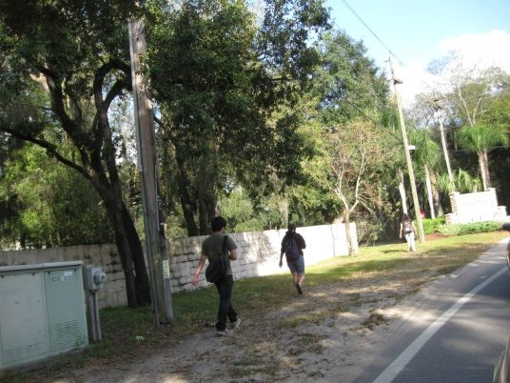
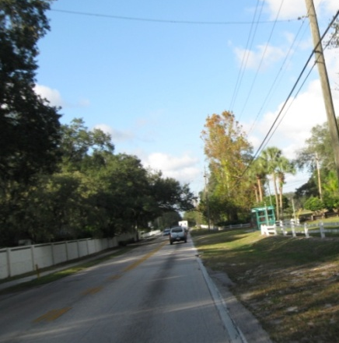
USF Area
56th Street, 42nd Street and Bruce B. Downs Boulevard ranked in the top 10 study corridors for high bike/ped crashes
Lack of sidewalks and poor pedestrian visibility along 42nd Street and 46th Street/Skipper Road due to tree canopies
Need for midblock crossing and sidewalks along 46th Street / Skipper Road at transit stops or student pickup/drop-off locations

Slide 20
Carrollwood Area
Fletcher Avenue ranked overall the No. 1 study corridor needing improvements (31/crashes per mile)
There are no bike lanes along this corridor and very limited room for them
Midblock crossing(s) along Fletcher Avenue should be considered
I-275 interchanges at Fletcher and Bearss Avenues need additional pedestrian crossing, signage and pavement markings

Slide 21
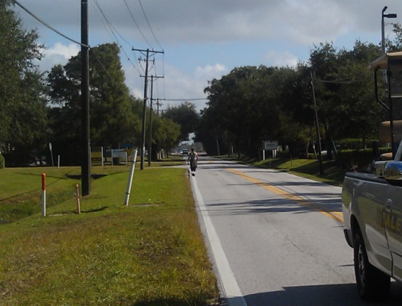
Town N’ Country/Egypt Lake Area
Veteran’s Expressway crosswalks provide no indicators to vehicles that pedestrians have the right-of-way and should be further evaluated
High mid-block pedestrian activity at Waters, Hanley and Armenia Avenues
Need for intersection upgrades to curb ramps, push buttons, and eliminate driveway access to corner businesses.
Sidewalks needed along Sligh Avenue
between Benjamin Road and the CSX railroad
Dale Mabry and Himes

Slide 22
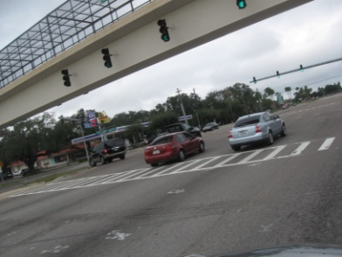
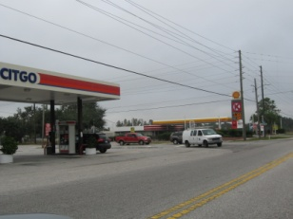
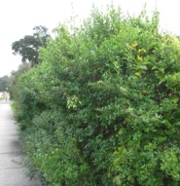
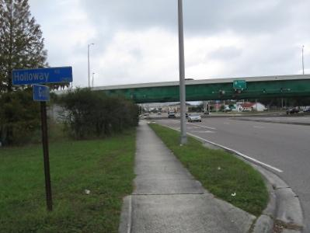
Citrus Park Area
Curb radius redesign to reduce speed from Gunn Hwy to Gunn Hwy
Need for mid-block crossing Gunn Highway between Erhlich Road and Citrus Park Drive
Need for pedestrian crosswalk with pavement marking is needed at Van Dyke Road signalized intersection
Potential implementation of rural roadway “sharrows” along Gunn Hwy between Tarpon Road and Van Dyke Road
Vegetated overgrowth/low lying canopied trees between Erhlich and Henderson Roads

Slide 23
Palm River and Brandon Areas
Low speeds and traffic volumes along 78th Street and Maydell Drive may provide opportunity for “sharrows” along both corridors
Lighting along roadway should be further evaluated
Continuous sidewalks along most Brandon corridors
Brandon corridors have the lowest bike/ped crash rates compared to other areas

Slide 24
Upcoming Steps…
Complete Improvement Recommendations
Prioritize / Rank Improvements by Corridor
Prepare Draft Report

